Slide 1
IBM SkillsBuild Decoding Data PBL Program 2025 Final Project Presentation
Project Name : Road Accident Severity Analysis

Slide 2
INTRODUCTION
OVERVIEW OF THE PROJECT :
This project aims to analyze the severity and patterns of road accidents
across India using real-world datasets. Through data analytics and
visualizations, we identify key factors contributing to accident severity and
predict high-risk accident-prone areas (hotspots). This helps stakeholders
take informed, preventive actions to reduce fatalities and enhance road
safety.
🎯 PROJECT OBJECTIVES:
Analyze accident severity based on driver, vehicle, road, and environmental factors.
Predict high-risk zones (hotspots) using location and time-based patterns.
Identify leading causes and demographics contributing to severe accidents.
Visualize insights through interactive dashboards using Power BI.
Recommend data-driven solutions aligned with sustainable development goals (SDGs).

Slide 3
PROBLEM IDENTIFICATION
❗ PROBLEM STATEMENT :
India faces a high number of road accidents every year, resulting in severe injuries
and fatalities. However, the absence of data-driven insights into when, where, and
why these accidents occur limits the ability to implement effective preventive
measures.
📌 SIGNIFICANCE OF THE PROBLEM :
Majority of accidents are preventable with better planning, awareness, and infrastructure.
Lack of localized insights into accident severity and hotspots prevents targeted intervention.
A data analytics-based approach can help authorities prioritize high-risk areas and reduce loss of life.
🌍 RELEVANT SUSTAINABLE DEVELOPMENT GOALS (SDGS) :
SDG 3 :Good Health & Well-being→ Reduce injuries and deaths from road accidents.
SDG 11 : Sustainable Cities & Communities→ Improve road safety and traffic infrastructure.
SDG 9 : Industry, Innovation & Infrastructure→ Use data-driven innovation to design safer transport
system

Slide 4
DATA COLLECTION
🔍. SOURCES OF DATA :
Kaggle – Road Accident Data (India)
Rich datasets with attributes like time, location, vehicle type, driver profile, road and weather conditions, and accident severity
LINK: https://www.kaggle.com/
📋 DATA DESCRIPTION :
Dataset 1: Focused on driver-related and collision-type factors.
Dataset 2: Focused on regional accident records, including accident severity
location, casualties, and contributing factors.

Slide 5
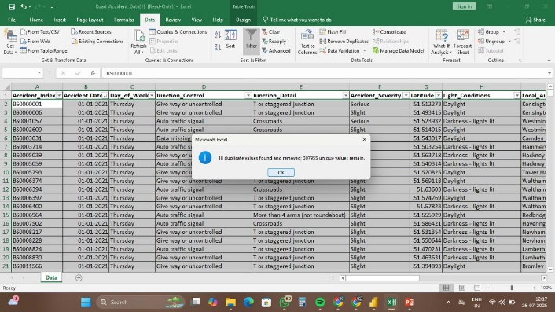
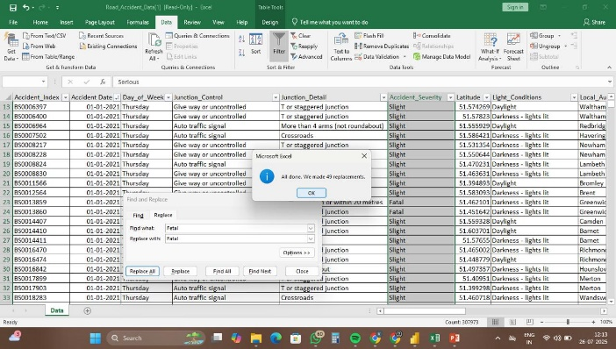
DATA PREPROCESSING
🔧DATA CLEANING METHODS :
Finding and removing duplicates from the dataset
Finding misspelt values and replacing them with correct values.

Slide 6
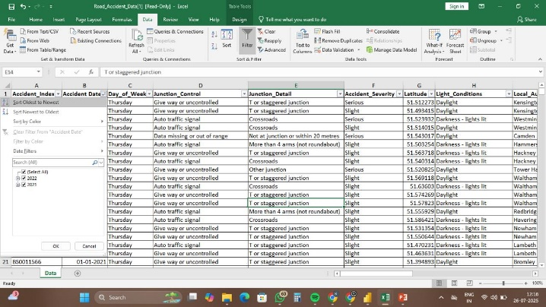
Sorting the columns accident date
🛠 Tools Used
Microsoft Excel for cleaning and preprocessing
Power BI for data modeling and exploration

Slide 7
DATA ANALYSIS
📈 Analytical Tools
Excel: Data cleaning, preprocessing, pivot tables.
Power BI: Visualization, dashboard creation, trend analysis.
Filtering & Aggregation: Segmented data by accident cause, road type, and environmental factors.
Analytical Methods
Descriptive Analysis: Used pivot tables to understand trends in accident frequency, severity, and distribution.
Comparative Analysis: Year-over-year (YoY) comparison of casualty data to observe progress or decline in safety.
Categorical Breakdown: Assessed impact of variables like vehicle type, road conditions, lighting, time, and driver demographics.
Geospatial Insights: Analyzed accident location patterns to identify urban vs rural severity clusters.

Slide 8
KEY FINDINGS
The following key findings are based on the analysis of road accident data
and observations collected during the project.
Urban Hotspots : Most accidents occurred in high-traffic city areas during peak hours especially near markets , traffic junctions and schools.
Main Causes : Over speeding ,drunk driving ,mobile use while driving were top reasons and breaking traffic rules. Lack of awareness an careless behaviour by drivers increased the chances of collisions.
Time Factor: Most accidents happened between 3 PM and 10 PM due to heavy traffic and low visibility . Fatigue and rush to reach destinations also contributed to careless driving during this time.
Age Group: People aged 18-35 were involved in the highest number of accidents. This is often due to rash driving, over speeding and lack of experience and safety awareness.
Poor Road Conditions: Many accidents occurred due to pothholes , broken pavements and lack of road maintenance . Damaged roads and uneven surfaces made driving unsafe and led to many accidents.

Slide 9
HYPOTHESIS DEVELOPMENT
✅ HYPOTHESIS STATEMENT:
"Road accidents are more severe in urban areas, during the daytime, and are highly influenced by road type,
vehicle category, and driver demographics.“
📌 RATIONALE:
Urban areas show a higher concentration of traffic, increasing accident probability.
Daytime accidents dominate the data, possibly due to increased vehicle movement.
Single carriageways and cars are the most common factors in severe accidents.
Driver age and gender patterns reflect risky behavior and exposure levels.
🔬 METHOD FOR TESTING:
Analyze accident data using pivot tables and filters (day, vehicle, area type, road conditions).
Analyze accident data using pivot tables and filters (day, vehicle, area type, road conditions).

Slide 10
SOLUTION DESIGN & IMPLEMENTATION PLAN
🎯 OBJECTIVE:
To analyze factors influencing road accident severity and identify accident-prone hotspots to support data-driven road safety improvements.
🧩 SOLUTION APPROACH:
Collected and cleaned two real-world accident datasets using MS Excel.
Analyzed severity patterns through pivot tables and filters.
Validated the hypothesis using summary stats and trends.
Built a Power BI dashboard to visualize key insights and hotspots.
🛠️ IMPLEMENTATION STEPS:
Collected and cleaned datasets.
Analyzed severity patterns using Excel pivot tables.
Designed a dynamic Power BI dashboard.

Slide 11
VISUALIZATION
Platform Used: Power BI
Prominent Features of the Dashboard:
The interactive dashboard provides a comprehensive overview of road accident severity in India using data from two years.
Key metrics such as Total Casualties (195.7K), Serious Casualties (144.4K), Fatal Casualties (2.9K), and others are displayed with year-over-year percentage changes.
Casualties by Vehicle Type clearly show cars (155.8K) as the major contributor to road accidents, followed by vans and bikes.
Monthly Trend Line Chart compares current year vs previous year casualties, highlighting spikes between July and September.
Urban vs Rural Analysis shows that urban areas account for 61.95% of total accidents.
Road Type Analysis reveals that single carriageways are the most accident-prone.
Day-wise Casualty Distribution indicates Friday and Tuesday as the riskiest days for road travel.
Light Condition Distribution highlights that 73.84% of accidents occurred during daytime, pointing to traffic density over poor visibility.
Dashboard includes slicers.

Slide 12
SITE MAP
Top Row: Overall KPIs (Casualties and Comparison %)
Left Panel: Casualties by Vehicle Type
Center Section:
Line Chart (Monthly Trends)
Bar Chart (Day of Week)
Right Panel:
Urban vs Rural Pie Chart
Road Type Bar Chart
Light Conditions Pie Chart

Slide 13
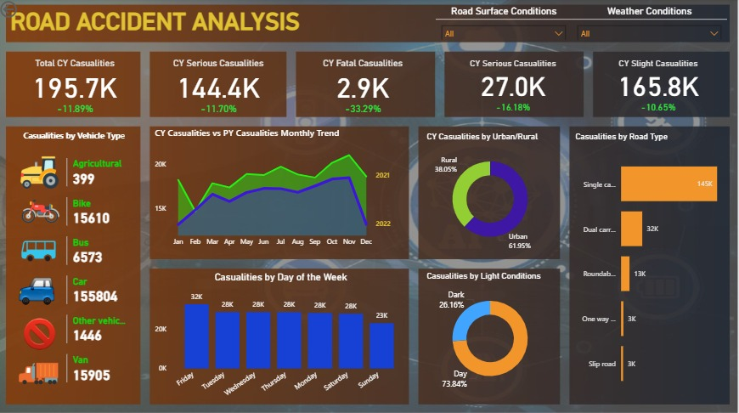
CONCLUSION
🖼DASHBOARD SNAPSHOT :
Dashboard link : https://drive.google.com/file/d/1JtT09kJjm0meHqS5x5inYYy2nTW73-LO/view?usp=drivesdk

Slide 14
📊 IMPACT OF THE PROPOSED SOLUTION :
Enabled data-driven decision-making by highlighting accident severity patterns.
Identified urban hotspots prone to frequent and severe accidents.
Revealed major causes such as vehicle type, road conditions, and time of day.
Helped policy makers and urban planners to focus on high-risk areas and periods.
Provided an intuitive and interactive platform for stakeholders to explore accident trends.
🔭 FUTURE WORK :
Integrate real-time accident data for live monitoring and alerts.
Include geospatial heatmaps for pinpointing hotspot regions.
Use predictive modeling (ML algorithms) to estimate accident probability.
Expand dataset sources by integrating hospital reports and traffic violation logs.
Evaluate state-level safety initiatives to measure policy effectiveness.

Slide 15
REFERENCES
Kaggle Datasets
Road Accident Data: https://www.kaggle.com/
Power BI (Microsoft)
Data Visualization and Dashboard Tool: https://powerbi.microsoft.com/
WHO Reports on Road Safety
Global status report on road safety: https://www.who.int/publications
IBM SkillsBuild Platform
For project template and learning resources: https://skillsbuild.org
MS Excel
Used for data cleaning, preprocessing , and pivot tables.

