Slide 1
BANK MARKETING ANALYTICS
iNeuron
Submitted By: Taj Hasan Mansuri

Slide 2
OBJECTIVE :
To get insights about customers who subscribed term deposits. Insights include their demographical details and various indicators to know the customer better.
To get insights about the effectiveness of the marketing campaign on the customers. These insights help the company to take data driven decisions which will enable the bank get more revenues by acquiring more customers as well as in cost cutting.

Slide 3
DATA SHARING AGREEMENT
Sample file name (ex bank-additional-full.csv)
Length of date stamp(8 digits)
Length of time stamp(6 digits)
Number of Columns
Column names
Column data type

Slide 4
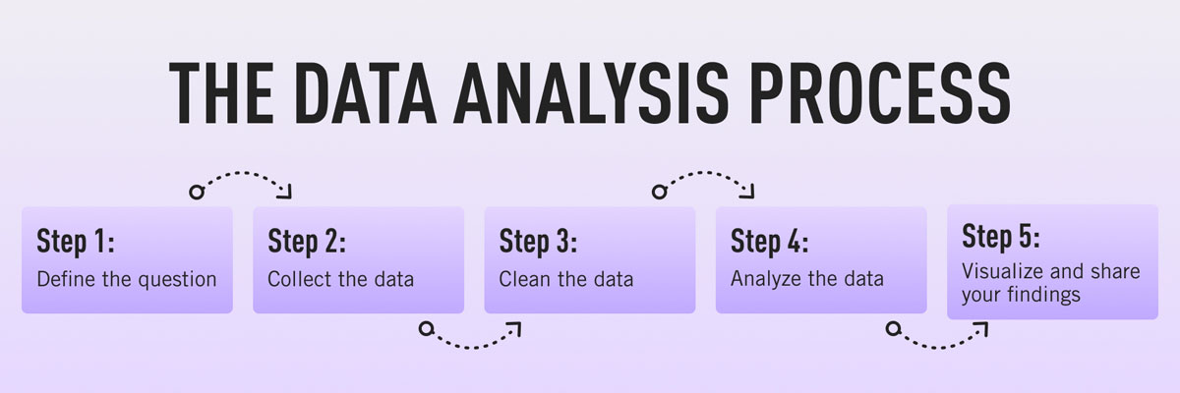
ARCHIETECTURE

Slide 5
DATA OVERVIEW:
The zip file includes two datasets:
bank-additional-full.csv with all examples, ordered by date (from May 2008 to November 2010).
bank-additional.csv with 10% of the examples (4119), randomly selected from bank-additional-full.csv.
The smallest dataset is provided to test more computationally demanding machine learning algorithms (e.g., SVM).
The binary classification goal is to predict if the client will subscribe a bank term deposit (variable y).
Number of Instances: 41188 for bank-additional-full.csv
Number of Attributes: 20 + output attribute.

Slide 6
KEY PERFORMANCE INDICATOR
Key indicators displaying a summary of the Bank marketing Campaign’s results and subscribers’ information based on various parameters :
1. No of Subscribers based on age range.
2. Subscriber’s demographics such as age, job, education and marital status.
3. Credit default information and analytics
4. Employment variation rate - quarterly indicator
5. Consumer price index - monthly indicator (numeric)
6. Consumer confidence index - monthly indicator (numeric)
7. Euribor 3-month rate - daily indicator (numeric)
8. Number of employees - quarterly indicator (numeric)

Slide 7
INSIGHT SUMMARY:
Insight 1: People who work in Administration, technician and Blue-collar jobs subscribe to term deposit the most.
Insight 2: People who are entrepreneur, unemployed or housemaid subscribe to term deposit the least.
Insight 3: Students, retired and unemployed are easiest to get whereas entrepreneur, blue-collar and
service people are difficult to get subscribed.
Insight 4: Conversion rate of married people is higher than the single and divorced people.
Insight 5: Customers who have either University degree or went High school or have enrolled in
professional course subscribed the term deposits most.
Insight 6: 38.8% Subscribers are in the age group of (29 to 39).
Insight 7: In the age between 60 to 90 the Leads conversion rate is maximum.
Insight 8: People in the age range of (30-40) are targeted maximum.
Insight 9: All of the Customers who have subscribed term deposit have not defaulted on credit.
Insight 10: Approximately half of the total leads have a home loan on them.
Insight 11: Approximately 50% of the customers subscribed within 1 contact.
Insight 12: There are two types of people that is; Cellular and Telephone Users and out of which
there are 63.47% of the Subscribers are Cellular users.
Insight 13: Average duration per call for customers who subscribe to term deposit is 9.2 minutes, maximum call duration is 69.983 minutes and minimum is 37 seconds.

Slide 8
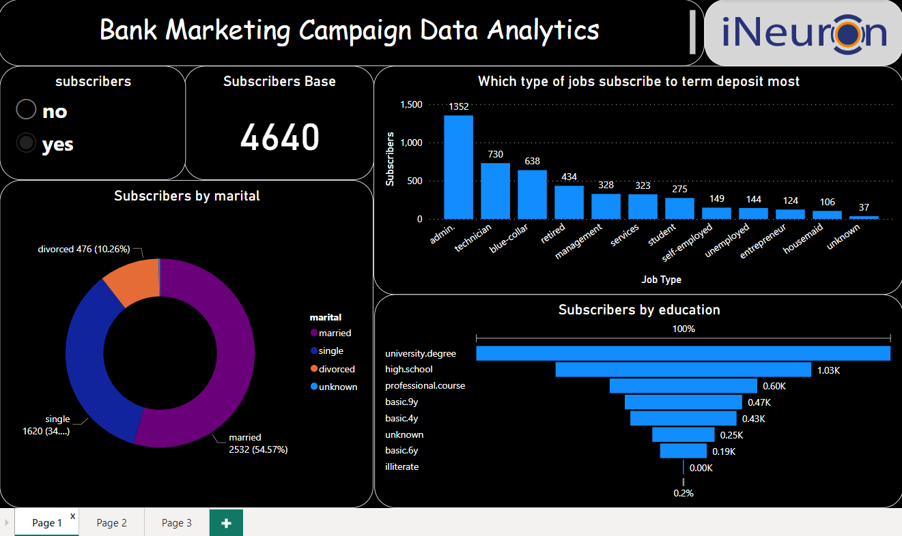

Slide 9
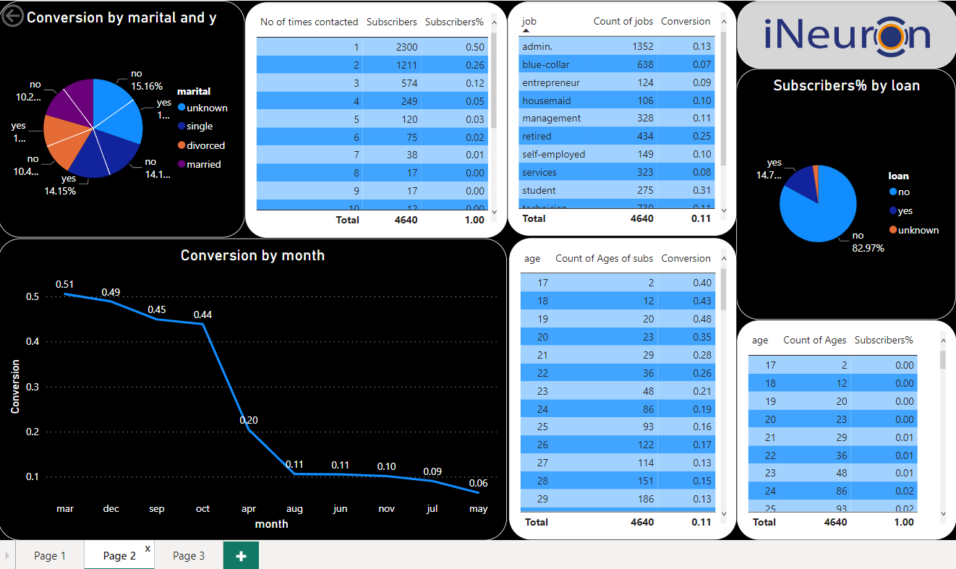

Slide 10
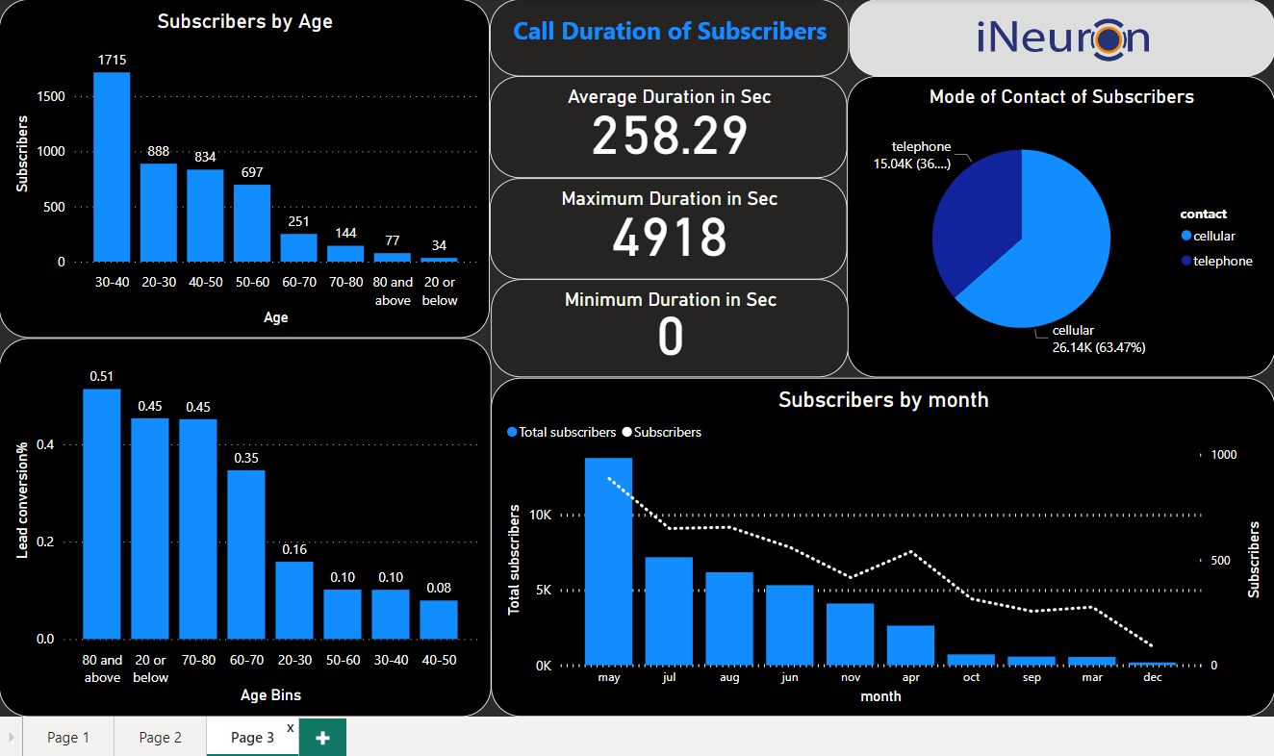

Slide 11
INSIGHTS FROM DASHBOARD
A total of 41188 people were called during the campaign out of which 4640 subscribed to the term deposit.
Call duration time for age group 60-90 is more as compared to age group 20-50 which indicates that younger customers need less time on call.
Out of 4640 customers, 54.57% of customers are married, 34.91% customers are single and 10.26% are divorced.
Many customers have a university degree or went to high school. Only 0.15% customers are illiterate.

Slide 12
Most common jobs of customers are in Administration, Technicians and Blue-collar. Very few number of customers are entrepreneurs or housemaid.
In the month of April, May, Jun, Jul, Aug and Nov the conversion ratio is least.
The highest leads conversion ratio stood at 0.51% whereas lowest is 0.06%.
Maximum customers are in the age range of 20-60. Maximum people were called in the age range of 20-50. Hence, leads conversion rate of people of age range 50-60 is highest
The lowest number of customers are age range of 80+ and 20 below. Usually, the people in the age range don’t have much time and earnings. So, they don’t invest in term deposit.
Average call duration of customers in 258.29 secs. Average consumer confidence index is -41 and Average Euribor 3m rate is 4.

Slide 13
Q & A:
Q1) What’s the source of data?
This dataset is publicly available for research. Available at: [pdf] http://dx.doi.org/10.1016/j.dss.2014.03.001 titled “Bank Marketing (with social/economic context)”
Q 2) What was the type of data?
The data was contained in the zip folder in csv format.
Q 3) What’s the complete flow you followed in this Project?
Refer all slides in sequence for better Understanding.
Q 4) What steps should I follow to get insights from the data?
Step1 – Download the data and store it in a location in your PC.
Step2 – Open PowerBI_Report.pbix file in your pc and then you can see all the insights.

