Slide 1
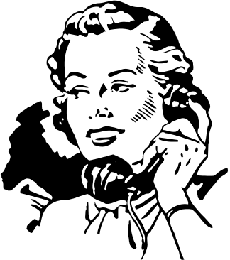
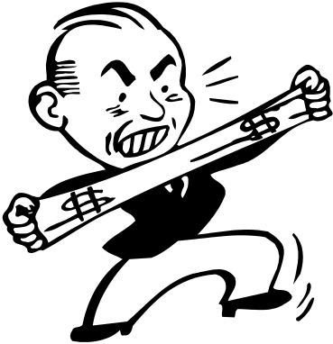

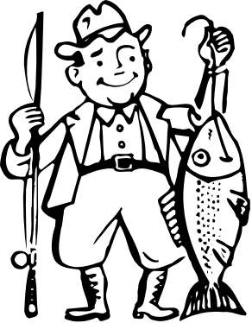
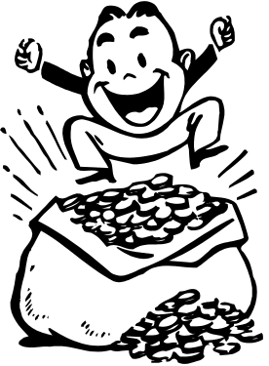
Nonverbal Communication

Slide 2
What is nonverbal communication?
“Oral and nonoral messages expressed by other than linguistic means.”
Messages transmitted by vocal means that do not involve language
Sign language and written words are not considered nonverbal communication

Slide 3
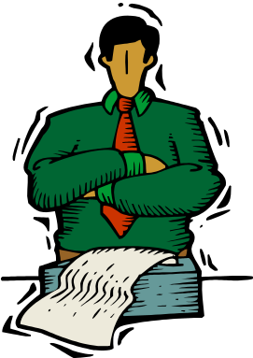

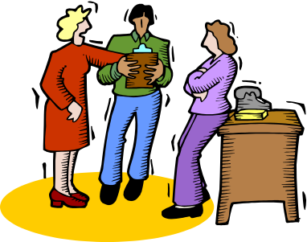
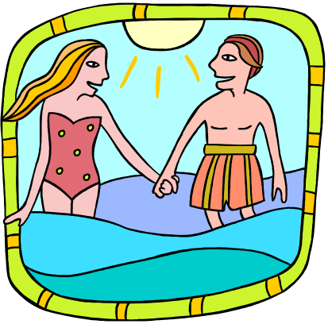
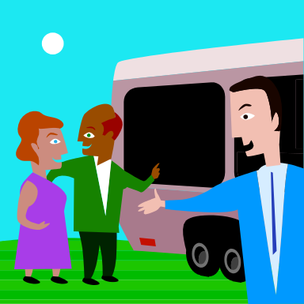
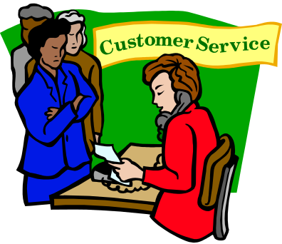
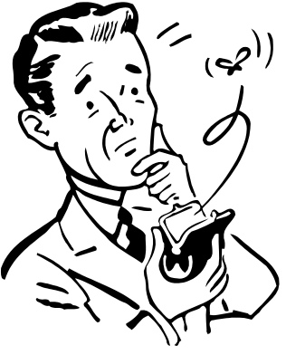
Nonverbal communication is powerful
60% of all communication is nonverbal
(Burgoon, Buller, & Woodall,1989)

Slide 4
There are 7 types of nonverbal behavior
Proxemics
Haptics
Chronemics
Kinesics
Artifacts
Vocalics or Paralanguage
Environment

Slide 5
PROXEMICS (distance)
Different cultures have different comfort levels of distance
As children grow older and become less dependent on parents they require more space
Men tend to take up more space than women
Example: When you go to the movies with someone of the opposite sex who usually gets the armrest?

Slide 6
Edward T. Hall’s 4 levels of distance
Intimate: 0 to 18 inches
personal: 18 inches to 4 feet
social: 4 to 10 feet
public: 10 feet to infinity

Slide 7
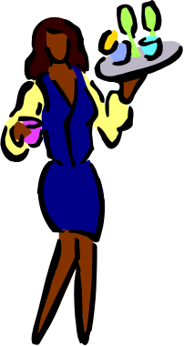
HAPTICS (touch)
The power of touch:
A (1997) study found that strangers that were touched were more likely to return change left in a phone booth(Klienke)
A (1992) study found that food servers who used touch received larger tips (Hornick)
Library study (1976) found that students who were slightly touched by clerk while checking out library books evaluated the library much more favorably than those who were not touched.

Slide 8
CHRONEMICS (time)
How is time used to communicate?
What does it mean to you when someone is always late?
A study conducted by Burgoon (1989) found that people who arrive 15 minutes late are considered dynamic, but much less competent, composed and sociable than those that arrive on time.

Slide 9
KINESICS (behavior)
Facial expressions
Eye contact
Body language
Gestures
Physical appearance

Slide 10
Facial expressions
The face is capable of conveying 250,000 expressions (Birdwhistle, 1970)
Smiling increases sociability, likeability, and attraction(LaFrance & Hecht, 1995)
Food servers who smile more often earn increased tips (Heslin & Patterson, 1982)
Studies conducted on students caught cheating found that students who smiled were treated with more leniency (LaFrance & Hecht, 1995)

Slide 11
Eye contact
Successful pan handlers establish eye contact (Beebe, 1974)
People are more likely to comply when more eye contact is used
Eye contact conveys a sense of sincerity
Eye contact establishes a connection between persons

Slide 12
Body language
Mirroring – building rapport with others by mimicking their nonverbal cues
People like those who are similar or equal to them
“Mirroring” body language facilitates compliance
Many self-help books suggest mirroring techniques to get people to like them
Example: The book Unlimited Power by, Anthony Robbins

Slide 13
Gestures
Gestures can be seen as subtle or not so subtle cues
We use gestures to take the place of words, or help us to increase understanding of what is being said

Slide 14
Physical Appearance
More attractive people are judged to be happier, more intelligent, friendlier, stronger, and kinder and are thought to have better personalities, better jobs, and greater marital competence (Knapp, 1992)
Attractive people get more dates, higher grades, higher tips, and lighter court sentences than unattractive people (Dunn, 2000)

Slide 15
Example:
  In a 1980 study 73 defendants who had been rated on physical attractiveness went to trial. Results showed that the more attractive defendants received significantly lighter sentences (Stewart).

Slide 16
ARTIFACTS (Dress, Belongings, etc.)
Material objects as an extension of oneself
Clothing has the power to influence
Change left in a phone booth was returned to well dressed people 77% of the time, poorly dressed people only 38% of the time
Several studies show that fancy suits, uniforms and high-status clothing are related to higher rates of compliance.
The situation governs appropriate dress

Slide 17
VOLCALICS (Paralanguage)
Use of voice to communicate includes elements such as pitch, rate, pauses, volume, tone of voice, silences, laughs, screams, sighs, etc.

Slide 18
Studies have found that people who talk louder, faster, and more fluently are more persuasive
Deep voices are often viewed as more credible
Powerless style of communication (pauses, umhs, uhs, tag questions) lowers perceptions of credibility

Slide 19
ENVIRONMENT
What we surround ourselves with
Example: The way we decorate our house tells others a lot about us

Slide 20
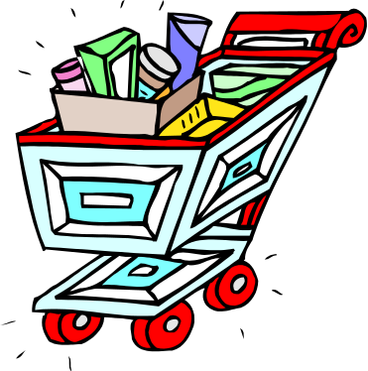
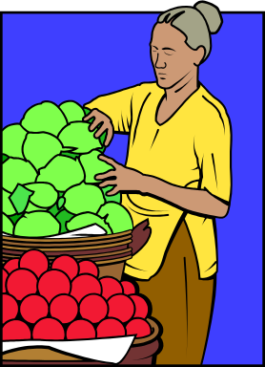
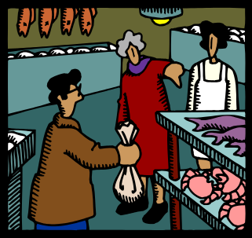
Environment is often used to influence nonverbally
Several researchers have found that supermarkets strategically place products
Staples such as dairy, meat and produce are in the back or on opposite sides of the store, in order to force shoppers to meander through aisles where they’ll be tempted to buy all kinds of other products

Slide 21
Children’s products are usually placed on lower shelves where they can easily be viewed
Snack foods, which appeal to impulsive buyers are usually placed near check-out areas and at the end of isles where they are more likely to be snatched up
(Field, 1996; Meyer, 1997: Tandingan, 2001)

Slide 22
Functions of Nonverbal Communication
Repeating
Substituting
Complementing
Accenting
Regulating
Contradicting
Deceiving

Slide 23
Repeating
The use of nonverbal behavior to say what you are saying in words
Emblems- are the nonverbal behaviors that we use to display what we mean
Example: head nods at the same time as someone saying “yes”

Slide 24
Substituting
The use of nonverbal behaviors to say things rather than words
We often answer questions others ask by responding nonverbally rather than verbally
Example: Nodding your head to answer a question rather than saying “yes”

Slide 25
Complementing
The use of nonverbal behaviors to strengthen what is being said with words.
Illustrators- nonverbal behaviors that support what is being said verbally
Example: A friend says “I am so sorry” and at the same time makes a sincerely sad face

Slide 26
Accenting
The way we emphasize certain words in order to clarify what we mean.
Example: “NO!” or “No????”

Slide 27
Regulating
Nonverbal behaviors that control the flow of the conversation, and tell us when it is our turn to talk, or when the other person is finished talking.
Example: while telling a story to a friend, one may pause to allow room for comments

Slide 28
Contradicting
When people are saying one thing yet their nonverbal behavior is telling us something completely different.
Example: A friend says, “I am so sorry” while smiling

Slide 29
In conclusion
A knowledge of the several factors involved with nonverbal communication, and an awareness of its power will improve our ability to communicate with others.

