Slide 1
Class and Objects Chapter – 5
DMSI

Slide 2
Memory allocation for Objects
memory space for objects is allocated when they are declared and not when the class is specified.
Actually, the member functions are created and placed in the memory space only once when they are defined as a part of a class specification.
What about member variables? Allocated separately for each variables.

Slide 3
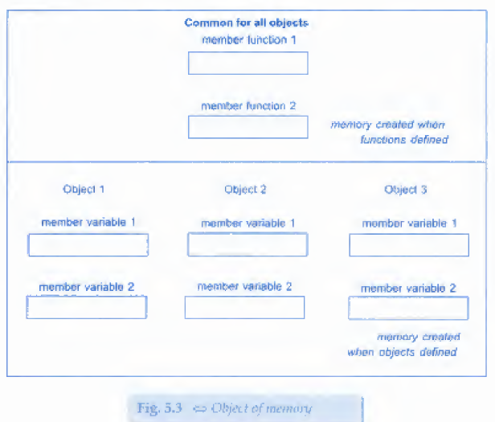

Slide 4
5.11 Static Data member
A static member variable has certain special characteristics. These are →
• It is initialized to zero when the first object of its class is created. No other initialization is permitted.
• Only one copy of that member is created for the entire class and is shared by all the objects of that class, no matter how many objects are created.
• It is visible only within the class, but its lifetime is the entire program.

Slide 5
It must be defined outside the class
int bsc :: count;
Cause they are stored separately than a part of the class.
At the time of object ‘bsc’ creation the count is initialized to zero
Every time object is created the count is increased

Slide 6
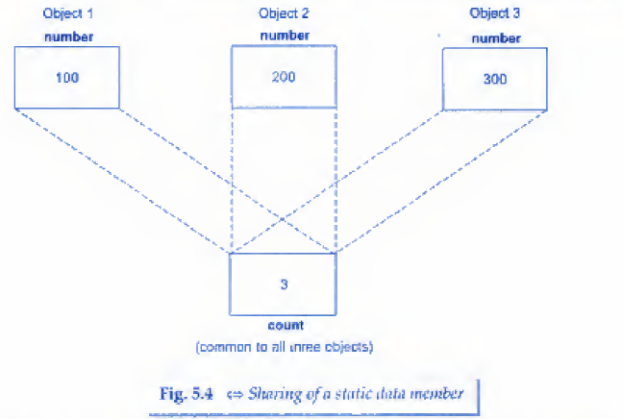

Slide 7
5.12 static member functions
Like static member variable, we can also have static member functions. A member Junction that is declared static has the following properties:-
• A static function can have access to only ether static members (functions or variables) declared in the same class,
• A static member function can be called using the class name {Instead of its objects} as follows:
class-name :: function-name;

Slide 8
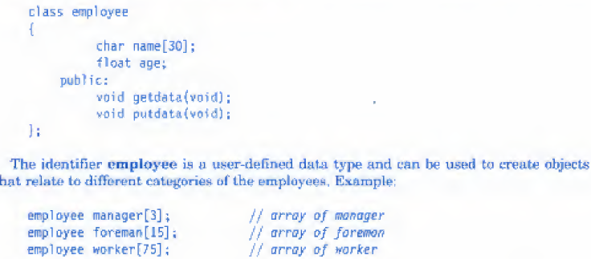
5.13 Arrays of Objects

Slide 9
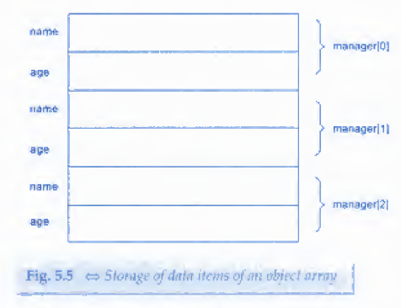
manager[i].putdata();

Slide 10
5.15 friendly functions
the private members cannot be accessed from outside the class. That is, a non-member function cannot have an access to the private data of a class.
consider a case where two classes, manager and scientist, have been defined. We would like to use a function income_tax() to operate on the objects of both these classes. In such situations, C++ allows the common function to be made friendly with both the classes, thereby allowing the function to have access to the private data of these classes.

Slide 11
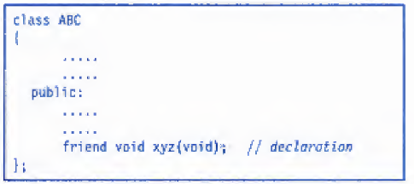

Slide 12
A friend function possesses certain special characteristics:
It is not in the scope of the class to which it has been declared as friend.
Since it is not in the scope of the class, it cannot be called using the object of that class.
It can be invoked like a normal function without the help of any object,
Unlike member functions, it cannot access the member names directly and has to use an object name and dot membership operator with each member name.
It can be declared either in the public or the private part of a class without affecting its meaning.
Usually, it has the objects as arguments.

Slide 13
END

