Slide 1
Constructors and Destructors Chapter – 6
DMSI

Slide 2
6.1 Introduction
A.input();
X.getdata( 100.299,95);
all these 'function call statements are used with the appropriate objects that have already been created. These functions cannot be used to initialize the member variables at the time of creation of their objects

Slide 3
Cont.
C++ provides a special member function called the constructor which enables an object to initialize itself when it is created.
This is know as automatic initialization.
It also provides another member function called the destructor that destroys the objects when they are no longer required.

Slide 4
6.2 Constructors
A constructor is a 'special' member function whose task is to initialize the objects of its class.
It is special because its name is the same as the class name.
The constructor is invoked whenever an object of its associated class is created. It is called constructor because it constructs the values data members of the class.

Slide 5
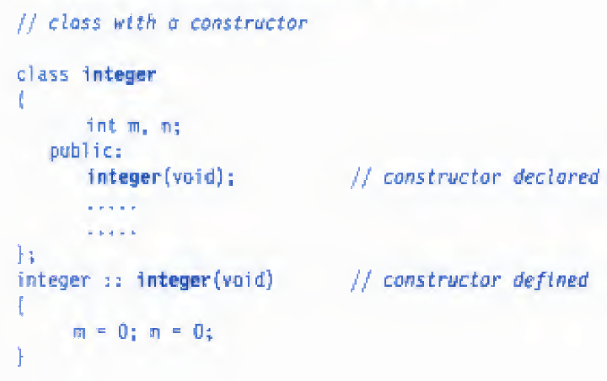
Cont.

Slide 6
not only creates the abject ‘int1' type integer but also initializes its data members ‘m’ and ‘n’ to zero
A constructor that accepts no parameters is called the default constructor. The default constructor for class A is A::A();

Slide 7
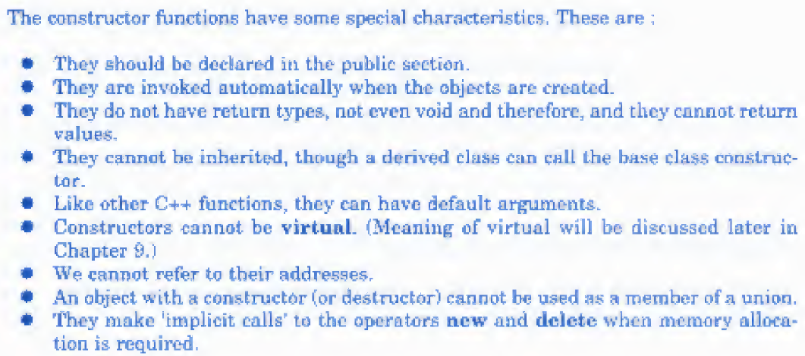
Constructor properties:

Slide 8
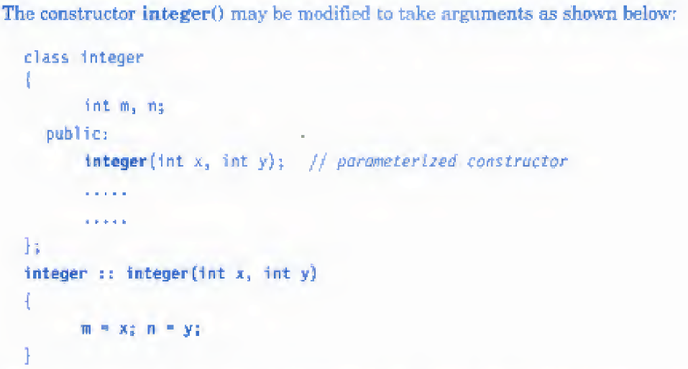
6.3 Parameterized Constructors
The constructors that can take arguments are called parameterized constructor.

Slide 9
integer int1;
is this object declaration statement correct? Why not?

Slide 10
We must pass the initial values as arguments to the constructor function when an object is declared. This can be done in two ways:
By calling the constructor explicitly.
By calling the constructor impliedly.
The following declaration illustrates the first method:

Slide 11
END

