Slide 1
Constructors and Destructors Chapter – 6
DMSI

Slide 2
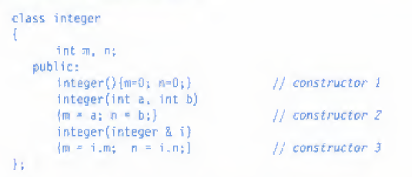
6.4 Multiple constructor in Class
Explain with example
In this case one class have more than one constructor
For example:

Slide 3

There are three constructors in the class integer.
The first constructor, which takes no arguments, is used to create objects which are not initialized;
The second, which takes one argument, is used to create objects and initialize them;
and the third, which takes two arguments, is also used to create objects and initialize

Slide 4
6.5 Constructors with Default Arguments
Complex (float real, float image=0);
It is important to distinguish between the default constructor A::A() and the default argument constructor A::A(int = 0).
The default argument constructor can he called with
either one argument or no arguments. When called with no arguments, it becomes a default constructor. When both these forms are used in a class, it causes ambiguity for a statement such as
A a;

Slide 5
6.7 Copy Constructor
a copy constructor is used to declare and initialize an object from another object. For example, the statement
Integer I2(I1):
would define the object 12 and at the same time initialize it to the values of I1.
Another form of this statement is
integer I2= I1;

Slide 6
Cont.
The process of initializing through a copy constructor is known as copy initialization.
Remember, the statement I2 = I1 ;
will not invoke the copy constructor, However, if i1 and i2 are objects this statement is legal and simply assigns the values of i1 to i2, member by member. This is the task of the overloaded assignment operator(=).

Slide 7
END

