Slide 1
OOP Lecture-2
Dr. Mohammad Shahidul Islam
Assistant professor

Slide 2
2.1 What is C++
Its an OOP Language
Introduced by AT&T bell laboratory in 1980’s
Still retains the power of C
Initially it was named as “C with classes”
C++ is a superset of C
Some differences will prevent the C to run in the C++ compiler

Slide 3
2.1 What is C++
Important features added over C are classes, inheritance, function overloading and operator overloading.
C++ allows programmers to build large programs with clarity, extensibility, and ease of maintenance incorporating the spirit and efficiency of C
It facilitates(সহজসাধ্য করে তোলা) bottom up approach which was top down in case of C

Slide 4
Applications of OOP
OOP language like C++ or JAVA is capable of handling large programs easily
Task includes development of editors, compilers, databases, communication systems and any complex real time systems

Slide 5
Applications of OOP
Since C++ allows us to create hierarchy-related objects, we can build special object oriented libraries which can be used later by many programmers.
While C++ is able to map the real-world problem properly, the C part of C++ gives the language the ability to get close to the machine-level details.
C++ programs are easily maintainable and expandable. When a new feature needs to be implemented, it is vary easy to add to the exiting structure of an object.

Slide 6
2.3 A Simple C++ Program
Printing a string
# include <iostream> // include header file
using namespace std;
Int main()
{
Cout<< “my name is ………..”; //C++ statement
Return 0;
} // end of example
Program Features
only one function, main(). //can have more
Like C the C++ statements terminate with semicolons

Slide 7
Example (cont.)
Comments
C++ introduces a new comment symbol //
Note that there is no closing symbol
for*(j=0; j<n; /* loops n times */ J++)
Can we use double slash?
Output Operator:
two ne C++ features, cout and <<.
The operator << is called the insertion or put to operator

Slide 8
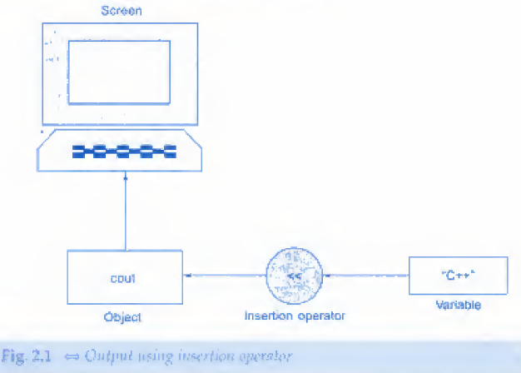
Output Operator:
You may recall that the operator << is the bit-wise left-shift operator and it can still be used for this purpose.
This is an example of how one operator can be used for different purposes, depending on the context.
This concept is known an operator overloading, an important aspect of polymorphism.

Slide 9
The iostream File
We have used the following #include directive in the program;
# include <iostream>
This directive causes the preprocessor to add the contents of the iostream file to the program.
It contains declarations for the identifier cout and the operator «.
Some old versions of C++ use a header file called ioslream.h.
This is one of the changes introduced by ANSI C++.

Slide 10
Return Type of main ( )
In C++, main() returns an integer type value to the operating system.
Therefore, every main() in C + + should end with a return(O) statement; otherwise a warning or an error might occur.
Since main() returns an integer type value, return type for main() is explicitly specified as int. Note that the default return type for all functions in C++ is int.
The following main without type and return will run with a warning:
main()
{
-----
-----
}

Slide 11
More C+ + Statements
#include<iostream>
using namespace std;
int main()
{
float v1,v2,sum, average;
cout<< "entr the numvers\n";
cin>> v1;
cin>> v2;
sum=v1+v2;
average=sum/2;
cout<< "sum= "<<sum<<"\n";
cout<< "average= "<<average<<"\n";
return 0;
}

Slide 12
Variables?
Input Operator?
Cascading of I/O Operators?
cout<< "sum= "<<sum<<"\n";
The multiple use of << in one statement is called cascading
What is the difference,
cout<< "sum= "<<sum<<“,"
<< "average= "<<average<<"\n";

Slide 13
Class
#include <iostream> using namespace std; class person { char name[30]; int age; public: void getdata(void); void display(void); }; void person:: getdata(void) { cout<<"enter the name\n"; cin>> name; cout<<"enter the age\n"; cin>>age; } | void person:: display(void) { cout<<"Name of the person: "<<name<<"\n"; cout<<"Age of the person: "<<age<<"\n"; } int main() { person p; p.getdata(); p.display(); return 0; }

Slide 14
Class (cont.)
Class person has two two functions called member function.
The main program uses person to declare variables of its type.
Here P is an object of type person.

Slide 15
Classes in Java:
public class Dog
{
String breed;
int age;
String color;
void barking(){ }
void hungry(){ }
void sleeping(){ }
}

Slide 16
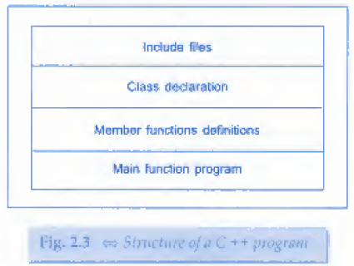
Structure of C++ program
The previous OOP code shows that a typical code can have four sections….
Include files
Class declaration
Member functions definition
Main function program

Slide 17
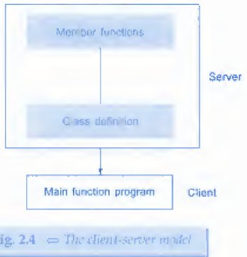
Client-Server model
The class definition includinf the member functions are known as server and
The main function is know as client

Slide 18
Creating source file
In C++ we can use text editor to create it
In UNIX we can use vi or ed editor
In dos we can use edlin
The created file should have appropritae extension to be recognised.

Slide 19
Compiling and Linking
The process of compiling and linking again depends upon the operating system.
Each system has its own command to run.

