Slide 1
Tokens, Expressions and Control Structures
Dr. Mohammad Shahidul Islam
AP, IIT, JU

Slide 2
3.2 Tokens
the smallest individual units in a program are known as tokens.
Eg:
Keywords
Identifiers
Constants
Strings
Operators
Usually program is written using these tokens, white spaces, and the syntax of the language.

Slide 3
3.3 Keywords
They are explicitly reserved identifier and
cannot be used as names for the program variables or
other user-defined program elements.
Some examples:
If
Else
Void
Int etc.

Slide 4
3.4 Identifiers and Constants
Identifiers refer to the names of variables, functions, arrays, classes, etc. created by the programmer.
They are the fundamental requirement of any language,
Each language has its own rules for naming these identifiers.

Slide 5
Constants
Constant refer to fixed values that do out change during the execution of a program.
They include integers, characters, floating point numbers and strings. Eg.
123 integer const
123.21 Floating point
“A” character const

Slide 6
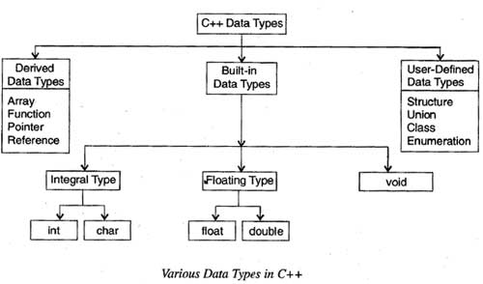
3.5 Basic Data Types
Data types in C++ can be classified under various categories as shown in Fig. 3.1,

Slide 7
Cont.
Compilers needs to support the language data types, known as basic or fundamental data types
the basic data types may have several modifiers preceding them to serve the needs of various situations.
modifiers like: ‘signed’, ‘unsigned’, ‘long’, and ‘short’ may be applied to character and integer basic/fundamental data types,

Slide 8
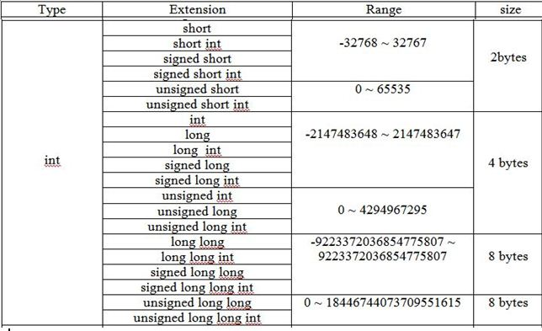
Fundamental data types and their ranges

Slide 9
3.6 User-Defined Data Types
user-defined data type known as class which can be used, just like any other basic data type, to declare variables.
The class variables are known as objects, which are the central focus of object-oriented programming,
public class Dog
{
String breed;
int age;
String color;
void barking(){ }
void hungry(){ }
void sleeping(){ }
}
class person
{
char name[30];
int age;
public:
void getdata(void);
void display(void);
};

Slide 10
Enumerated Data Type
An enumerated data type is another user-defined type which provides a way for attaching names to numbers,
enum shape(circle, square, triangle);
enum colour(red. blue, green, yellow);

Slide 11
Arrays, functions and pointers
the application of arrays in C++ is similar to that in C.
When initializing a character array in ANSI C, the compiler will allow us to declare the array size as the exact length of the string constant. E.g.:
char string[3] = "xyz";
in C++, the size should be one larger than the number of characters in the string.

Slide 12
functions
Concept of functions has changed a lot from C to C++.
The is to cope up with the OOP.
This makes the program more reliable and readable.

Slide 13
pointers
The concept of functions has also changed a lot from C to C++.
As C++ is an OOP language, its adds the concept of constant pointer and pointer to a constant.
E.g:
char * const p1= "GOOD"; // constant pointer
char const * p1= "GOOD"; // pointer to constant

