Slide 1
Tokens, Expressions and Control Structures
DMSI
Lec - 4

Slide 2
3.8 Symbolic Constants
Two ways to define constant:
Using the qualifier const, and
Defining a set of integer constants using ‘enum’ keyword.
const int size =10;
char name[size];
they can be made local by declaring static
to give a const value an external linkage so that it can be referenced from another file, we must explicitly define it as an extern in C++, eg?

Slide 3
Constant
enum {X,Y,Z};
What is the value of X,Y and Z?
Another way of defining this? const X=0;?
We can also assign values to X, Y, and Z explicitly. Example;
enum{X=100, Y=150, Z=200};?

Slide 4
3-9 Type Compatibility
C++ is very strict with regard to type compatibility as compared to C. For instance, C++ defines int, short int, and long int as three different types. They must be cast when their values are assigned to one another. Similarly, unsigned char, char, and signed char are considered as different types, although each of these has a size of one byte, In C++, the types of values must be the same for complete compatibility, or else, a cast must be applied.
Why? These restrictions in C++ are necessary in order to support function overloading where two functions with the same name are distinguished using the type of function arguments. (add example from the book)

Slide 5
3.10 Declaration of Variables
Variable must be declared before they are used in the program.
Why OOP-L C++ variable declaration is better than C? with example
C++ allows the declaration of a variable any where in the scope. This means that a variable can be declared right at the place of its first use. This makes the program much easier to write and reduces the errors that may be caused by having to scan back and forth. It also makes the program easier to understand because the variables are declared in the context of their use.

Slide 6
Example (Do it at home and show me the result)
int main() { float x; float sum; for int (i=1; i<5; i++) { cin » x; sum=sum +X; } | float average;//declaration average = sum/(i-1); cout « average; return 0:
What is the disadvantage of declaring variables anywhere in the program?

Slide 7
3.11 Dynamic Initialization of Variables
What do you mean by dynamic initialization of variables?
OOP permits initialization of the variables at run time. This is referred to as dynamic initialization. In C++ a variable can be initialized at run time using expressions at the place can be combined into a single statement of declaration, For example,
float average; //declare where it is necessary
average = sum/ i;
Can be cobbined into single statement
float average = sum/i; //initialize dynamically at run time

Slide 8
5.12 ‘Reference’ Variables
What do you mean by ‘Reference’ variables? How to declare it in the program?
It’s a variable gives the output similar to another variable and indicate the same memory address.
Example;
float total =100;
float & sum = total;.
Here cout>>sum; and cout>>total; gives 100 as output.

Slide 9
Cont.
Any change in total will reflect to sum (read example from book)
A reference variable must be initialized at the time of declaration. (eg int & sum)
A major use of this is in argument passing.

Slide 10
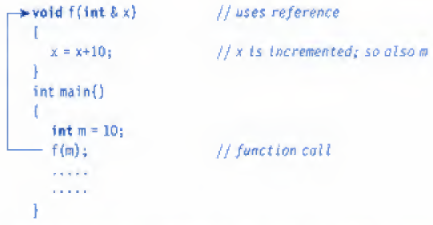
Cont.
When the function call f(m)> is executed, the following initialization occurs:
int & x = m;
Thus x becomes an alias of m after executing the statement
f (m)

Slide 11
Cont.
The call by reference procedure is useful in OOP because it permits the manipulation of objects by reference, and eliminates the copying of object parameters back and forth,
It is also important to note that references can be created not only for built in data types but also for user-defined data types such as structures and classes.
References work wonderfully well with these user-defined data types.

Slide 12
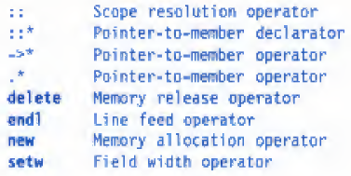
3.1 3 Operators in C + +
we can give several meanings to an operator, depending upon the types of arguments used.
This process is known as operator overloading.?

Slide 13
3.14 supper resolution operator
Like C, C++ is also a block structured language.
Blocks atld etor*1^ can ^ in constructing
programs. We know that the same variable name can be used to have different meanings in
different blocks, The scope ofthe variable extends from the point of its declaration till the end
of the block containing the declaration, A variable declared inside a block is said to be local to
that block. Consider thu following .Hegmunt uf a propria rn:

