Slide 1
OOP Lec - 5
DMSI

Slide 2
Memory Management Operator
malloc() and calloc()
Free() to free the dynamically allocated memory
Along with these C++ supports new and delete which gives full control over the memory.

Slide 3
Cont.
NEW:
pointer_variable= new data_type;
Here data type can be any data
Eg : p = new int;
Is p declared before? It has to be declared
E.g. int *p = new int;

Slide 4
Cont.
new can be used to create a memory space for any data type including user-defined types such an arrays, structures and classes. The general form For a one-dimensional array is:
pointer_variable= new data_type [];
For more dimention
pointer_variable= new data_type[][][];

Slide 5
Cont.
If we write *p = new int[10]; and if indicated 10 images then p[0] denotes the first image.
What is the wrong with the above statement?
When a data object is no longer needed, it is destroyed to release the memory space for reuse. The general form of Its use is:
delete pointer-variable;

Slide 6
Cont.
If we want to free a dynamically allocated array, we must use the fallowing form of delete:
delete [size] pointer-variable;
Is it tough to remember the size? Tough, therefore we do not need to remember it…….so what can we write???
What will happen if enough memory space is not available for allocation?

Slide 7
What are the advantages of the new operator over malloc()?
The new operator offers the following advantages over the function maaloc() :
1. It automatically computes the size of the data object . We need not use the operator sizeof,
2. It automatically returns the correct pointer type, so that there is no need to use a type cast.
3. It is possible to initialize the object while creating the memory space,
4. like any other operator, new and delete can be overloaded.

Slide 8

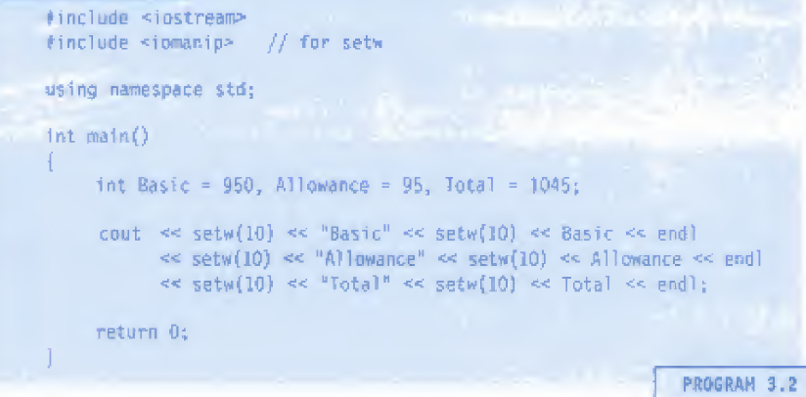
3.17 Manipulators
elnl, setw
Same as “\n”
What is the o/p of the following program?

Slide 9
3. 19 Expressions and Their Types
What does the term ‘expression’ means in programming language? Types?
An expression is a combination of operators, constants and variables arranged as per the rules of the language.
It may also include function calls which return values.
An expression may consist of one or more operands, and zero or more operators to produce a value.

Slide 10
Types
Expressions may be of the following seven types:
* Constant expressions (read book for examples)
* Integral expressions ( “ )
* Float expressions ( “ ), 5 + float (10)
* Pointer expressions ( “ )
* Relational expressions ( “ ), x < y, x==y etc
* Logical expressions ( “ ), x < y && x==y etc
* Bitwise expressions ( “ ), x >> 3 ;(shift x by 3 bits)
Compound expressions ( “ )

Slide 11


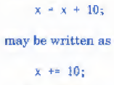
3.20 Special Assignment Expressions
Chained Assignment
Embedded Assignment
Compound Assignment
+= is called comp. assign.

Slide 12
3.21 Implicit or automatic Conversions
When the compiler encounters an expression, it divides the expression into sub expressions consisting of one operator and one or two operands.
For a binary operator, if the operands type differ, the compiler converts one of them to match with the other, using the rule that the "smaller” type is converted to the "wider” type.
For example if one of the operand is an int and the other is a float, the int is converted into a float because a float is wider than an int. The “Water-fall" model shown in Fig. 3.3 illustrates this rule.

Slide 13
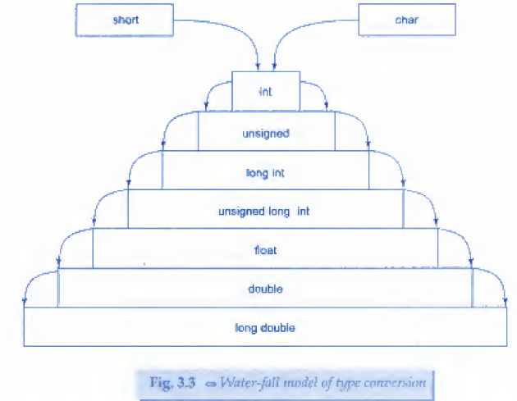
The “Water-fall" model of type conversion

Slide 14
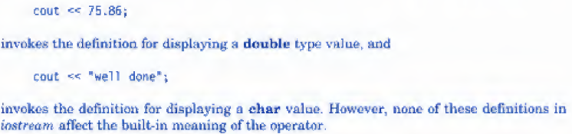
3.22 Operator Overloading

