Slide 1
OOP Lec - 6
DMSI

Slide 2
3.23 Operator Precedence
the multiplication operator will continue having higher precedence than the add operator.
The table in the next page shows the precedence

Slide 3
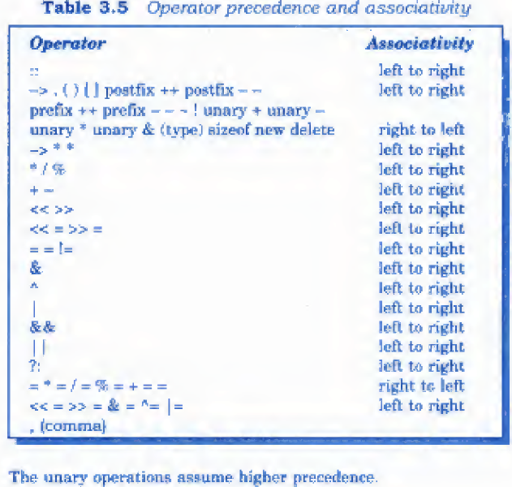

Slide 4
in OOP, large number of functions are used that pass messages and process the data contained in objects.
A function is set up to perform a task. When the task is complex many different algorithms can be designed to achieve the same goal.
Some are simple to comprehend, while others are not. Experience has also shown that the number of bugs that occur, is related to the format of the program.

Slide 5
The format should be such that it is easy to trace the flow of execution of statements. This would help not only in debugging but also in the review and maintenance of the program later.
One method of achieving the objective of an accurate, error-resistant and maintainable code is to use one or any combination of the following three control structures:

Slide 6
Types of control structures
1. Sequence structure (straight line)
2. Selection structure (branching)
3. Loop structure (iteration or repetition)
All programs can be coded using these.
This is called structured programming

Slide 7
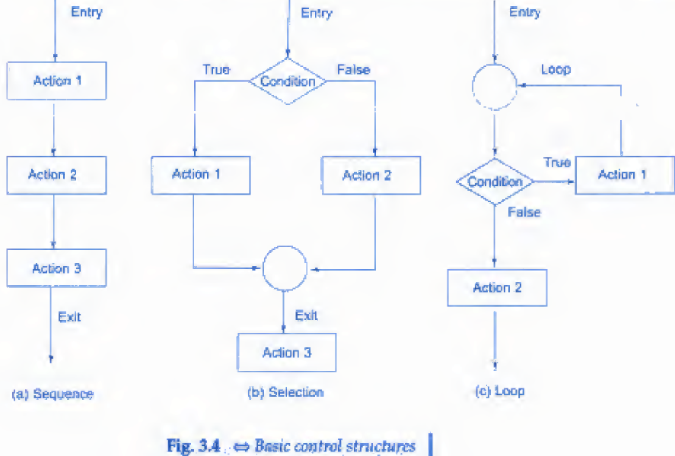

Slide 8
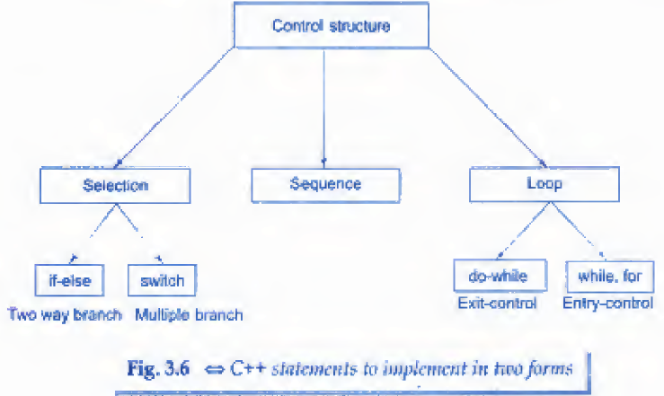

Slide 9
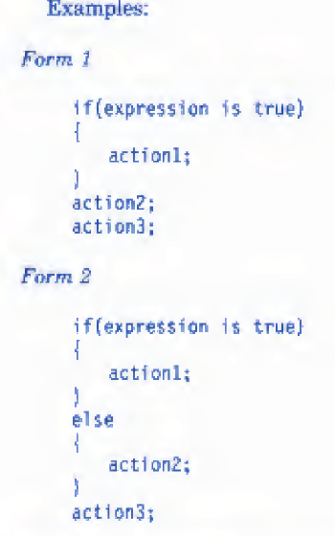
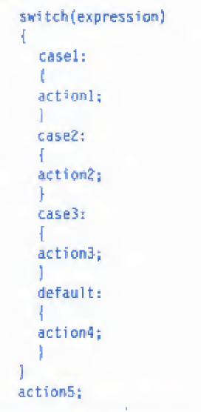

Slide 10
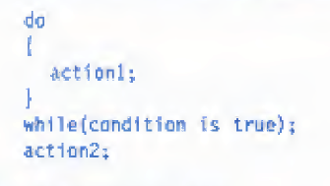
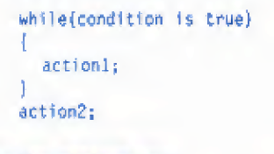
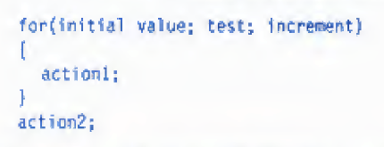

Slide 11
Chapter – 4 Functions in C++
What is benefits of using functions? Explain with example.
Like C++ operators, a C++ function can be overloaded to make it perform different tasks depending on the arguments pass to it.
Most of these modifications are done to meet the object oriented facilities.

Slide 12
4.2 The Main Function
In C main does not return anything.
In C++ it returns and ‘int’
It is a good practice to return value.
As C++ always returns, in the main its not mandatory to mention ‘int’
Many os tests the return value to check whether there was a problem or not
Returning 0 means there was no problem.

