Slide 1
OOP Lec – 7-8
DMSI

Slide 2
4,3 Function Prototyping
Function prototyping is one of the major improvements added to C++ functions.
The prototype describes the function interface to the compiler by giving details such as the number and type of arguments and the type of return values.
With function prototyping a template is always used when declaring and defining a function.
When a function is called, the compiler uses the template to ensure that proper arguments are passed, and the return value is treated correctly.

Slide 3
Cont.
Function prototype is a declaration statement in the calling program and is of the following form;
type function -name ( argument- list);
The argument list contains the types and names of arguments that must be passed to the function.
Example
float volume (int x, float y , float z)

Slide 4
4.4 Call by Reference
In traditional C, a function call passes arguments by value. The called function creates a new set of variables and copies the values of arguments into them. The function does not have access to the actual variables in the calling program and can only work on the copies of values.
This mechanism is fine if the function does not need to alter the values of the original variables in the calling program.

Slide 5
Cont.
Provision of the reference variables in C++ permits us to pass parameters to the functions by reference.
When we pass arguments by reference, the 'formal' arguments in the called function becomes aliases to the 'actual' arguments in the calling function.
This means that when the function is working with its own arguments, it is actually working on the original data.

Slide 6
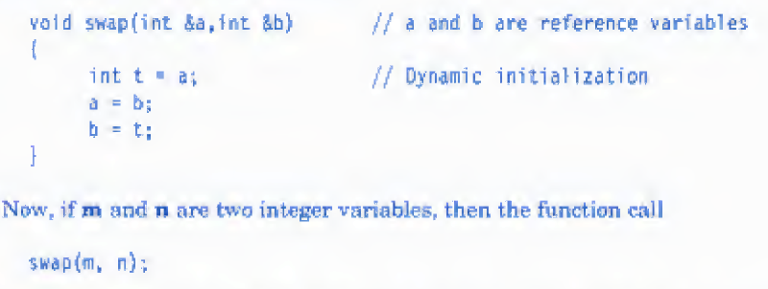
Example of referencing

Slide 7
4.6 Inline Functions
Why?
One of the objectives of using function in a program is to save some memory space, which becomes appreciable when a function is likely to be called many times, However, every time a function in called, it takes a lot of extra time in executing series of instructions for tasks such as jumping to the function, saving registers, pushing arguments into the stack, and returning to the calling function. When a function is small, a substantial percentage of execution time may be spent in such overheads.

Slide 8
Cont.
Solution?
inline function
An inline function is a function that is expanded in line when it is invoked. That is, the compiler replaces the function call with the corresponding function code.
Eg→ next page

Slide 9
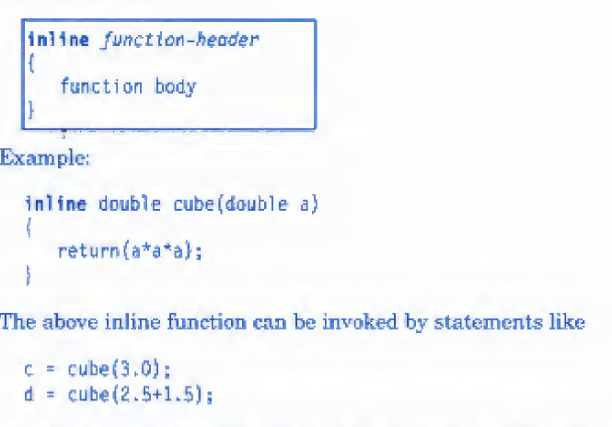
eg

Slide 10
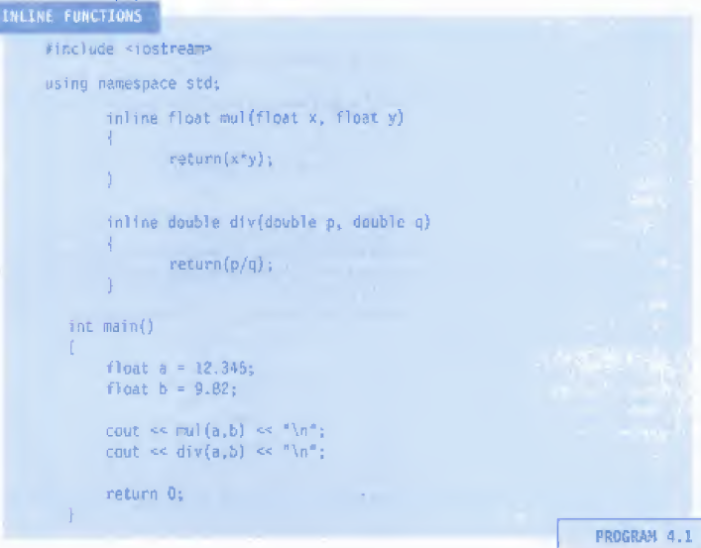

Slide 11
4. 7 Default Arguments
C++ allows us to call a function without specifying all its arguments.
In such cases, the function assigns a default value to the parameter which does not have a matching argument in the function call.
The compiler looks at the prototype for possible arguments.

Slide 13

4.8 const Arguments
The qualifier const tells the compiler that the function should not modify the argument

Slide 14
4.9 Function Overloading
Explain with example the function overloading
Means we can use the same function name to create functions that perform a variety of different tasks. This is also known as function polymorphism in OOP.

Slide 15
Cont.
Using the concept of function overloading; we can design a family of functions with one function name but with different argument lists.
The function would perform different operations depending on the argument list in the function call, The correct function to be invoked is determined by checking the number and type of the arguments but not on the function type.
For example, an overloaded add() function handles different types of data as shown below:

Slide 16
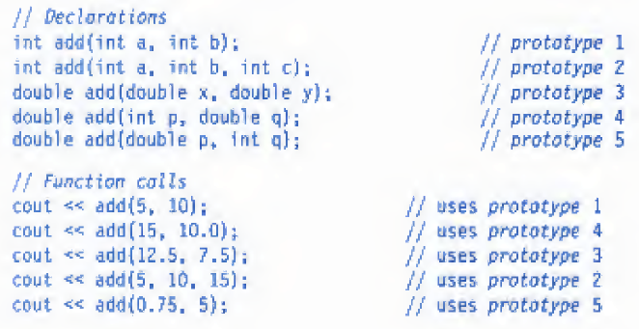
Cont.

Slide 17
Cont.
A function call first matches the prototype having the same number and type of arguments
and then calls the appropriate function for execution,
A best match must be unique,
The function selection involves the following steps:

Slide 18
Cont.
The compiler first tries to find an exact match in which the types of actual arguments are the same, and use that function.
If an exact match is not found, the compiler uses the integral promotions to the actual arguments h such as (to find a match.)
char to int
float to double

Slide 19
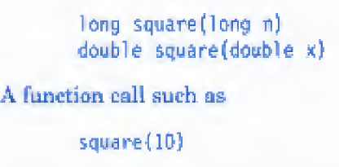
3. When either of them fails, the compiler tries to use the built-in. conversions (the implicit assignment conversions) to the actual arguments and then uses the function whose match is unique.
What is problem with
this function call?
Notes:
will cause an error because int argument can be converted to either long or double,
thereby creating an ambiguous situation as to which version of square should be
used.

Slide 20
If all of the steps fail, then the compiler will try the user-defined conversions in combination with integral promotions and built-in conversions to find a unique match, User-defined conversions are often used in handling class objects.

Slide 21
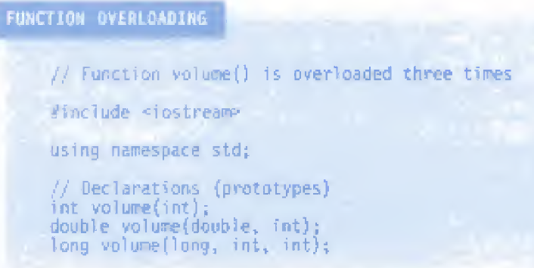

Slide 22
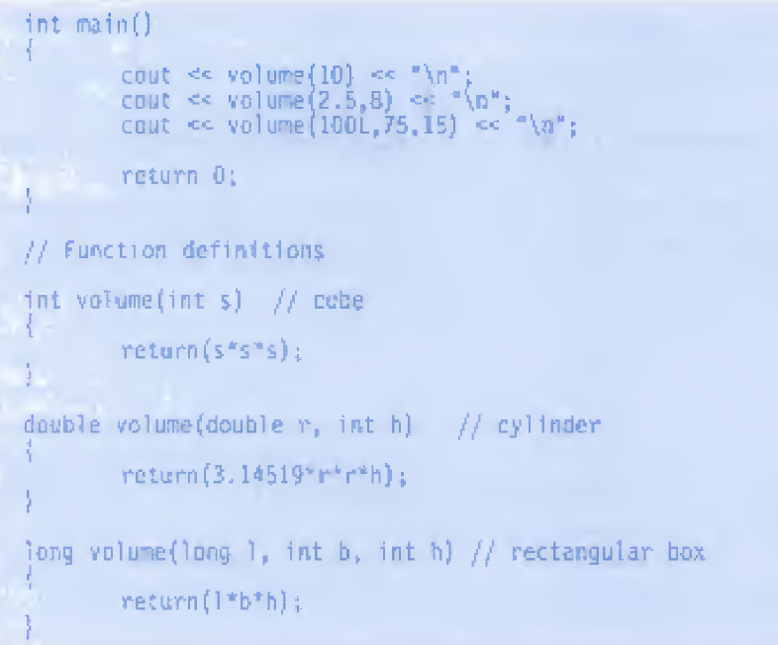

Slide 23
4.11 Math Library Functions
The standard C++ supports many math functions that can be used for performing certain commonly used calculations.
Most frequently used math library functions are summerized in Table 4.1.

Slide 24
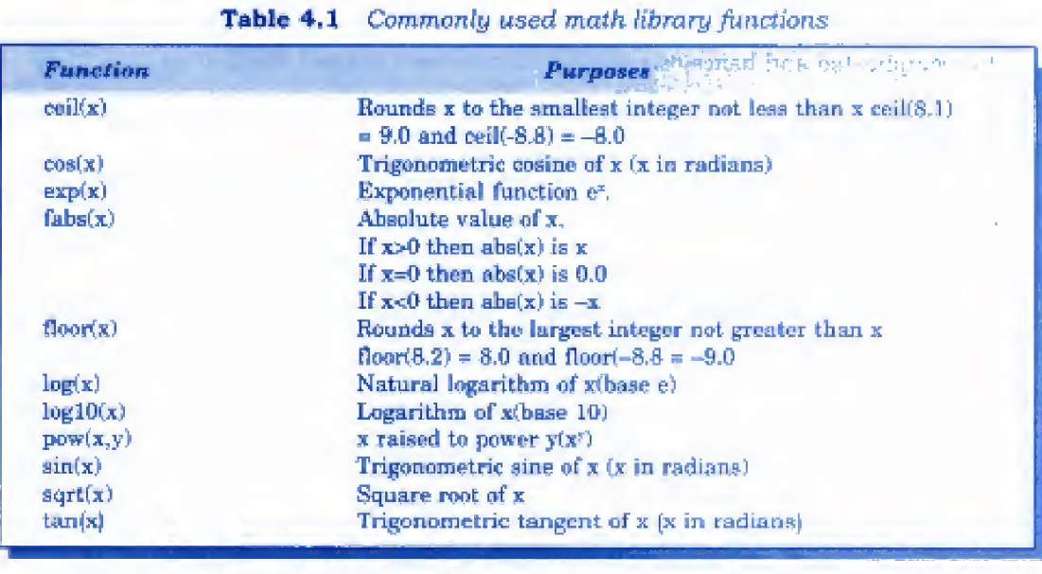

Slide 25
Important Points
It is possible to reduce the size of program by calling and using functions at different places in the program.
In C++ the main() returns a value of type int to the operating system. Since the return type of functions is int by default, the keyword int in the main( ) header is optional.
Moat C++ compilers issue a warning, if there Is no return statement.

Slide 26
Function prototyping gives the compiler the details about the functions such as the number and type* of arguments and the type of return values.
Reference variables in C++ permit us to pass parameters to the functions by reference. A function can also return a reference to a variable.
When a function is declared inline, the compiler replaces the function call with the respective function code. Normally, a small size function is made as inline.
The compiler may ignore the inline declaration if the function declaration is too long or too complicated and hence compile the function as a normal function.
C++ allows us to assign default values to the function parameters when the function is declared, in such a case we can call a function without specifying all its argument. The defaults are always added from right La left.
In C + + , an argument to a function can be declare as const, indicating that the function should not modify the argument.

Slide 27
Cont.
C++ allows function overloading. That is, we can have more than one function with the same name in out program. The compiler matches the function call with the exact function code by checking the number and type of the arguments.
C++ supports two new types; of functions, namely friend functions and virtual functions.
Many mathematical computations can be carried out using the library functions supported by the C++ standard library.

