Slide 1
Class and Objects Chapter – 5
DMSI

Slide 2
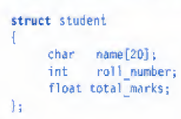

Structures in C
How to define structure in C?
Structure member/ elements
Call by dot
Name tag

Slide 3
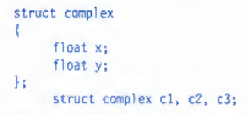

Limitations
The standard C does not allow the struct data type to be treated like built-in types.
Another important limitation of C structures is that they do not permit data hiding. Structure members can be directly accessed by the structure variables by any function anywhere in their scope. In other words the structure members are public members.

Slide 4
C++ structure extensions
It attempts to bring the user-defined types as close as possible to the built-in data types, and also provides a facility to hide the data
which is one of the main principles of OOP.
Inheritance, a mechanism by which one type can inherit characteristics from other types,

Slide 5
Cont.
a structure tan have hath variables and functions as members.
It can also declare some members as private, so that they can be accessed only by member functions.
Student A; no need for keyword ‘structure’
C++ incorporates all these extensions in another user-defined type known as class,

Slide 6
5.3 Class
What is class?
How to define class?
The only difference between a structure and a class in C++ is that, by default, the members of a class are private, while, by default, the members of structure are public.

Slide 7
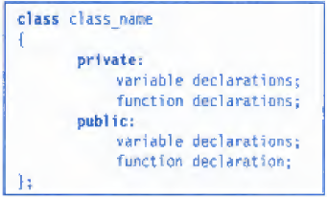
cont
Abstract data type cl_name
Terminated by ;
Contains both var and func.
Has 2 visibility labels
These keywords are followed by colon :

Slide 8
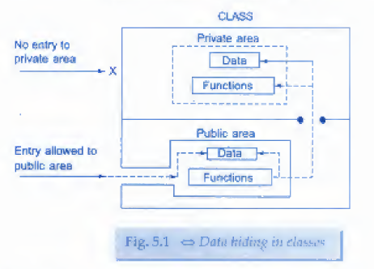
Data hiding
Private members can be accessed only in class
By default all are prvt

Slide 9
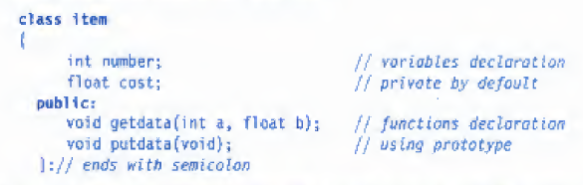
The variables declared, inside the class are known as data members and the functions are known as member function.

Slide 10
The binding of data and functions together into a single class type variable is referred to as encapsulation.

Slide 11
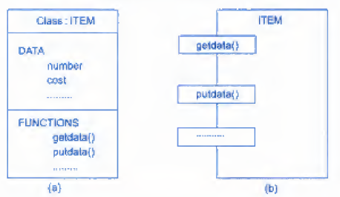
Getdata()
Putdata()
They are only functions to communicate with outside
Two class defining notation in OOP

Slide 12
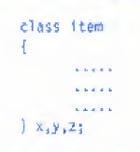
Creating object
The last one is used rarely

Slide 13

Accessing class members
Main() cannot access directly the class var’s
Member functions must be used:
Below statements are illegal.

Slide 14
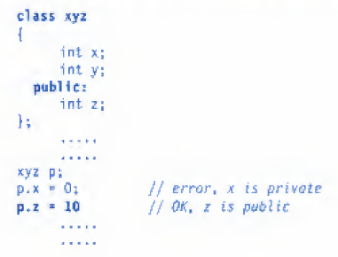
Cont.
What is wrong with the following program,

Slide 15
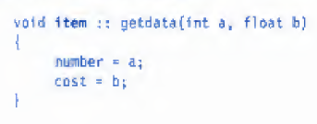
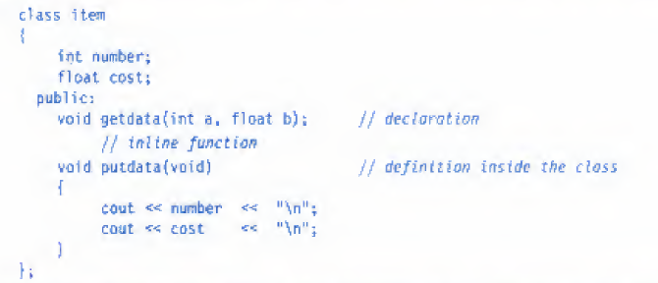
5.4 defining member functions
Outside class
Inside class

Slide 16
Home work 5.5

Slide 17
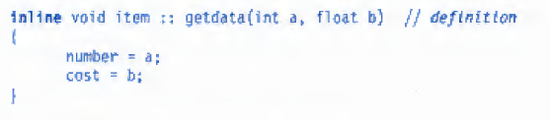
5.6 Making a outside function inline

Slide 18


5.7 nesting of member func

Slide 19
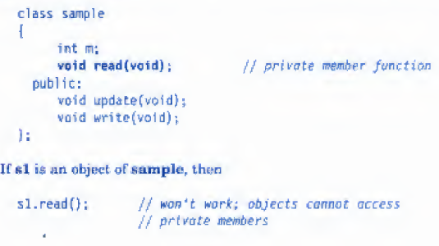
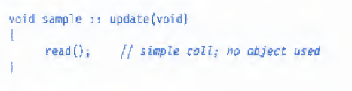
5.8 private member func

