Slide 1
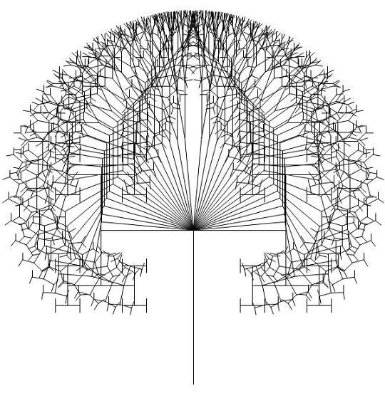




Effect of Branching Strategy on Software Quality
Authors
Emad Shihab
Christian Bird
Thomas Zimmermann

Slide 2
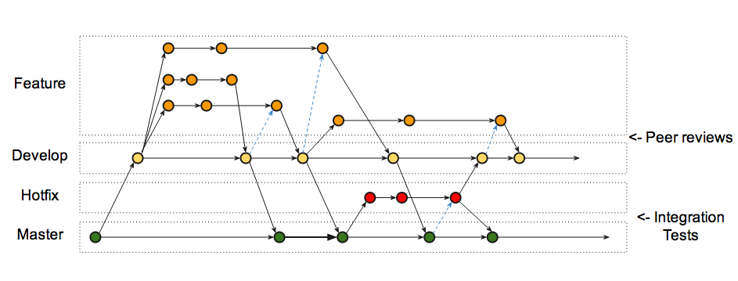
Branches in Git

Slide 3
Branches in Git
Allows development of features with Isolation
May lead to integration failures due to merge conflicts and unseen dependencies

Slide 4
Branching Strategies
Branching according to Software Architecture
Branching according to Organizational Structure

Slide 5
Contributions
Define Metrics to capture the effects on Software Quality
Quantify Effects of Branching on Software Quality
Examine Effect of Mismatch between branching structure and organizational structure.
Provide Recommendations of proper usage of branch.

Slide 6





Slide 7


Slide 8



Data Collection

Slide 9
Data Collection
Windows 2003
- Historical development data for each binary.
- Large releases Vista and Win7.
Windows Vista
Windows 7

Slide 10
Research Questions
How much and in what ways does branching affect software quality?
  Evaluate quality at the component level and the branch level through the use of a number of measures of branch use.
  Represents the testable hypotheses.
  Represents rationale that underlies each of these hypotheses.

Slide 11
Hypotheses
Branch Activity
Branch Scatter
Branch Depth
Branching according to architectural structure
  Architectural Mismatch
Branching according to organizational structure
  Organizational Mismatch

Slide 12
Statistical Model

Slide 13
Case Study Result

Slide 14
Effect of Branching on
Software Quality

Slide 15
Branching Strategies

Slide 16
Practical Implementation

