Slide 1
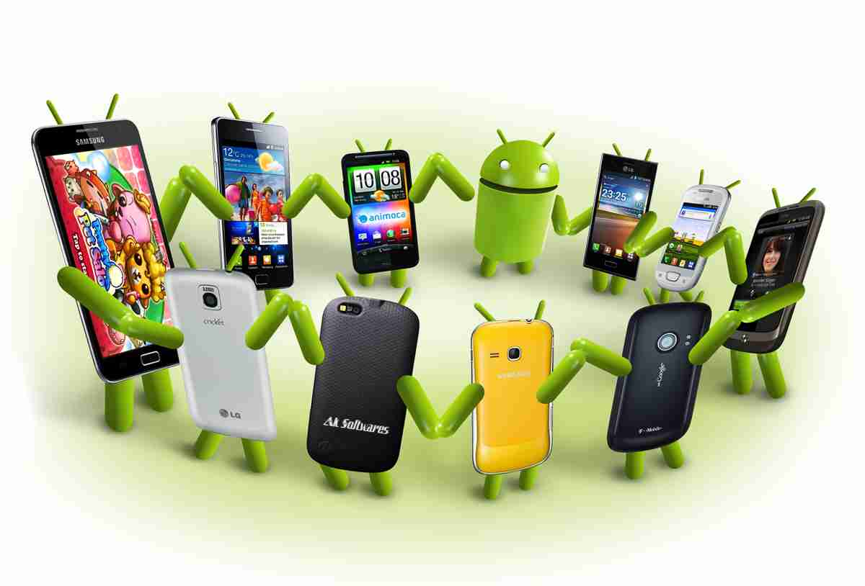
Prioritizing The Devices To Test Your App On:
A Case Study Of Android Game Apps
Authors
Hammad Khalid
Meiyappan Nagappan
Emad Shihab
Ahmed E. Hassan

Slide 2


Prioritizing Android Devices

Slide 3
RQ1: What percentage of devices account for the majority of user reviews?
RQ2: How can new developers identify the devices that they should focus their testing efforts on?
RQ3: Do the star ratings from different Android devices vary significantly?

Slide 4



Study Design
Data selection:
- user reviews of the top 99 Android game apps
- October 2012 to January 2013
Data Collection:
- from Google Play
- 144,689 reviews
- 5 different star-ratings
Identify the devices:
- 89,239 device-related reviews

Slide 5
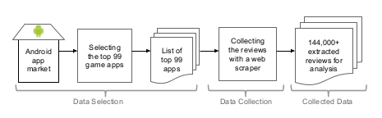

Slide 6
Preliminary Analysis
Are the reviews from many different devices or a small set of devices?
89,239 reviews
187 unique devices
114 have more
than 100 reviews
The magnitude of the Android fragmentation problem
Importance of identifying the devices that give the most reviews to apps
For prioritizing QA efforts

Slide 7
Results
Review share of 10% means that a device gave 10% of all reviews
RQ1:
What percentage of devices account for the majority of user reviews?
DEFINE review share := % of reviews from one device / total number of reviews
foreach( review ) {
* determine the device /* where the review was posted from */
* calculate ‘review share’
}
DETERMINE: ? % of devices covered ? % (0-80) of the user reviews

Slide 8
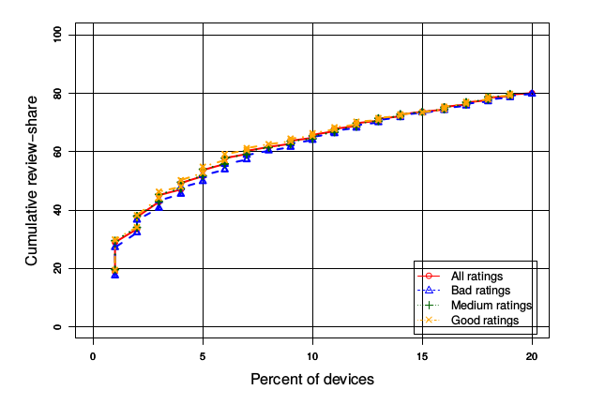
RQ1 Findings
A small percentage of
devices make up the majority of user reviews
20% devices 80% reviews

Slide 9
Results
RQ2:
How can new developers identify the devices that they should focus their testing efforts on?
DEFINE review share := % of reviews from one device / total number of reviews
var devices = [ ]
foreach( category ) {
* aggregate the review data of every top rated app
foreach ( app ) {
devices[ ] := device having higher ‘review share’
}
}
Devices having the most review share across all existing top rated game apps are a good indicator of which devices are likely to have a large review share for each game app.

Slide 10
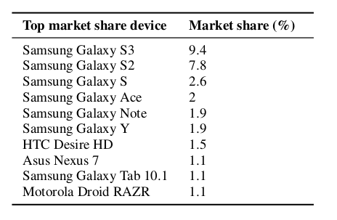
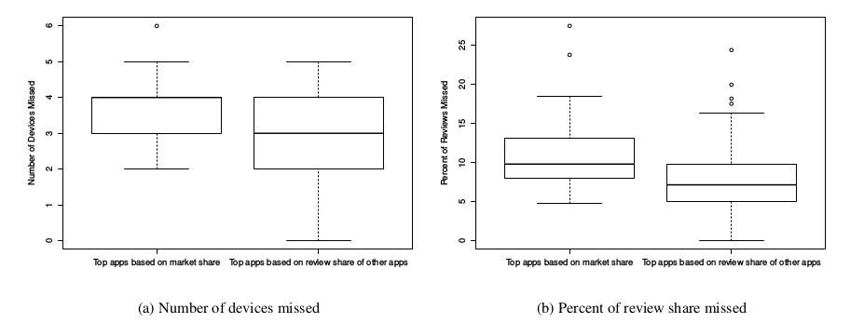
Table 1: Market Share of the most popular android devices
Market Share := # of active devices in the market

Slide 11

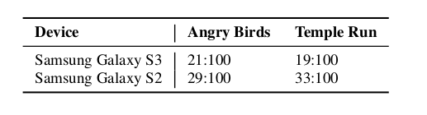
Results
RQ3:
Do the star ratings from different Android devices vary significantly?
Separately compare the reviews
Table 2: Example of the table for bad-ratings given by devices
Bad
Medium
Good

Slide 12
Compare
  Scott-Knott test (cluster-based multi-comparison)
  Sorts the % of bad reviews
  Groups the devices
  If significantly different, find another group

Slide 13
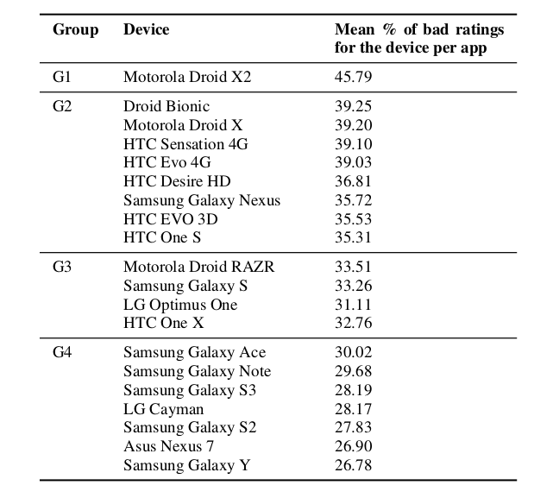
Table 3: Statistically significantly different groups of devices

Slide 14
Devices may give significantly worse review
Understand and decide why?

Slide 15
Analyze Motorola Droid X2 review comments
677 bad reviews
Look for keywords
Findings:
  12% performance issue
  6% display issue

Slide 16
Threats to Validity
Causal link
Limited dated review data
‘Top apps’ by Google Play

Slide 17
Analyze Samsung Galaxy Y review comments
787 bad reviews
Look for keywords
Findings:
  5% performance issue
  6% display issue

Slide 18
Age of devices can be a factor for bad ratings

Slide 19
Conclusion
* Helpful for game app developers
* Prioritizing devices for QA effort
* Some devices give statistically significantly worse ratings then others
- Identify problematic device

