Slide 1
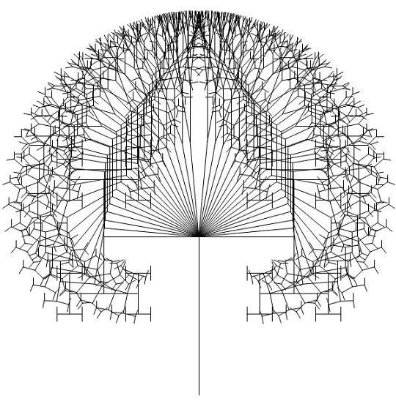

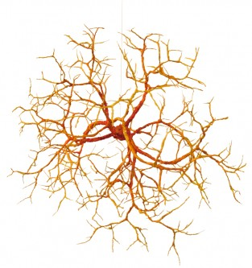
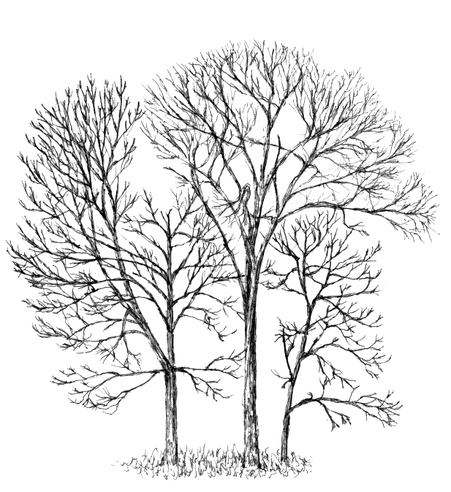
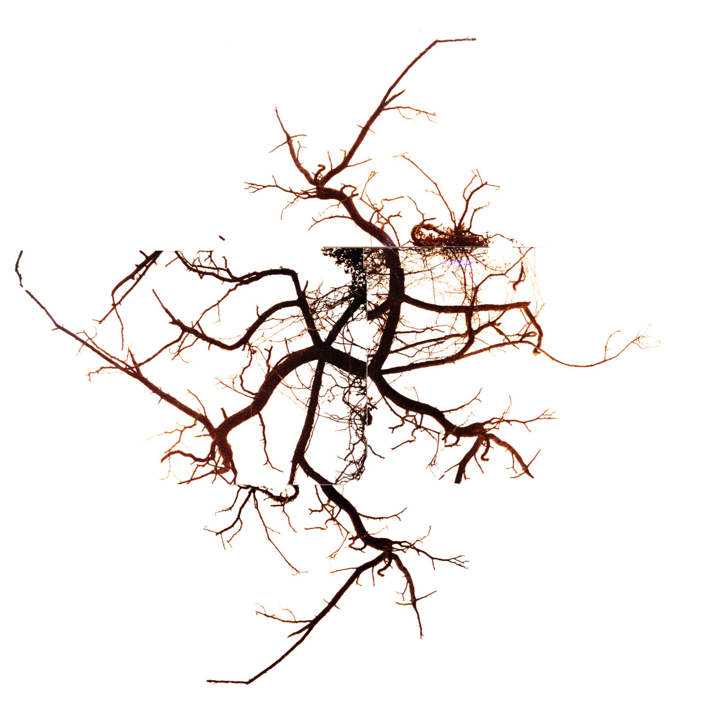
Effect of Branching Strategy on Software Quality
Authors
Emad Shihab
Christian Bird
Thomas Zimmermann

Slide 2
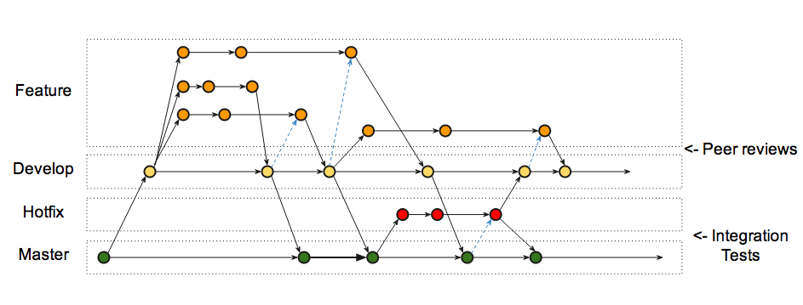
Branches in Git
Allows development of features with Isolation
May lead to integration failures due to merge conflicts and unseen dependencies

Slide 3
Branching Strategies
Branching according to Software Architecture
Branching according to Organizational Structure

Slide 4
Contributions
Define Metrics to capture the effects on Software Quality
Quantify Effects of Branching on Software Quality
Examine Effect of Mismatch between branching structure and organizational structure.
Provide Recommendations of proper usage of branch.

Slide 5


Data Collection

Slide 6
Data Collection
Windows 2003
- Historical development data for each binary.
- Large releases Vista and Win7.
Windows Vista
Windows 7

Slide 7
Research Questions
How much and in what ways does branching affect software quality?
  Evaluate quality at the component level and the branch level through the use of a number of measures of branch use.
  Represents the testable hypotheses.
  Represents rationale that underlies each of these hypotheses.

Slide 8





Effects on Component Quality
Architectural and Organizational
Congruence

Slide 9

Hypotheses
Effects on Component Quality
H1: Branch Activity
  Software components with high branching activity have more failures
# branching changes / # development changes

Slide 10
Hypotheses
Effects on Component Quality
H2: Branch Scatter
  a. Software components spread across many branch families have more failure
  b. Software components developed equally in multiple branch families have more failure
# BranchFamilies(component) / # development changes
The more scattered in branches, the more is integration failure

Slide 11
Hypotheses
Effects on Component Quality
H3: Branch Depth
  a. Software components developed primarily in deeper branches have more failures
  Software components developed evenly in LD, MD and HD have more failures

Slide 12
Hypotheses
Effects on Component Quality
H3: Branch Depth
Commit for foo.dll
Commit for bar.dll
Branch Family 1
Main Branch
Low Depth
Medium Depth
High Depth
Branch Family 2
Ratio of LD MD HD

Slide 13
Hypotheses
Architectural and Organizational Congruence
H4: Branching According to Architectural Structure
  a. Branches with higher architectural mismatch have more failures
  b. Branches with higher organizational mismatch have more failures

Slide 14
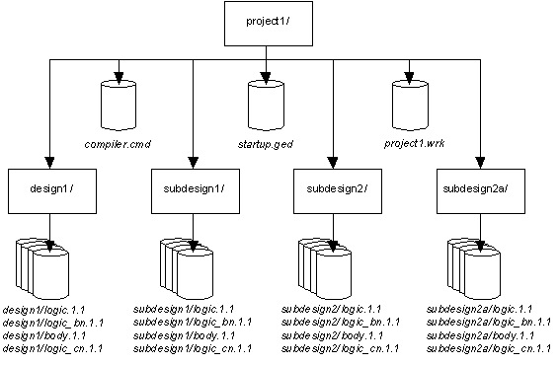
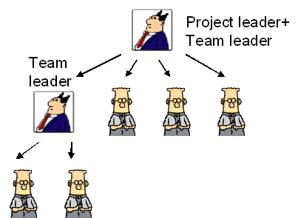
Hypotheses
Architectural and Organizational Congruence
Architectural Mismatch:
  # Individual system
  # Subsystem
  # Area
  # Component
  # Sub-Components
Organizational Mismatch:
  # Managers
  # Development Lead
  # Engineers

Slide 15
Analysis Techniques
Multiple Linear Regression
  Model outcome of response variable
  Model the relationship
Measures are in component level
Variance Inflation Factor (VIF) analysis

Slide 16
Case Study Result
Post-release failure model for Vista
 | Base Model | Model 2 | Model 3 | Model 4 | Model 5
log(Size) | + | + | + | + | +
log(Churn) | + | + | + | + | +
log(Complexity)
log(Dev. Changes) | + | + | + | +
log(No. Files) | + | + | + | + | +
Branch Activity |  | + | + | + | +
log(Branch Scatter) |  |  | +
BS Entropy |  |  | + | + | +
Low Branch Depth |  |  |  | + | +
log(High Branch Depth)
Branch Depth Entropy |  |  |  | - | +
Branch Groups |  |  |  |  | -
R2 | 72% | 75% | 77% | 77% | 79%

Slide 17
Case Study Result
Post-release failure model for Windows7
 | Base Model | Model 2 | Model 3 | Model 4 | Model 5
log(Size) | + | + | + | + | +
log(Churn) | + | + | + | + | +
log(Complexity) | + | + | + | + | +
log(Dev. Changes) | + | + | + | +
log(No. Files) | + | + | + | + | +
Branch Activity |  | + | + | + | +
log(Branch Scatter)
BS Entropy |  |  | - | - | -
Low Branch Depth
log(High Branch Depth)
Branch Depth Entropy
Branch Groups |  |  |  |  | +
R2 | 17% | 18% | 19% | 19% | 36%

Slide 18
Effect of Branching on
Software Quality
Model fit of Architectural and Organizational mismatch
 | Vista | Windows7
Arch mismatch | 0.426** | 0.308**
Org mismatch | 0.543** | 0.321**
Org+Arch | 0.594** | 0.385**
(p<0.01**, p<0.05*)

Slide 19
Practical Implementation
Reduce branch activity
Reduce scattering development
Branch structure alignment closer to organizational structure

Slide 20
Threats
Pre-release failures might in some cases be a measure of quality.
Both projects are developed and by Microsoft

