Slide 1
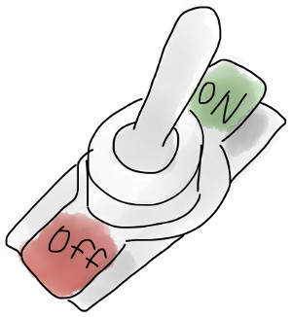
Feature Toggling: Control Over Code and Features During Release
Md Tajmilur Rahman

Slide 2

Feature Flags are Technical Debts?
-Jim Bird

Slide 3
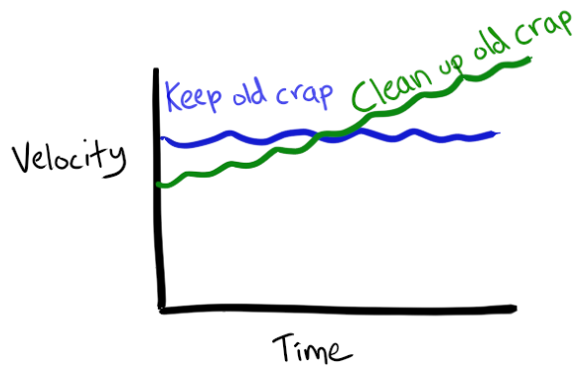

Slide 4


Slide 5
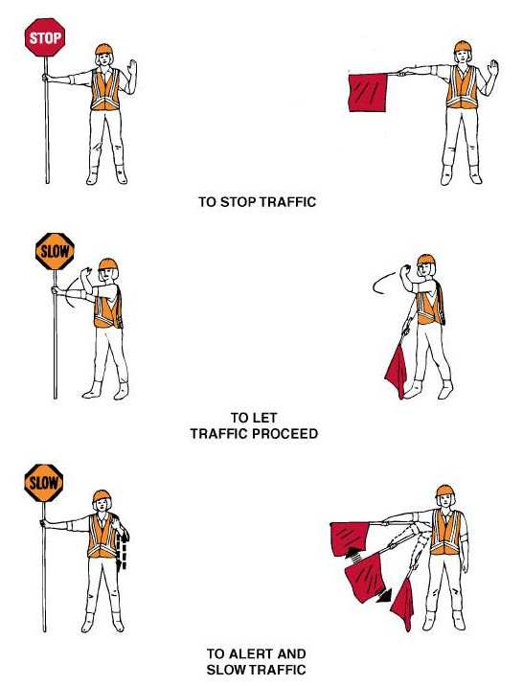


Slide 6
Feature Flags/Switches/Bits
Basic Concept:
1. A configuration file
2. Use these flags in the code of the running application
3. Block the entry points to the features by toggling the corresponding flag
4. Unblock the feature just by toggling in the config file
** For feature toggles it's usually sufficient to run two combinations,
1. All the toggles on that are expected to be on in the next release
2. All toggles on
- Martin Fowler

Slide 7

Feature Flags/Switches/Bits
namespace switches {
extern const char kDebugOnStart[];
extern const char kEnableOpenMax[];
extern const char kNoMessageBox[];
}
// Enable hardware decoding using OpenMax API.
// In practice this is for ChromeOS ARM.
const char kEnableOpenMax[] = "enable-openmax";

Slide 8
public void someBusinessMethod() {
if( MyFeatures.FEATURE_ONE.isActive() ) {
// do new exciting stuff here
}
[...]
}

Slide 9
Use Feature Flags with Caution
Feature Flags need to be Short Lived

Slide 10
Research Questions

Slide 11
RQ1
What is feature flag, how feature flags are being used?
    Quantitative analysis to understand the usage of Flags and Toggles

Slide 12
RQ2
How many features get toggled in a release and how long lived are they?
R1.0
R1.1
R1.2

Slide 13
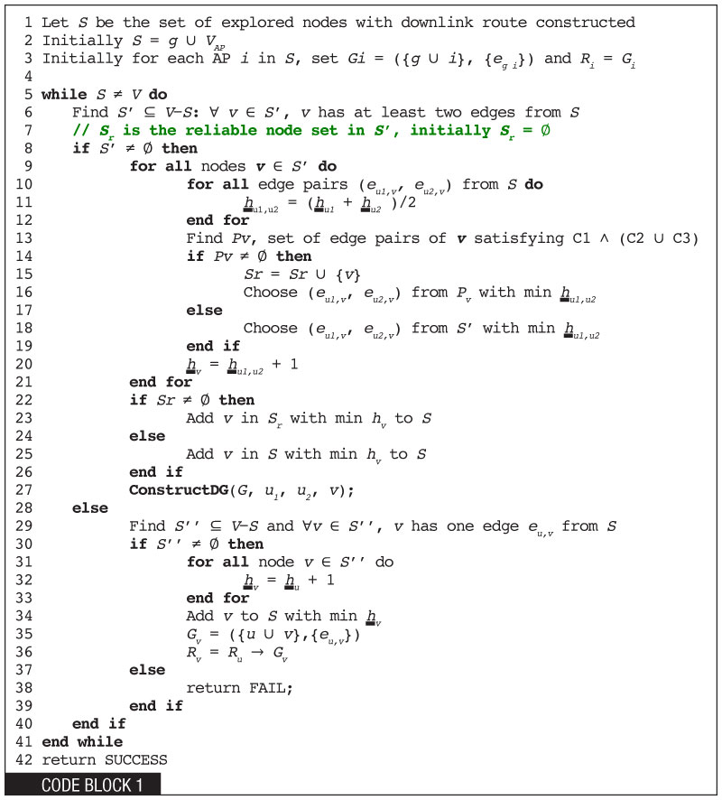
RQ3
What percentage of code that is under feature toggles. How many are reverted right before a release / during stabilization?

Slide 14



RQ4
Who are the developer(s) who do the toggling?

Slide 15
RQ5
What aspects lead developers to make feature toggles?

