Slide 1

Travis CI
A distributed build platform for Open Source
Md Tajmilur Rahman
Mahsa Moosavi
Amir Saboury

Slide 2
CI: Continuous Integration
Continuous Integration is a software
development practice where members of
a team integrate their work frequently ... verified by an
automated build (including test)
to detect integration errors.
-- Martin Fowler

Slide 3

What is Travis CI?
A hosted continuous integration service for open-source and private projects
An Open Source platform
Works with DVC
It's a Build System
Works with Open Source
and Private Repositories
Notes:
1. Travis CI and sub projects are open source
Available at: github.com/travis-ci
They have 20 members and growing
Still it's considered as alpha version but very functional.
2. It allows users to contribute build capacities by connecting a VM that runs a build agent somewhere on their underused servers. (Ameer can add few more words here)
TravisCI web application runs on Heroku but Travis workers, VM that runs the build are contributed by users

Slide 4


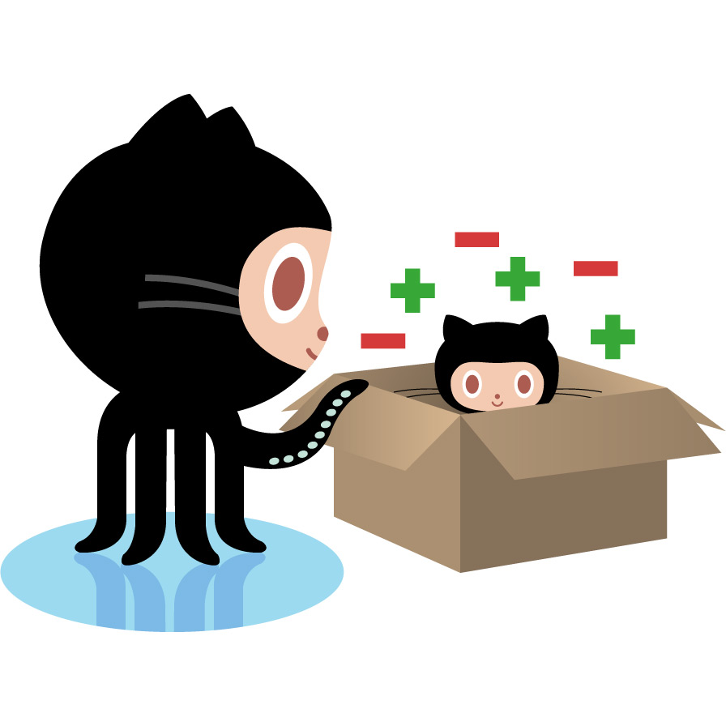




Build System
Git Push

Slide 5




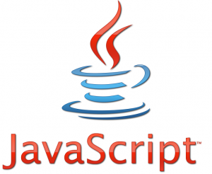
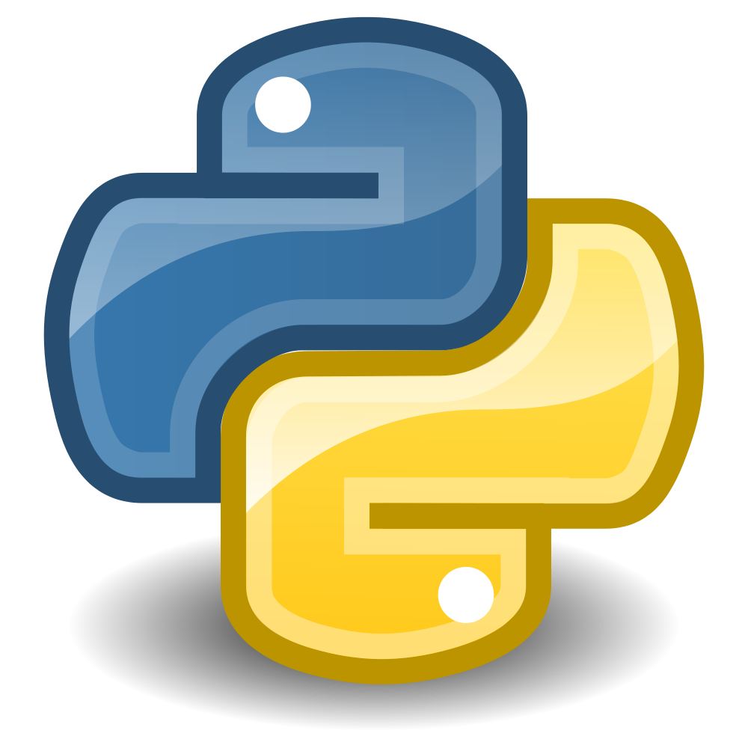

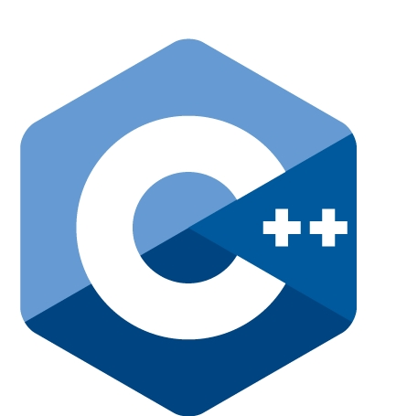




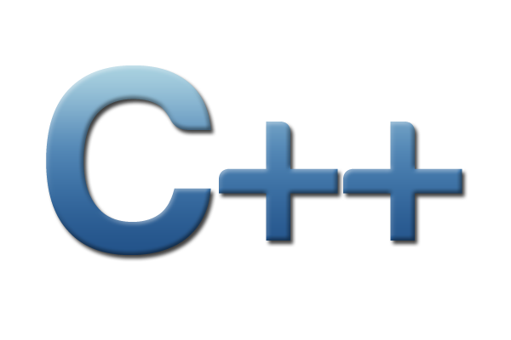

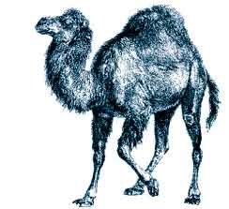


Language Support
Android, C/C++, Clojure, Erlang, Go, Groovy, Haskell, Java, Javascript, NodeJS, Objective-C,
Perl, PHP, Phyton, Ruby, Scala
Languages

Slide 6












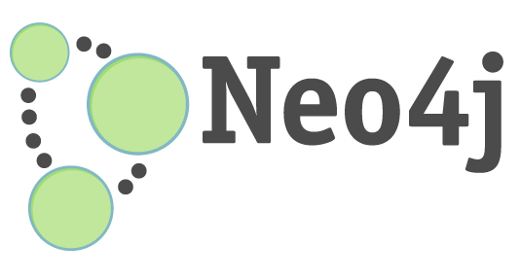


Services
MySQL, PostgreSQL, MongoDB, CouchDB, Redis, Riak, RabbitMQ, Memcached, Cassandra, Neo4j, Elasticsearch, Krestel, SQLite3, ZeroMQ
Services

Slide 7








Notifications
Email, IRC, Campfire, Flowdock, HipChat, Sqwiggle, Slack, Webhook

Slide 8
How it works?

Slide 9
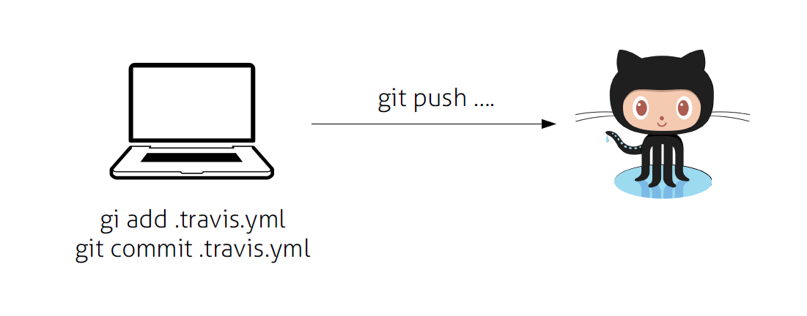

Slide 10
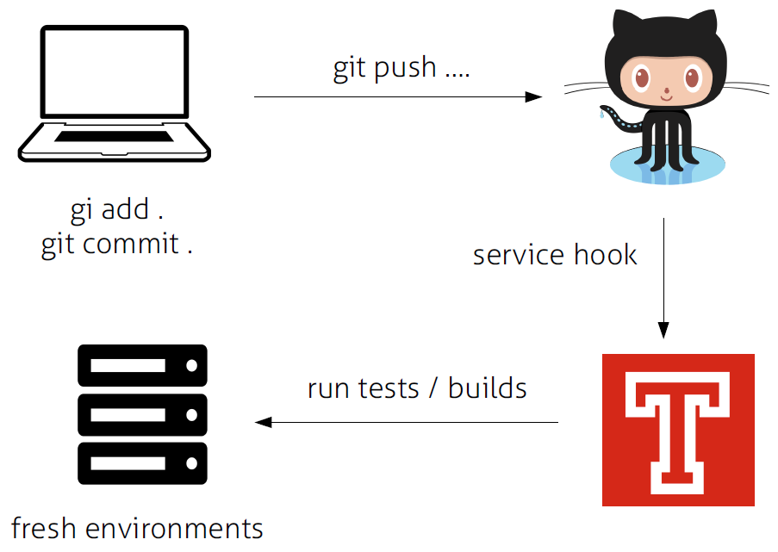

Slide 11
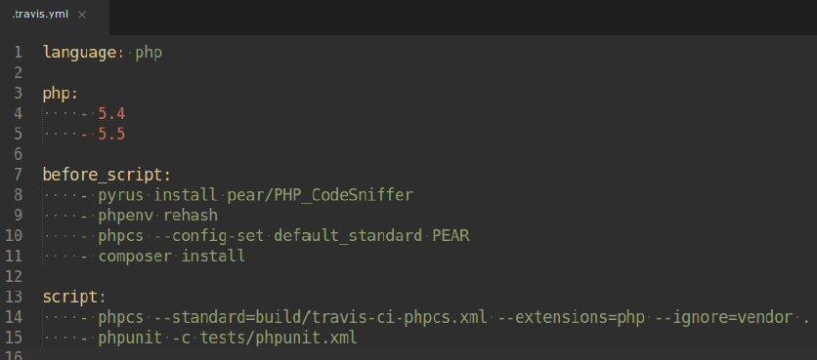
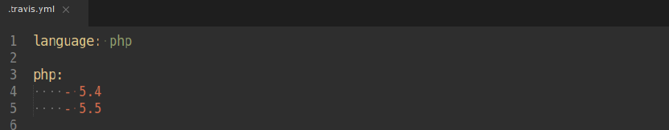
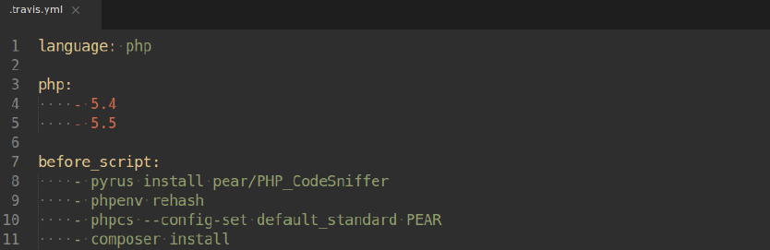

Slide 12
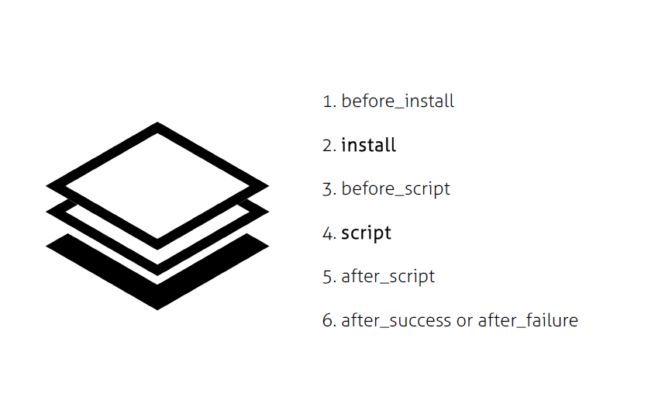
A Build Life-Cycle

Slide 13
Live Demo

Slide 14

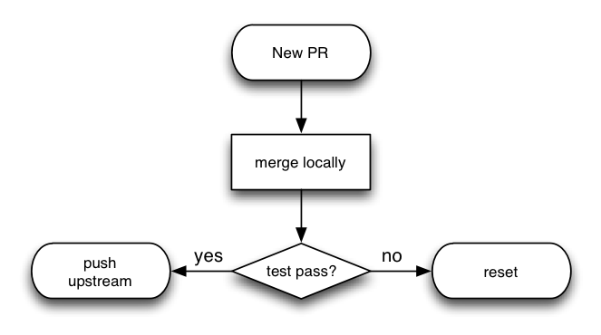
RQ1: What if a pull request comes into my repository?
Notes:
Travis CI receives a pull request
update the commit status of the commits involved
which in turn shows on GitHub as either a warning that the build is still running, that the pull request should be merged with caution because the build failed, or that it can be merged safely because the build was successful.

Slide 15
RQ2: What happens if a pull request is not mergable?
Notes:
It cannot build and test if the request is not mergable.

Slide 16
RQ3: How can we encrypt files that include sensitive data?
Notes:
It provides the command-line tool to encrypt the sensitive data before pushing changes into git-hub.

Slide 17

The End-Goal is

Slide 18


Better Quality
Minimum Effort

Slide 19

Make the Life Easier

Slide 20
Pros
It's Free
Popular and Trending
Fast
Hosted
Git-Hub Integrated

Slide 21
Cons
Limited Control
Limited Extentibility
Only Supports Git-Hub

Slide 22
