Slide 1

Travis CI
A distributed build platform for Open Source
Md Tajmilur Rahman
Mahsa Moosavi
Ameer

Slide 2
CI: Continuous Integration
Continuous Integration is a software
development practice where members of
a team integrate their work frequently ... verified by an
automated build (including test)
to detect integration errors.
-- Martin Fowler

Slide 3

What is Travis CI?
A hosted continuous integration service for open-source and private projects
An Open Source platform
Works with DVC
It's a Build System
It is for the Open Source community
Notes:
1. Travis CI and sub projects are open source
Available at: github.com/travis-ci
They have 20 members and growing
Still it's considered as alpha version but very functional.
2. It allows users to contribute build capacities by connecting a VM that runs a build agent somewhere on their underused servers. (Ameer can add few more words here)
TravisCI web application runs on Heroku but Travis workers, VM that runs the build are contributed by users

Slide 4








Build System
Git Push

Slide 5




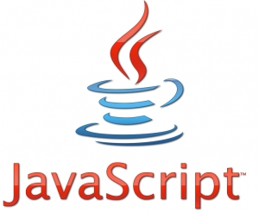
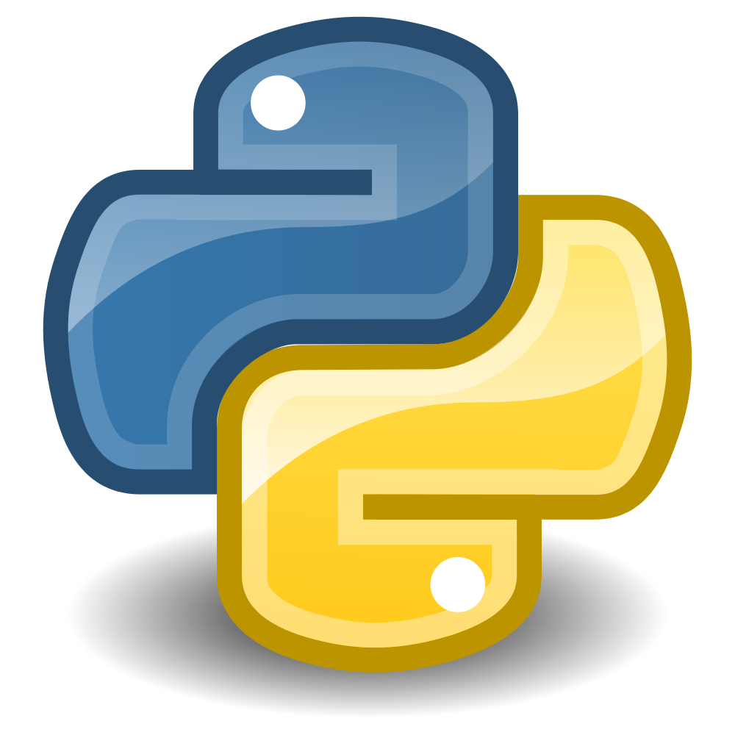

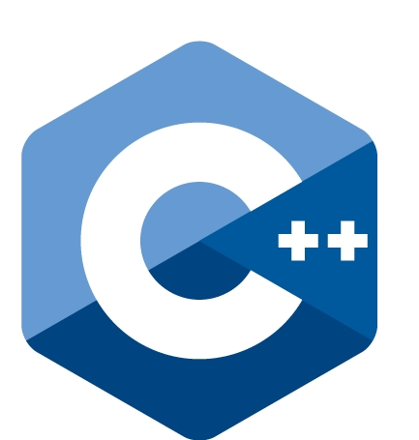
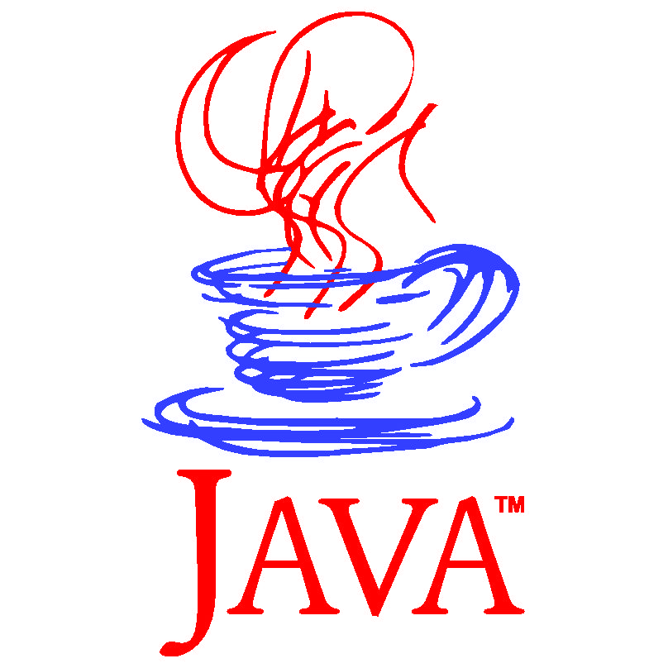



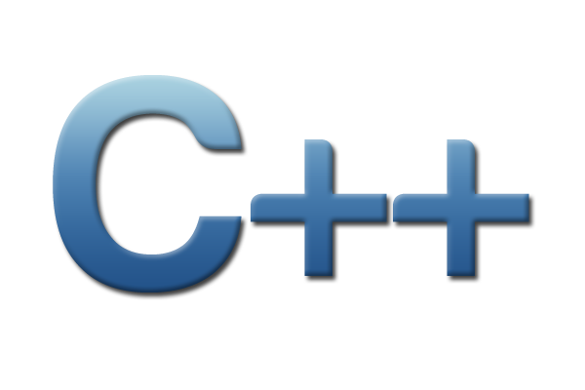



Language Support
Android, C/C++, Clojure, Erlang, Go, Groovy, Haskell, Java, Javascript, NodeJS, Objective-C,
Perl, PHP, Phyton, Ruby, Scala

Slide 6














Services
MySQL, PostgreSQL, MongoDB, CouchDB, Redis, Riak, RabbitMQ, Memcached, Cassandra, Neo4j, Elasticsearch, Krestel, SQLite3, ZeroMQ

Slide 7








Notifications
Email, IRC, Campfire, Flowdock, HipChat, Sqwiggle, Slack, Webhook

Slide 8
How it works?

Slide 11
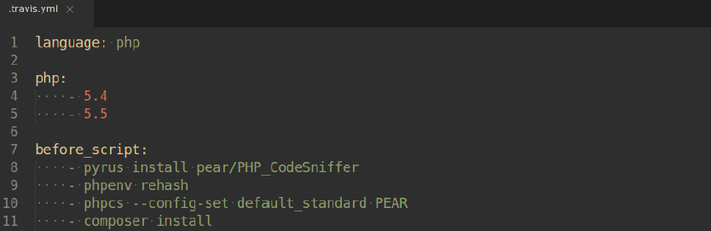

Slide 13
A Build Life-Cycle

Slide 14
Live Demo

Slide 15
What if a pull request comes into my repository?

Slide 16
What happens if a pull request is not mergable?

Slide 17
The End-Goal is

