Slide 1
<number>
SOEN 6611 – Software Measurement
Course Outline
Winter 2014
Instructor: Nikolaos Tsantalis

Slide 2
<number>
Course objectives
The course will cover 3 aspects of software measurement
Theoretical aspect
Product metrics: Complexity, Object-oriented metrics, theoretical & empirical validation
Process metrics: Cost, effort estimation
Research aspect (discussing recent papers)
Practical aspect (develop tools that collect metrics and perform empirical studies)

Slide 3

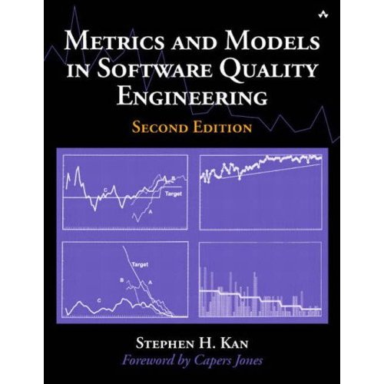
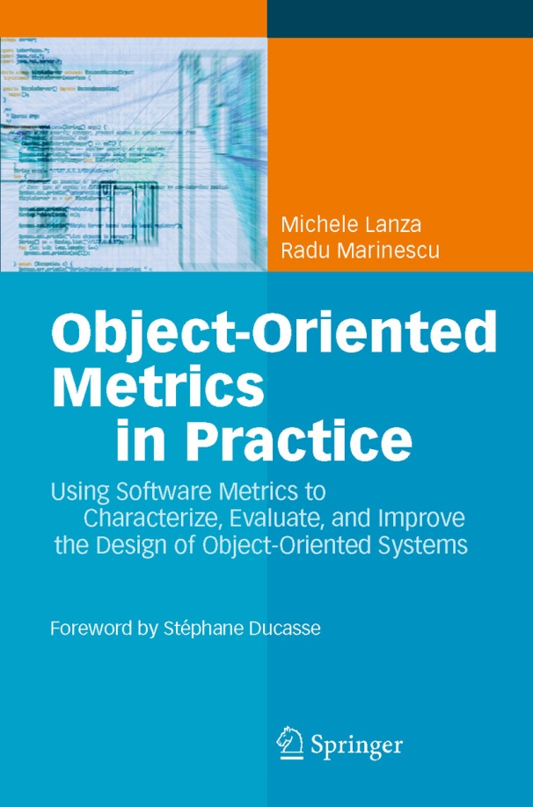
<number>
Recommended Textbooks
1998
2002
2006

Slide 4
<number>
Office hours
Fridays 3pm to 5pm
Department Council meetings on Fridays 1:30pm-3pm may take sometimes longer
Always send an email to schedule a meeting

Slide 5
<number>
Programmer on Duty
Giri Krishnan (g_pana@encs.concordia.ca)
Mondays 2:00-5:00 pm @ H-815
Again, send an email to Giri to arrange a meeting

Slide 6
<number>
Course website
Moodle SOEN 6611 2012/4
Course material:
Lecture slides
References
Links to tutorials
Announcements
Forum:
Ask questions
Exchange ideas
Help each other

Slide 7
<number>
Course evaluation
Midterm test: 40%
Paper presentation: 20%
Final project: 40%

Slide 8
<number>
Paper presentations
3 sessions.
X papers in each session (1-2 students per paper).
Non-presenters read 2-3 papers of their preference and submit a list of questions/comments before the class. (10%)
10 minutes for each presentation plus 5 minutes for Q&A.
Evaluation will be based on the quality of the presentation delivery and the ability to answer the questions of your colleagues and the instructor. (10%)

Slide 9

<number>
Final project
Team project (4-6 students)
Develop metrics as Eclipse plug-in
Collect metrics from open-source projects
Find correlations with other artifacts/processes
Final deliverables:
Source code (40%)
Empirical study: 10-page report (50%)
project presentation in class (10%)

Slide 10
<number>
Preparing for the Project (1)
Form a team (required skills: programming, paper writing, statistical analysis, presentation)
Select the type of the study you will perform. Search the literature for similar studies (more details in next slides)
Select a set of projects to be analyzed, Criteria:
Source code availability in Java (code should compile with no errors)
Existence of multiple versions, if you want to examine the evolution of metrics
Existence of issue tracking systems, if you want to examine correlations with bugs, etc.
Find complementary tools, if necessary (e.g., refactoring detection tools, issue tracking analysis tools)

Slide 11
<number>
Preparing for the Project (2)
Select the set of metrics you want to implement (QMOOD, MOOD, C&K, Bieman & Kang)
Find formal definitions for the metrics and make sure you have no problems in understanding them.
Make a resource plan: Who will work on what and when?
Send a report to me (1-2 pages) with all those details + references with relevant empirical studies.

Slide 12
<number>
Metrics resources
(complete list on Moodle)
S. R. Chidamber , C. F. Kemerer, "A Metrics Suite for Object Oriented Design," IEEE Transactions on Software Engineering, vol. 20, no. 6, pp. 476-493, June 1994. [C&K metrics]
Jagdish Bansiya and Carl G. Davis, "A Hierarchical Model for Object-Oriented Design Quality Assessment," IEEE Transactions on Software Engineering, vol. 28, no. 1, pp. 4-17, January 2002. [QMOOD]
Jehad Al Dallal, "Mathematical Validation of Object-Oriented Class Cohesion Metrics," International Journal Of Computers, vol. 4, no. 2, 2010. [Various Cohesion metrics]
F. Brito e Abreu, "The MOOD Metrics Set," 9th European Conference on Object-Oriented Programming (ECOOP'95), Workshop on Metrics, 1995.
Object-oriented metrics - http://www.aivosto.com/project/help/pm-oo.html

Slide 13
<number>
Project Type 1: Correlation of metrics with other software artifacts/activities
Sample hypotheses to be investigated:
Classes with poor metric values present more bugs (error-proneness).
Classes with poor metric values change more frequently (change-proneness).
Classes with poor metric values are refactored more frequently.
Classes with poor metric values are tested more frequently (i.e., the corresponding test classes are updated more frequently)

Slide 14
<number>
Project Type 2: Examine the evolution of metrics by mining repositories
Assess whether the quality of a project improves or deteriorates in time based on metrics evolution.
Find components in the code that have great positive or negative impact on design quality.
Find design changes that affected positively or negatively the design quality throughout the history of the project.
Suggest possible improvements for the design problems that you detected and apply them in source code (you can use the detection strategies proposed by Marinescu to detect design problems).

Slide 15
<number>
Final Report format
Introduction + motivation
Related works
Metrics definition
Metrics implementation details
Empirical study
Selection of examined variables
Formulation of a hypothesis
Experiment design (justify the selection of projects, description of their characteristics, etc.)
Data collection (describe the collected data and how you obtained it)
Statistical analysis, Discussion of results
Threats to validity
Conclusions

Slide 16
<number>
References
V. R. Basili, L. C. Briand, and W. L. Melo, “A Validation of Object-Oriented Design Metrics as Quality Indicators,” IEEE Transactions on Software Engineering, vol. 22, no. 10, pp. 751-761, 1996.
Hector M. Olague, Letha H. Etzkorn, Sampson Gholston, and Stephen Quattlebaum, “Empirical Validation of Three Software Metrics Suites to Predict Fault-Proneness of Object-Oriented Classes Developed Using Highly Iterative or Agile Software Development Processes,” IEEE Transactions on Software Engineering, vol. 33, no. 6, pp. 402-419, June 2007.
K. El Emam, S. Benlarbi, N. Goel, and S. Rai, “The Confounding Effect of Class Size on the Validity of Object-Oriented Metrics,” IEEE Transactions on Software Engineering, vol. 27, no. 7, pp. 630-650, July 2001.
Radu Marinescu, “Measurement and Quality in Object-Oriented Design,” PhD thesis, Politehnica University of Timisoara, Romania, 2002.

