Slide 1
SOEN 6611 – Software Measurement
Introduction
Computer Science and Software Engineering
© 2013 Nikolaos Tsantalis
<number>

Slide 2
Terminology
Measure: is the number or symbol assigned to an entity in order to characterize an attribute. [Norman Fenton]
Measurement: is the process by which numbers or symbols are assigned to attributes of entities in the real world in such a way as to describe them according to clearly deﬁned rules. [Norman Fenton], or simply the process of computing/estimating a measure
<number>

Slide 3
Terminology
Metric: is a quantitative estimation of the degree that a characteristic is present in a system based on measures.
Example:
The number of bugs in a system is a measure.
The process of collecting and counting the bugs is a measurement.
Correlating the number of bugs (measure) with a characteristic of a system (e.g., quality) is a metric.
<number>

Slide 4
Software Metrics - Categories
Software metrics are categorized in:
Process/Project metrics (cost & effort estimation, advancement, reuse, process reliability)
Product metrics
Internal: cover properties visible only to the development team (size, complexity, adherence to coding standards)
External: cover properties visible to the users of a product (reliability, functionality, efficiency, usability, portability, maintainability)
<number>

Slide 5
Activities in the measurement process
Formulation: the definition or selection of appropriate metrics for the examined project/problem.
Collection: the method used to collect the data required for the computation of the metrics.
Analysis: the application of statistical methods in order to extract significant correlations between output and input variables.
Interpretation: the evaluation of the analysis results with respect to quality characteristics.
Feedback: recommendations to the development team in order to improve specific parts of the software system or the applied practices and processes.
<number>

Slide 6
Measurement Scale Types
A measurement scale is a set of predefined symbols or values in order to represent certain common measures. There are 4 main types:
Nominal
Ordinal
Interval
Ratio
Increasing order
of sophistication
<number>

Slide 7
Nominal Scale
represents a set of labels or names applied to specific cases or categories
there is no notion of ordering among the categories.
Example: blood types (A, B, AB, O)
Involves arithmetic characteristic of equality (“=”)
<number>

Slide 8
Ordinal Scale
Useful to augment the nominal scale with information about an ordering of the categories.
involves rank ordering items (“>”, “<”, “=”)
higher number indicates more of the characteristic being measured;
The numbers represent ranking only, so addition, subtraction, and other arithmetic operations have no meaning.
Example: Excellent, Very good, Good, Fair, Poor
<number>

Slide 9
Interval Scale
This scale captures information about the size of the intervals (distance) that separate the categories.
includes uniqueness, rank order, and equal intervals between adjacent categories;
Addition and subtraction are acceptable on the interval scale, but not multiplication and division.
Example: Temperature scale (Fahrenheit and Celsium)
this scale has an arbitrary zero
A temperature of 20 degrees cannot be interpreted as twice as hot as 10 degrees.
<number>
Notes:
An interval scale preserves order, as with an ordinal scale.
An interval scale preserves differences but not ratios.
Zero on this scale does not indicate an absence of the characteristic being measured; cannot establish ratios;
<number>

Slide 10
Ratio Scale
A ratio scale is an interval scale with ratio on which there exists an absolute zero
all arithmetic operations apply: equivalence, rank order, equal intervals, has true zero point.
Example: Lines of code
zero lines of code indicates the absence of code
a program of 2,000 LOC can be interpreted as having twice the size of a program of 1,000 LOC.
<number>

Slide 11
Scale Types in a nutshell
Scale type | Applicable operations | Representative data
Nominal | = | Categories
Ordinal | =, <, > | Rankings
Interval | =, <, >, +, - | Differences
Ratio | =, <, >, +, -, *, / | True zero point
<number>

Slide 12
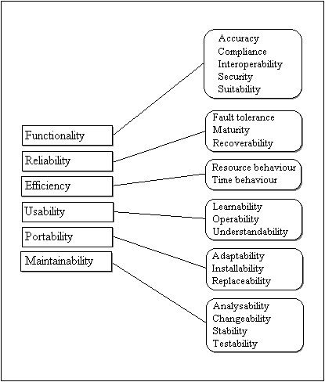
ISO/IEC 9126 Quality Characteristics
<number>

Slide 13
References
Norman E. Fenton, Shari Lawrence Pfleeger, Software Metrics: A Rigorous and Practical Approach, Second Edition, Course Technology, 1998.
<number>

