Slide 1
SOEN 6611 – Software Measurement
Slice-based cohesion
Computer Science and Software Engineering
© 2013 Nikolaos Tsantalis

Slide 2
Slice-based cohesion
Ott and Thuss proposed slice-based metrics as a means to measure the level of cohesion within a module (method or function).
The deﬁned cohesion metrics are computed based on slice proﬁles.
L. M. Ott, and J. J. Thuss, "The Relationship between Slices and Module Cohesion," 11th International Conference on Software Engineering (ICSE'89), pp. 198-204, 1989.
L. M. Ott, and J. J. Thuss, "Slice-based metrics for estimating cohesion," First International Software Metrics Symposium (METRICS'93), pp. 71-81, 1993.

Slide 3
What is a program slice?
A program slice consists of all the statements in a program that may affect the value of a variable x at a speciﬁc point of interest p.
The pair (p, x) is referred to as slicing criterion.
Slices are computed by ﬁnding sets of directly or indirectly related statements based on control and data dependences.

Slide 4
What is a slice profile?
Let V_{M} be the set of variables used by module M and V_{O} be a subset of V_{M} containing only the output variables of M.
According to Ott & Thuss output variables are:
the variable which is returned by M
the global variables which are modiﬁed by M
the parameters which are passed by reference and are modiﬁed by M
A slice profile is a convenient table representation for revealing slice patterns within a module.

Slide 5
Slice profile
drawWidth | scaleX | scale
 |  | |
| | | | |
 | |
| | | | |
 | |
|
 |  | |
| | | | |
 | |
|
 |  | |
The "|" symbol in position (x, y) of the slice profile table indicates that the statement
in row x is required for the computation of the variable in column y.

Slide 6
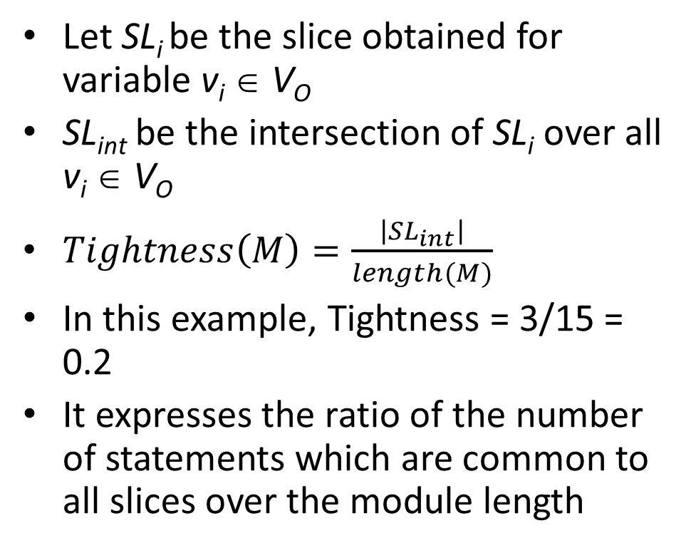
Slice-based cohesion metrics – Tightness
 | drawWidth | scaleX | scale
1
2 |  |  | |
3 | | | | | |
4
5 |  | |
6
7 | | | | | |
8 |  | |
9 | |
10 |  |  | |
11 | | | | | |
12 |  | |
13 | |
14 |  |  | |
15
Let SL_{i} be the slice obtained for variable v_{i} ∈ V_{O}
SL_{int} be the intersection of SL_{i} over all v_{i} ∈ V_{O}
$Tightness\left(M\right)=\frac{\left|{SL}_{int}\right|}{length(M)}$
In this example, Tightness = 3/15 = 0.2
It expresses the ratio of the number of statements which are common to all slices over the module length

Slide 7
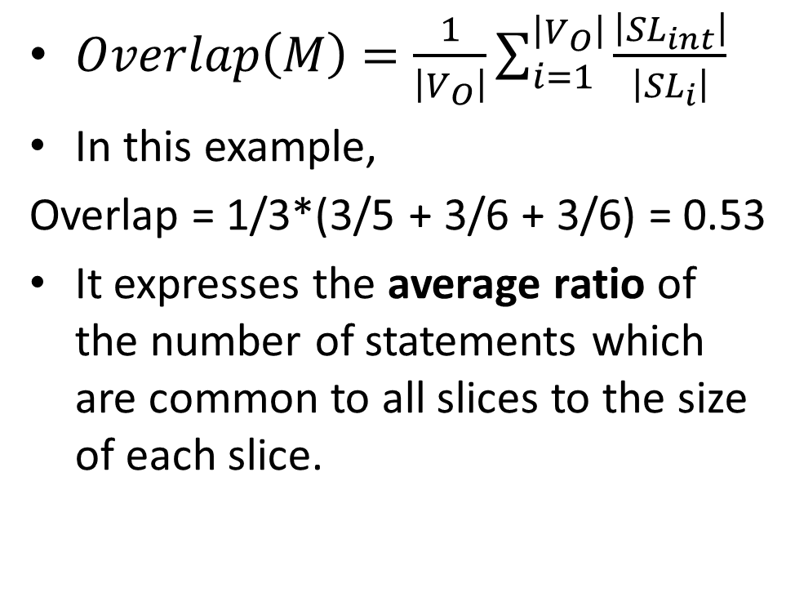
Slice-based cohesion metrics – Overlap
 | drawWidth | scaleX | scale
1
2 |  |  | |
3 | | | | | |
4
5 |  | |
6
7 | | | | | |
8 |  | |
9 | |
10 |  |  | |
11 | | | | | |
12 |  | |
13 | |
14 |  |  | |
15
$Overlap\left(M\right)=\frac{1}{\left|V_{O}\right|}\sum_{i=1}^{\left|V_{O}\right|}{\frac{\left|{SL}_{int}\right|}{\left|{SL}_{i}\right|}}$
In this example,
Overlap = 1/3*(3/5 + 3/6 + 3/6) = 0.53
It expresses the average ratio of the number of statements which are common to all slices to the size of each slice.

Slide 8
Interpretation of metric values
The higher the tightness and overlap of a module is, the more cohesive the module is.
Trying to decompose a highly cohesive module would introduce excessive code duplication between the original module and the newly extracted modules.

Slide 9
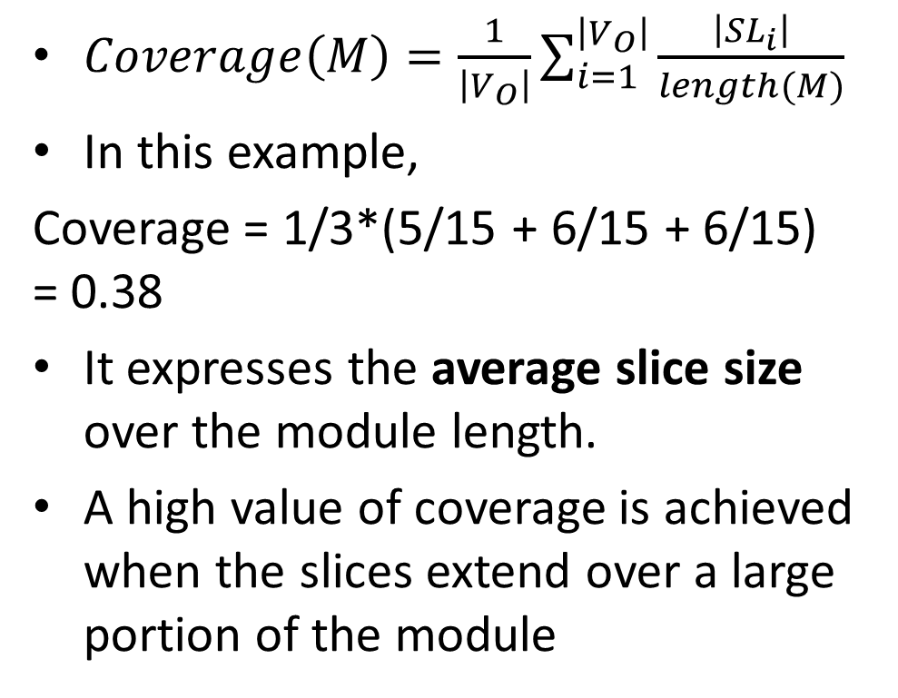
Slice-based cohesion metrics – Coverage
 | drawWidth | scaleX | scale
1
2 |  |  | |
3 | | | | | |
4
5 |  | |
6
7 | | | | | |
8 |  | |
9 | |
10 |  |  | |
11 | | | | | |
12 |  | |
13 | |
14 |  |  | |
15
$Coverage\left(M\right)=\frac{1}{\left|V_{O}\right|}\sum_{i=1}^{\left|V_{O}\right|}{\frac{\left|{SL}_{i}\right|}{length(M)}}$
In this example,
Coverage = 1/3*(5/15 + 6/15 + 6/15) = 0.38
It expresses the average slice size over the module length.
A high value of coverage is achieved when the slices extend over a large portion of the module

Slide 10
Computing slices
In order to compute the slice for a given slicing criterion (p, x), we first have to construct the program dependence graph (PDG) of the module.
By recursively traversing backwards the incoming edges starting from node p, we can obtain the slice of interest.

Slide 11
Program Dependence Graph
The nodes of a PDG represent the statements of the corresponding module.
Each node has a set of deﬁned variables which consists of the variables whose value is modiﬁed through an assignment, and a set of used variables which consists of the variables whose value is used within the statement.
The edges represent control and data flow dependences between the statements.

Slide 12
Control dependences
A control dependence edge from node p to node q denotes that the execution of statement q depends on the control conditions of statement p.
Control dependences actually represent the nesting of statements.
The method signature is represented as a special node (method entry node) that has outgoing control dependences to all statements directly nested within its body.

Slide 13
Control dependence
1
2
3
4
5
6
7
15
8
9
10
11
12
13
14

Slide 14
Data dependences
The sets of deﬁned and used variables are used to compute data dependences between the statements throughout the module’s execution ﬂow.
A data dependence edge from node p to node q due to variable x denotes that
statement p deﬁnes variable x
statement q uses variable x
there exists a control ﬂow path from statement p to q without an intervening deﬁnition of x.

Slide 15
Def/Use table
 | Defined | Used
1 | g | --
2 | scale | --
3 | drawWidth | available
4 | drawHeight | available
5 | scaleX | --
6 | scaleY | --
7 | -- | drawWidth, minimumDrawWidth
8 | scaleX | drawWidth, minimumDrawWidth
9 | drawWidth | minimumDrawWidth
10 | scale | --
11 | -- | drawWidth, maximumDrawWidth
12 | scaleX | drawWidth, maximumDrawWidth
13 | drawWidth | maximumDrawWidth
14 | scale | --
15 | chartArea | drawWidth, drawHeight

Slide 16
Extraction of data dependences based on the CFG
 | Defined | Used
1 | g | --
2 | scale | --
3 | drawWidth | available
4 | drawHeight | available
5 | scaleX | --
6 | scaleY | --
7 | -- | drawWidth, minimumDrawWidth
8 | scaleX | drawWidth, minimumDrawWidth
9 | drawWidth | minimumDrawWidth
10 | scale | --
11 | -- | drawWidth, maximumDrawWidth
12 | scaleX | drawWidth, maximumDrawWidth
13 | drawWidth | maximumDrawWidth
14 | scale | --
15 | chartArea | drawWidth, drawHeight
2
3
F
3
4
5
6
7
11
T
T
8
12
13
F
9
10
14
Why is there a dependence
from node 3 to 11, 12 & 15
although nodes 9 & 13 that
define variable drawWidth
are interleaved?
join node
15

Slide 17
Find the outgoing data dependences from nodes 9 & 13
 | Defined | Used
1 | g | --
2 | scale | --
3 | drawWidth | available
4 | drawHeight | available
5 | scaleX | --
6 | scaleY | --
7 | -- | drawWidth, minimumDrawWidth
8 | scaleX | drawWidth, minimumDrawWidth
9 | drawWidth | minimumDrawWidth
10 | scale | --
11 | -- | drawWidth, maximumDrawWidth
12 | scaleX | drawWidth, maximumDrawWidth
13 | drawWidth | maximumDrawWidth
14 | scale | --
15 | chartArea | drawWidth, drawHeight
2
3
4
5
6
7
F
11
T
T
8
12
13
F
9
13
9
10
14
join node
15

Slide 18
Final Program Dependence Graph
1
How can we get the
statements required
for the computation
of statement 15?
2
3
4
5
6
7
15
8
9
10
11
control
12
13
14
data due to drawWidth
data due to drawHeight

Slide 19
Backward Slicing
1
15
2
3
4
7
15
3
4
5
6
7
11
8
9
10
11
9
control
12
13
14
13
data due to drawWidth
data due to drawHeight

Slide 20
Backward slicing

Slide 21
Slice profiles with JDeodorant
Demo time

Slide 22
Empirical studies
Timothy M. Meyers and David Binkley, “An empirical study of slice-based cohesion and coupling metrics,” ACM Transactions on Software Engineering and Methodology, vol. 17, no. 1, Article 2, December 2007.

