Slide 1
SOEN 6611 – Software Measurement
Object-Oriented Metrics
The history of coupling metrics

Slide 2
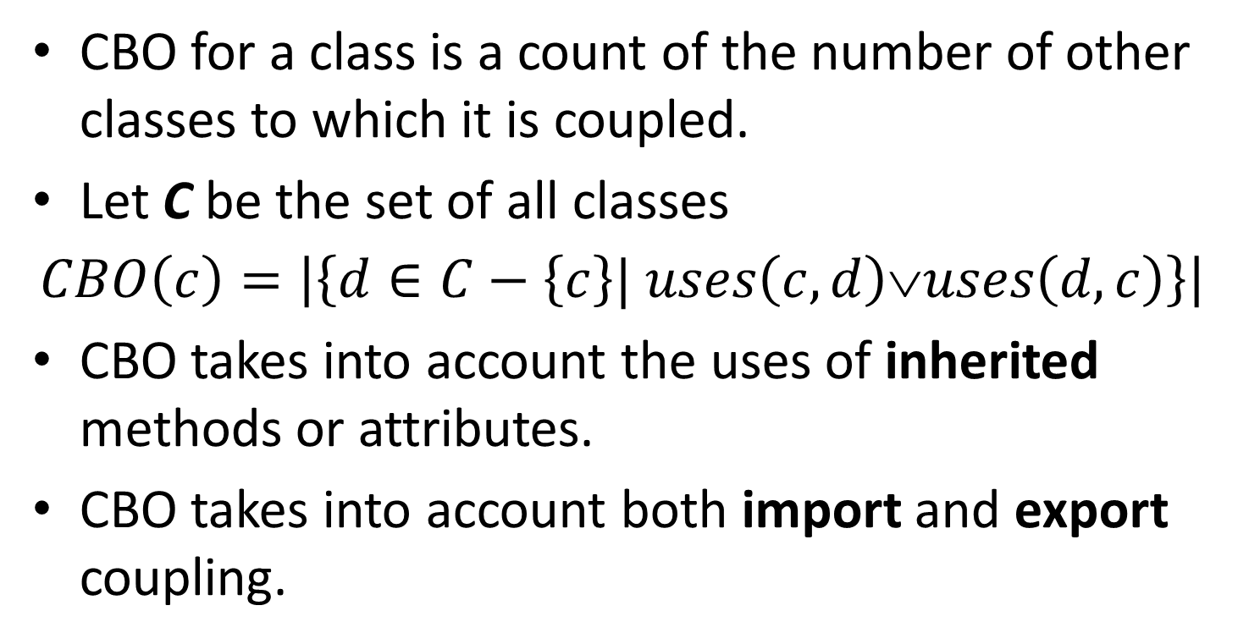
Coupling Between Objects (CBO) Chidamber & Kemerer, 1994
CBO for a class is a count of the number of other classes to which it is coupled.
Let C be the set of all classes
$$CBO\left(c\right)=\left|\left\{d∈C−\left\{c\right\}| uses\left(c,d\right)∨uses\left(d,c\right)\right\}\right|$$
CBO takes into account the uses of inherited methods or attributes.
CBO takes into account both import and export coupling.

Slide 3
CBO computation example
A
SuperC
CBO(C) = 3
B

Slide 4
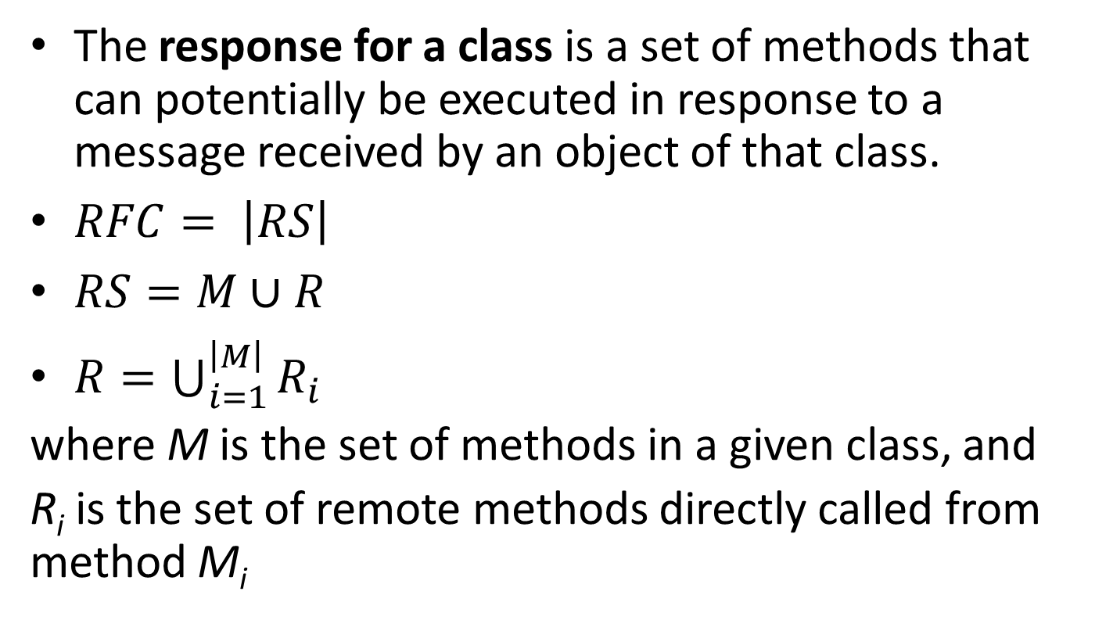
Response For Class (RFC) Chidamber & Kemerer, 1994
The response for a class is a set of methods that can potentially be executed in response to a message received by an object of that class.
$RFC= \left|RS\right|$
$RS=M∪R$
$R=\bigcup_{i=1}^{\left|M\right|}{R_{i}}$
where M is the set of methods in a given class, and
R_{i} is the set of remote methods directly called from method M_{i}

Slide 5
RFC details
In the definition of RFC, it is not clear whether the set M of all methods in the class also includes inherited methods.
Normally, inherited methods may be invoked in response to a message sent to an object.

Slide 6
RFC computation example
M
|M| = 1
|R| = 3
RFC(C) = 4
R

Slide 7
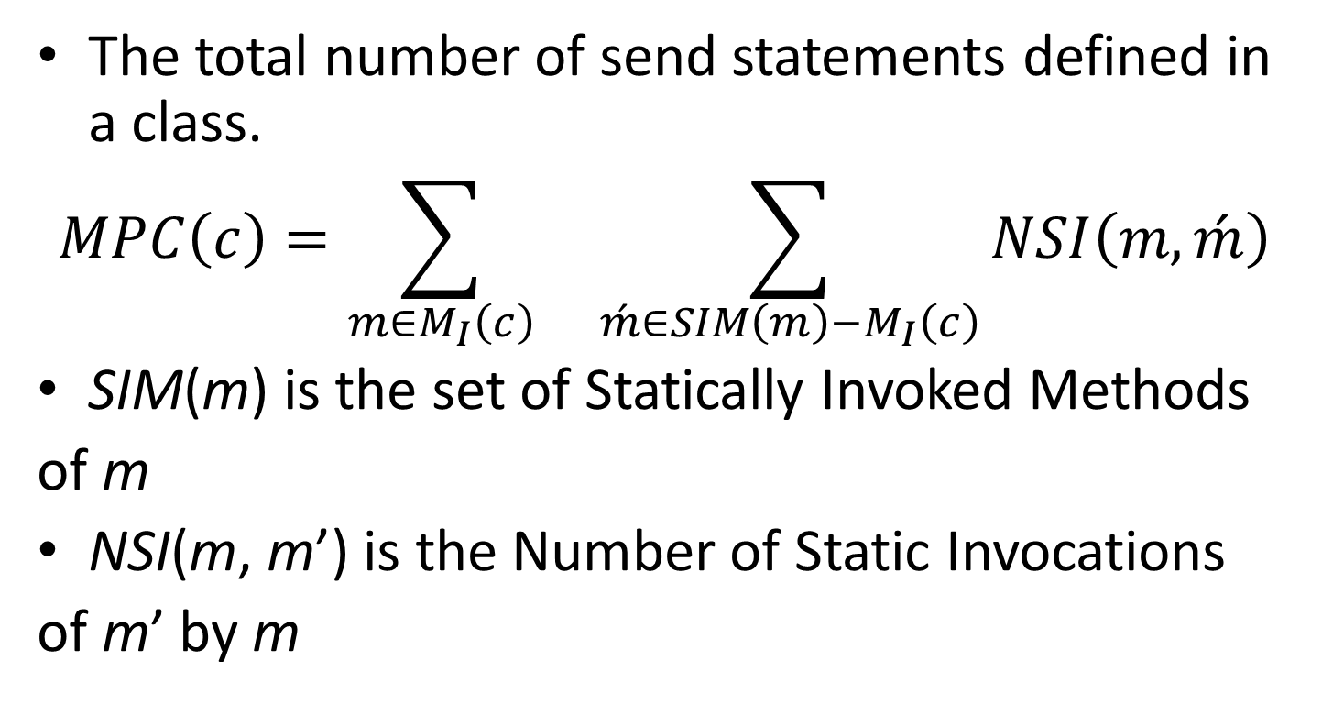
Message Passing Coupling (MPC) Li and Henry, 1993
The total number of send statements defined in a class.
$$MPC\left(c\right)=\sum_{m∈M_{I}\left(c\right)}{ \sum_{\acute{m}∈SIM\left(m\right)−M_{I}\left(c\right)}{NSI\left(m,\acute{m}\right)}}$$
SIM(m) is the set of Statically Invoked Methods
of m
NSI(m, m’) is the Number of Static Invocations
of m’ by m

Slide 8
MPC details
MPC takes into account only local methods in set M_{I}(c). This means that inherited methods are excluded, but overridden methods are included.
With respect to method invocations, again it is not clear whether invocations of inherited methods should be counted.

Slide 9
MPC computation example
Method calls
to other classes
MPC(C) = 3
MPC’(C) = 4
Method calls
to super class

Slide 10
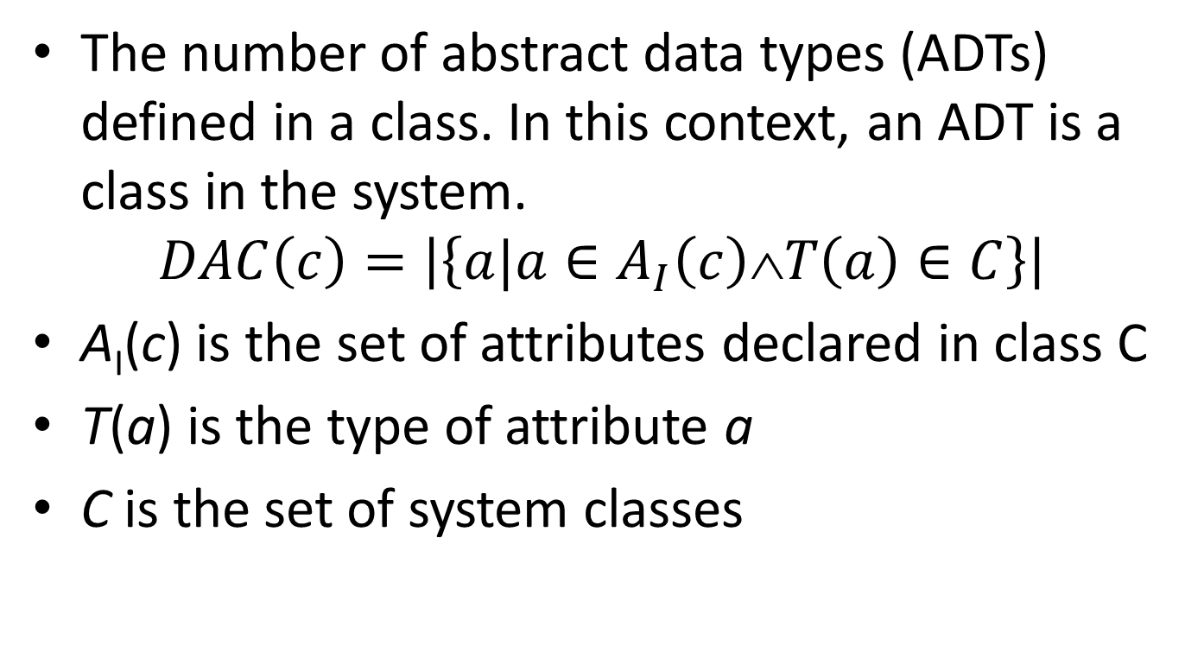
Data Abstraction Coupling (DAC) Li and Henry, 1993
The number of abstract data types (ADTs) defined in a class. In this context, an ADT is a class in the system.
$$DAC\left(c\right)=\left|\left\{a|a∈A_{I}\left(c\right)∧T\left(a\right)∈C\right\}\right|$$
A_{I}(c) is the set of attributes declared in class C
T(a) is the type of attribute a
C is the set of system classes

Slide 11
DAC computation example
Type of attribute
doesn't belong to
System classes
DAC(C) = 1
due to attribute b of B type
Type of attribute
belongs to
System classes

Slide 12
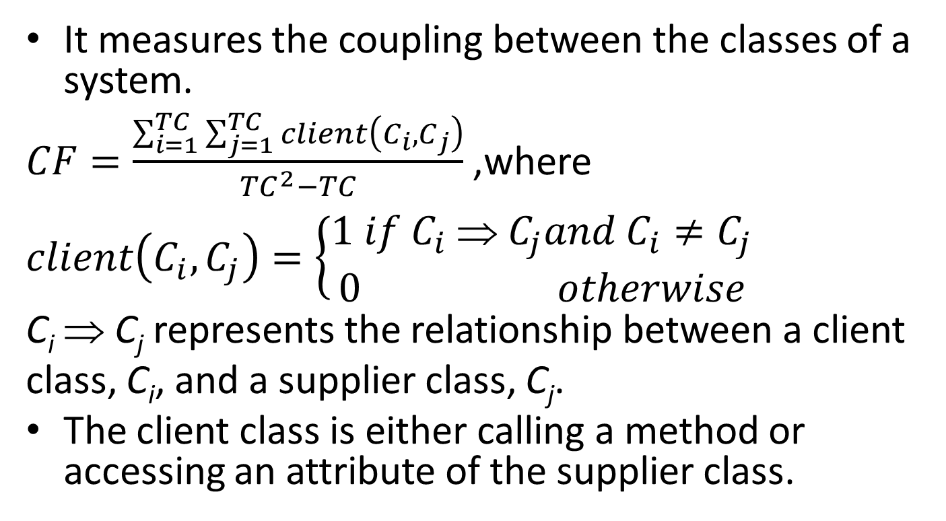
Coupling Factor (CF)
It measures the coupling between the classes of a system.
$CF=\frac{\sum_{i=1}^{TC}{\sum_{j=1}^{TC}{client\left(C_{i},C_{j}\right)}}}{{TC}^{2}−TC}$ ,where
$$client\left(C_{i},C_{j}\right)=\left\{\begin{aligned}1 if C_{i} \text{⇒} C_{j}and{ C}_{i}≠C_{j} \\ 0 otherwise\end{aligned}\right.$$
C_{i} ⇒ C_{j} represents the relationship between a client
class, C_{i}, and a supplier class, C_{j}.
The client class is either calling a method or accessing an attribute of the supplier class.

Slide 13
CF computation example
CF = 3/12
client(C, SuperC) = 1
client(A, C) = 1
client(C, B) = 1

Slide 14
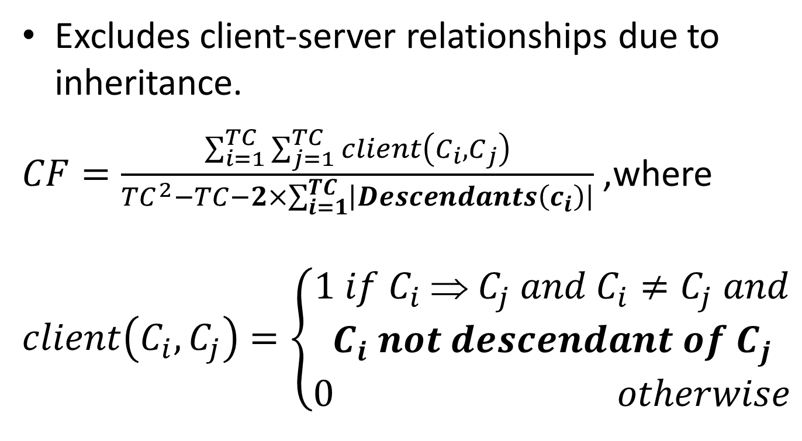
Coupling Factor (CF) Briand et al. definition
Excludes client-server relationships due to inheritance.
$CF=\frac{\sum_{i=1}^{TC}{\sum_{j=1}^{TC}{client\left(C_{i},C_{j}\right)}}}{{TC}^{2}−TC−2×\sum_{i=1}^{TC}{\left|Descendants\left(c_{i}\right)\right|}}$ ,where
$$client\left(C_{i},C_{j}\right)=\left\{\begin{aligned}\begin{aligned}1 if C_{i} \text{⇒} C_{j} and{ C}_{i}≠C_{j} and \\ C_{i} not descendant of C_{j}\end{aligned} \\ 0 otherwise\end{aligned}\right.$$

Slide 15
CF computation example
CF = 2/10
client(A, C) = 1
client(C, B) = 1

Slide 16
References
Lionel C. Briand, John W. Daly, and Jürgen K. Wüst, “A Unified Framework for Coupling Measurement in Object-Oriented Systems,” IEEE Transactions on Software Engineering, vol. 25, no. 1, January/February 1999, pp. 91-121.

