Slide 1
SOEN 6611 – Software Measurement
Empirical Validation of
Software Metrics

Slide 2
Why is it important?
A measure may be correct from a theoretical (measurement) perspective, it may not be of practical use in industrial settings.
Empirical validation is necessary to demonstrate the usefulness of a metric in practical applications.

Slide 3
Empirical validation of metrics
1. Selection of dependent and independent variables
The dependent variable is usually an external quality characteristic (e.g. fault proneness, change proneness)
The independent variables are usually internal characteristics of the software system (e.g., size, complexity, coupling, cohesion) or the development team.

Slide 4
Empirical validation of metrics
2. Formulation of a hypothesis
In statistical hypothesis testing two hypotheses are compared:
Null hypothesis: states that there is no relation between the phenomena whose relation is under investigation.
Alternative hypothesis: states that there is some kind of relation between the phenomena
The alternative hypothesis may take several forms:
Two-sided: there is some effect, in a yet unknown direction
One-sided: the direction of the hypothesized relation, positive or negative, is fixed in advance.

Slide 5
Empirical validation of metrics
3. Experimental design
Selection of the subjects (software systems, developers) that will participate in the experiment.
Justification of the selection.
Description of the subjects and their characteristics:
Size of the projects
Experience of the developers
Development processes being applied
Experiment type:
Controlled experiment (describe the experimental and control samples)
observational study

Slide 6
Empirical validation of metrics
4. Data collection procedure
Describe the collected data (e.g., source code versions, bug reports)
Describe the collection method:
Questionnaires
Interviews
Observations
Tools computing metrics

Slide 7
Empirical validation of metrics
5. Data Analysis/Statistical Tests
Summary/Descriptive Statistics: is applied to summarize a set of observations, in order to communicate the largest amount as simply as possible.
Correlation analysis: is applied to determine the degree to which two or more quantities are linearly associated.
Regression analysis: is used to examine how the typical value of the dependent variable changes when any one of the independent variables is varied, while the other independent variables are held fixed (linear, polynomial, or exponential)

Slide 8
Boxplots
A boxplot (also known as a box-and-whisker plot) is a convenient way of graphically depicting groups of numerical data through their five-number summaries:
the smallest observation (sample minimum),
lower quartile (Q1)
median (Q2)
upper quartile (Q3)
and largest observation (sample maximum).
A boxplot may also indicate which observations, if any, might be considered outliers.

Slide 9
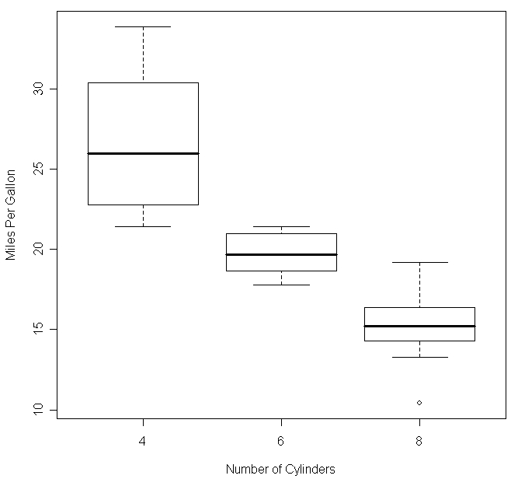
Boxplots
sample maximum
Upper quartile
75th percentile
50 % of the cases
fall inside the box
(interquartile range)
median
Lower quartile
25th percentile
sample minimum
outlier

Slide 10
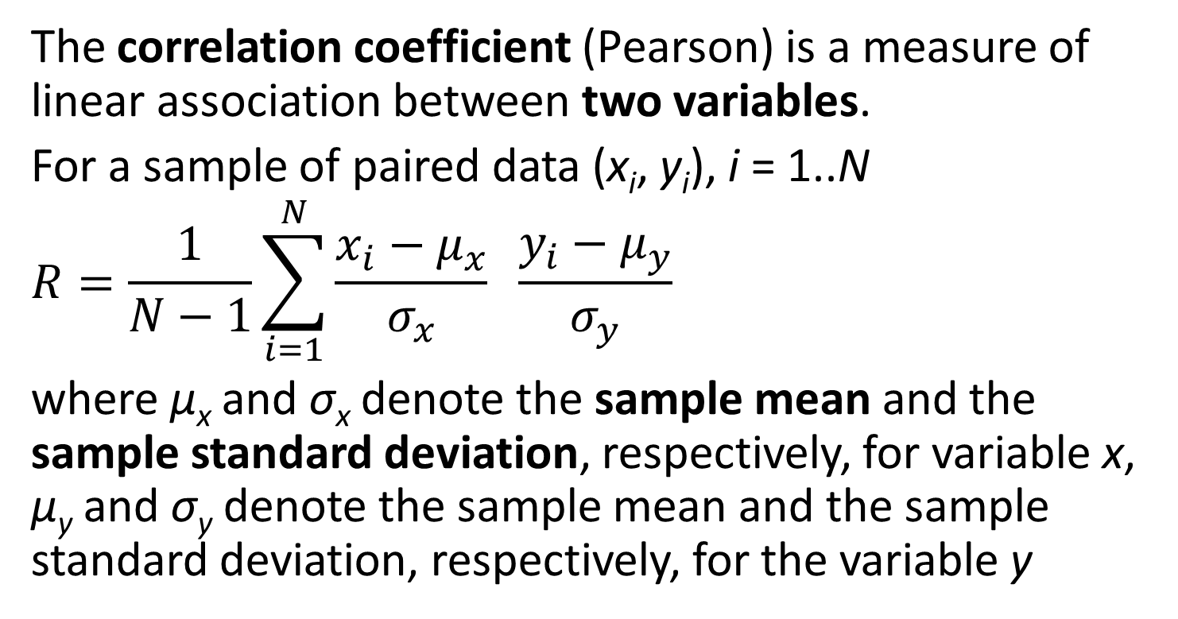
Correlation
The correlation coefficient (Pearson) is a measure of linear association between two variables.
For a sample of paired data (x_{i}, y_{i}), i = 1..N
$$R=\frac{1}{N−1}\sum_{i=1}^{N}{\frac{x_{i}−μ_{x}}{σ_{x}} \frac{y_{i}−μ_{y}}{σ_{y}}}$$
where μ_{x} and σ_{x} denote the sample mean and the sample standard deviation, respectively, for variable x, μ_{y} and σ_{y} denote the sample mean and the sample standard deviation, respectively, for the variable y

Slide 11
Correlation coefficient interpretation
R falls between [-1, 1]
Usually, a value over 0.9 implies a very strong positive correlation, while a value below -0.9 implies a very strong negative correlation.
Correlation | Negative | Positive
None | −0.09 to 0.0 | 0.0 to 0.09
Small | −0.3 to −0.1 | 0.1 to 0.3
Medium | −0.5 to −0.3 | 0.3 to 0.5
Strong | −1.0 to −0.5 | 0.5 to 1.0

Slide 12
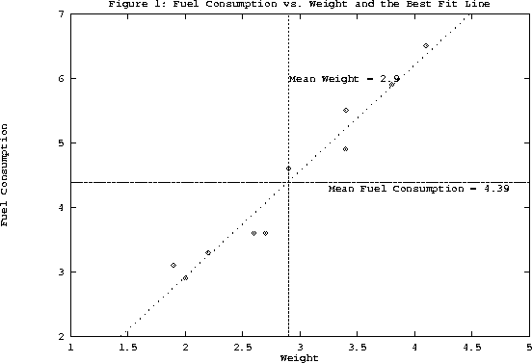
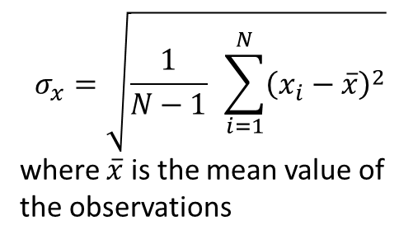
Correlation example
Sample standard deviation
$$σ_{x}=\sqrt{\frac{1}{N−1} \sum_{i=1}^{N}{{\left(x_{i}−\overline{x}\right)}^{2}}}$$
where $\overline{x}$ is the mean value of
the observations
y_{i} - μ_{y}
(x_{i}, y_{i})
x_{i} - μ_{x}

Slide 13
Correlation example
Weight (x) | Fuel Consumption (y)
3.4 | 5.5
3.8 | 5.9
4.1 | 6.5
2.2 | 3.3
2.6 | 3.6
2.9 | 4.6
2.0 | 2.9
2.7 | 3.6
1.9 | 3.1
3.4 | 4.9
R = 0.976
very strong and positive

Slide 14
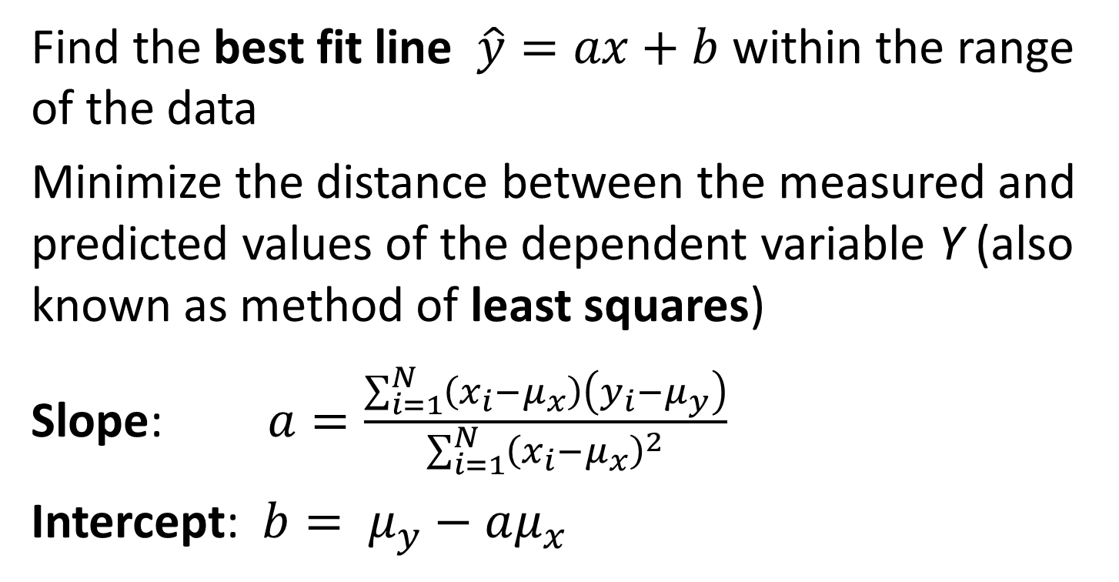
Linear Regression
Find the best fit line $\hat{y}=ax+b$ within the range of the data
Minimize the distance between the measured and predicted values of the dependent variable Y (also known as method of least squares)
Slope: $a=\frac{\sum_{i=1}^{N}{\left(x_{i}−μ_{x}\right)\left(y_{i}−μ_{y}\right)}}{\sum_{i=1}^{N}{{\left(x_{i}−μ_{x}\right)}^{2}}}$
Intercept: $b= μ_{y}−aμ_{x}$

Slide 15
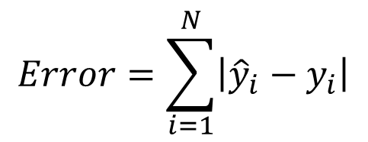

Linear Regression
$$\hat{y}=1.639x−0.3631$$
$$Error=\sum_{i=1}^{N}{\left|{\hat{y}}_{i}−y_{i}\right|}$$
a = 1.639

Slide 16
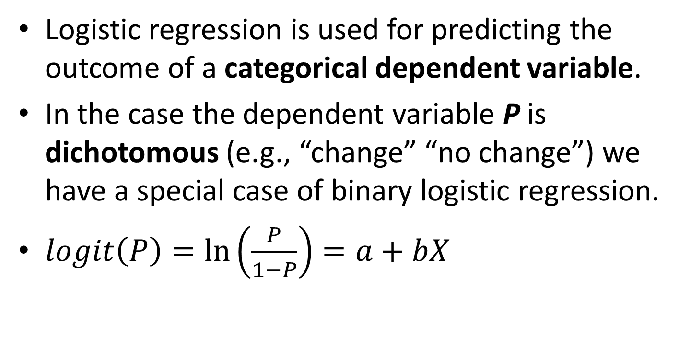
Logistic Regression
Logistic regression is used for predicting the outcome of a categorical dependent variable.
In the case the dependent variable P is dichotomous (e.g., “change” “no change”) we have a special case of binary logistic regression.
$logit\left(P\right)=ln\left(\frac{P}{1−P}\right)=a+bX$

Slide 17
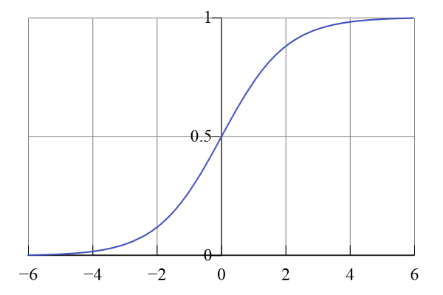
logit(P)

Slide 18
Empirical validation of metrics
6. Threats to validity
Internal validity: the extent to which a study minimizes systematic error or bias (selection bias, change of measurement instruments, change of subjects, confounding factors).
External validity: the extent to which the results of a study can be generalized to other situations and to other subjects (replication studies)
Construct validity: the degree to which a test measures what it claims (Does IQ test measure intelligence?)

Slide 19
References
V. R. Basili, L. C. Briand, and W. L. Melo, “A Validation of Object-Oriented Design Metrics as Quality Indicators,” IEEE Transactions on Software Engineering, vol. 22, no. 10, pp. 751-761, 1996.
C. Wohlin, P. Runeson, M. Höst, M.C. Ohlsson, B. Regnell, A. Wesslén, Experimentation in Software Engineering: An Introduction, Kluwer Academic Publishers, 2000.
Hector M. Olague, Letha H. Etzkorn, Sampson Gholston, and Stephen Quattlebaum, “Empirical Validation of Three Software Metrics Suites to Predict Fault-Proneness of Object-Oriented Classes Developed Using Highly Iterative or Agile Software Development Processes,” IEEE Transactions on Software Engineering, vol. 33, no. 6, pp. 402-419, June 2007.
K. El Emam, S. Benlarbi, N. Goel, and S. Rai, “The Confounding Effect of Class Size on the Validity of Object-Oriented Metrics,” IEEE Transactions on Software Engineering, vol. 27, no. 7, pp. 630-650, July 2001.

