Slide 1
Empirical Study Comparing Quality Metrics and Code Volatility + (Bonus) Prediction Model!
Md Tajmilur Rahman
Shams Azad
Amish Gala
Vinodkumar Raghu

Slide 2
Key Message

Slide 3
Definitions
Code Volatility: the propensity for a given code fragment to change over different releases.
Association Rules: get info from Shams’ document

Slide 4
Apache Timeline
Analyzed Apache Ant over four releases (1.5 – 1.8), plus 1 for validation / prediction (1.9):
1.5: July 2002
1.7: Dec 2006
1.9: March 2013
Apache Ant
1.6: Dec 2003
1.8: Feb 2010
15_to_16
16_to_17
17_to_18
18_to_19
Notes:
Date rev1_5 = Runner.DATEFORMAT.parse("2002-07-10 00:00:00 -0500");
Date rev1_6 = Runner.DATEFORMAT.parse("2003-12-18 00:00:00 -0500");
Date rev1_7 = Runner.DATEFORMAT.parse("2006-12-19 00:00:00 -0500");
Date rev1_8 = Runner.DATEFORMAT.parse("2010-02-08 00:00:00 -0500");
Date rev1_9 = Runner.DATEFORMAT.parse("2013-03-07 00:00:00 -0500");

Slide 5
Buckets
High Volatility:
Java class in all 3 sets
(294 total)
15_to_16
(434 commits)
Set of Java Classes
(788)
Med. Volatility:
Java class in any 2 sets (503 total)
16_to_17 (630 commits)
Set of Java Classes
(1089)
17_to_18
(296 commits)
Set of Java Classes
(565)
Low Volatility:
Java class in any 1 set
(554 total)
18_to_19
(101 commits)
Set of Java Classes used for validation
Notes:
Give example

Slide 6
Research Questions
Does HV code exhibit lower quality metrics compared to LV code?
Based on volatility and association rules, can we build a practical change propensity model?
Notes:
Now that we have the set of Java classes into three buckets (HV, MV, LV), we can pose our research questions

Slide 7
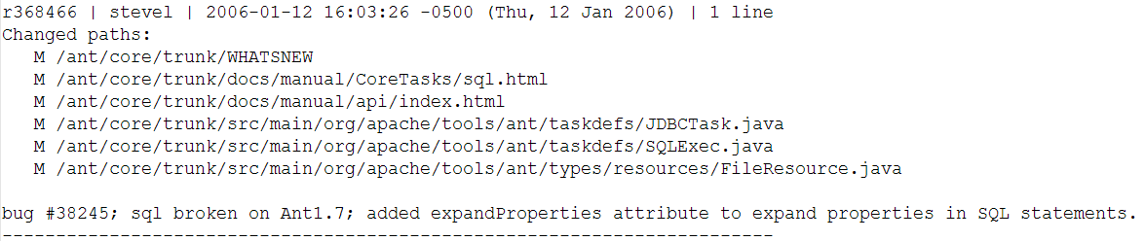
Log Parser /1
Have access to complete SVN commit history for Apache Ant. Example commit:
Parsed, cleaned, and filtered the data into our model (buckets of Java commits):
15_to_16, 16_to_17…
HV, MV, LV
Notes:
Talk about removing commits which were unusable (commits which changed the license, and removed the authors from code etc.)

Slide 8
Log Parser /2
Handled:
Parsing the complete log, calculating volatility
Writing the files to be used in JD (lists of HV, MV, and LV)
Writing the files which show which Java classes were modified together (for association rules)
Leveraged:
Collections, Guava, StackOverflow…

Slide 9
Developed Metrics in JD
Class Metrics (C&K):
LCOM (Given) + LCOM (Henderson)
Cohesion
RFC
Size / LOC
System Metrics (MOOD):
MHF
AHF

Slide 10
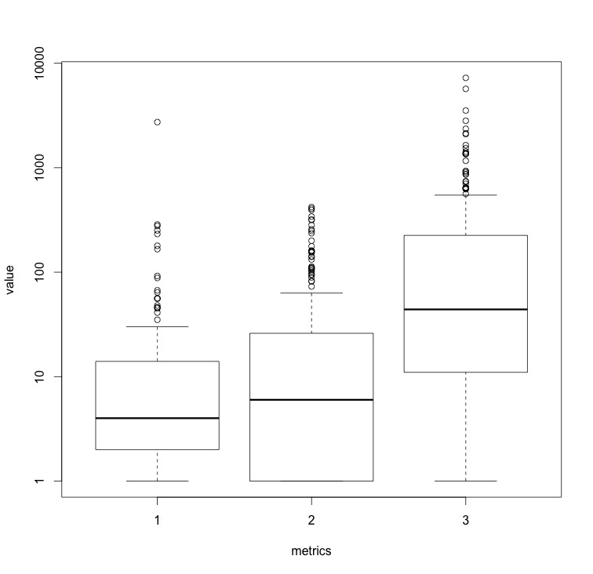
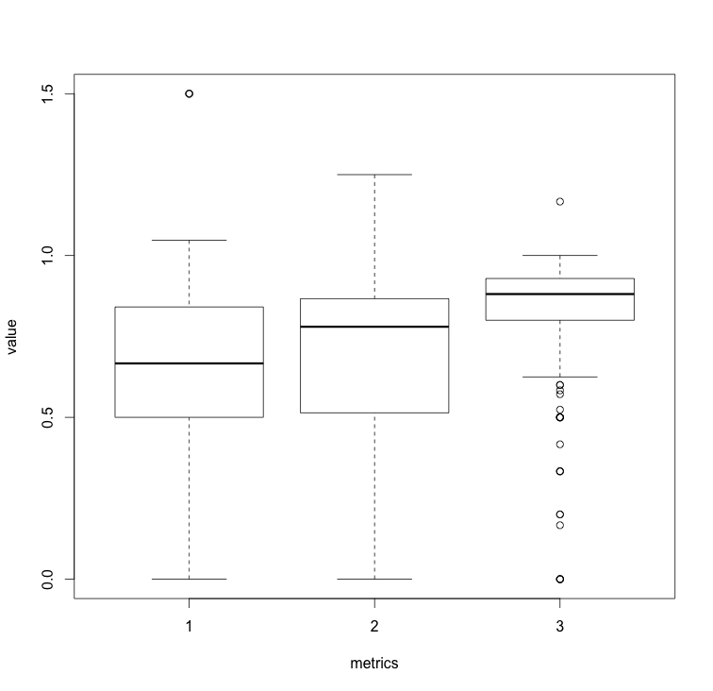
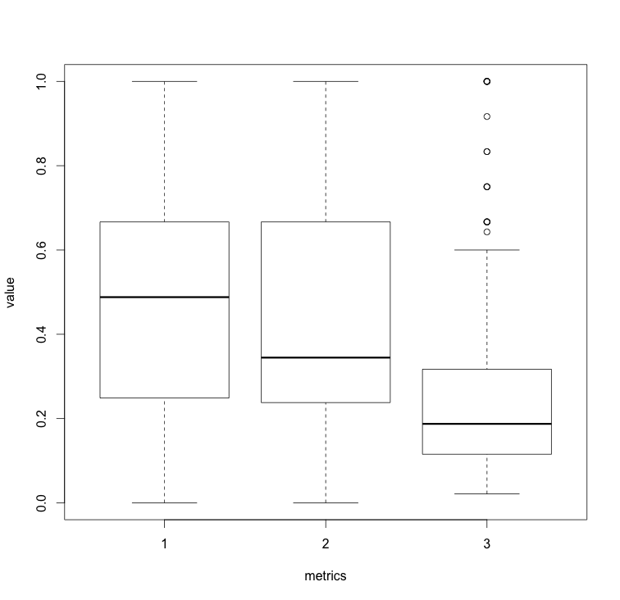
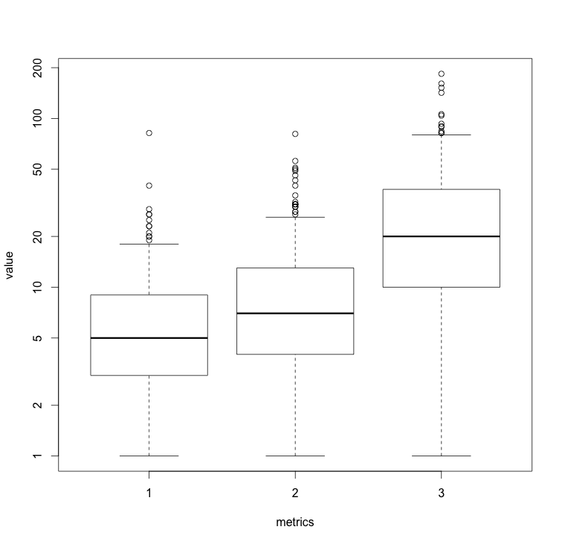
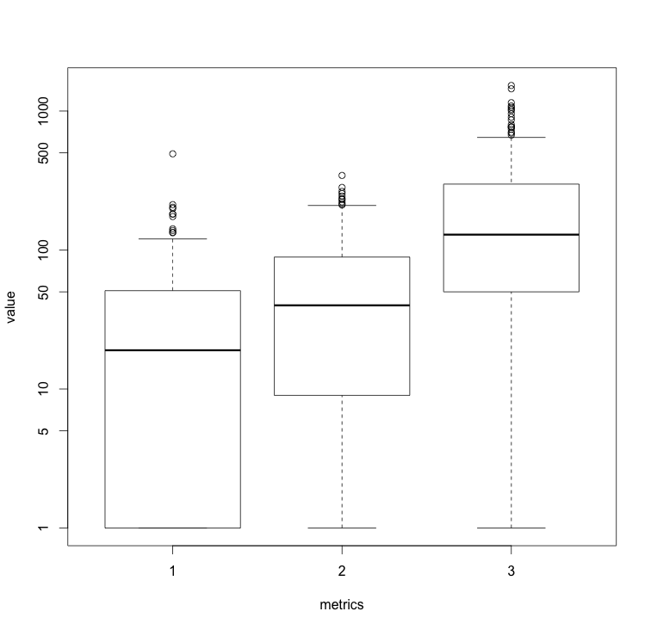
Results: Volatility ~ Quality Metrics
LCOM
LCOM Henderson
Cohesion
RFC
Size / LOC

Slide 11
Results Discussion
It was clear that more volatile code tends to exhibit lower quality metrics

Slide 12
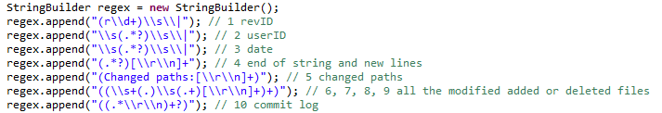
Challenges Faced
Parsing the massive SVN commit log using regex
Victim of catastrophic backtracking (SO in Eclipse):
Computing the association rules required large computing power (16GB ram!)

