Slide 1
SOEN 6611 – Software Measurement
Object-Oriented Metrics
Chidamber & Kemerer (CK)

Slide 2
Chidamber & Kemerer metrics suite
The quality properties of object-oriented design are captured by:
Complexity
Coupling
Cohesion
Inheritance
Size
Chidamber & Kemerer proposed the first metrics suite for object-oriented design in 1994.

Slide 3
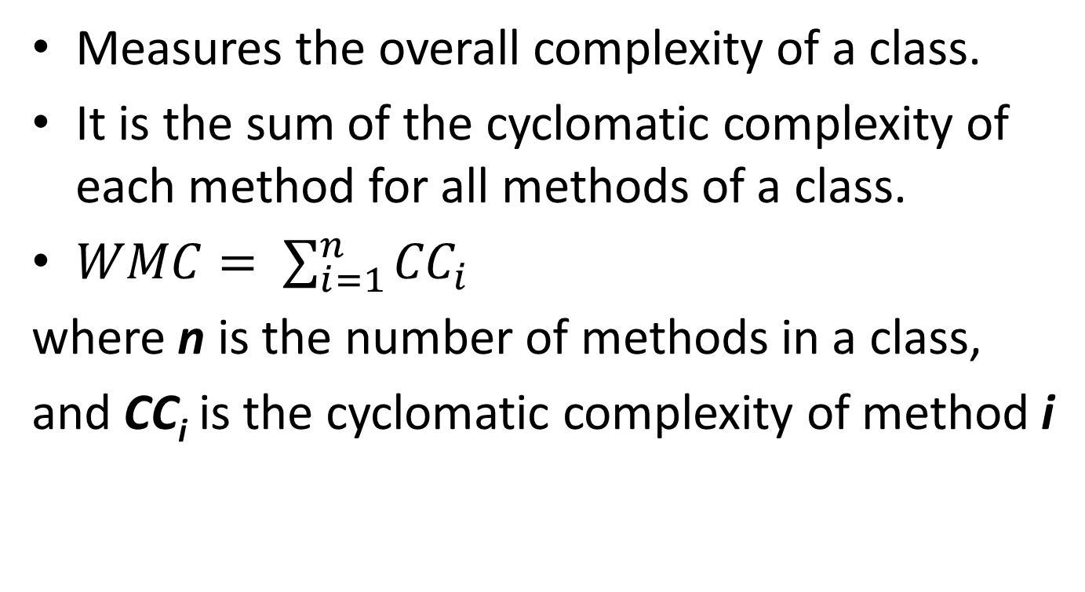
Category: Complexity Weighted Methods per Class (WMC)
Measures the overall complexity of a class.
It is the sum of the cyclomatic complexity of each method for all methods of a class.
$WMC= \sum_{i=1}^{n}{{CC}_{i}}$
where n is the number of methods in a class,
and CC_{i} is the cyclomatic complexity of method i

Slide 4
WMC Discussion
A class with a disproportionately high number of complex methods:
is more likely to be prone to errors,
is more difficult to be extended,
is more likely to become less reusable.
The use of this metric enables the design team to focus review and testing resources on those classes with the greatest potential for improvement.

Slide 5
Category: Inheritance Depth of Inheritance Tree (DIT)
The DIT for class X is the maximum path length from X to the root of the inheritance tree.
A
DIT(A) = 0
DIT(B) = 1
DIT(C) = 0
DIT(D) = 2
DIT(E) = 3
DIT(F) = 4
B
C
D
E
F

Slide 6
DIT Discussion
The higher value of DIT, the more difficult to comprehend, test and maintain a class, due to the larger number of base classes that have to be inspected.
Understanding and debugging a class may require to inspect a number of methods and attributes inherited from base classes.
Changes are more error-prone due to inheritance related design violations.

Slide 7
Category: Inheritance Number of Children (NOC)
The NOC for class X is the number of immediate subclasses of X in the inheritance tree.
A
NOC(A) = 1
NOC(B) = 1
NOC(C) = 1
NOC(D) = 2
NOC(E) = 1
NOC(F) = 0
B
C
D
E
F

Slide 8
NOC Discussion
The higher the value of NOC, the higher the reuse of the base class.
However, if the base contains errors/bugs, these will propagate to a larger number of subclasses.

Slide 9
Category: Coupling Coupling Between Objects (CBO)
CBO represents the number of classes coupled to a given class. Coupling may occur through:
method calls (including calls to superclass)
field accesses (including accesses to superclass)
parameter types
return types
thrown exception types.
CBO takes into account both import and export coupling.

Slide 10
CBO computation example
CBO(Customer) = 2
CBO(Order) = 2
CBO(CreditCardInfo) = 1
CBO(Book) = 3
CBO(RegularBook) = 1
CBO(Ebook) = 1

Slide 11
CBO Discussion
The less coupled a class is, the easier it is to reuse it in another program.
The higher the coupling of a class, the more change-prone it is (due to change propagation), and therefore maintenance is more difficult.
High coupling has been found to indicate fault-proneness.

Slide 12
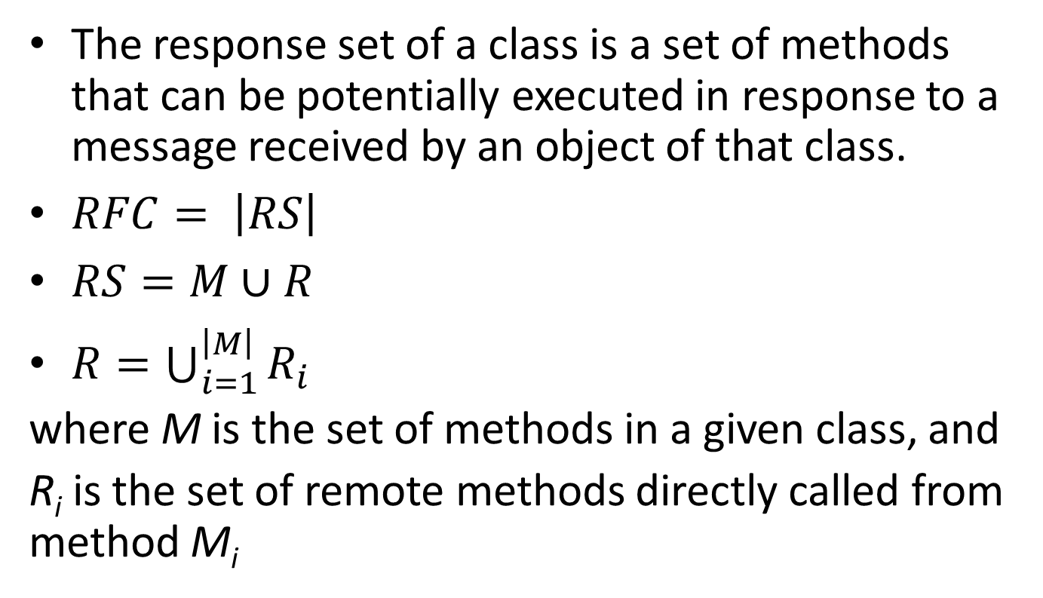
Category: Coupling Response For a Class (RFC)
The response set of a class is a set of methods that can be potentially executed in response to a message received by an object of that class.
$RFC= \left|RS\right|$
$RS=M∪R$
$R=\bigcup_{i=1}^{\left|M\right|}{R_{i}}$
where M is the set of methods in a given class, and
R_{i} is the set of remote methods directly called from method M_{i}

Slide 13
RFC computation example
Suppose that class A has four methods:
A.m1 calls B.m2
A.m2 calls C.m1
A.m3 calls A.m4
A.m4 calls no method
M = {A.m1, A.m2, A.m3, A.m4}
R = {B.m2} ∪ {C.m1} ∪ {A.m4} ∪ ∅
RS = M ∪ R = {A.m1, A.m2, A.m3, A.m4, B.m2, C.m1}
RFC = |RS| = 6

Slide 14
RFC discussion
The higher the value of the RFC, the higher the level of understanding required on the part of the tester.
A large RFC value has been found to indicate more faults.

Slide 15
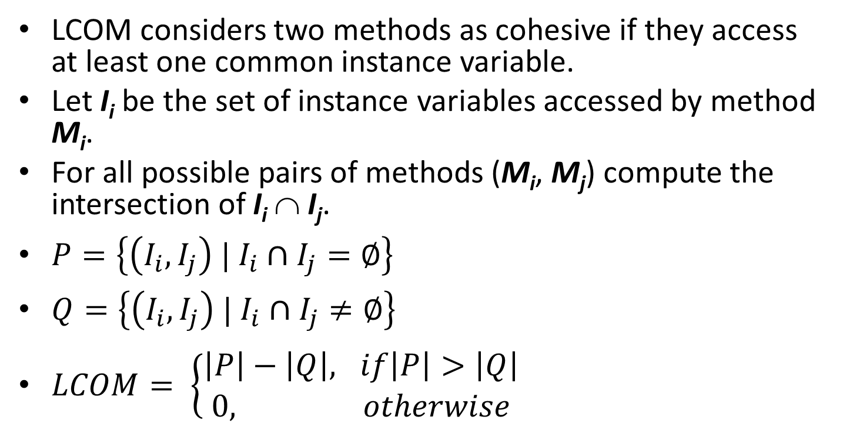
Category: Cohesion Lack of Cohesion of Methods (LCOM)
LCOM considers two methods as cohesive if they access at least one common instance variable.
Let I_{i} be the set of instance variables accessed by method M_{i}.
For all possible pairs of methods (M_{i}, M_{j}) compute the intersection of I_{i} ∩ I_{j}.
$P=\left\{\left(I_{i},I_{j}\right) | I_{i}∩I_{j}=∅\right\}$
$Q=\left\{\left(I_{i},I_{j}\right) | I_{i}∩I_{j}≠∅\right\}$
$LCOM= \left\{\begin{aligned}\left|P\right|−\left|Q\right|, if\left|P\right|>\left|Q\right| \\ 0, otherwise\end{aligned}\right.$

Slide 16
LCOM criticism
LCOM1 gives a value of zero for very different classes.
Its definition is based on method-data interaction, which may not be a correct way to define cohesiveness in the object-oriented world.
A class that gets/sets its own internal data via its getter/setter methods, and not via direct variable read/write, may show a high LCOM1.

Slide 17
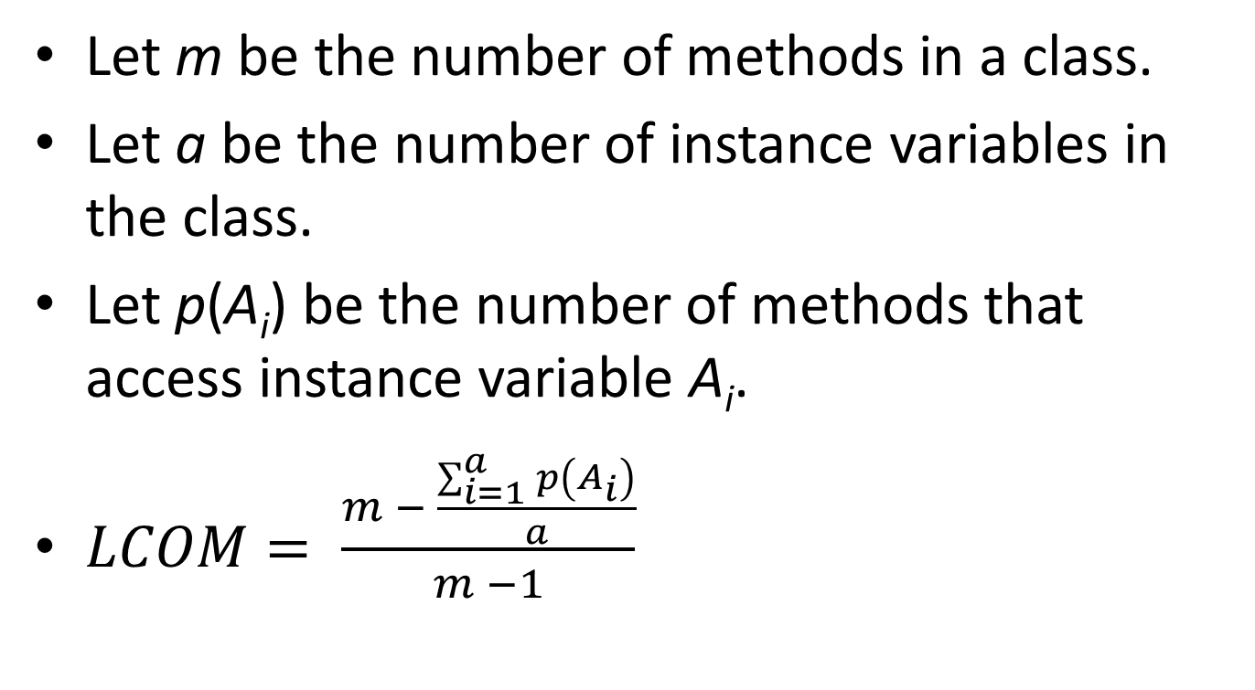
Henderson-Sellers normalized LCOM
Let m be the number of methods in a class.
Let a be the number of instance variables in the class.
Let p(A_{i}) be the number of methods that access instance variable A_{i}.
$LCOM= \frac{m − \frac{\sum_{i=1}^{a}{p\left(A_{i}\right)}}{a}}{m −1}$

Slide 18
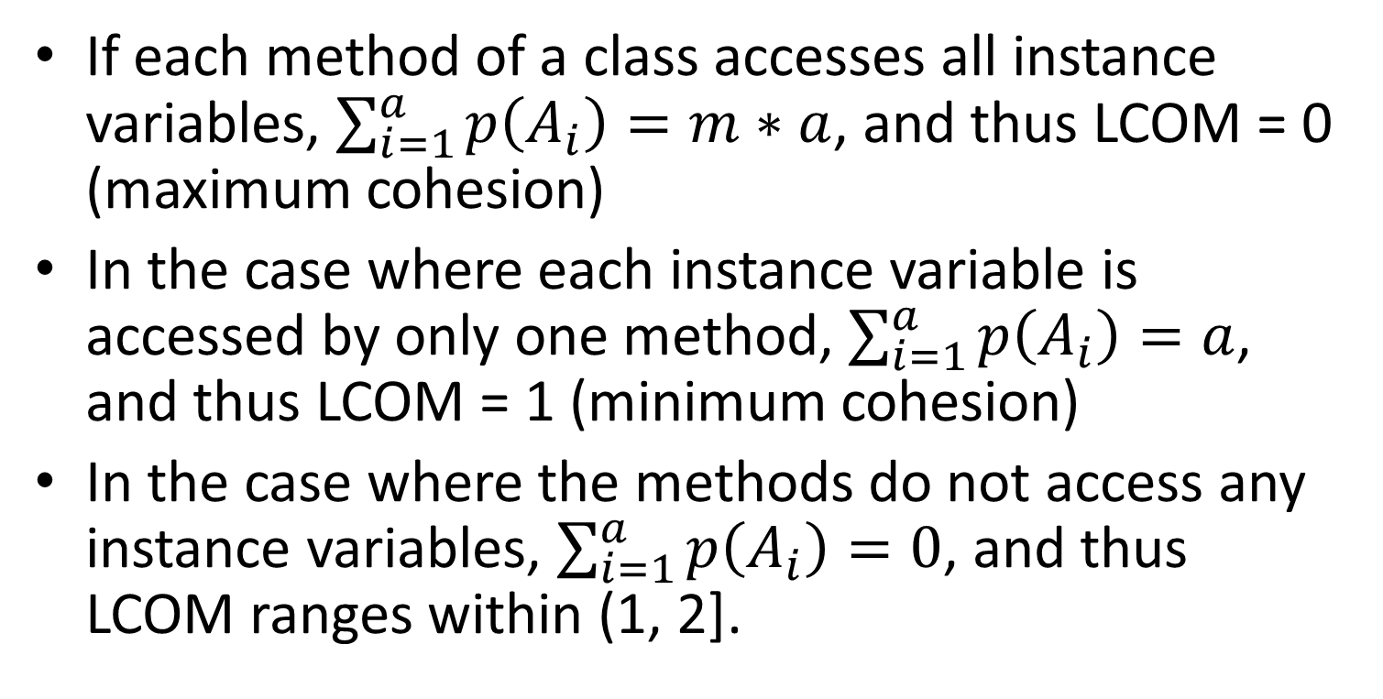
Henderson-Sellers normalized LCOM
If each method of a class accesses all instance variables, $\sum_{i=1}^{a}{p\left(A_{i}\right)}=m∗a$, and thus LCOM = 0 (maximum cohesion)
In the case where each instance variable is accessed by only one method, $\sum_{i=1}^{a}{p\left(A_{i}\right)}=a$, and thus LCOM = 1 (minimum cohesion)
In the case where the methods do not access any instance variables, $\sum_{i=1}^{a}{p\left(A_{i}\right)}=0$, and thus LCOM ranges within (1, 2].

Slide 19
Hitz & Montazeri LCOM
It measures the number of connected components in a class.
The class is represented as a directed graph, where nodes represent its methods and attributes, while edges represent method calls and attribute accesses.
If there exist more than 1 connected components, this is a clear indication that the class should be decomposed.

Slide 20
Hitz & Montazeri LCOM
The connected components can be found by applying Tarjan’s algorithm
m1
m3
m4
In this example, we have two
connected components, namely
{m1, m2, a1} and {m3, m4, m5, a2}
and thus LCOM = 2
m2
m5
a1
a2

Slide 21
References
S. R. Chidamber , C. F. Kemerer, "A Metrics Suite for Object Oriented Design," IEEE Transactions on Software Engineering, vol. 20, no. 6, pp. 476-493, June 1994.
W. Li, and S. Henry, "Object-Oriented Metrics that Predict Maintainability," Journal of Systems and Software, vol. 23, no. 2, pp. 111-122, 1993.
B. Henderson-Sellers, L. Constantine, and I. Graham, "Coupling and Cohesion (Towards a Valid Metrics Suite for Object-Oriented Analysis and Design)," Object-Oriented Systems, vol. 3, no. 3, pp. 143-158, 1996.
M. Hitz, B. Montazeri, "Measuring Coupling and Cohesion In Object-Oriented Systems," Proc. Int. Symposium on Applied Corporate Computing, Monterrey, Mexico, Oct. 1995.

