Slide 1
SOEN 6611 – Software Measurement
Object-Oriented Metrics
The history of cohesion metrics

Slide 2
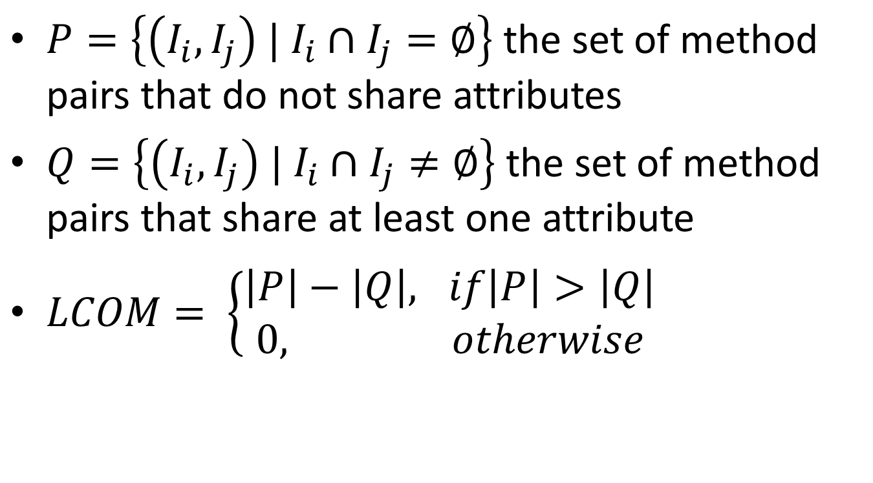
LCOM (Chidamber & Kemerer, 1994)
$P=\left\{\left(I_{i},I_{j}\right) | I_{i}∩I_{j}=∅\right\}$ the set of method pairs that do not share attributes
$Q=\left\{\left(I_{i},I_{j}\right) | I_{i}∩I_{j}≠∅\right\}$ the set of method pairs that share at least one attribute
$LCOM= \left\{\begin{aligned}\left|P\right|−\left|Q\right|, if\left|P\right|>\left|Q\right| \\ 0, otherwise\end{aligned}\right.$

Slide 3
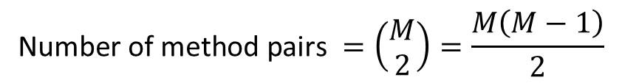
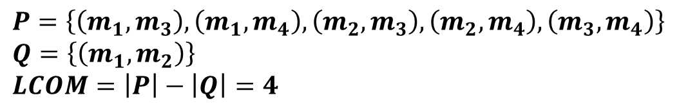
LCOM (Chidamber & Kemerer) example
a₁
a₄
$$\text{Number} \text{of} \text{method} \text{pairs} =\left(\begin{matrix}M \\ 2\end{matrix}\right)=\frac{M\left(M−1\right)}{2}$$
m₁
m₂
m₃
m₄
$$P=\left\{\left(m_{1},m_{3}\right),\left(m_{1},m_{4}\right),\left(m_{2},m_{3}\right),\left(m_{2},m_{4}\right),\left(m_{3},m_{4}\right)\right\}$$
$$Q=\left\{\left(m_{1},m_{2}\right)\right\}$$
$$LCOM=\left|P\right|−\left|Q\right|=4$$

Slide 4
LCOM (Li & Henry, 1993)
The number of disjoint components in the graph that represents:
each method as a node
the sharing of at least one attribute between two methods as an edge

Slide 5

LCOM (Li & Henry) example
a₁
a₄
m₁
m₂
m₃
m₄
m₁
m₂
m₃
m₄
$$LCOM=3$$

Slide 6
LCOM (Hitz & Montazeri, 1995)
The number of disjoint components in the graph that represents:
each method as a node
the sharing of at least one attribute between two methods as an edge
The presence of a method call between two methods as an edge

Slide 7

LCOM (Hitz & Montazeri) example
a₁
a₄
m₁
m₂
m₃
m₄
m₁
m₂
m₃
m₄
$$LCOM=1$$

Slide 8
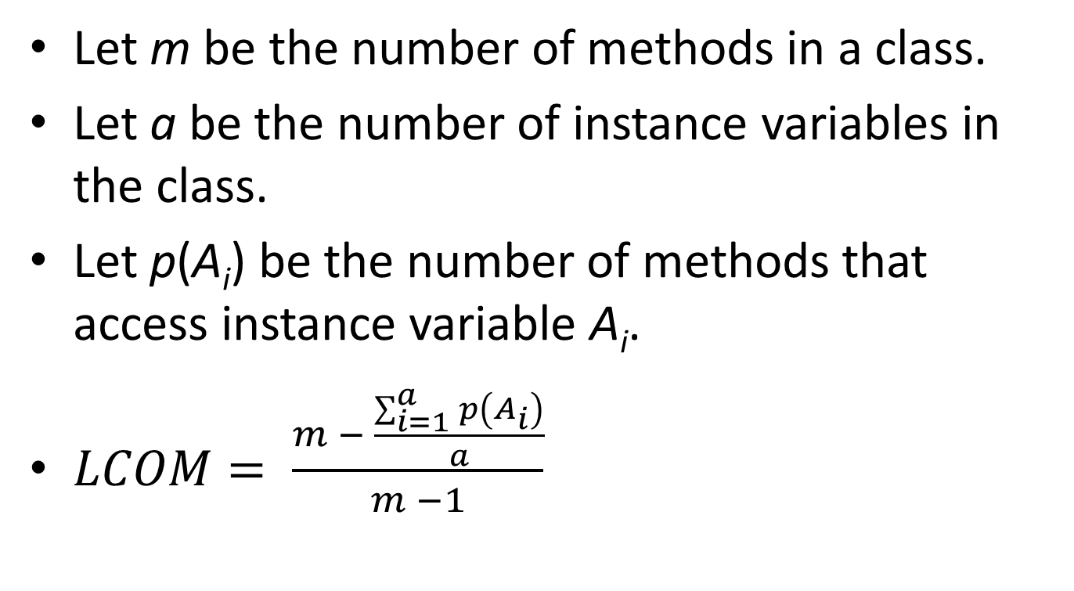
LCOM (Henderson-Sellers, 1996)
Let m be the number of methods in a class.
Let a be the number of instance variables in the class.
Let p(A_{i}) be the number of methods that access instance variable A_{i}.
$LCOM= \frac{m − \frac{\sum_{i=1}^{a}{p\left(A_{i}\right)}}{a}}{m −1}$

Slide 9
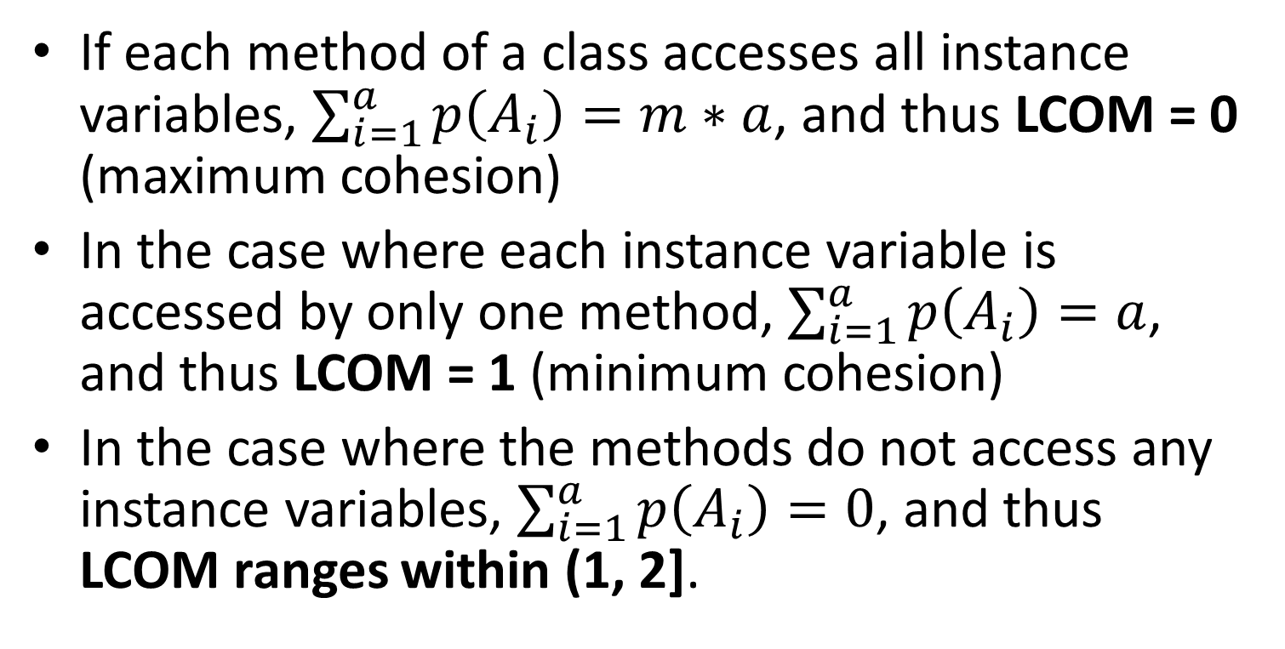
Henderson-Sellers normalized LCOM
If each method of a class accesses all instance variables, $\sum_{i=1}^{a}{p\left(A_{i}\right)}=m∗a$, and thus LCOM = 0 (maximum cohesion)
In the case where each instance variable is accessed by only one method, $\sum_{i=1}^{a}{p\left(A_{i}\right)}=a$, and thus LCOM = 1 (minimum cohesion)
In the case where the methods do not access any instance variables, $\sum_{i=1}^{a}{p\left(A_{i}\right)}=0$, and thus LCOM ranges within (1, 2].

Slide 10
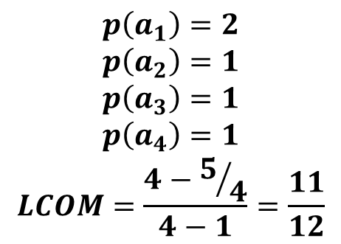
LCOM (Henderson-Sellers) example
a₁
a₂
a₃
a₄
$$p\left(a_{1}\right)=2$$
$$p\left(a_{2}\right)=1$$
$$p\left(a_{3}\right)=1$$
$$p\left(a_{4}\right)=1$$
$$LCOM=\frac{4−5/4}{4−1}=\frac{11}{12}$$
m₁
m₂
m₃
m₄

Slide 11
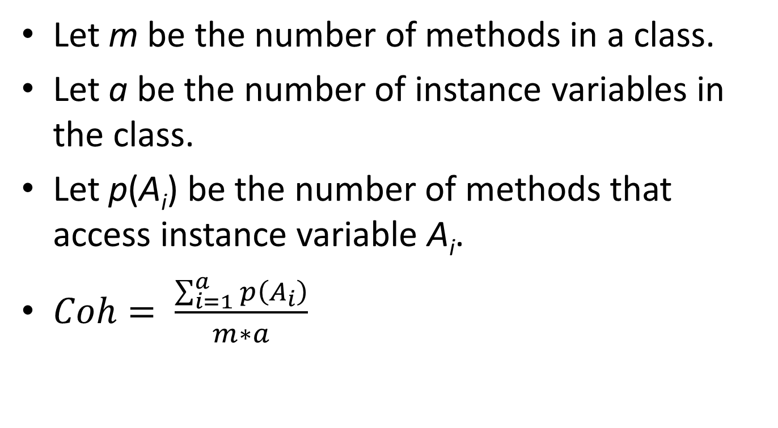
Coh (Briand et al., 1998)
Let m be the number of methods in a class.
Let a be the number of instance variables in the class.
Let p(A_{i}) be the number of methods that access instance variable A_{i}.
$Coh= \frac{\sum_{i=1}^{a}{p\left(A_{i}\right)}}{m∗a}$

Slide 12
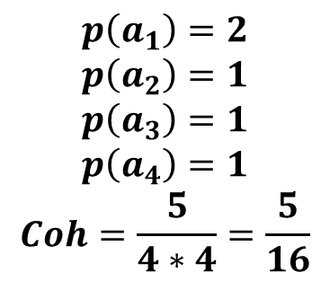
Coh (Briand et al.) example
a₁
a₂
a₃
a₄
$$p\left(a_{1}\right)=2$$
$$p\left(a_{2}\right)=1$$
$$p\left(a_{3}\right)=1$$
$$p\left(a_{4}\right)=1$$
$$Coh=\frac{5}{4∗4}=\frac{5}{16}$$
m₁
m₂
m₃
m₄

Slide 13
Tight Class Cohesion (Bieman & Kang, 1995)
The relative number of directly connected pairs of methods. Two methods are directly connected if they are directly connected to an attribute.
A method m is directly connected to an attribute, when the attribute appears
within m's body or
within the body of a method that is directly or transitively invoked by method m.

Slide 14
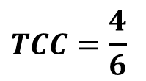
TCC (Bieman & Kang) example
Access a₁
Access a₃
Access a₃
a₁
a₂
a₃
a₄
m₁
m₂
m₃
m₄
m₁
m₂
m₃
m₄
Access a₃
$$TCC=\frac{4}{6}$$

Slide 15
Loose Class Cohesion (Bieman & Kang, 1995)
The relative number of directly or transitively connected pairs of methods. Two methods are transitively connected if they are indirectly connected to an attribute.
A method m, which is directly connected to an attribute j, is indirectly connected to an attribute i when there is a method that is directly or transitively connected to both attributes i and j.
j
i
m
X

Slide 16
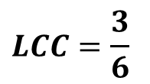
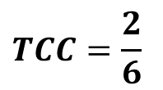
TCC vs. LCC example
Access a₁
Access a₃
$$TCC=\frac{2}{6}$$
a₁
a₂
a₃
a₄
m₁
m₂
m₃
m₄
m₁
m₂
m₃
m₄
m₁
m₂
m₃
m₄
$$LCC=\frac{3}{6}$$
m₂ accesses both a₁ and a₃
m₃ is indirectly connected to a₁
m₁ is indirectly connected to a₃

Slide 17
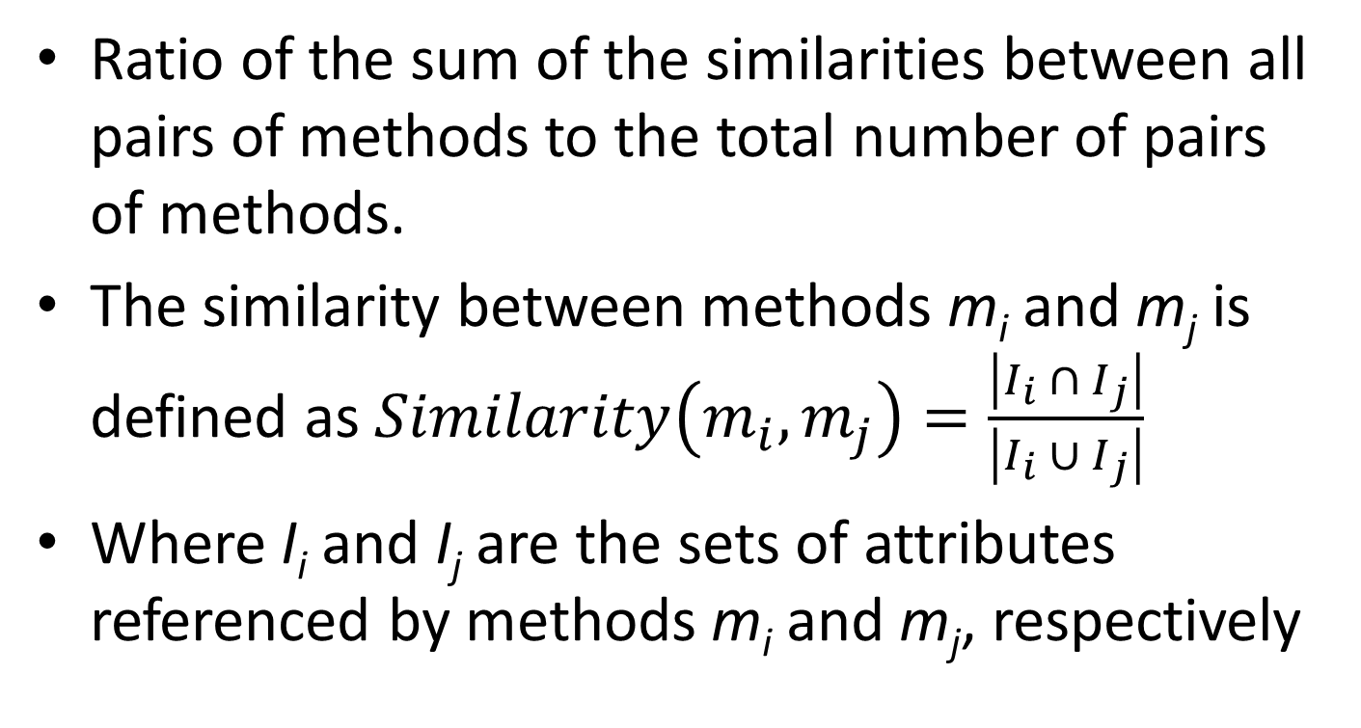
Class Cohesion (Bonja & Kidanmariam, 2006)
Ratio of the sum of the similarities between all pairs of methods to the total number of pairs of methods.
The similarity between methods m_{i} and m_{j} is defined as $Similarity\left(m_{i}, m_{j}\right)=\frac{\left|I_{i} ∩{ I}_{j}\right|}{\left|I_{i} ∪{ I}_{j}\right|}$
Where I_{i} and I_{j} are the sets of attributes referenced by methods m_{i} and m_{j}, respectively

Slide 18
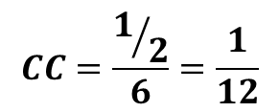
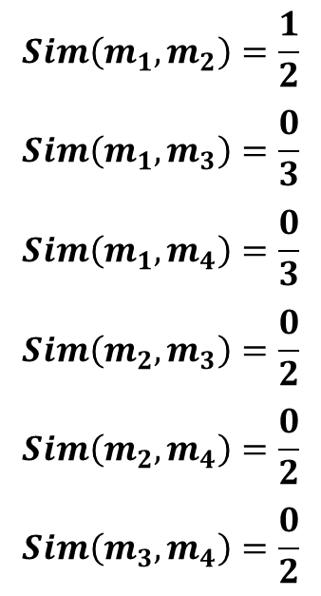
Class Cohesion (Bonja & Kidanmariam) example
$$Sim\left(m_{1},m_{2}\right)=\frac{1}{2}$$
$$Sim\left(m_{1},m_{3}\right)=\frac{0}{3}$$
$$Sim\left(m_{1},m_{4}\right)=\frac{0}{3}$$
$$Sim\left(m_{2},m_{3}\right)=\frac{0}{2}$$
$$Sim\left(m_{2},m_{4}\right)=\frac{0}{2}$$
$$Sim\left(m_{3},m_{4}\right)=\frac{0}{2}$$
a₁
a₂
a₃
a₄
$$CC=\frac{1/2}{6}=\frac{1}{12}$$
m₁
m₂
m₃
m₄

Slide 19
References
S. R. Chidamber , C. F. Kemerer, "A Metrics Suite for Object Oriented Design," IEEE Transactions on Software Engineering, vol. 20, no. 6, pp. 476-493, June 1994.
W. Li, and S. Henry, "Object-Oriented Metrics that Predict Maintainability," Journal of Systems and Software, vol. 23, no. 2, pp. 111-122, 1993.
M. Hitz, B. Montazeri, "Measuring Coupling and Cohesion In Object-Oriented Systems," Proc. Int. Symposium on Applied Corporate Computing, Monterrey, Mexico, Oct. 1995.
J. M. Bieman, and B.-K. Kang, "Cohesion and reuse in an object-oriented system," Proc. Symposium on Software reusability (SSR '95), pp. 259-262, 1995.
B. Henderson-Sellers, L. Constantine, and I. Graham, "Coupling and Cohesion (Towards a Valid Metrics Suite for Object-Oriented Analysis and Design)," Object-Oriented Systems, vol. 3, no. 3, pp. 143-158, 1996.
C. Bonja, and E. Kidanmariam, "Metrics for class cohesion and similarity between methods," ACM Southeast Regional Conference, pp. 91-95, 2006.

