Slide 1
Empirical Study Comparing Quality Metrics with Code Volatility, and Investigating a Prediction Model
Md Tajmilur Rahman
Shams Azad
Amish Gala
Vinodkumar Raghu

Slide 2
Definitions
Code Volatility: the propensity for a given code fragment to change over different releases
Example: MyClass.java changed between versions 1 and 2, and also between version 3 and 4
This class has a volatility of 2 / 3
Association Rules: conditional statements that help in finding relationships between random objects
Antecedent: an item (of interest) found in the data
Consequent: an item that is found in combination with the antecedent
Mining this data allows us to form prediction models:
“if a person buys milk, there’s a 60% chance he’ll buy eggs”

Slide 3
The Data: Apache Timeline
Analyzed Apache Ant over four releases (1.5 – 1.8), plus 1 for validation / prediction (1.9):
1.5: July 2002
1.7: Dec 2006
1.9: March 2013
Apache Ant
1.6: Dec 2003
1.8: Feb 2010
15_to_16
16_to_17
17_to_18
18_to_19
Notes:
Date rev1_5 = Runner.DATEFORMAT.parse("2002-07-10 00:00:00 -0500");
Date rev1_6 = Runner.DATEFORMAT.parse("2003-12-18 00:00:00 -0500");
Date rev1_7 = Runner.DATEFORMAT.parse("2006-12-19 00:00:00 -0500");
Date rev1_8 = Runner.DATEFORMAT.parse("2010-02-08 00:00:00 -0500");
Date rev1_9 = Runner.DATEFORMAT.parse("2013-03-07 00:00:00 -0500");

Slide 4
Organizing Data: Buckets
High Volatility:
Java class in all 3 sets
(294 total)
15_to_16
(434 commits)
Set of Java Classes
(788)
Med. Volatility:
Java class in any 2 sets (503 total)
16_to_17 (630 commits)
Set of Java Classes
(1089)
17_to_18
(296 commits)
Set of Java Classes
(565)
Low Volatility:
Java class in any 1 set
(554 total)
18_to_19
(101 commits)
Set of Java Classes used for validation
Notes:
Give example

Slide 5
Research Questions
What is the relationship between code volatility and quality metrics?
Hypothesis: HV code exhibit lower quality metrics compared to LV code
Based on volatility and association rules, can we build a practical change propensity model?
Hypothesis: Based on historical volatility data and association rules, we can predict which classes may also change
Notes:
Now that we have the set of Java classes into three buckets (HV, MV, LV), we can pose our research questions

Slide 6
Design and Methodology
"It's not the tools that you have faith in - tools are just tools. They work, or they don't work. It's people you have faith in or not."

Slide 7
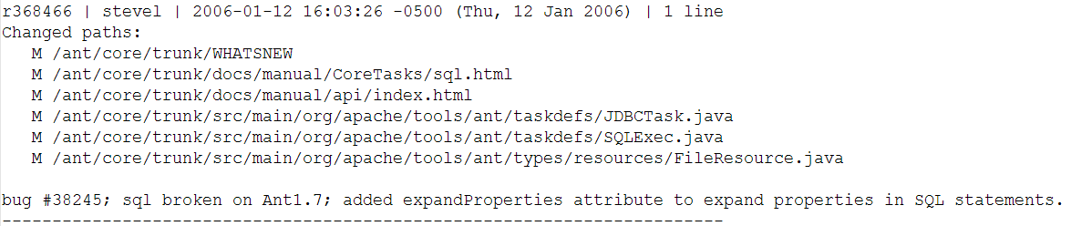
Log Parser /1
Had access to the complete SVN commit history for Apache Ant. Example commit:
Parsed, cleaned, and filtered the data into our model (buckets of Java commits):
15_to_16, 16_to_17…
HV, MV, LV
Notes:
Talk about removing commits which were unusable (commits which changed the license, and removed the authors from code etc.)
Bring back our main point: we’re investigating whether higher volatility code exhibits lower quality metrics

Slide 8
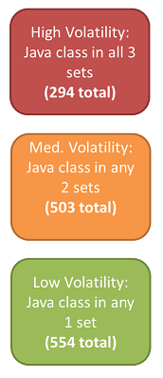
Log Parser /2
Plain ol’ Java project, which handled:
Parsing the complete log, calculating volatility
Writing the text files to be used in JD (lists of HV, MV, and LV classes)
Writing the files which show which Java classes were modified together (for association rules)
Leveraged:
Collections, Guava, StackOverflow…

Slide 9
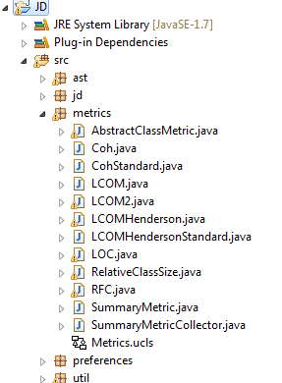
Metrics Integrated into JD
Class Metrics (C&K):
LCOM (given) + LCOM (Henderson)
Cohesion
RFC
Size / LOC
System Metrics (MOOD):
MHF
AHF
Notes:
In parallel to extracting all the class information from the logs,

Slide 10
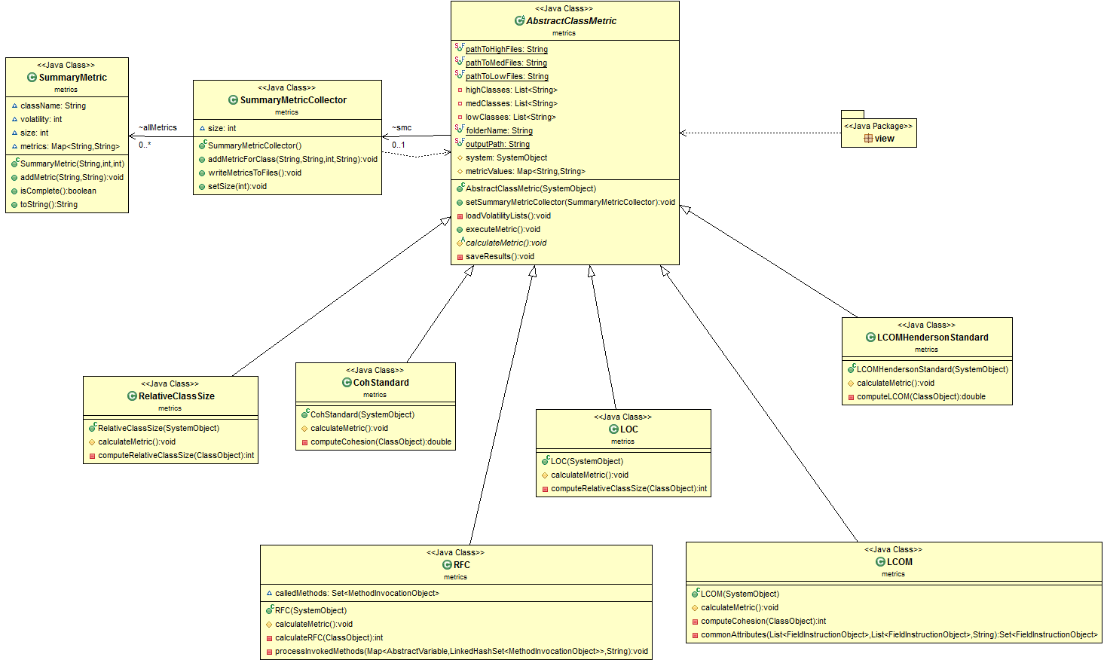
Design
Notes:
Much like everybody else, we started in the same place that the UI integration happens -> the runnable within the MetricsAction java class
We started developed our metrics in individual classes, to do the calculation
We saw some common behavior, and extracted an abstract parent class to manage common tasks -> loading the volatility buckets and writing the results to the database. We implemented a standard template pattern so that each child class would need to only implement one method, and write to a collection defined in the parent.
Finally we needed some additional data to check if the metrics were themselves correlated, so we designed a summary metrics collector which only interacted with the abstract
System level metrics not shown (MHF, AHF) – not ready yet!

Slide 11
Association Rules
Code elements changed in a single commit are taken as one transaction
Created three different files for four different versions of apache ant.
Applied Apriori algorithm to get the association rule
Minimum support: 9%
Minimum confidence: 50%.

Slide 12
A glimpse of a rule
{ /ant/core/trunk/src/main/org/apache/tools/ant/taskdefs/optional/perforce/P4Change.java} => { /ant/core/trunk/src/main/org/apache/tools/ant/taskdefs/optional/perforce/P4Counter.java}
The above rules says that when ever a developer change something in P4Change.java then he should also gives more attention on the file P4Counter.java.
A rule gives an important hint to the developer

Slide 13
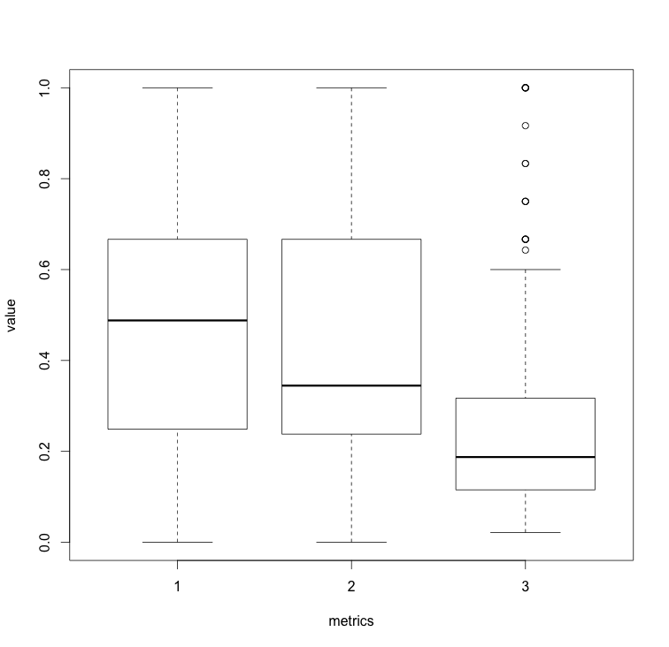
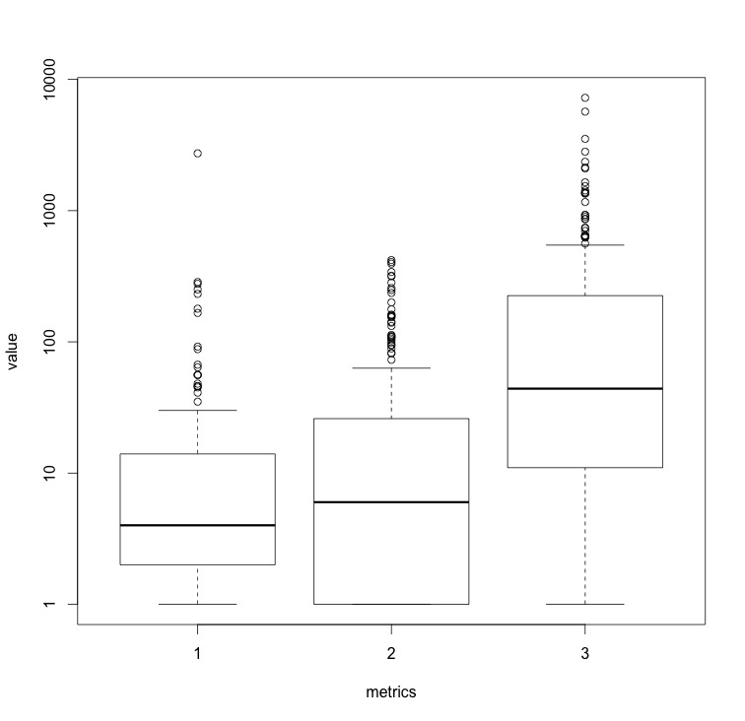
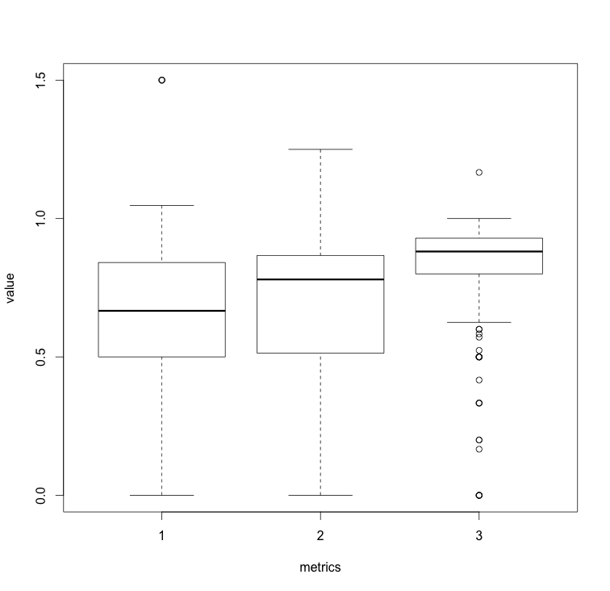
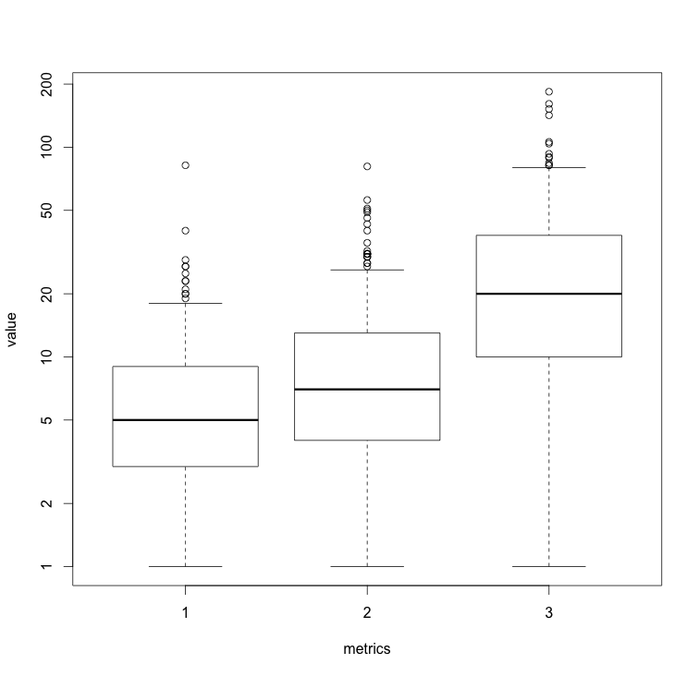
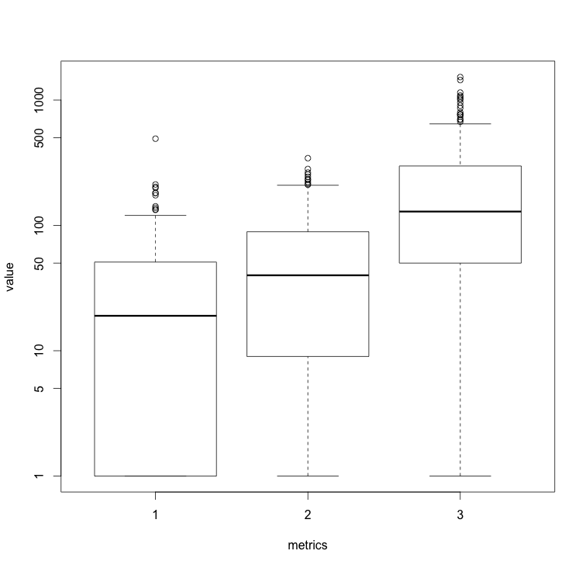
Results: Volatility ~ Quality Metrics
Cohesion
LCOM
LCOM Henderson
RFC
Size / LOC

Slide 14
Results: Metrics Correlation
 | Coh | Lcom | Lcom_h | Loc | RFC | Relative_Size
Coh | 1.00000
Lcom | -0.24631 | 1.00000
Lcom_h | -0.96238 | 0.16640 | 1.00000
Loc | -0.49723 | 0.44354 | 0.34259 | 1.00000
RFC | -0.52309 | 0.82539 | 0.36112 | 0.71414 | 1.00000
Relative_Size | -0.45214 | 0.32464 | 0.30957 | 0.97546 | 0.60745 | 1.00000
Low Volatility
 | Coh | Lcom | Lcom_h | Loc | RFC | Relative_Size
Coh | 1.00000
Lcom | -0.49787 | 1.00000
Lcom_h | -0.97217 | 0.38735 | 1.00000
Loc | -0.50970 | 0.57340 | 0.39795 | 1.00000
RFC | -0.44099 | 0.64572 | 0.30974 | 0.74532 | 1.00000
Relative_Size | -0.49208 | 0.50096 | 0.39083 | 0.96111 | 0.71735 | 1.00000
Med Volatility
 | Coh | Lcom | Lcom_h | Loc | RFC | Relative_Size
Coh | 1.00000
Lcom | -0.34738 | 1.00000
Lcom_h | -0.93932 | 0.26818 | 1.00000
Loc | -0.51472 | 0.65227 | 0.39144 | 1.00000
RFC | -0.55733 | 0.79999 | 0.42153 | 0.83401 | 1.00000
Relative_Size | -0.51278 | 0.66683 | 0.39364 | 0.98594 | 0.84090 | 1.00000
High Volatility
Notes:
What does this slide tell us:
- Across all buckets, many metrics are strongly correlated. This is good and bad – good that they validate each other, but bad that they do not offer much new knowledge.

Slide 15
Results: Association Rules
Precision – It describes which fraction of the returned items was actually expected.
We got a precession of 10% as we have only taken consideration of only 5 version into account.
Recall - How many consequents(C) are matches with the expected outcome (E).
Recall value was only 2% due to large number of commits in one transaction.

Slide 16
Results Discussion
It was clear that more volatile code tends to exhibit lower quality metrics

Slide 17
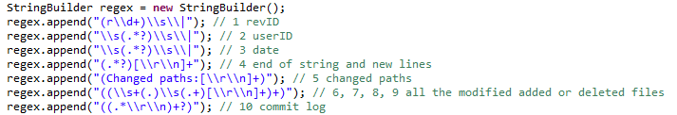
Challenges Faced
Parsing the massive SVN commit log using regex
Victim of catastrophic backtracking (SO in Eclipse):
Computing the association rules required large computing power (16GB ram!)

Slide 18
Threats to Validity
Construct
Internal
External
Reliability

