Slide 1
Empirical Study Comparing Quality Metrics with Code Volatility, and Investigating a Prediction Model
Md Tajmilur Rahman
Shams Azad
Amish Gala
Vinodkumar Raghu

Slide 2
Definitions
Code Volatility: the propensity for a given code fragment to change over different releases
Example: MyClass.java changed between versions 1 and 2, and also between version 3 and 4
This class has a volatility of 2 / 3
Association Rules: conditional statements that help in finding relationships between random objects
Antecedent: an item (of interest) found in the data
Consequent: an item that is found in combination with the antecedent
Mining this data allows us to form prediction models:
“if a person buys milk, there’s a 60% chance he’ll buy eggs”

Slide 3
The Data: Apache Timeline
Analyzed Apache Ant over four releases (1.5 – 1.8), plus 1 for validation / prediction (1.9):
1.5: July 2002
1.7: Dec 2006
1.9: March 2013
Apache Ant
1.6: Dec 2003
1.8: Feb 2010
15_to_16
16_to_17
17_to_18
18_to_19
Notes:
Date rev1_5 = Runner.DATEFORMAT.parse("2002-07-10 00:00:00 -0500");
Date rev1_6 = Runner.DATEFORMAT.parse("2003-12-18 00:00:00 -0500");
Date rev1_7 = Runner.DATEFORMAT.parse("2006-12-19 00:00:00 -0500");
Date rev1_8 = Runner.DATEFORMAT.parse("2010-02-08 00:00:00 -0500");
Date rev1_9 = Runner.DATEFORMAT.parse("2013-03-07 00:00:00 -0500");

Slide 4
Organizing Data: Buckets
High Volatility:
Java class in all 3 sets
(294 total)
15_to_16
(434 commits)
Set of Java Classes
(788)
Med. Volatility:
Java class in any 2 sets (503 total)
16_to_17 (630 commits)
Set of Java Classes
(1089)
17_to_18
(296 commits)
Set of Java Classes
(565)
Low Volatility:
Java class in any 1 set
(554 total)
18_to_19
(101 commits)
Set of Java Classes used for validation
Notes:
Give example

Slide 5
Research Questions
What is the relationship between code volatility and quality metrics?
Hypothesis: HV code exhibit lower quality metrics compared to LV code
Based on association rules, can we build a practical change propensity model?
Hypothesis: Based on association rules and historical data, we can predict which classes may also change in the current version
Notes:
Now that we have the set of Java classes into three buckets (HV, MV, LV), we can pose our research questions

Slide 6
Design and Methodology
"It's not the tools that you have faith in - tools are just tools. They work, or they don't work. It's people you have faith in or not."

Slide 7
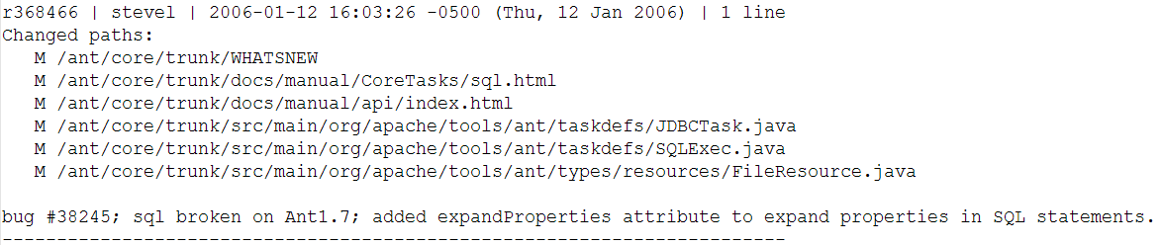
Log Parser /1
Had access to the complete SVN commit history for Apache Ant. Example commit:
Parsed, cleaned, and filtered the data into our model (buckets of Java commits):
15_to_16, 16_to_17…
HV, MV, LV
Notes:
Talk about removing commits which were unusable (commits which changed the license, and removed the authors from code etc.)
Bring back our main point: we’re investigating whether higher volatility code exhibits lower quality metrics

Slide 8
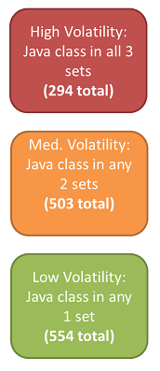
Log Parser /2
Plain ol’ Java project, which handled:
Parsing the complete log, calculating volatility
Writing the text files to be used in JD (lists of HV, MV, and LV classes)
Writing the files which show which Java classes were modified together (for association rules)
Leveraged:
Collections, Guava, StackOverflow…

Slide 9
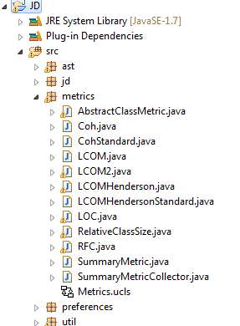
Metrics Integrated into JD
Class Metrics (C&K):
LCOM (given) + LCOM (Henderson)
Cohesion
RFC
Size / LOC
System Metrics (MOOD):
MHF
AHF
Notes:
In parallel to extracting all the class information from the logs,

Slide 10
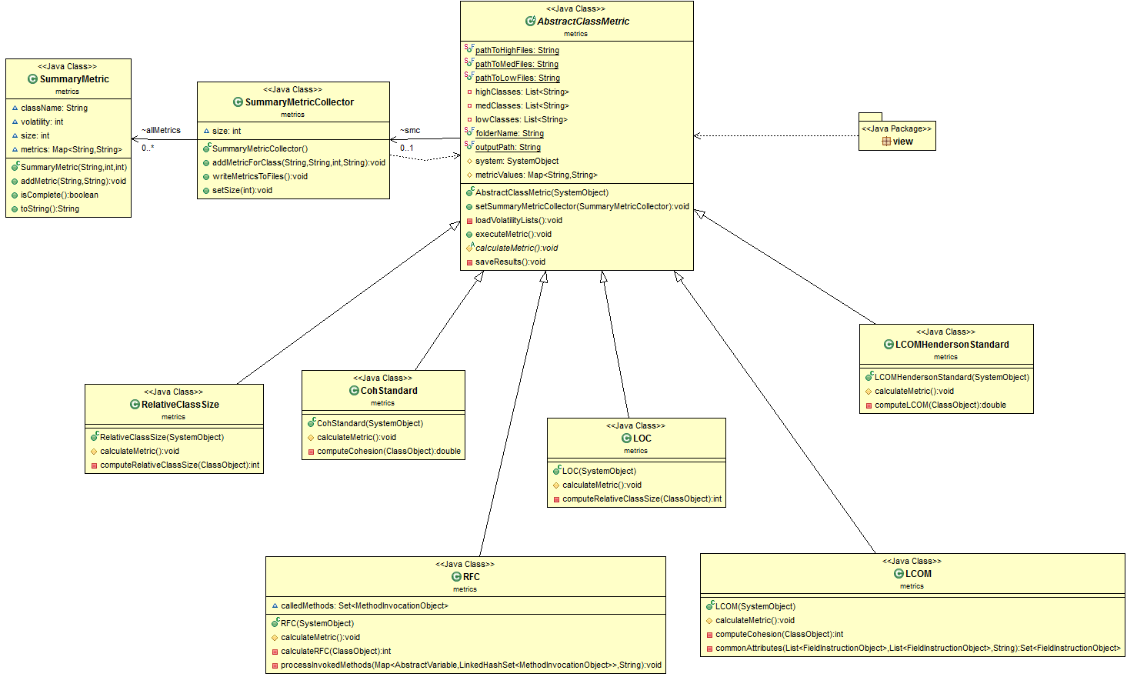
Design
Notes:
Much like everybody else, we started in the same place that the UI integration happens -> the runnable within the MetricsAction java class
We started developed our metrics in individual classes, to do the calculation
We saw some common behavior, and extracted an abstract parent class to manage common tasks -> loading the volatility buckets and writing the results to the database. We implemented a standard template pattern so that each child class would need to only implement one method, and write to a collection defined in the parent.
Finally we needed some additional data to check if the metrics were themselves correlated, so we designed a summary metrics collector which only interacted with the abstract
System level metrics not shown (MHF, AHF) – not ready yet!

Slide 11
Definition: Support and Confidence
An example frequent itemset:
{Chicken, Clothes, Milk} [sup = 3/7]
Association rule from the itemset:
{Chicken, Clothes ➔ Milk} [sup = 3/7, conf = 2/3]
Assume:
Minimum support = 30%
Minimum confidence = 60%
t1: Beef, Chicken, Milk t2: Beef, Cheese t3: Cheese, Boots t4: Beef, Chicken, Cheese | t5: Beef, Chicken, Clothes, Cheese, Milk t6: Chicken, Clothes, Milk t7: Chicken, Milk, Clothes

Slide 12
Association Rules /1
Created three different “change” files for four different versions of Apache Ant
1.5 to 1.6 …
Code elements changed in a single commit are taken as one transaction
Prepared the transaction set to train our model
Filtered transactions to only include the Java class modification (not addition or deletion)
Notes:
The above rule indicates the following:
Whenever a developer changes something in P4Change.java then he should also pay more attention to P4Counter.java

Slide 13
Association Rules /2
Applied Apriori algorithm to get the association rules (remembering that we have ~1300 commits):
Minimum support: 9%
Minimum confidence: 50%
/ant/core/…/P4Change.java ➔ /ant/core/…/P4Counter.java
Notes:
The rules can give important hints to the developer / team
Probabilistic model to help with related code changes

Slide 14
Results and discussion
Code Volatility and Quality Metrics
Association Rules and Prediction Model

Slide 15
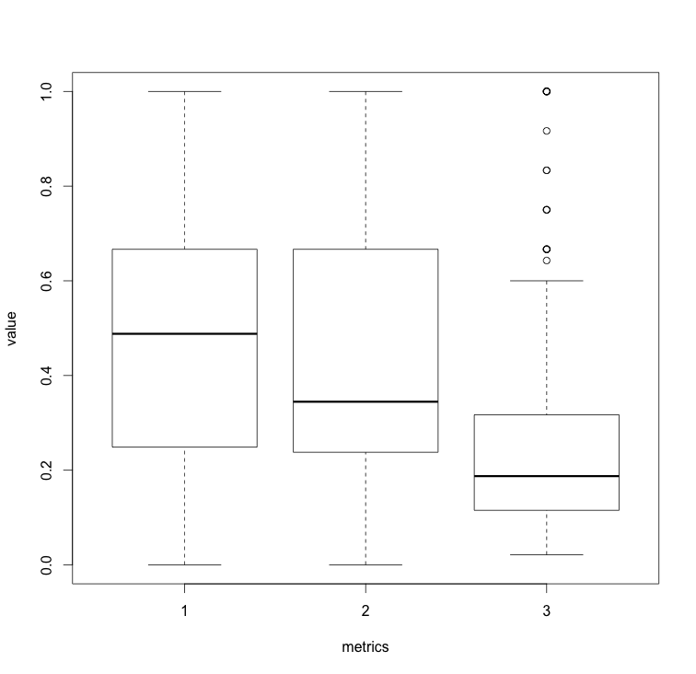
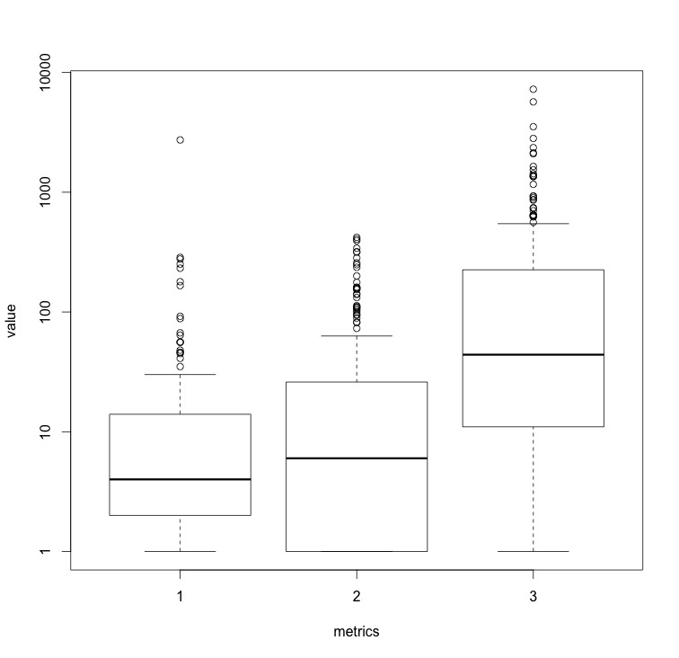
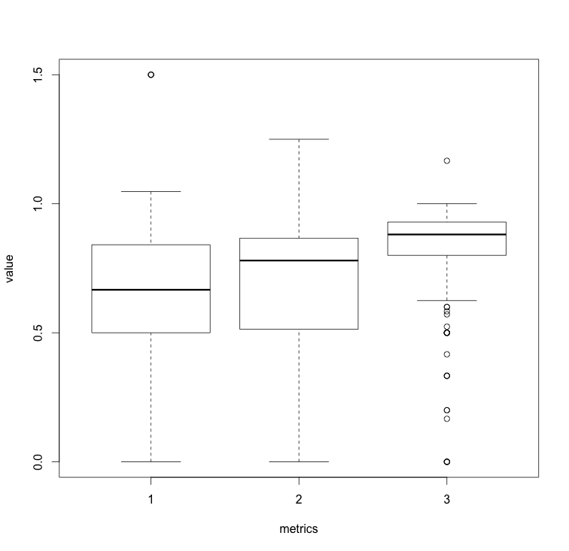
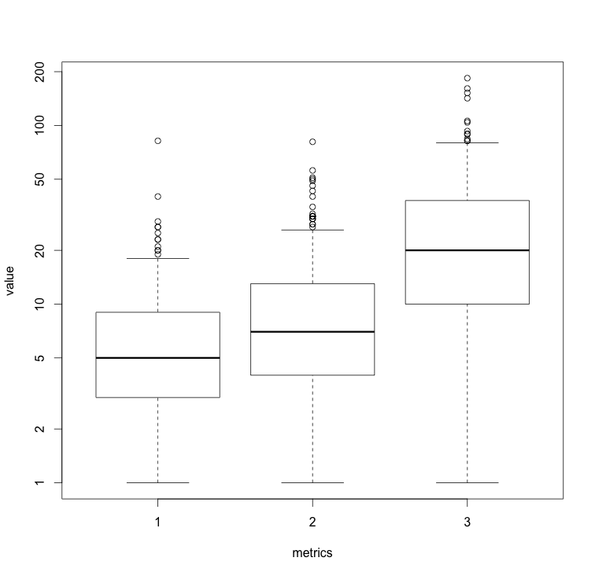
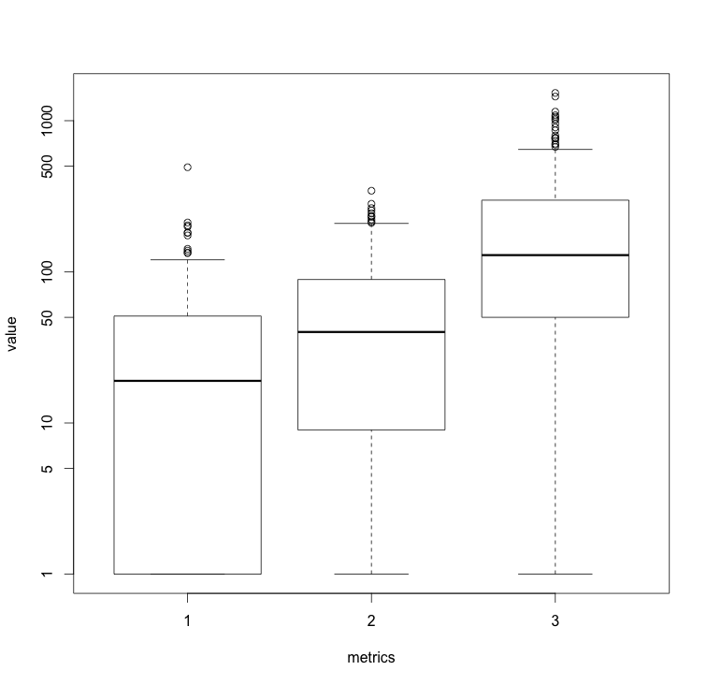
Results: Volatility ~ Quality Metrics
Cohesion
LCOM
LCOM Henderson
RFC
Size / LOC

Slide 16
Results: Pearson Linear Regression - Correlation between Metrics
 | Coh | Lcom | Lcom_h | Loc | RFC | Relative_Size
Coh | 1.00000
Lcom | -0.24631 | 1.00000
Lcom_h | -0.96238 | 0.16640 | 1.00000
Loc | -0.49723 | 0.44354 | 0.34259 | 1.00000
RFC | -0.52309 | 0.82539 | 0.36112 | 0.71414 | 1.00000
Relative_Size | -0.45214 | 0.32464 | 0.30957 | 0.97546 | 0.60745 | 1.00000
Low Volatility
 | Coh | Lcom | Lcom_h | Loc | RFC | Relative_Size
Coh | 1.00000
Lcom | -0.49787 | 1.00000
Lcom_h | -0.97217 | 0.38735 | 1.00000
Loc | -0.50970 | 0.57340 | 0.39795 | 1.00000
RFC | -0.44099 | 0.64572 | 0.30974 | 0.74532 | 1.00000
Relative_Size | -0.49208 | 0.50096 | 0.39083 | 0.96111 | 0.71735 | 1.00000
Med Volatility
 | Coh | Lcom | Lcom_h | Loc | RFC | Relative_Size
Coh | 1.00000
Lcom | -0.34738 | 1.00000
Lcom_h | -0.93932 | 0.26818 | 1.00000
Loc | -0.51472 | 0.65227 | 0.39144 | 1.00000
RFC | -0.55733 | 0.79999 | 0.42153 | 0.83401 | 1.00000
Relative_Size | -0.51278 | 0.66683 | 0.39364 | 0.98594 | 0.84090 | 1.00000
High Volatility
Notes:
What does this slide tell us:
- Across all buckets, many metrics are strongly correlated. This is good and bad – good that they validate each other, but bad that they do not offer much new knowledge.

Slide 17
Results: Association Rules
Precision: fraction of the returned items that was actually correct
Application of rules resulted in 10% precision
Recall: how many consequents are matched with all actual changed files
Recall value calculated at 2%
Low value partially due to large number of Java classes in a single commit
Notes:
only considered 5 versions (4 change files)

Slide 18
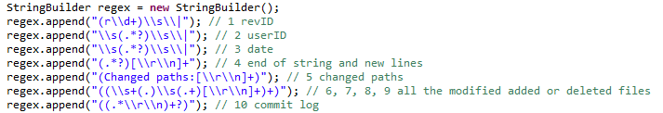
Challenges Faced
Parsing the massive SVN commit log using regex
Victim of catastrophic backtracking (SO in Eclipse):
Computing the association rules required large computing power and quite some processing time

Slide 19
Challenges Faced /2
Cleaning the transactions to calculate association rules was time consuming (some duplicates and corrupt data)
Infrastructure:
Distributed programming using Git led to some merge conflicts
Spent time resolving lost / corrupted data
Three different OS versions (Ubuntu, OSX, Windows 7) caused some difficulties
.classpath and .project issues
CRLF vs. LF

Slide 20
Threats to Validity
Construct
The time between each successive release was not uniform (varied between 1.5 years to 4 years)
Internal
External
Only used 1 project (should also repeat this on other OSS projects)
Reliability
Association rules based only on 4 versions (3 collections of files)

Slide 21
Summary
Over multiple versions of Apache Ant, it was clear that more volatile code tended to exhibit lower quality metrics (C&K + MOOD)
Based on historical SVN data, we attempted to build a prediction model using association rules
Precision and recall values were calculated
Both were quite low; however, they do give valuable information to the developer / team

