Slide 1
SOEN 6611 – Software Measurement
Object-Oriented Metrics
Fernando Brito e Abreu (MOOD)

Slide 2
MOOD Metrics
Fernando Brito e Abreu defined MOOD metrics in 1995, as a means to provide a summary of the overall quality of an object-oriented project.
The quality properties captured by MOOD are:
Encapsulation
Coupling
Inheritance
Polymorphism

Slide 3
Category: Encapsulation Method Hiding Factor (MHF)
Method hiding factor measures how methods are encapsulated in the classes of a system.
Computation strategy
Visibility for method M_{mi}: Count the number of other classes (excluding the class in which M_{mi} belongs to) that can call M_{mi} and average it over total number of classes minus 1.
Apply step 1 for each method in the system and sum the results.
Divide the final sum with the total number of methods.

Slide 4
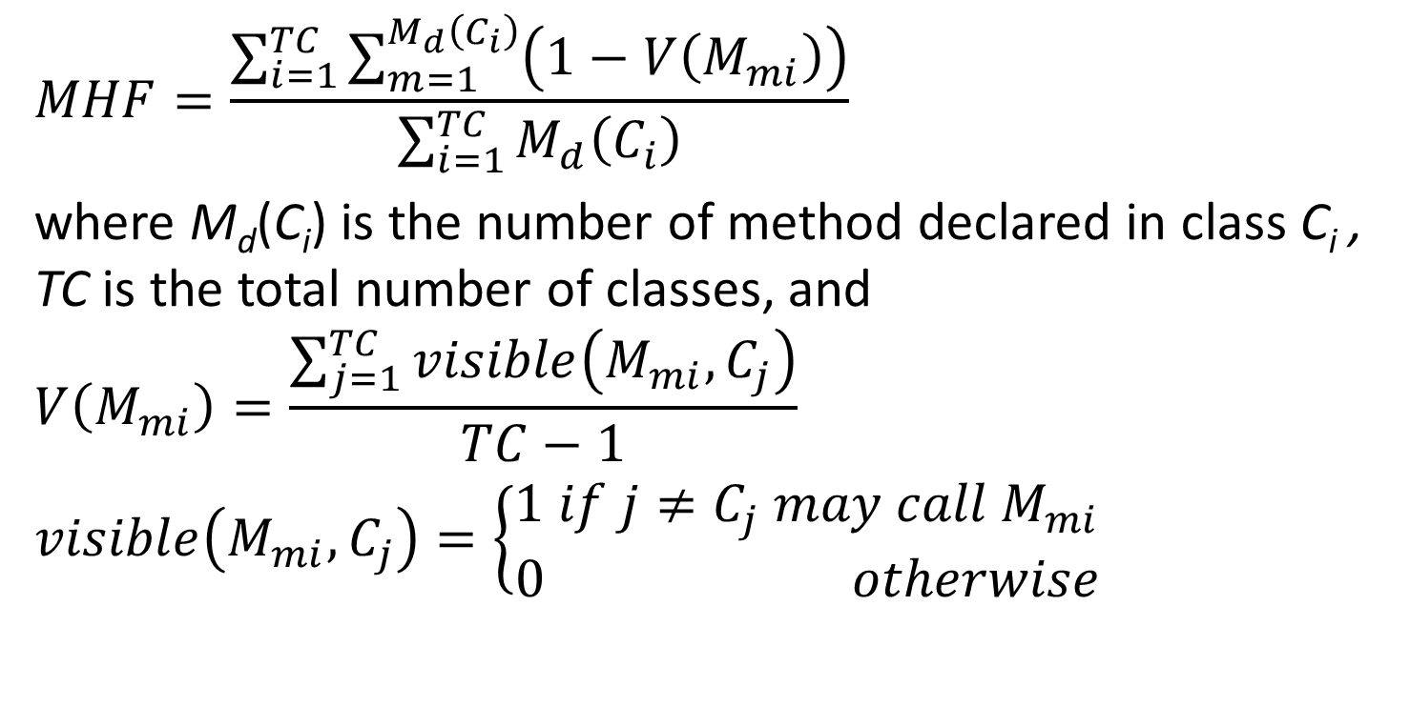
Category: Encapsulation Method Hiding Factor (MHF)
$$MHF=\frac{\sum_{i=1}^{TC}{\sum_{m=1}^{M_{d}\left(C_{i}\right)}{\left(1−V\left(M_{mi}\right)\right)}}}{\sum_{i=1}^{TC}{M_{d}\left(C_{i}\right)}}$$
where M_{d}(C_{i}) is the number of method declared in class C_{i} , TC is the total number of classes, and
$$V\left(M_{mi}\right)=\frac{\sum_{j=1}^{TC}{visible\left(M_{mi},C_{j}\right)}}{TC−1}$$
$$visible\left(M_{mi},C_{j}\right)=\left\{\begin{aligned}1 if j≠C_{j} may call M_{mi} \\ 0 otherwise\end{aligned}\right.$$

Slide 5
Method Hiding Factor (MHF) Visibility
Modifier | Class | Package | Subclass | World
public | Y | Y | Y | Y
protected | Y | Y | Y | N
no modifier | Y | Y | N | N
private | Y | N | N | N

Slide 6
MHF Discussion
If all methods are private, MHF=100%
If all methods are public, MHF=0%
A low MHF value indicates that a large proportion of methods are unprotected and the probability of errors is high.
A high MHF value indicates very little functionality. It may also indicate that the design includes a high proportion of specialized methods that are not available for reuse.

Slide 7
Category: Encapsulation Attribute Hiding Factor (AHF)
Attribute hiding factor measures how attributes are encapsulated in the classes of a system.
It has the same definition as MHF, but using attributes rather than methods.
Ideally, all attributes should be hidden, and thus AHF=100% is the ideal value. Very low values of AHF should trigger attention.

Slide 8
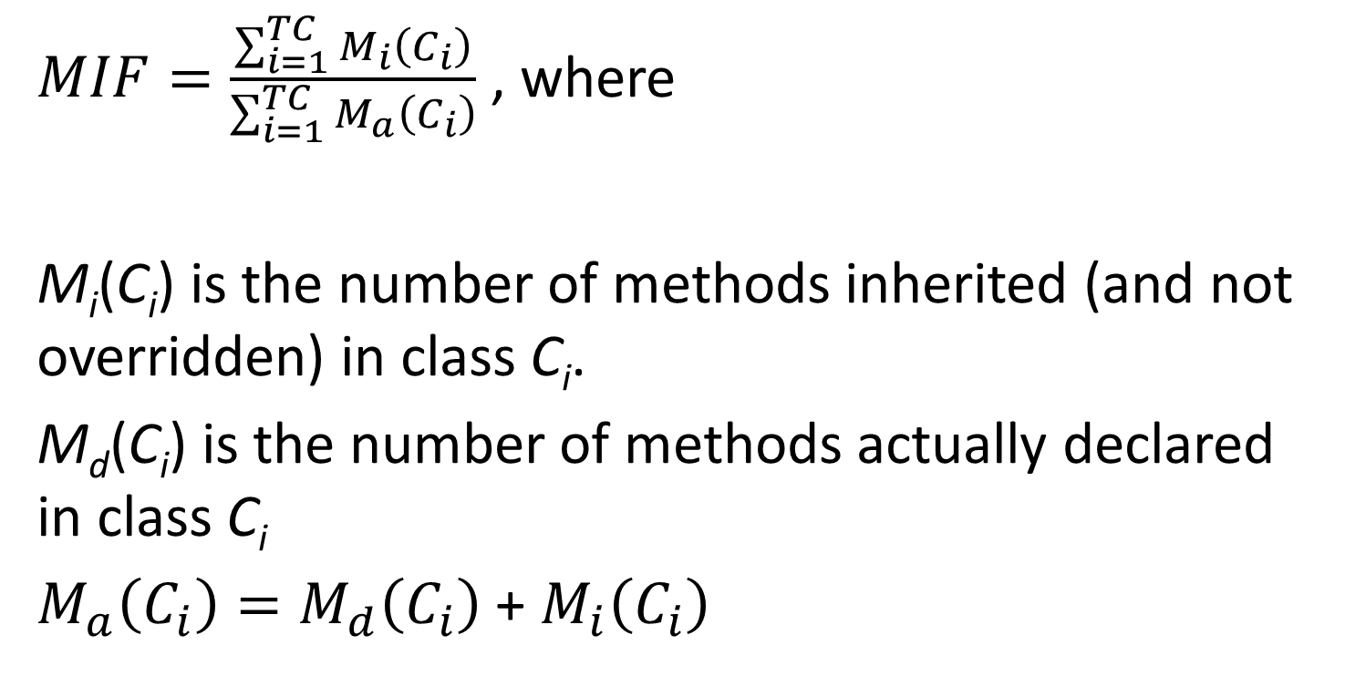
Category: Inheritance Method Inheritance Factor (MIF)
$MIF=\frac{\sum_{i=1}^{TC}{M_{i}\left(C_{i}\right)}}{\sum_{i=1}^{TC}{M_{a}\left(C_{i}\right)}}$ , where
M_{i}(C_{i}) is the number of methods inherited (and not overridden) in class C_{i}.
M_{d}(C_{i}) is the number of methods actually declared in class C_{i}
$M_{a}\left(C_{i}\right)=M_{d}\left(C_{i}\right)$ + $M_{i}\left(C_{i}\right)$

Slide 9
MIF Discussion
A low MIF value indicates lack of inheritance or heavy use of overriding, which essentially minimizes the benefit of reuse through inheritance. If all inherited methods are overridden, then MIF=0
A high MIF value indicates that most subclasses do not declare their own methods, and thus inheritance is redundant. If a class does not declare its own methods, then MIF=1

Slide 10
Category: Inheritance Attribute Inheritance Factor (AIF)
It has the same definition as MIF, but using attributes rather than methods.
A low value indicates lack of inheritance or heavy use of shadowing/hiding (when a subclass declares an attribute despite being inherited from its superclass), which is a bad practice.
A high AIF value indicates that most subclasses do not declare their own attributes, and thus inheritance is redundant.

Slide 11
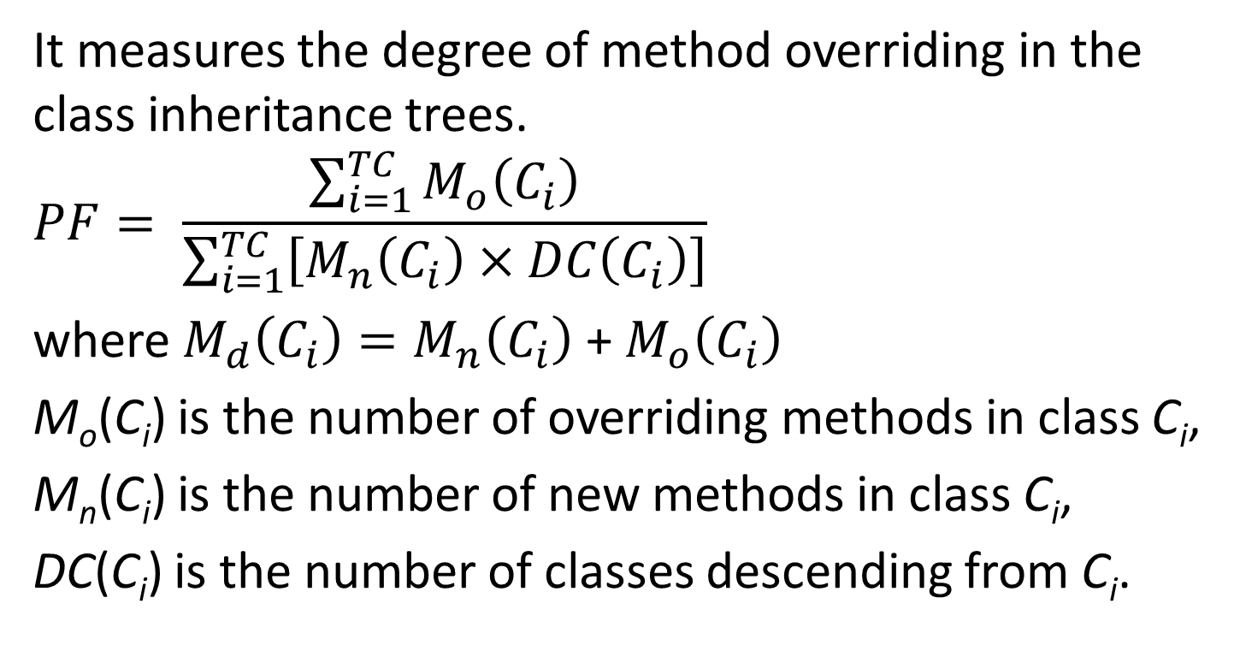
Category: Inheritance Polymorphism Factor (PF)
It measures the degree of method overriding in the class inheritance trees.
$$PF= \frac{\sum_{i=1}^{TC}{M_{o}\left(C_{i}\right)}}{\sum_{i=1}^{TC}{\left[M_{n}\left(C_{i}\right)×DC\left(C_{i}\right)\right]}}$$
where $M_{d}\left(C_{i}\right)=M_{n}\left(C_{i}\right)$ + $M_{o}\left(C_{i}\right)$
M_{o}(C_{i}) is the number of overriding methods in class C_{i},
M_{n}(C_{i}) is the number of new methods in class C_{i},
DC(C_{i}) is the number of classes descending from C_{i}.

Slide 12
PF Discussion
In the formula, the numerator is equal to the actual number of overrides in a system and the denominator is the maximum number of possible overrides in a system. Thus, PF is an indirect measure of the relative amount of dynamic binding in a system.
If all methods are overridden in all derived classes, PF=100%.
A PF value of 0% may indicate that the system does not make use of inheritance or polymorphism.

Slide 13
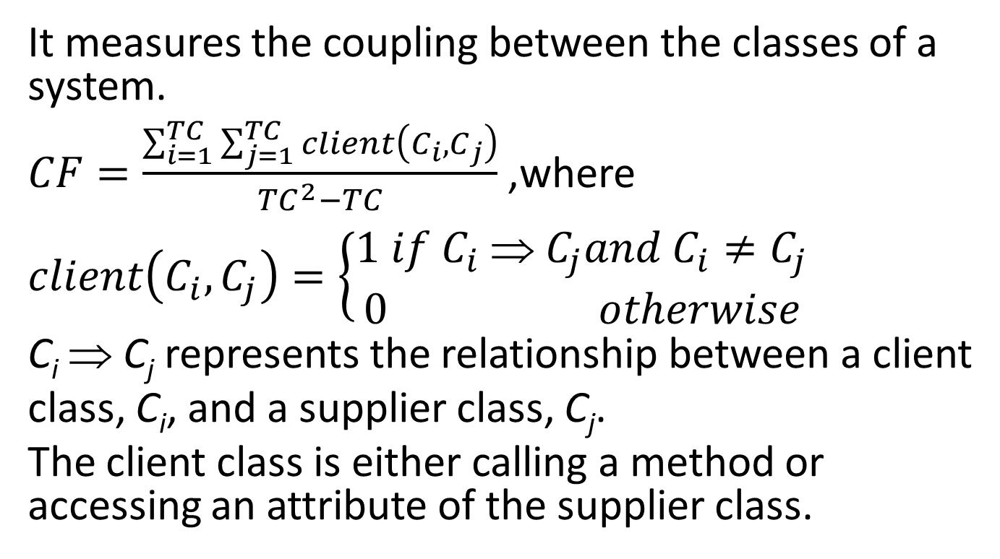
Category: Coupling Coupling Factor (CF)
It measures the coupling between the classes of a system.
$CF=\frac{\sum_{i=1}^{TC}{\sum_{j=1}^{TC}{client\left(C_{i},C_{j}\right)}}}{{TC}^{2}−TC}$ ,where
$$client\left(C_{i},C_{j}\right)=\left\{\begin{aligned}1 if C_{i} \text{⇒} C_{j}and{ C}_{i}≠C_{j} \\ 0 otherwise\end{aligned}\right.$$
C_{i} ⇒ C_{j} represents the relationship between a client
class, C_{i}, and a supplier class, C_{j}.
The client class is either calling a method or accessing an attribute of the supplier class.

Slide 14
CF Discussion
If no classes are coupled, CF = 0%.
If all classes are coupled to all other classes, CF=100%.
Coupling due to inheritance relationships is not taken into account in the computation of CF.
Bidirectional coupling has twice the effect of unidirectional coupling.

Slide 15
References
F. Brito e Abreu, "The MOOD Metrics Set," 9th European Conference on Object-Oriented Programming (ECOOP'95), Workshop on Metrics, 1995.
F. Brito e Abreu, and W. Melo, "Evaluating the Impact of Object-Oriented Design on Software Quality," 3rd International Software Metrics Symposium (METRICS'96), pp.90-99, 1996.
Rachel Harrison, Steve J. Counsell, and Reuben V. Nithi, "An Evaluation of the MOOD Set of Object-Oriented Software Metrics," IEEE Transactions on Software Engineering, vol. 24, no. 6, pp. 491-496, June 1998.

