Slide 1
SOEN 6611 – Software Measurement
Object-Oriented Metrics
Bansiya and Davis (QMOOD)

Slide 2
The QMOOD model
Bansiya and Davis proposed the QMOOD hierarchical model in 2002, for the assessment of high-level quality attributes in object-oriented designs.
It allows to assess the quality of a software system at design-level (UML Class Diagram) without requiring a source code implementation.

Slide 3
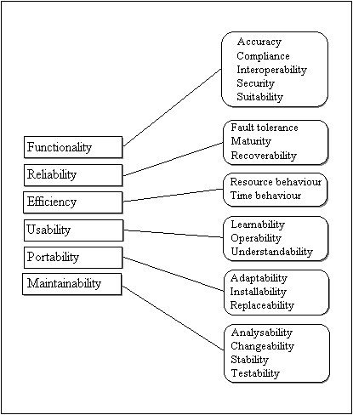
ISO/IEC 9126 Quality Characteristics

Slide 4
Modified version of ISO 9126 attributes
6 Quality Attributes:
1) Functionality - - kept
Reliability - - excluded (implementation oriented)
2) Efficiency - - changed to Effectiveness of design
Usability - - excluded (implementation oriented)
3) Maintainability - - changed to Understandability
4) Portability - - changed to Extendibility
5) Reusability - - added
6) Flexibility - - added

Slide 5
QMOOD metrics
Metric | Description | Design property | System level aggregation
DSC (Design size in classes) | Number of classes in the design. | Design Size | sum
NOH (Number of Hierarchies) | Number of class hierarchies in the design. | Hierarchies | sum
ANA (Average number of ancestors) | The number of classes from which a class inherits information. This metric is equivalent to DIT (Depth of Inheritance Tree) from Chidamber and Kemerer. | Abstraction | average
DAM (Data Access Metric) | The ratio of the number of private (protected) attributes to the total number of attributes declared in the class. | Encapsulation | average
DCC (Direct Class Coupling) | Count of the different number of classes that a class is directly related to (by attribute declarations and parameters). | Coupling | average

Slide 6
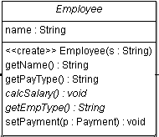
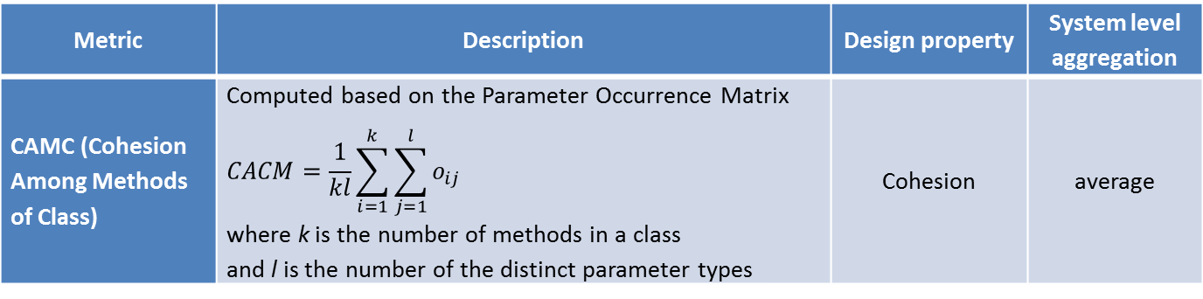
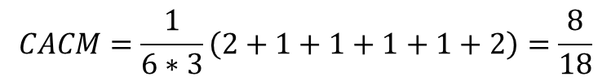
QMOOD metrics
Metric | Description | Design property | System level aggregation
CAMC (Cohesion Among Methods of Class) | Computed based on the Parameter Occurrence Matrix $$CACM=\frac{1}{kl}\sum_{i=1}^{k}{\sum_{j=1}^{l}{o_{ij}}}$$ where k is the number of methods in a class and l is the number of the distinct parameter types | Cohesion | average
Method/Type | String | Payment | Employee
Employee | 1 | 0 | 1
getName | 0 | 0 | 1
getPayType | 0 | 0 | 1
calcSalary | 0 | 0 | 1
getEmpType | 0 | 0 | 1
setPayment | 0 | 1 | 1
$$CACM=\frac{1}{6∗3}\left(2+1+1+1+1+2\right)=\frac{8}{18}$$

Slide 7
QMOOD metrics
Metric | Description | Design property | System level aggregation
MOA (Measure of Aggregation) | Count of the part-whole relationships realized by attributes. | Composition | sum
MFA (Measure of Functional Abstraction) | The ratio of the number of methods inherited by a class to the total number of methods accessible by member methods of the class (inherited + defined). | Inheritance | average
NOP (Number of polymorphic methods) | Count of the abstract methods. | Polymorphism | sum
CIS (Class Interface size) | Count of the number of public methods in a class. | Messaging | average
NOM (Number of Methods) | Count of all the methods defined in a class. | Complexity | average

Slide 8
Quality Attributes
 | Reusability | Flexibility | Understand ability | Functionality | Extendibility | Effectiveness
Design Size | ↑ |  | ↓ | ↑
Hierarchies |  |  |  | ↑
Abstraction |  |  | ↓ |  | ↑ | ↑
Encapsulation |  | ↑ | ↑ |  |  | ↑
Coupling | ↓ | ↓ | ↓ |  | ↓
Cohesion | ↑ |  | ↑ | ↑
Composition |  | ↑ |  |  |  | ↑
Inheritance |  |  |  |  | ↑ | ↑
Polymorphism |  | ↑ | ↓ | ↑ | ↑ | ↑
Messaging | ↑ |  |  | ↑
Complexity |  |  | ↓

Slide 9
Quality attributes
Reusability = -0.25*Coupling + 0.25*Cohesion + 0.5*Messaging + 0.5*Design Size
Flexibility = 0.25*Encapsulation -0.25*Coupling + 0.5*Composition + 0.5*Polymorphism
Understandability = -0.33*Abstraction + 0.33*Encapsulation -0.33*Coupling + 0.33*Cohesion -0.33*Polymorphism -0.33*Complexity -0.33*Design Size

Slide 10
Quality attributes
Functionality = 0.12*Cohesion + 0.22*Polymorphism + 0.22*Messaging + 0.22*Design Size +0.22*Hierarchies
Extendibility = 0.5*Abstraction -0.5*Coupling + 0.5*Inheritance + 0.5*Polymorphism
Effectiveness = 0.2*Abstraction + 0.2*Encapsulation + 0.2*Composition + 0.2*Inheritance + 0.2*Polymorphism

Slide 11
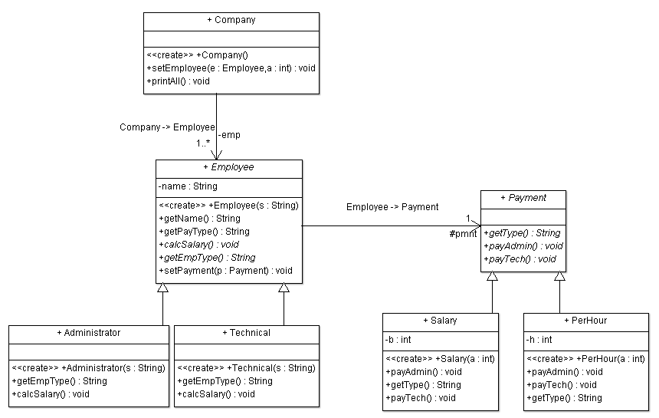
QMOOD example (v1)

Slide 12
QMOOD computation (v1)
Class-level metrics:
Metric/Class | Company | Employee | Administrator | Technical | Payment | PerHour | Salary | System value
DAM | 1 | 1 | 0 | 0 | 0 | 1 | 1 | 0.571
DCC | 1 | 1 | 0 | 0 | 0 | 0 | 0 | 0.286
CAMC | 0.556 | 0.444 | 0.667 | 0.667 | 1 | 0.625 | 0.625 | 0.655
MOA | 1 | 1 | 0 | 0 | 0 | 0 | 0 | 2
MFA | 0 | 0 | 0.571 | 0.571 | 0 | 0 | 0 | 0.163
NOP | 0 | 2 | 0 | 0 | 3 | 0 | 0 | 5
CIS | 3 | 6 | 3 | 3 | 3 | 4 | 4 | 3.714
NOM | 3 | 6 | 3 | 3 | 3 | 4 | 4 | 3.714
ANA | 0 | 0 | 1 | 1 | 0 | 1 | 1 | 0.571
System-level metrics:
DSC = 7
NOH = 2
Notes:
0.571 = 4/7

Slide 13
QMOOD computation (v1)
System-level metrics:
Property | Metric | System value
Encapsulation | DAM | 0.571
Coupling | DCC | 0.286
Cohesion | CAMC | 0.655
Composition | MOA | 2
Inheritance | MFA | 0.163
Polymorphism | NOP | 5
Messaging | CIS | 3.714
Complexity | NOM | 3.714
Design Size | DSC | 7
Hierarchies | NOH | 2
Abstraction | ANA | 0.571
Reusability 5.44925
Flexibility 3.57125
Understandability -5.06385
Functionality 3.97568
Extendibility 2.724
Effectiveness 1.661

Slide 14
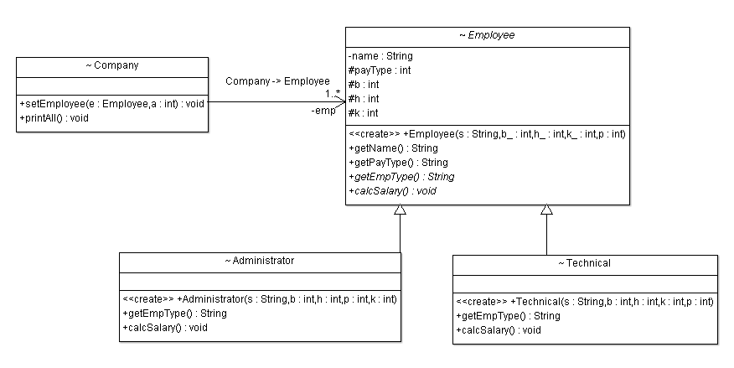
QMOOD Example (v2)

Slide 15
QMOOD computation (v2)
Class-level metrics:
Metric/Class | Company | Employee | Administrator | Technical | System value
DAM | 1 | 1 | 0 | 0 | 0.5
DCC | 1 | 0 | 0 | 0 | 0.25
CAMC | 0.556 | 0.467 | 0.556 | 0.556 | 0.534
MOA | 1 | 0 | 0 | 0 | 1
MFA | 0 | 0 | 0.5 | 0.5 | 0.25
NOP | 0 | 2 | 0 | 0 | 2
CIS | 3 | 5 | 3 | 3 | 3.5
NOM | 3 | 5 | 3 | 3 | 3.5
ANA | 0 | 0 | 1 | 1 | 0.5
System-level metrics:
DSC = 4
NOH = 1
Notes:
0.5 = 3/6

Slide 16
QMOOD computation (v2)
System-level metrics:
Property | Metric | System value
Encapsulation | DAM | 0.5
Coupling | DCC | 0.25
Cohesion | CAMC | 0.534
Composition | MOA | 1
Inheritance | MFA | 0.25
Polymorphism | NOP | 2
Messaging | CIS | 3.5
Complexity | NOM | 3.5
Design Size | DSC | 4
Hierarchies | NOH | 1
Abstraction | ANA | 0.5
Reusability 3.821
Flexibility 1.5625
Understandability -3.04128
Functionality 2.37408
Extendibility 1.25
Effectiveness 0.85

Slide 17
Comparison
 | System1 | System2
Reusability | 5.44925 | 3.821
Flexibility | 3.57125 | 1.5625
Understandability | -5.06385 | -3.04128
Functionality | 3.97568 | 2.37408
Extensibility | 2.724 | 1.25
Effectiveness | 1.661 | 0.85

Slide 18
References
Jagdish Bansiya and Carl G. Davis, "A Hierarchical Model for Object-Oriented Design Quality Assessment," IEEE Transactions on Software Engineering, vol. 28, no. 1, pp. 4-17, January 2002.
Steve Counsell, Stephen Swift, and Jason Crampton, "The interpretation and utility of three cohesion metrics for object-oriented design," ACM Transactions on Software Engineering and Methodology, vol. 15, no. 2, pp. 123-149, April 2006.

