Slide 1
SOEN 6611 – Software Measurement
Object-Oriented Metrics
The history of cohesion metrics
Computer Science and Software Engineering
© 2013 Nikolaos Tsantalis
<number>

Slide 2
LCOM (Chidamber & Kemerer, 1994)
the set of method pairs that do not share attributes
the set of method pairs that share at least one attribute
<number>

Slide 3
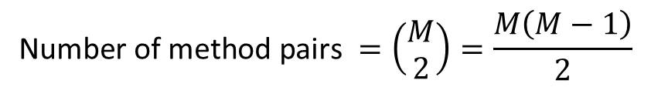
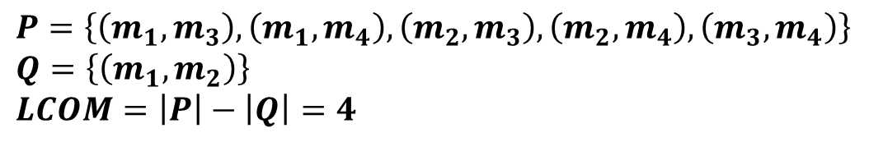
LCOM (Chidamber & Kemerer) example
a1
a4
m1
m2
m3
m4
<number>
Notes:
<number>

Slide 4
LCOM (Li & Henry, 1993)
The number of disjoint components in the graph that represents:
each method as a node
the sharing of at least one attribute between two methods as an edge
<number>

Slide 5

LCOM (Li & Henry) example
a1
a4
m1
m2
m3
m4
m1
m2
m3
m4
<number>

Slide 6
LCOM (Hitz & Montazeri, 1995)
The number of disjoint components in the graph that represents:
each method as a node
the sharing of at least one attribute between two methods as an edge
The presence of a method call between two methods as an edge
<number>

Slide 7

LCOM (Hitz & Montazeri) example
a1
a4
m1
m2
m3
m4
m1
m2
m3
m4
<number>

Slide 8
LCOM (Henderson-Sellers, 1996)
Let m be the number of methods in a class.
Let a be the number of instance variables in the class.
Let p(Ai) be the number of methods that access instance variable Ai.
<number>

Slide 9
Henderson-Sellers normalized LCOM
If each method of a class accesses all instance variables, , and thus LCOM = 0 (maximum cohesion)
In the case where each instance variable is accessed by only one method, , and thus LCOM = 1 (minimum cohesion)
In the case where the methods do not access any instance variables, , and thus LCOM ranges within (1, 2].
<number>

Slide 10
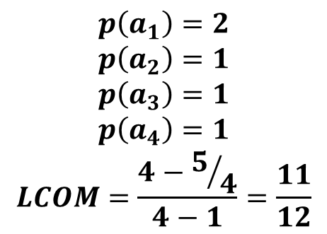
LCOM (Henderson-Sellers) example
a1
a4
m1
m2
m3
m4
<number>

Slide 11
Coh (Briand et al., 1998)
Let m be the number of methods in a class.
Let a be the number of instance variables in the class.
Let p(ai) be the number of methods that access instance variable ai.
<number>

Slide 12
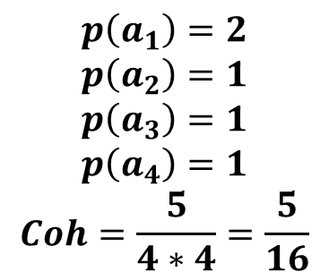
Coh (Briand et al.) example
a1
a4
m1
m2
m3
m4
<number>

Slide 13
Tight Class Cohesion
(Bieman & Kang, 1995)
The relative number of directly connected pairs of methods. Two methods are directly connected if they are directly connected to an attribute.
A method m is directly connected to an attribute, when the attribute appears
within m's body or
within the body of a method that is directly or transitively invoked by method m.
<number>

Slide 14
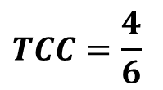
TCC (Bieman & Kang) example
Access a1
Access a3
Access a3
a1
a4
m1
m2
m3
m4
m1
m2
m3
m4
Access a3
<number>

Slide 15
Loose Class Cohesion
(Bieman & Kang, 1995)
The relative number of directly or transitively connected pairs of methods. Two methods are transitively connected if they are indirectly connected to an attribute.
A method m, which is directly connected to an attribute j, is indirectly connected to an attribute i when there is a method that is directly or transitively connected to both attributes i and j.
j
i
m
X
<number>

Slide 16
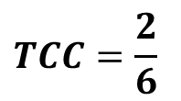
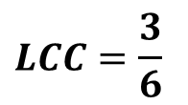
TCC vs. LCC example
Access a1
Access a3
a1
a2
a3
a4
m1
m2
m3
m4
m1
m2
m3
m4
m1
m2
m3
m4
m2 accesses both a1 and a3
m3 is indirectly connected to a1
m1 is indirectly connected to a3
<number>

Slide 17
Class Cohesion
(Bonja & Kidanmariam, 2006)
Ratio of the sum of the similarities between all pairs of methods to the total number of pairs of methods.
The similarity between methods mi and mj is defined as
Where Ii and Ij are the sets of attributes referenced by methods mi and mj, respectively
<number>

Slide 18
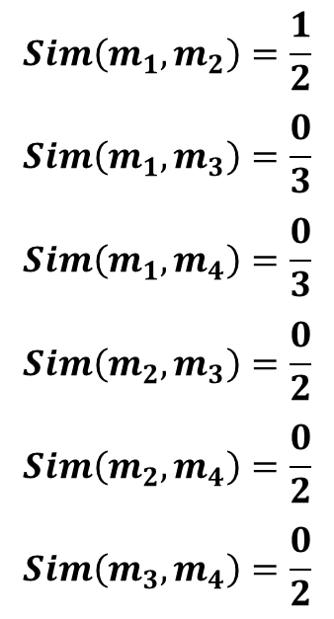
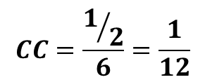
Class Cohesion (Bonja & Kidanmariam) example
a1
a2
a3
a4
m1
m2
m3
m4
<number>

Slide 19
References
S. R. Chidamber , C. F. Kemerer, "A Metrics Suite for Object Oriented Design," IEEE Transactions on Software Engineering, vol. 20, no. 6, pp. 476-493, June 1994.
W. Li, and S. Henry, "Object-Oriented Metrics that Predict Maintainability," Journal of Systems and Software, vol. 23, no. 2, pp. 111-122, 1993.
M. Hitz, B. Montazeri, "Measuring Coupling and Cohesion In Object-Oriented Systems," Proc. Int. Symposium on Applied Corporate Computing, Monterrey, Mexico, Oct. 1995.
J. M. Bieman, and B.-K. Kang, "Cohesion and reuse in an object-oriented system," Proc. Symposium on Software reusability (SSR '95), pp. 259-262, 1995.
B. Henderson-Sellers, L. Constantine, and I. Graham, "Coupling and Cohesion (Towards a Valid Metrics Suite for Object-Oriented Analysis and Design)," Object-Oriented Systems, vol. 3, no. 3, pp. 143-158, 1996.
C. Bonja, and E. Kidanmariam, "Metrics for class cohesion and similarity between methods," ACM Southeast Regional Conference, pp. 91-95, 2006.
<number>

