Slide 1
Identification of Coordination Requirements: Implications for the Design of Collaboration and Awareness Tools
Samuel Mugnaini Donadelli
Concordia University
SOEN691D - Open Source Software and Mining

Slide 2
Overall summary
Coordination requirements (CR) quantifies the size of developers interaction.
Data based on software project historical background.
Research performed in a big software project which coordination requirements presented high variance and it is often spread outside of the teams scope.
CR and coordination activities congruence works on lessening the software development time.
Core developers switched their way of exchange eletronic information over time, reaching great congruence.
Notes:
Coordination requirements (CR) presents which developer works together with other developer in order to perform their tasks.
It is matrix based on historical projects data: files, developers, Modification Requests (a.k.a commits), IRC chat, human resources and location.
The research investigated coordination requirements in a big software project and it presented high variance and it is often spread outside of the teams scope.
Congruence requirements congruence works on lessening the software development time. It considers the CR and the coordination activities values.
Core developers switched their way of exchange eletronic information progressively, reaching great congruence.

Slide 3
Method and data
Three research questions:
Coordination requirements stability
Congruence in task perfomance.
Communication and CR evolution over time.
Data:
Modification Request (a.k.a. Commits).
MR tracking system – its historical data.
IRC chat – conversation logs.
Notes:
Commits = serve as a demand to fix bug or to request an software functionality improvement.
IRC = used communication channel among developers, where they resolved MRs.

Slide 4
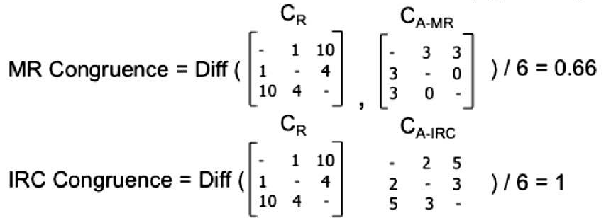
CR and congruence
Result of Task Assignment X Task Dependencies
Devs\Files | A | B | C | D | E
Terry | 1929 | 895 | 1632 | 2448 | 1019
Marie | 734 | 1200 | 2204 | 1185 | 1136
Lucien | 1259 | 846 | 1619 | 1705 | 723
Gayle | 1888 | 1563 | 2412 | 2642 | 1163
Task Assignment table
Devs\Files | A | B | C | D | E
Terry | 23 | 17 | 26 | 01 | 22
Marie | 21 | 14 | 06 | 22 | 04
Lucien | 12 | 20 | 09 | 11 | 20
Gayle | 17 | 29 | 22 | 20 | 17
Task Dependencies table
Files\Files | A | B | C | D | E
A | - | 4 | 44 | 13 | 32
B | 4 | - | 25 | 43 | 5
C | 44 | 25 | - | 41 | 7
D | 13 | 43 | 41 | - | 16
E | 32 | 5 | 7 | 16 | -
Transposed matrix of Task Assignment
files \devs | Terry | Marie | Lucien | Gayle
A | 23 | 21 | 12 | 17
B | 17 | 14 | 20 | 29
C | 26 | 6 | 9 | 22
D | 1 | 22 | 11 | 20
E | 22 | 4 | 20 | 17
Coordination Requirements Matrix
dev/dev | Terry | Marie | Lucien | Gayle
Terry | - | 120763 | 103044 | 160935
Marie | 120763 | - | 88399 | 138778
Lucien | 103044 | 88399 | - | 127946
Gayle | 160935 | 138778 | 127946 | -
Notes:
Coordination Requirements (Dev per Dev) which indicates the extent to each pair of dev must have to coordinate their work.
Structural Congruence captures the potential paths of communication and coordination that members of a formal team have through various mechanisms such as team meetings and other work-related activities.
Geographical congruence, similarly to the case of organization structure, is built around the idea of potential paths of communication and coordination that exist when individuals work in the same physical location [1, 24].
MR communication congruence considers an exchange of technical information between engineers i and j only when both i and j explicitly commented in the modification request report.
IRC communication congruence was computed based on interaction between developers from the IRC logs.

Slide 5
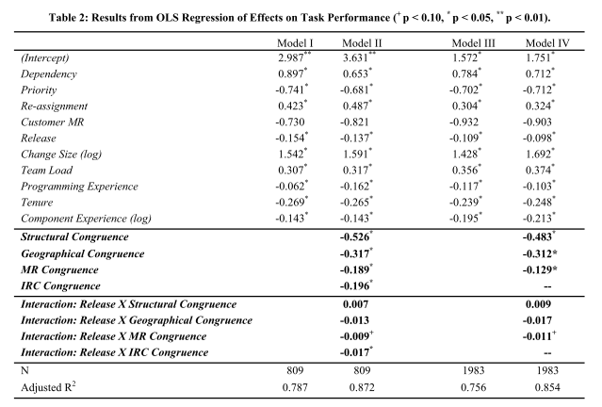
Findings
Notes:
The described variables are all related to Modification Requirements. The models were based on IRC chat logs N=809 and Modification requests N=1983. The difference between them were 1 and 2 = IRC and model 2 had Congruence's calculation. Models 3 and 4 = MRs and 4 had congruence calculations.
Dependency was measured as the number of modification requests that the focal MR depends on in order to for the task to be performed.
Priority: Management prioritized the activities of the developer by using a scale from 1 to 5 in the modification request report here 5 was the highest priority and 1 the lowest.
Task re-assignment was measured as the number of times an MR was re-assigned to a different engineer or team.
Customer MR: MRs opened by customers could represent work items with higher importance consequently affecting the resolution time. A dummy variable was used to indicate if the MR is associated with the service request from a customer.
Release variable identifies the release of the product that the modification request is associated with.
The change size was computed as the number of files that were modified as part of the change for the focal MR.
Team load is a measure of the average work load of the teams responsible for the components associated with the modification request.
programming experience was computed as the average number of years of programming experience prior to joining the company of all the engineers involved in the modification request.
Tenure was measured as the average number of months in the company of all the engineers that worked in the modification request at the time the work associated with the MR was completed.
Component experience was computed as the average number of times that the engineers responsible for the modification request have worked on the same files affected by the focal modification request.
Models II and IV statistical significant measures.
Congruence measures have negative values associate with reduction in resolution time. This shows how important is congruence communication and tasks activities.
Structural congruence =shorter development times when coordination requirements are and communication paths exists, team task performance increases.
Geographical congruence had a positive effect on resolution time.
Communication congruence based on the interactions amongst engineers through the MR reports as well as IRC were also statistically significant suggesting the usefulness of these tools in facilitating coordination among individuals that belong to different teams and be from different locations.
Furthermore the congruence and CR evolution overtime the author found that developers are using IRC and MR to fill the gaps of Structure.
Core developers has more impact on congruence calculation , because they are more productive regarding MRs.
The main goal of this research was to provide a possible tool to be used in a webbased environment where developers could check their coordination requirements and manage their job instantly.

Slide 6
Cristicisms
The CR matrix considers just the interaction between pairs of developers instead of getting larger group of developers.
The commits complexity are not being applied in CR calculation.
CR matrices from large projects with large historical data may take a long process time.
Developers may have lots of prioritary MRs and the CR could be too much information to manage at once and get their job done.

