Slide 1
On Reallocation of Resources During Releases
Md Tajmilur Rahman
Dr. Peter C. Rigby
Concordia University
Montreal, QC H3G 1M8
Canada

Slide 2
Background
Disruptive Events
  Developers take shortcuts
  Lead developer leaves
  Immediate fix of security vulnerability
  Increased number of testing than review
  Reorganizing or reallocation due to managers' decision

Slide 3
Basic Idea of the Work
Examine Linux Kernel development commit log data
Quantify:
  Release Process
  Release Segments
  Distribution of Resources
  Code Ownership
  Focus on Code
  Percentage of Working with Owned Files

Slide 4
Organizing the Paper
Abstract
Introduction
Background
Related Papers
Methodology and Data
Results
Threats to Validity
Conclusions

Slide 5
Research Questions
RQ1: What is the release process used by the project?
RQ2: How many developers are allocated throughout different segments of a release cycle? What significant difference can be observed between the segments of a release cycle?
RQ3: Do developers work on different areas of the system around the time of release?
RQ4: Do developers work in others’ code in a high proportion during the rush period?
RQ5: How long a commit takes to get pushed into the main kernel? Does it differ in different periods of release?
RQ6: Are there certain areas of the system that receive increased attention (i.e. do developers focus on a smaller set of files around releases)?

Slide 6
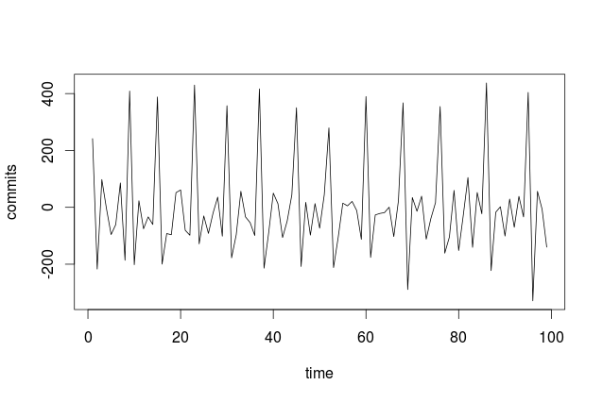
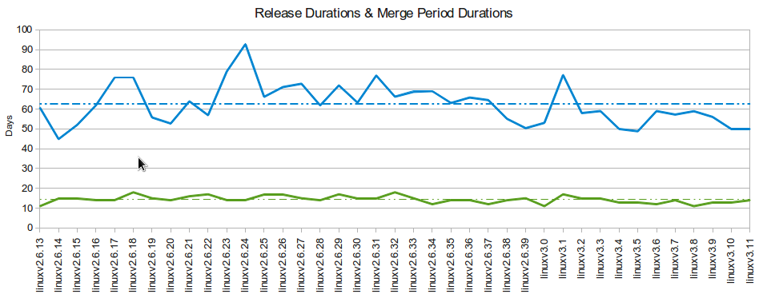
RQ 1
What is the release process used by the project?
Linuxv2.6.14-rc1
Linuxv2.6.13
Linuxv2.6.14
Total Commits: 381,152 (400441)
DP: 292,926 (76.85%),
Total Files: 70,210
Total Releases: 331 (340)
Stable Releases: 39 (40)

Slide 7
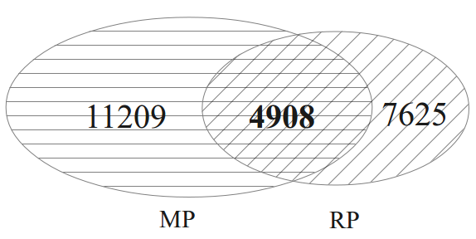
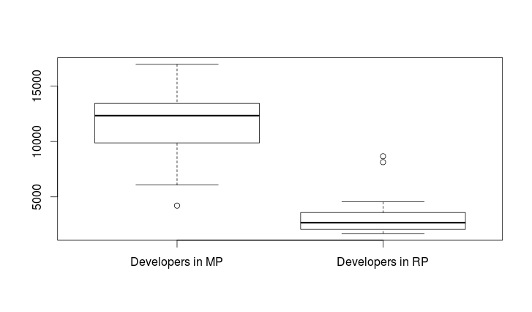
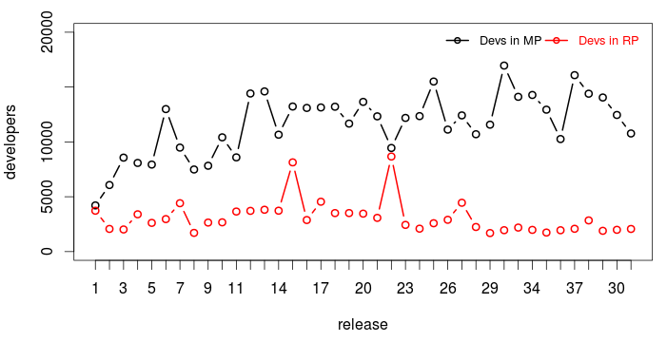
RQ 2
How many developers are allocated throughout different segments of a release cycle? What significant difference can be observed between the segments of a release cycle?
Total Developers: 13926 (14621)

Slide 8
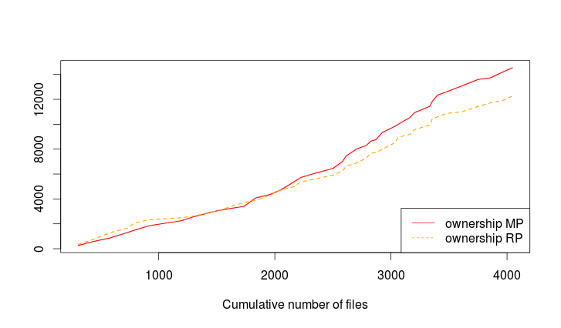
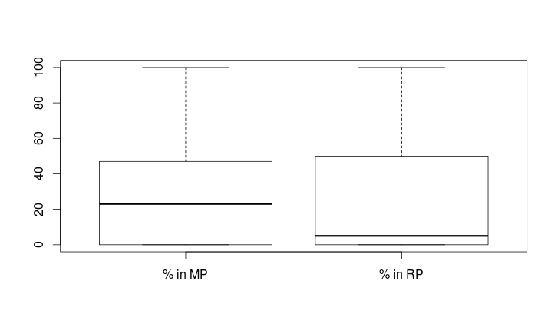
RQ 3,4
Do developers work on different areas of the system around the time of release?
Do developers work in others’ code in a high proportion during the rush period?

Slide 9
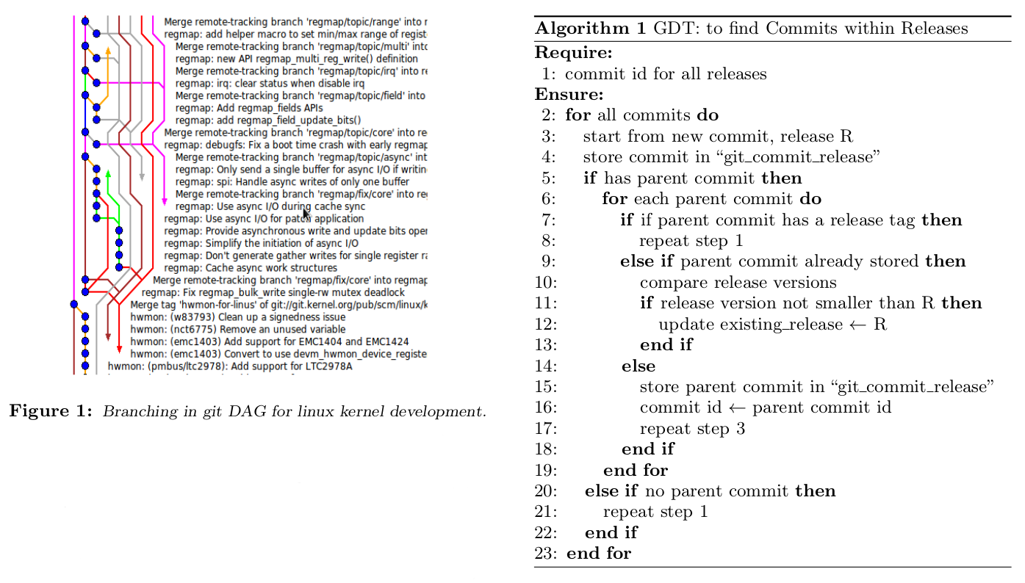
RQ 5
How long a commit takes to get pushed into the main kernel? Does it differ in different periods of release?

Slide 10
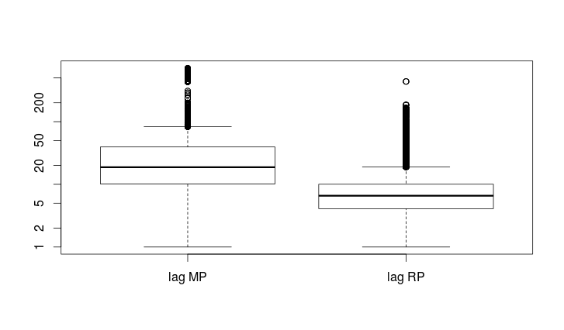
RQ 5 Continued
Lag RP: 5.57
Lag DP: 26.15

Slide 11
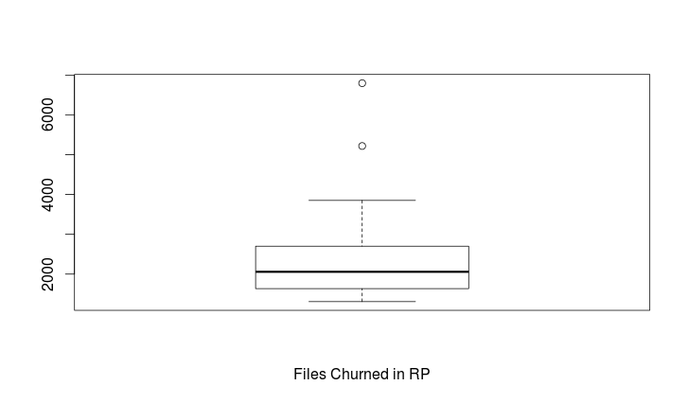
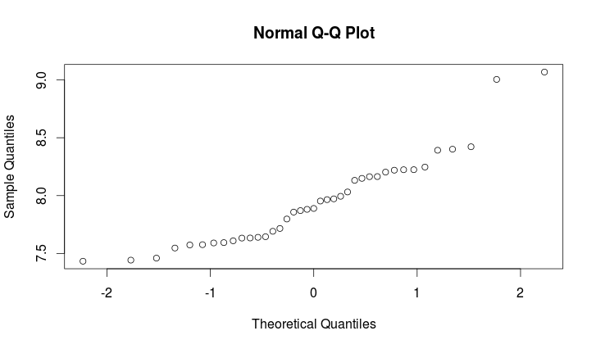
RQ 6
Are there certain areas of the system that receive increased attention (i.e. do developers focus on a smaller set of files around releases)?
In linuxv2.6.13:
2938 files churned
5 of them had exceptionally high number of churns
4 of them had >10,000 churns
Avg Churn: 3077
Min: 1691
Max: 8669
Jaccard similarity index between consecutive sets of files having highly increased focus in different releases

Slide 12
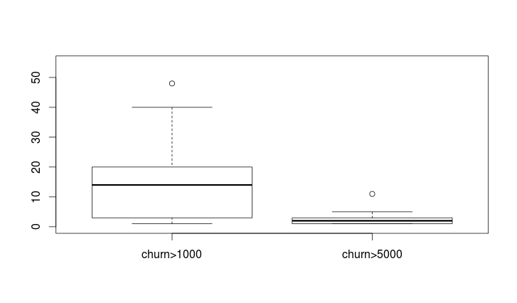
RQ 6 Continued
Around 2000 files get churns except 2 releases
Around 2.846 files get highly increased attention having over 5000 churns
Around 16.78 files having over 1000 churns

Slide 13
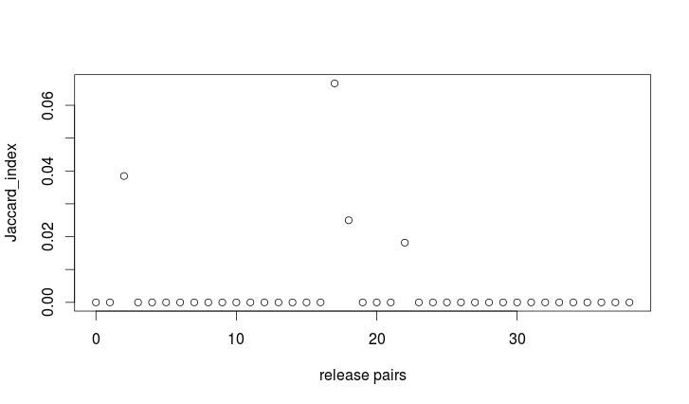
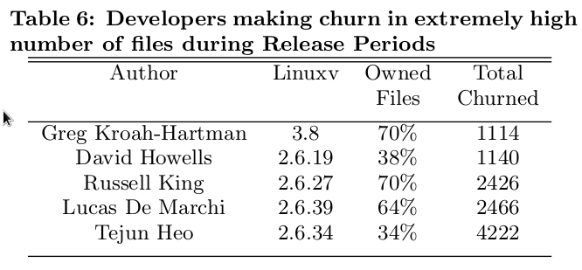
RQ 6 Continued
In average each developer deals 5.52 files in RP
There are 29 releases where developers are working in comparatively large number of files during RP

Slide 14
Validation and Conclusion
The basic structure and the development process of Linux Kernel.
The distribution of developers in two different segments in a complete release cycle.
Role of developers during development period and the significance of release period.
Developers’ focus around the time of release
Percentage of working with native code during development period and release period.

