Slide 1
Use of Relative Code Churn Measures to Predict System Defect Density
Nachiappan Nagappan
Dept. Computer Science and Engineering, North Carolina State University
Thomas Ball
Microsoft Research
This presentation is based on the research paper published in proceedings of the
27th international conference on Software engineering, ICSE 2005.
New York, NY, USA ©2005
Pages: 284-292
ISBN:1-58113-963-2,
Collected from the ACM Digital Library
http://dl.acm.org/citation.cfm?id=1062514

Slide 2

Overall Idea
Early prediction of System Defect Density
Using set of relative code churn measures
Showing that this measure is more predictive than Absolute Measures of code churn
Case study on Windows Server 2003 for validity.
Accuracy is 89.0%
Source of reference http://dl.acm.org/citation.cfm?id=1062514

Slide 3
Hypothesis
Code that have been changed many times before release have more likely post release defects.
 | Hypothesis
H1 | Increased in relative code churn measures is accompanied by an increase in system defect density
H2 | Using relative values of code churn predictors is better than using absolute values to explain system defect density
H3 | Relative code churn measures can be used as efficient predictors of system defect density
H4 | Relative code churn measures can be used to discriminate between fault and not fault-prone binaries
Source of reference http://dl.acm.org/citation.cfm?id=1062514

Slide 4

Data
Microsoft Windows 2003
  44.97 millions LOC
  2465 binaries
  96,189 files
Source of reference http://dl.acm.org/citation.cfm?id=1062514

Slide 5
Absolute Measures
Total LOC
Churned LOC
Deleted LOC
File Count
Weeks of Churn
Churn Count
Files Churned
Source of reference http://dl.acm.org/citation.cfm?id=1062514

Slide 6
Relative Code Churn Measures
M1: Churned LOC / Total LOC
M2: Deleted LOC / Total LOC
M3: Files Churned / File Count
M4: Churn Count / File Churned
M5: Weeks of Churn / File Count (gives sense of complexity)
M6: Lines Worked On / Weeks of Churn (sum of M1,M2)
M7: Churned LOC / Deleted LOC
M8: Lines Worked On / Churn Count
Source of reference http://dl.acm.org/citation.cfm?id=1062514

Slide 7

Case Study
Correlation analysis between Relative Code-Churn Measures and System Defect Density
 | M1 | M2 | M3 | M4 | M5 | M6 | M7 | M8 | Defects/KLOC
M1 | 1.0 | .834 | .795 | .413 | .707 | .651 | .466 | .588 | .883
M2 |  | 1.0 | .645 | .553 | .747 | .446 | .219 | .492 | .798
M3 |  |  | 1.0 | .186 | .749 | .434 | .445 | .269 | .868
M4 |  |  |  | 1.0 | .531 | .429 | .210 | .631 | .288
M5 |  |  |  |  | 1.0 | .263 | .201 | .390 | .729
M6 |  |  |  |  |  | 1.0 | .701 | .843 | .374
M7 |  |  |  |  |  |  | 1.0 | .507 | .288
M8 |  |  |  |  |  |  |  | 1.0 | .262
Defects/KLOC |  |  |  |  |  |  |  |  | 1.0
M3
M1
M4
M7
M8
M2
M5
M6
Source of reference http://dl.acm.org/citation.cfm?id=1062514

Slide 8
Correlation Analysis
M1: Churned LOC / Total LOC
M2: Deleted LOC / Total LOC
0.466
M1
M7
0.834
0.219
M2
M7: Churned LOC / Deleted LOC:
  Quantifier of new development.
  Acts as a cross check on M1 and M2
Source of reference http://dl.acm.org/citation.cfm?id=1062514

Slide 9
Fitting of Statistical Models
Compare predictive models build using absolute measures against predictive models built using relative churn measures.
Regression Models:
  Using all measures
  Stepwise regression
  PCA
Coefficient of Determination:
  R²
  Adjusted R²
Source of reference http://dl.acm.org/citation.cfm?id=1062514

Slide 10
Fitting of Statistical Models Continued...
Regression Fit Using All Measures
Model | R² | Adjusted R² | Root MSE
All Measures | 0.811 | 0.811 | 1.301215
Stepwise Regression Models
Model | R² | Adjusted R² | Root MSE
a | 0.592 | 0.592 | 1.908727
b | 0.685 | 0.685 | 1.677762
c | 0.769 | 0.769 | 1.437246
d | 0.802 | 0.801 | 1.331717
e | 0.808 | 0.807 | 1.312777
f | 0.810 | 0.809 | 1.305817
g | 0.811 | 0.811 | 1.300985
Predictors: (Constant), M2
Predictors: (Constant), M2, M3
Predictors: (Constant), M2, M3, M8
Predictors: (Constant), M2, M3, M8, M1
Predictors: (Constant), M2, M3, M8, M1, M6
Predictors: (Constant), M2, M3, M8, M1, M6, M5
Predictors: (Constant), M2, M3, M8, M1, M6, M5, M4
Source of reference http://dl.acm.org/citation.cfm?id=1062514

Slide 11
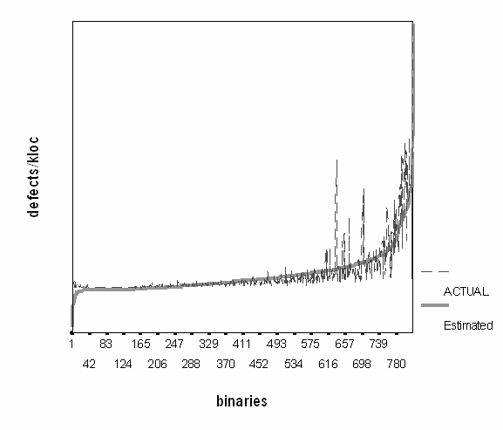
Fitting of Statistical Models Continued...
Actual vs Estimated System Defect Density
Source of reference http://dl.acm.org/citation.cfm?id=1062514

Slide 12

Defect Density Prediction
Data Splitting Technique – measure the ability to predict
Regression data fit (1645)
Model | R² | Adjusted | F-Test sig.
All measures | 0.821 | 0.820 | 938.304
Step-wise | 0.821 | 0.820 | 1072.975
PCA | 0.762 | 0.761 | 1749.113
820
1645
Correlation Results
Model | Pearson | Spearman
All measures | 0.889 | 0.929
Step-wise | 0.889 | 0.929
PCA | 0.849 | 0.826
Source of reference http://dl.acm.org/citation.cfm?id=1062514

Slide 13
Defect Density Prediction Continued...
Random splits data fit
Model | R² | Adjusted R² | F-Test | Pearson Correlation | Spearman Correlation
Random1: All | 0.836 | 0.835 | 1045.07 | 0.873 | 0.931
Random1: Stepwise (drop none) | 0.836 | 0.835 | 1045.07 | 0.873 | 0.931
Random1: PCA | 0.757 | 0.756 | 1701.98 | 0.858 | 0.836
Random2: All | 0.822 | 0.821 | 941.86 | 0.878 | 0.917
Random2: Stepwise (drop M4) | 0.821 | 0.820 | 1074.05 | 0.876 | 0.906
Random2: PCA | 0.765 | 0.764 | 1776.87 | 0.847 | 0.825
Random3: All | 0.799 | 0.798 | 813.12 | 0.899 | 0.892
Random3: Stepwise (drop M7) | 0.799 | 0.798 | 927.54 | 0.901 | 0.893
Random3: PCA | 0.737 | 0.736 | 1529.25 | 0.880 | 0.818
Source of reference http://dl.acm.org/citation.cfm?id=1062514

Slide 14
Limitations
Internal Validity:
  Inflating “Weeks of Churn” measure
External Validity:
  Different sized softwares may be incomparable
Source of reference http://dl.acm.org/citation.cfm?id=1062514

Slide 15

Criticism
New developers working creates potential bugs inside the code but not as a detected bug.
Newer developer's codes (in-house or OSS) need to be reviewed.
Churns may occur due to code-review feedbacks not only from bug-fix or new feature.
Source of reference http://dl.acm.org/citation.cfm?id=1062514

Slide 16

Conclusion
Relative code-churn measures are better predictor
Increase in this measure is accompained by an increase in system defect density.
Source of reference http://dl.acm.org/citation.cfm?id=1062514

