Slide 1
On Reallocation of Resources During Releases
Md Tajmilur Rahman
Concordia University
Montreal, QC H3G 1M8
Canada

Slide 2
Background
Disruptive Events
  Developers take shortcuts
  Lead developer leaves
  Immediate fix of security vulnerability
  Increased number of testing than review
  Reorganizing or reallocation due to managers' decision

Slide 3
RQ1
What is the release process used by the project?

Slide 4
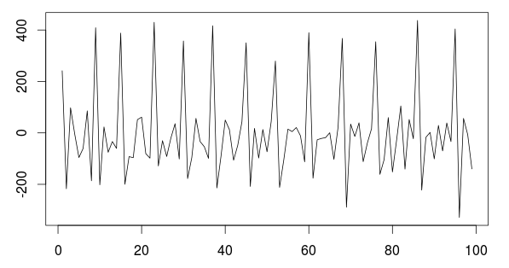
RQ 1
Rolling Release Development Model
Linuxv2.6.14-rc1
rc7
Total Commits: 381,152 (400441)
Commits in DP: 292,926 (76.85%),
Total Files: 70,210
Total Releases: 331 (340)
Stable Releases: 39 (40)
Linuxv2.6.13
Linuxv2.6.14
Typical Release Cycle of Linux Kernel

Slide 5
RQ2
How many developers are allocated throughout different segments of a release cycle?
What significant difference can be observed between the segments of a release cycle?

Slide 6
RQ2 Continued
Releases | Developers | Commits | Devs in DP | Devs in RP
39 | 13926 | 381152 | 11209 | 7625

Slide 7
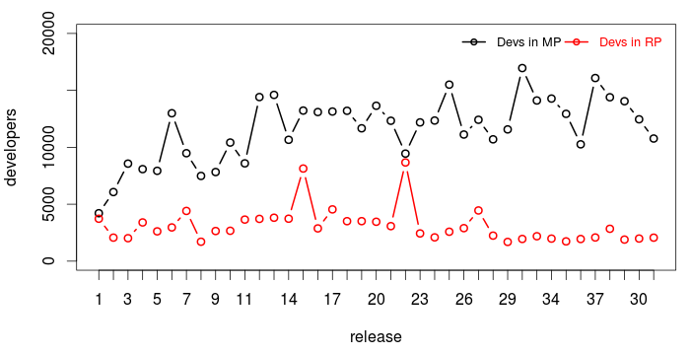
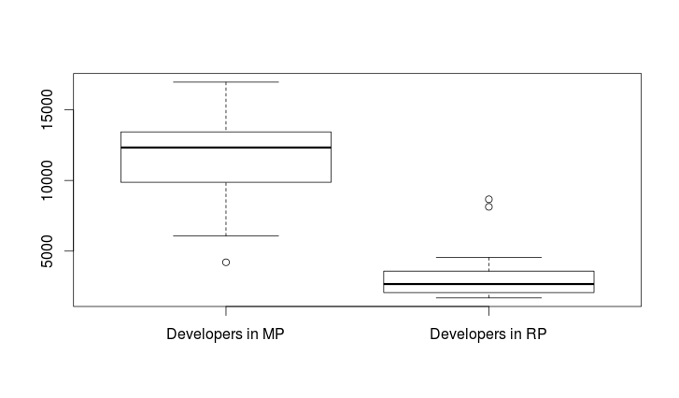
RQ 2 Continued
Developers working in Development and Release period

Slide 8
RQ3
Do developers work on different areas of the system around the time of release?

Slide 9
RQ3
4908
DP
11209
RP
7625

Slide 10
RQ4
Do developers work in others’ code in a high proportion during the release period?

Slide 11
RQ 4
% of working with owned files in DP and RP for developers work in both

Slide 12
RQ4 Continued

Slide 13
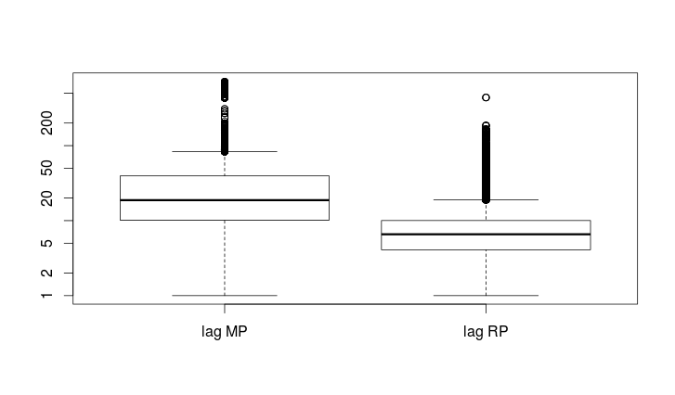
RQ 5
How long a commit takes to get pushed into the main kernel? Does it differ in different periods of release?
Lag RP: 5.57
Lag DP: 26.15

Slide 14
RQ 6
Are there certain areas of the system that receive increased attention (i.e. do developers focus on a smaller set of files around releases)?
Q1. How many churns were made to the files during release
Periods?
Q2. How many files get churns exceptionally high in number? Do we see this in every release cycles?
Q3. How many files each developer deals with during re-
lease development period?
Q4. How many files developer deal with large number of
files during release development period? What is the
percentage of ownership of them while working for a
large number of files in a release period?
Q5. If there is any area that requires increased attention in
the system, then what is the Jaccard distance of those
areas throughout different releases? Are they being
focused iteratively by releases?

Slide 15
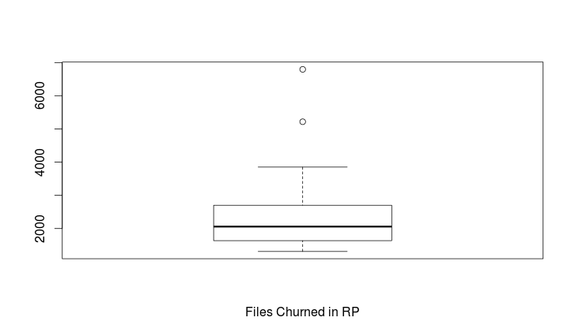
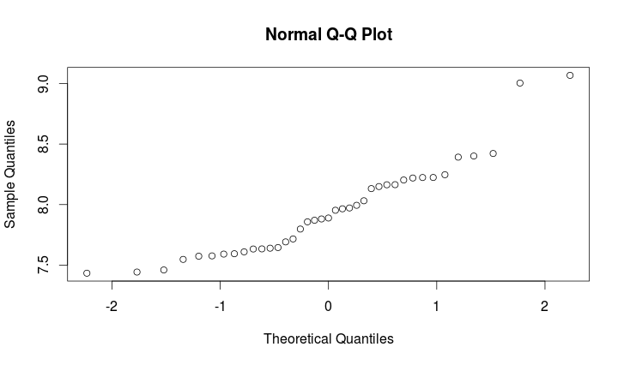
RQ 6 Continued
In linuxv2.6.13:
2938 files churned
5 of them had exceptionally high number of churns
4 of them had > 10,000 churns
Avg Churn: 3077
Min: 1691
Max: 8669
Jaccard similarity index between consecutive sets of files having highly increased focus in different releases

Slide 16
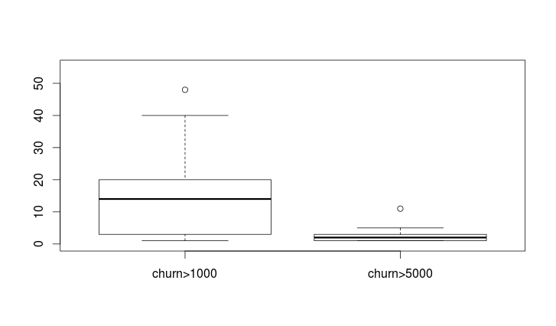
RQ 6 Continued
Around 2000 files get churns except 2 releases
Around 2.846 files get highly increased attention having over 5000 churns
Around 16.78 files having over 1000 churns
Files having high focus on during Release Period

Slide 17
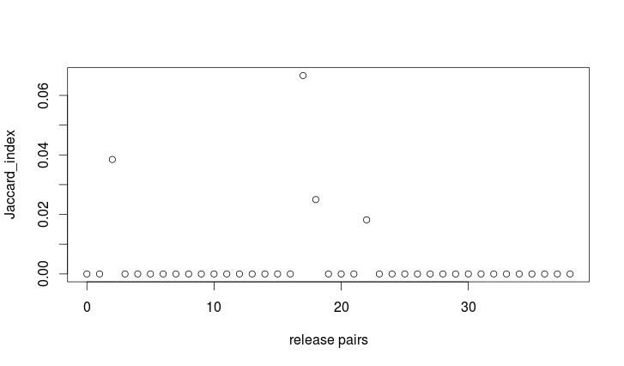
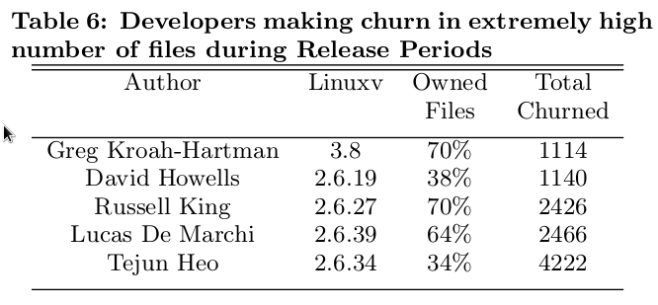
RQ 6 Continued
In average each developer deals 5.52 files in RP
There are 29 releases where developers are working in comparatively large number of files during RP
Developers making extremely high number of churns

Slide 18
Validation and Conclusion
Following items have been reported by our measurements:
  The basic structure and the development process of Linux Kernel.
  The distribution of developers in two different segments in a complete release cycle.
  Role of developers during development period and the significance of release period.
  Developers' focus around the time of release, percentage of working with native code during development period and release period

