Slide 1

Flood monitoring and early warning system using Arduinio

Slide 2

AMERICAN INTERNATIONAL UNIVERSITY-BANGLADESH
Course Code: EEE 4103
Course Name:
Microprocessor and Embedded Systems [U]
Course Teacher: DEBRAJ DAS
Lecturer
Department of Electrical and Electronic Engineering
Group Members:
Name ID Program
1.Zarin Anan 23-55874-3 BSc [CSE]
2.Tajmun Nahar Tisha 23-54386-3 BSc [CSE]
3.Kazi Ayesha Afia Rayeesa 23-52794-2 BSc [CSE]
4.Saharia Sanzida Liya 23-53055-3 BSc [CSE]
5.Lubna Islam Shuzona 24-56570-1 BSc [CSE]

Slide 3
Aims and Objectives
1. Develop a Low-Cost Monitoring System
Use Arduino with ultrasonic, rainfall, and GSM/GPRS modules.
Monitor rainfall and water levels in real time.
2. Provide Automatic Early Warnings
Send LED alerts when water reaches a dangerous level.
Activate buzzer and LED indicators automatically.
3. Simulate and Validate the System
Build the complete system in Tinkercad.
Test response time and reliability from sensing to alert.
4. Classify Flood-Risk Levels
Analyse sensor readings using predefined thresholds.
Classify conditions as Normal, Warning, or High risk.

Slide 4
Introduction:
Background and Motivation
Flooding is one of the most damaging natural disasters worldwide.
Bangladesh and South Asia experience severe monsoon floods almost every year.
These floods cause loss of life, property damage, and economic disruption.
Many existing warning systems are expensive and cannot reach rural communities in time.
Climate change is increasing the frequency and severity of floods.
An affordable and locally deployable flood-monitoring system is urgently needed.
Why This Matters
A survey of 56 people showed that:
75% have experienced flooding in their area.
55.36% face floods every year.
78.6% are affected by road blockages.
66.1% are concerned about property damage.
64.3% reported water contamination.
An effective early-warning system can give communities enough time to prepare, evacuate and reduce potential damage.

Slide 5
Literature Review
1.Ganancias et al. [1] developed a multi-hazard monitoring EWS using water-level, soil-moisture, and ground-displacement sensors with GSM communication. However, limited geographic coverage and equipment availability remained major gaps.
2.Ayorinde et al. [2] achieved ±1.8 cm accuracy and 5–10 s SMS latency using Arduino, HC-SR04, and GSM. However, GSM failure during extreme rainfall and limited long-term testing were reported.
Ramadan & Sulistya [3] proposed a low-cost system using a conductive water-level sensor and threshold detection to reduce false alarms. However, it was tested only in laboratory conditions and did not consider debris or sediment buildup.
3.Faturochman et al. [4] developed an ESP32-based system with ultrasonic sensing and Telegram alerts, achieving accurate water-level measurements. However, it relied on simple threshold logic and lacked atmospheric data.
4.Susanti et al. [5] achieved high-precision tidal flood monitoring with an RMSE of 0.08943. However, the absence of digital filtering made the system vulnerable to wave noise.
5.Mansuit et al. [6] integrated water-level monitoring with temperature, humidity, and pressure using adaptive sampling. However, the system was evaluated only using simulated data, leaving its real-world performance unverified.

Slide 6
Literature Review
Limitations:
Limited real-world and long-term testing.
GSM/network failures during extreme rainfall.
Sensor vulnerability to debris, sediment and wave noise.
Heavy reliance on simple fixed thresholds.
Lack of combined rainfall + water-level monitoring in several studies.
Some systems were tested only in laboratory or simulated environments.
How Our Work Is Better / Research Gap Addressed:
Combines water-level and rainfall sensors for more comprehensive flood detection.
Provides multiple alert mechanisms: SMS + buzzer + LED, rather than relying on only one communication channel.
Uses threshold-based reasoning/basic prediction to classify normal, warning and critical flood conditions.
Includes Tinkercad simulation to evaluate sensor-to-alert response and reliability before hardware deployment.
Focuses on a low-cost and scalable solution suitable for rural and underserved flood-prone areas.

Slide 7
Research /Working Method:
1. Sensor Data Collection
Rain sensor detects the presence and intensity of rainfall.
Ultrasonic sensor (HC-SR04) measures the water level without direct contact.
Both sensors continuously send data to the Arduino Uno.
2. Data Processing & Decision Making
Arduino processes the sensor readings in real time.
Predefined threshold values are used to classify the situation as:
  🟢 Normal
  🟡 Warning
  🔴 Critical
Rainfall information is considered along with the water-level readings to improve flood detection.
3. Early Warning & Monitoring
LCD displays the current water level and system status.
LED indicators show the flood severity.
Buzzer provides an immediate audible warning when a critical level is detected.
The system is designed as a low-cost, scalable solution for flood-prone areas.
4. Simulation & Testing
The complete sensor-to-alert process is first tested in Tinkercad.
Different rainfall and water-level conditions are simulated.
Response time and system reliability are evaluated under different flood scenarios.

Slide 8
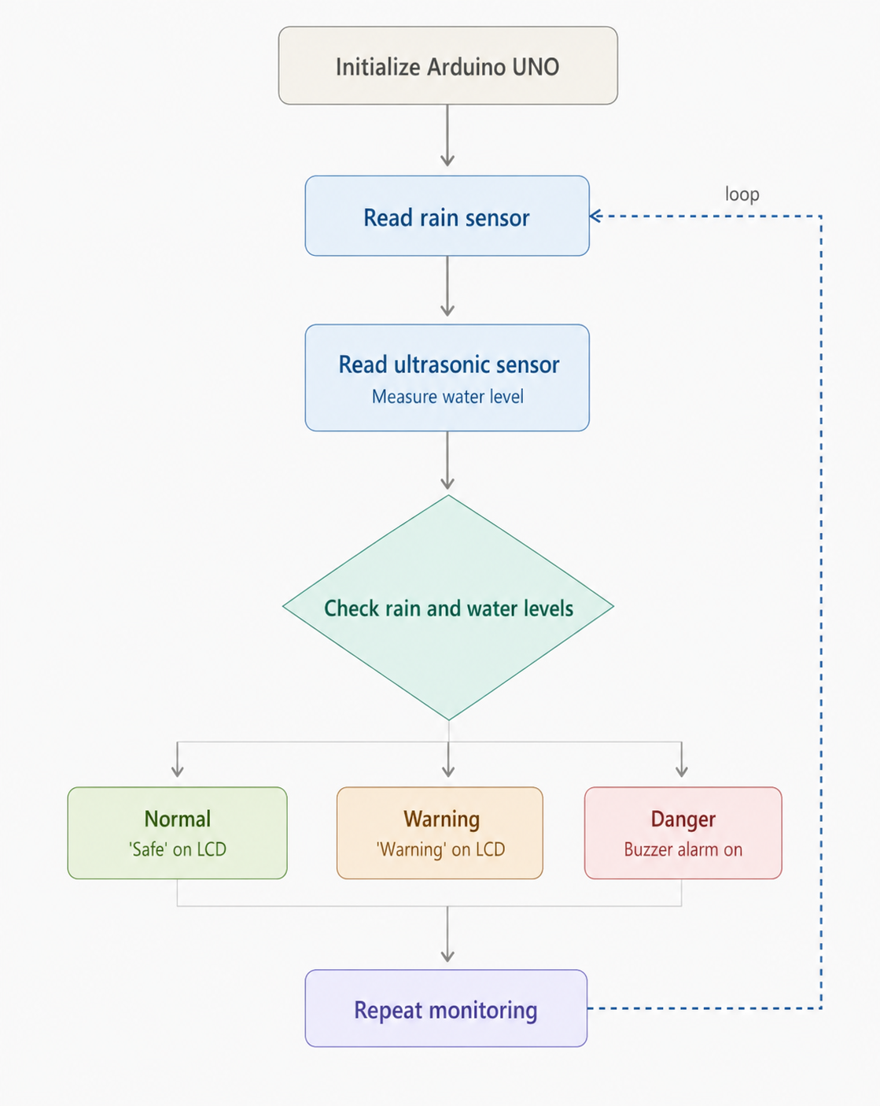
Block Diagram:

Slide 9
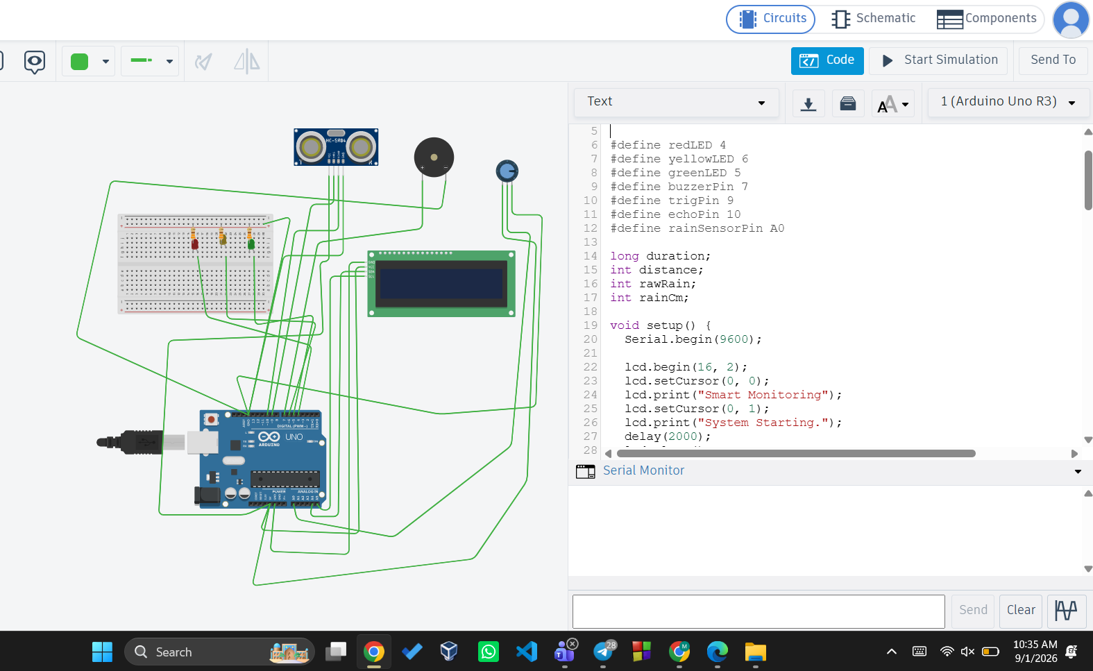
Simulation
Fig1:
Simulation of project with LED off in tinkercad

Slide 10
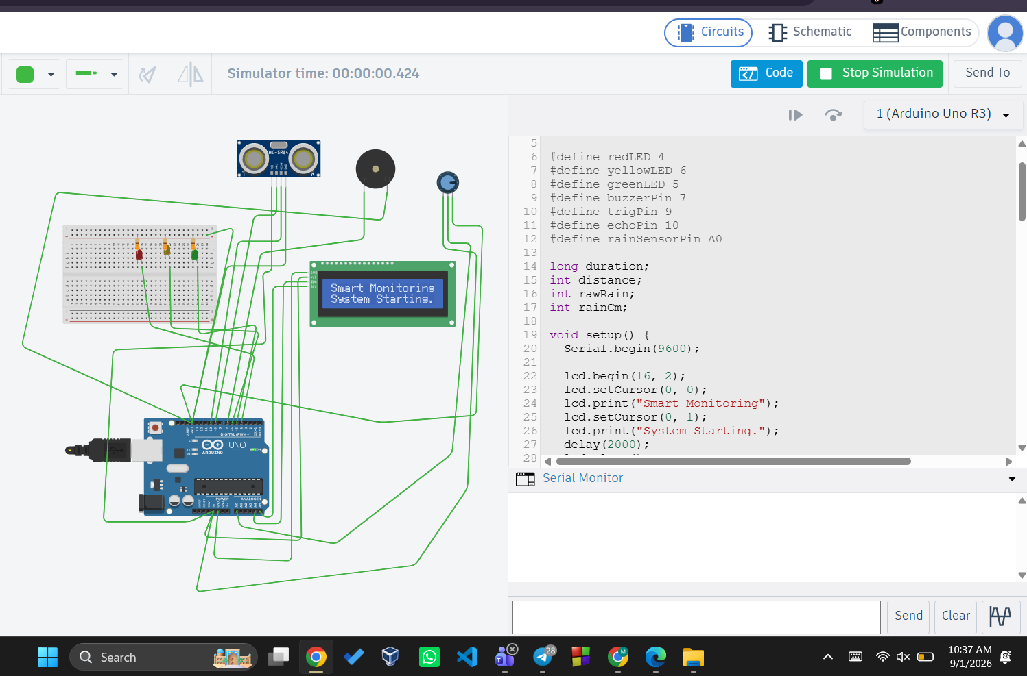
Simulation
In Fig2:
Simulation of project with LED ON in tinkercad

Slide 11
Description/Methodology of the Work
1.System Design & Components:
.The proposed system is a low-cost Arduino-based flood monitoring and early warning system.
.Arduino Uno acts as the main controller for processing sensor data.
.Rain sensor detects rainfall conditions.
.HC-SR04 ultrasonic sensor measures the water level without direct contact.
.LCD displays real-time water-level and system status.
.LEDs and buzzer provide visual and audible warnings.
.The system uses predefined threshold levels to identify different flood conditions.
2. System Working Method:
Rain Detection
  The rain sensor continuously monitors rainfall.
Water-Level Measurement
  The ultrasonic sensor measures the distance between the sensor and water surface.
Data Processing
  Arduino receives and processes both sensor readings.
Flood-Level Classification
  Sensor values are compared with predefined thresholds.
  The system identifies Normal, Warning, or Critical conditions.

Slide 12
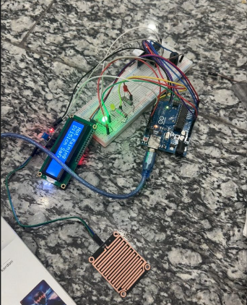
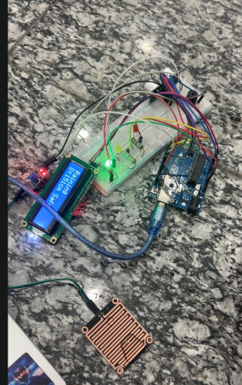
Picture of Setup
Fig3: Setup with LED on showing not raining
Fig4: Setup with LED on showing raining

Slide 13
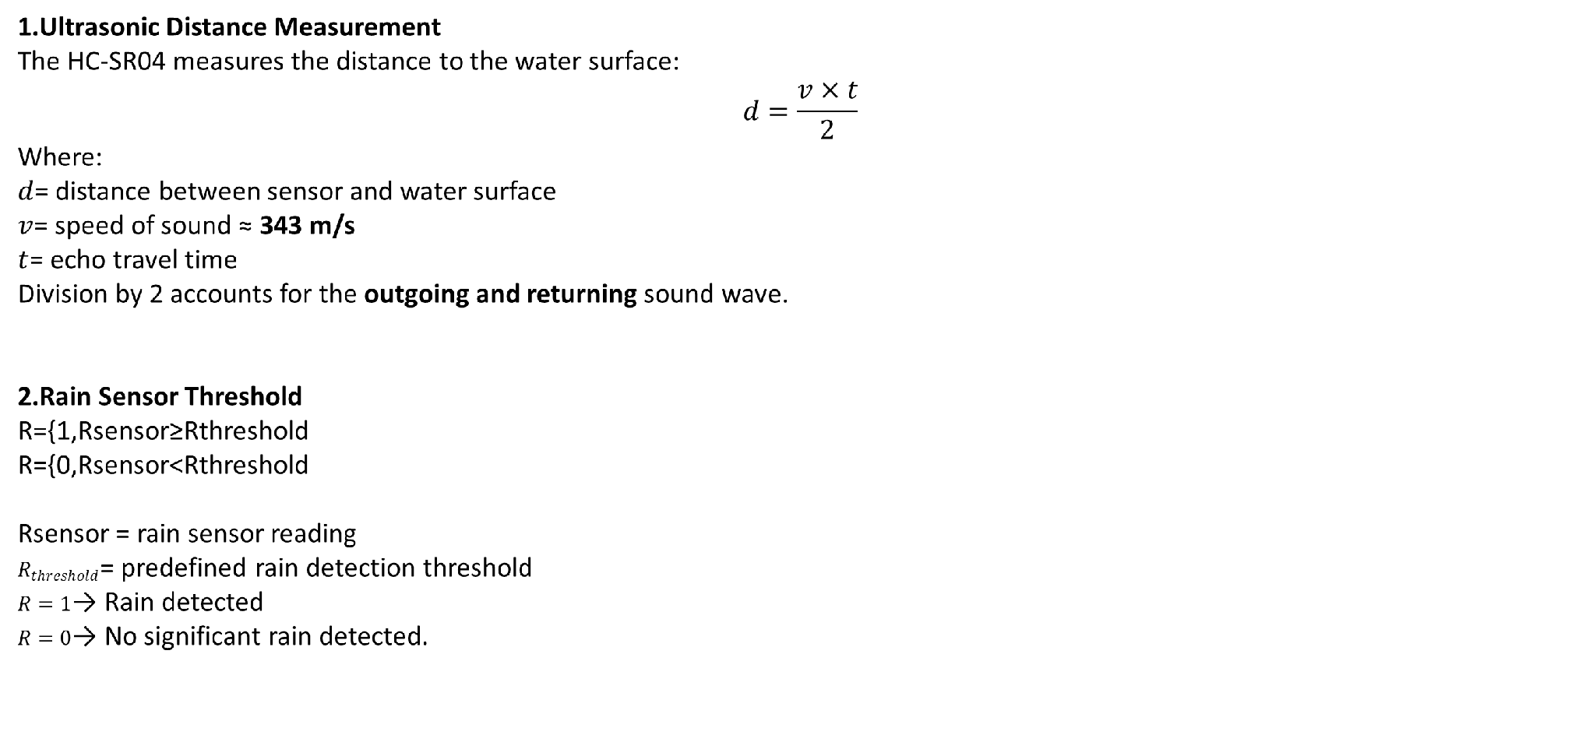
Equations/Mathematical Model

Slide 14
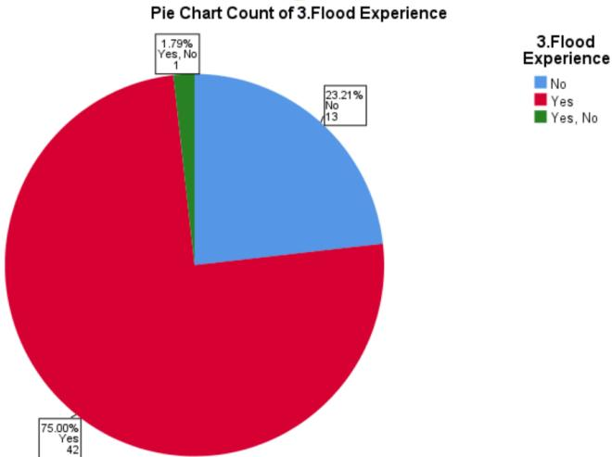
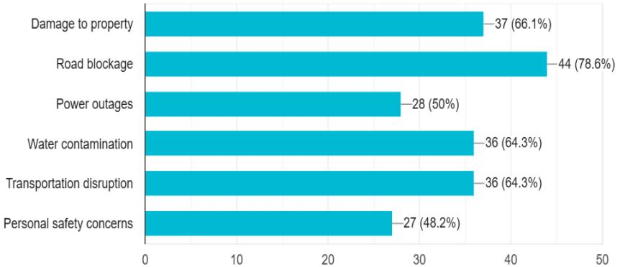
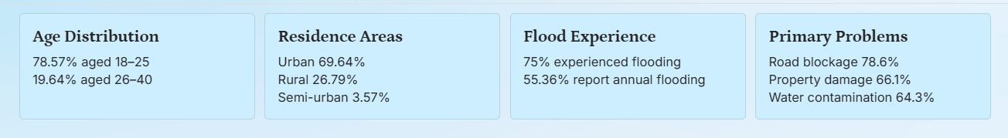
Survey Report:
Which problems do you face during flooding?
Fig5: Distribution of respondents' prior flood experience
Fig6: Survey Result

Slide 15
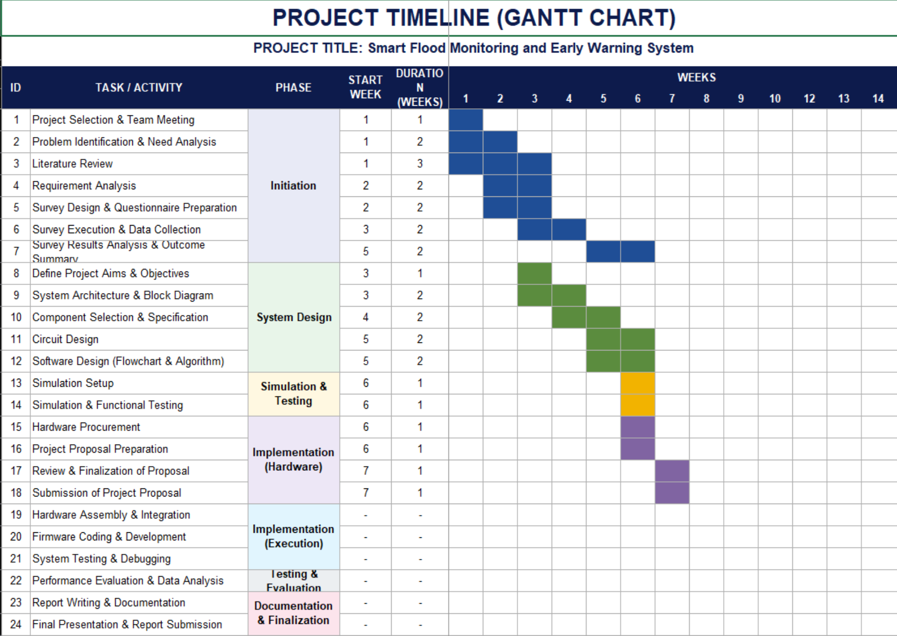
Gantt Chart:
Fig7: Project timeline Gantt chart for Flood Monitoring and Early Warning System

Slide 16
Result and Outcome
The system successfully monitored rainfall and water-level changes in real time.
Different simulated sensor values produced the correct flood-risk classification.
Normal condition: Safe status displayed with the normal indicator.
Warning condition: Warning message and indicator activated.
Critical condition: Buzzer and emergency alert activated.
The monitoring process repeated automatically for continuous detection.
The simulation demonstrated a fast and reliable response to changing flood conditions.

Slide 17
Discussion
The Arduino UNO collects data from the rain sensor and ultrasonic sensor.
The rain sensor detects rainfall intensity, while the ultrasonic sensor measures the water level.
Sensor readings are compared with predefined thresholds.
The system classifies the flood condition as Normal, Warning, or Critical.
LED, LCD, buzzer, and provide warnings.
Tinkercad simulation is used to test the complete sensor-to-alert process.
Combining rainfall and water-level data helps reduce false warnings.

Slide 18
Conclusion
The project presents a low-cost Arduino-based flood monitoring and early-warning system.
Rain and ultrasonic sensors allow continuous monitoring of rainfall and water level.
Threshold-based analysis provides clear Normal, Warning, and Critical classifications.
Automatic alerts improve response time during possible flood situations.
Tinkercad simulation confirms the system’s basic functionality before hardware deployment.
The proposed system can improve disaster preparedness in flood-prone communities.

Slide 19

Future Scope
In the future, the system can be tested under real flood conditions and expanded using multiple sensor nodes to cover larger areas. A web or mobile dashboard can be developed for remote monitoring, while cloud storage can maintain long-term rainfall and water-level records. Solar power and battery backup can ensure continuous operation during power failures. GSM reliability can also be added for severe weather conditions. Furthermore, machine learning can be added to predict floods earlier using historical sensor data, and a weatherproof casing can protect the hardware from rain, debris, and physical damage.

Slide 20
THANK YOU

