Slide 1
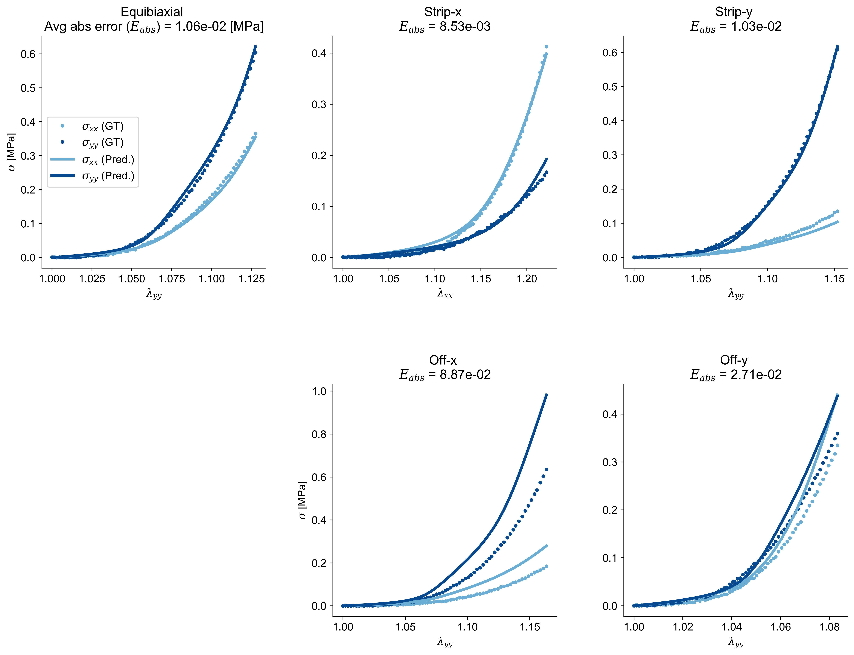
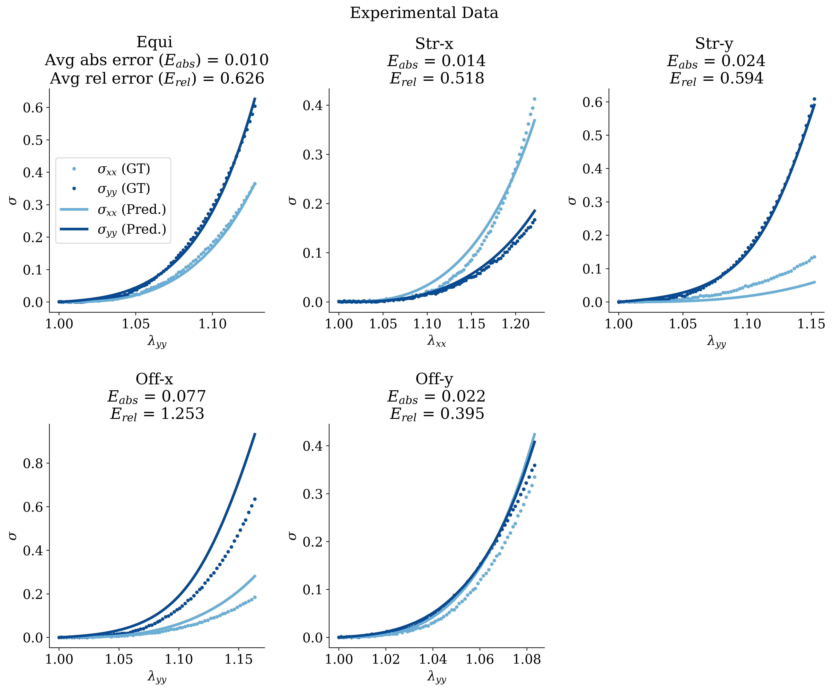
(a)
(b)
(c)
T
T
T
Legend:
(d)
(e)
E_{abs}: Average Absolute Error
E_{rel} : Average Relative Error
V
V
T
: Training
V
: Validation
Loading Protocols:

