Slide 1
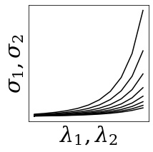
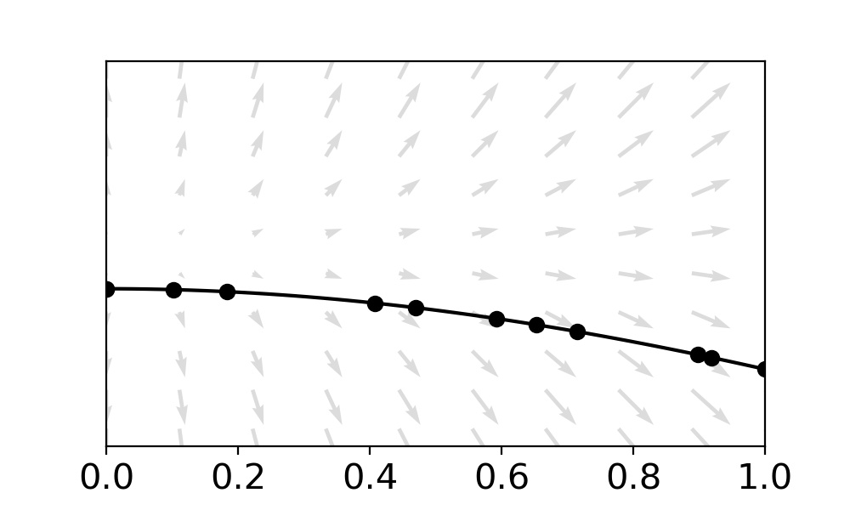
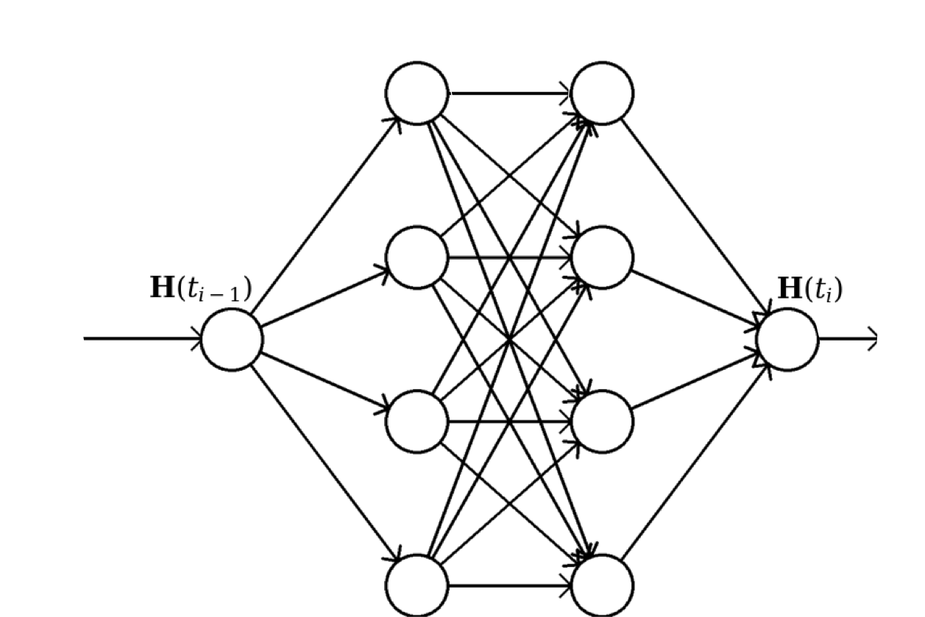
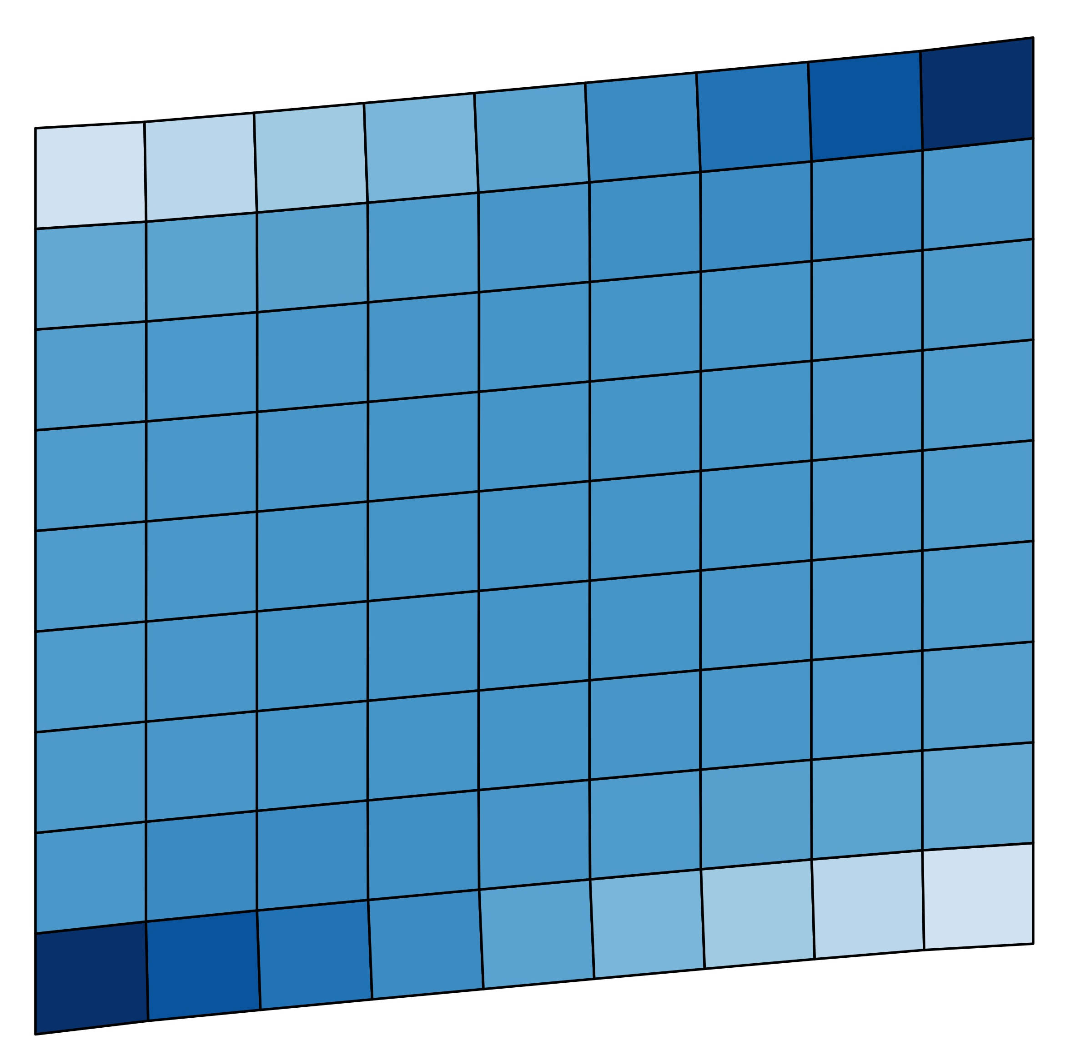
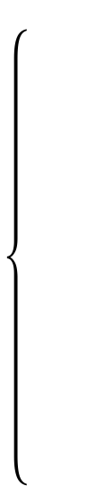

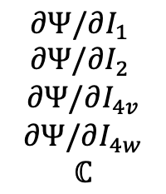
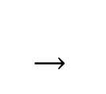



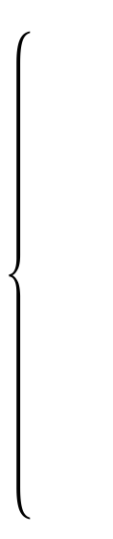

Neural ODE
Training Data
Continuous transformation of the
hidden state
$$σ_{1}, σ_{2}$$
Training Loss
Training
$$J_{i}$$
$$Ψ_{i}$$
$$∂Ψ/∂I_{1}$$
$$∂Ψ/∂I_{2}$$
$$∂Ψ/∂I_{4v}$$
$$∂Ψ/∂I_{4w}$$
$$ℂ$$
Neural ODE
$$σ_{1}$$
$$σ_{2}$$
$λ_{1}, λ_{2} \underset{→}{ }J_{1}, J_{2}, J_{4v}, J_{4w}$
Inference
FEM

Slide 2
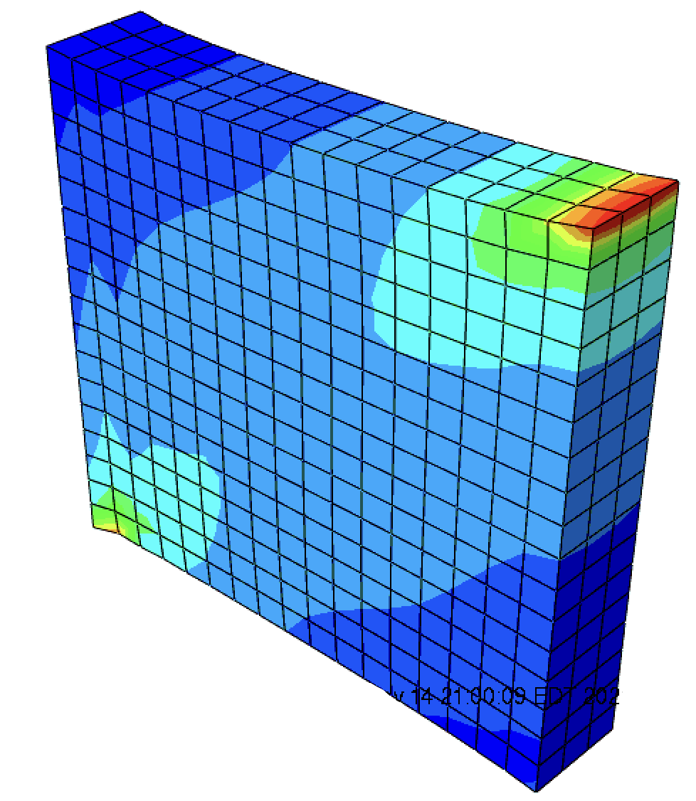


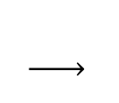
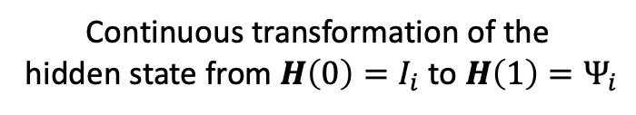


Neural ODE
Training Data
Continuous transformation of the
hidden state from $H\left(0\right)=I_{i}$ to $H\left(1\right)=Ψ_{i}$
$$σ_{1}, σ_{2}$$
Training Loss
Training
$$I_{i}$$
$$Ψ_{i}$$
$$Ψ_{1}$$
$$Ψ_{2}$$
$$Ψ_{4v}$$
$$Ψ_{4w}$$
$$ℂ$$
Neural ODE
$${\overline{σ}}_{1}$$
$${\overline{σ}}_{2}$$
$λ_{1}, λ_{2} \underset{→}{ }{ I}_{1}, I_{2}, I_{4v}, I_{4w}$
Inference
FEM

Slide 3
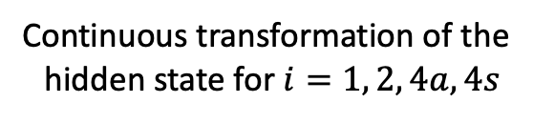
Neural ODE
Training Data
Continuous transformation of the
hidden state for $i=1, 2, 4a, 4s$
$$σ_{1}, σ_{2}$$
Training Loss
Training
$$I_{i}$$
$$Ψ_{i}$$
$$Ψ_{1}$$
$$Ψ_{2}$$
$$Ψ_{4v}$$
$$Ψ_{4w}$$
$$ℂ$$
Neural ODE
$${\overline{σ}}_{1}$$
$${\overline{σ}}_{2}$$
$λ_{1}, λ_{2} \underset{→}{ }{ I}_{1}, I_{2}, I_{4v}, I_{4w}$
Inference
FEM

