Slide 1
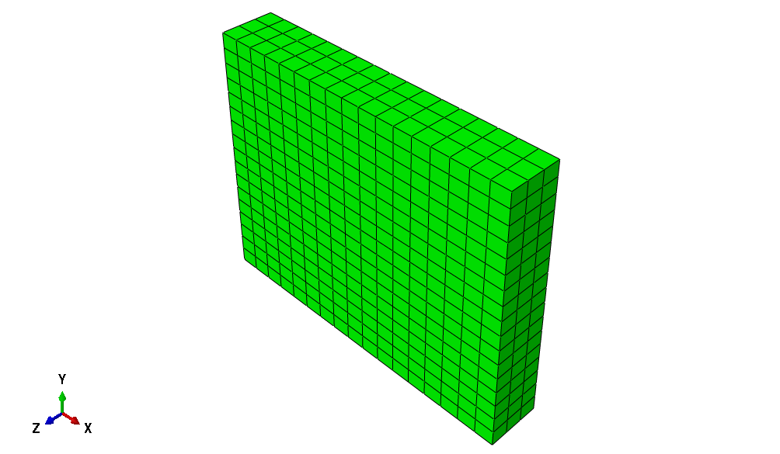
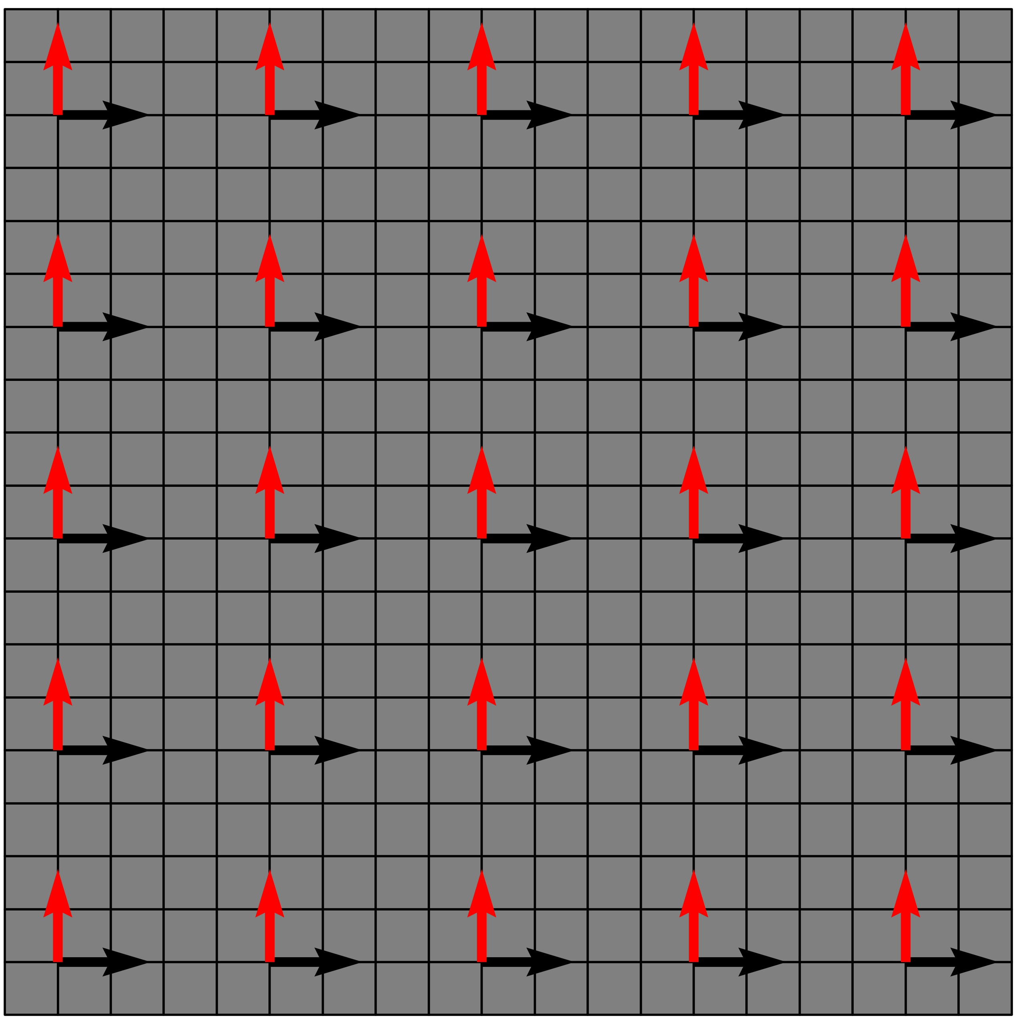
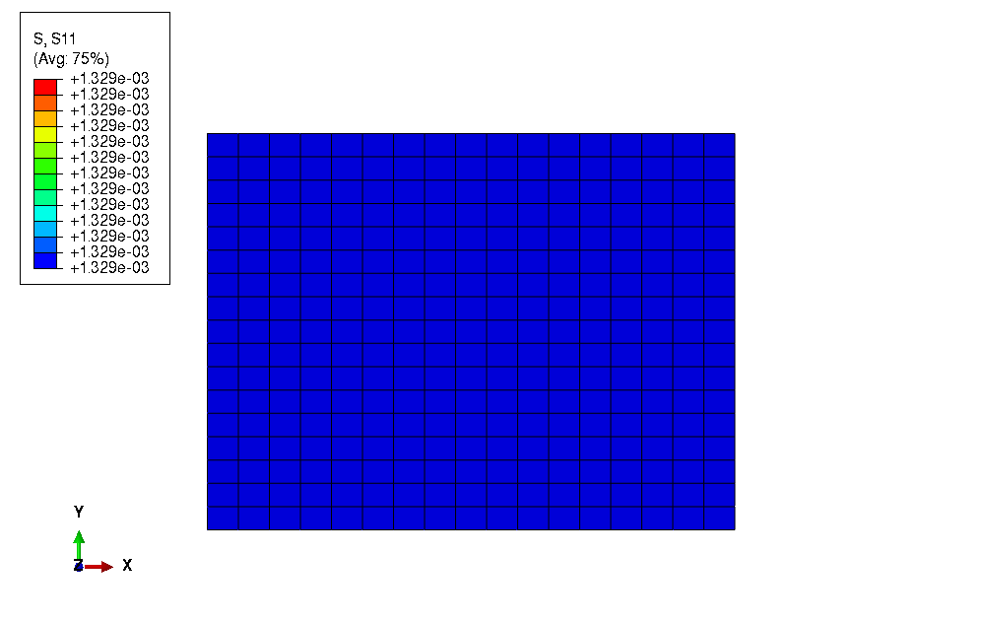
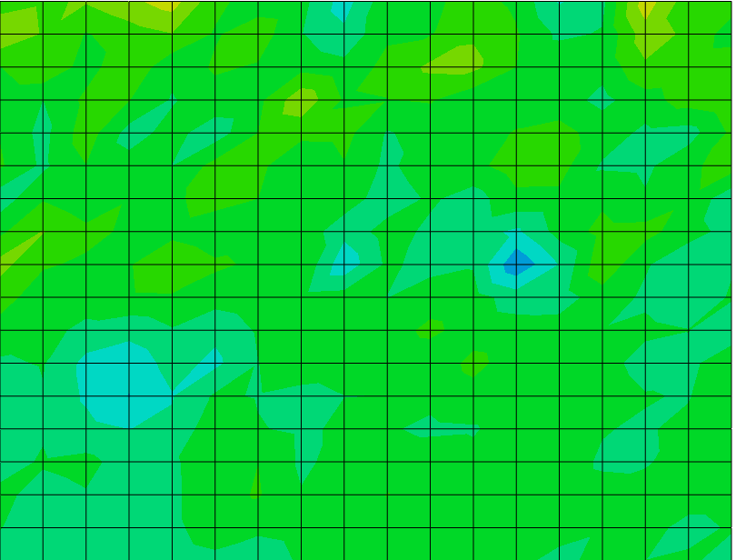
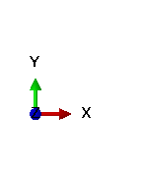
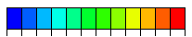
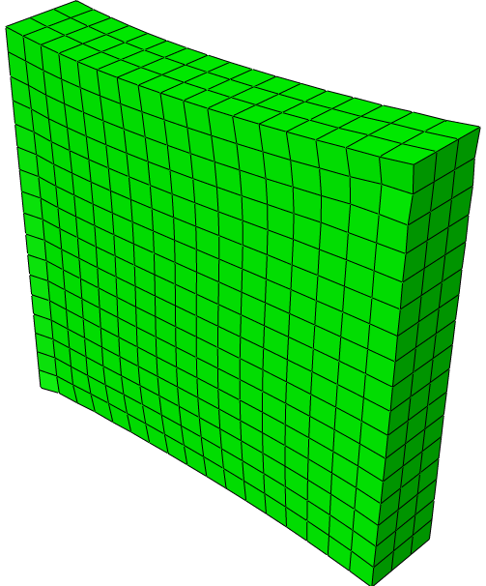
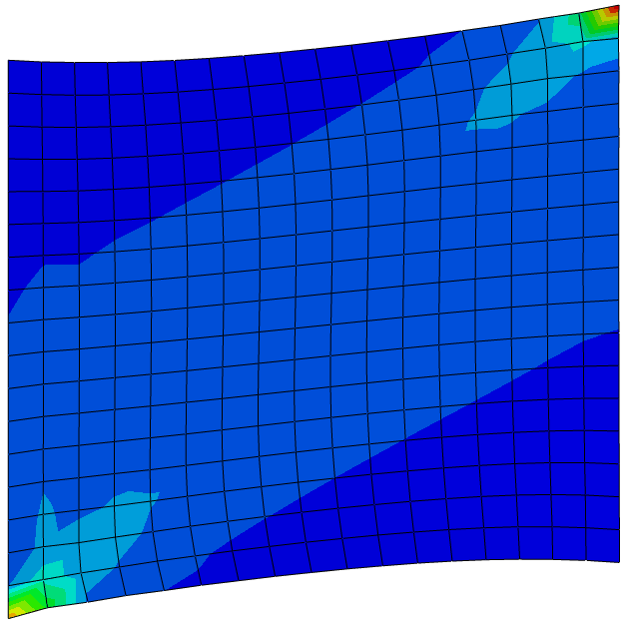
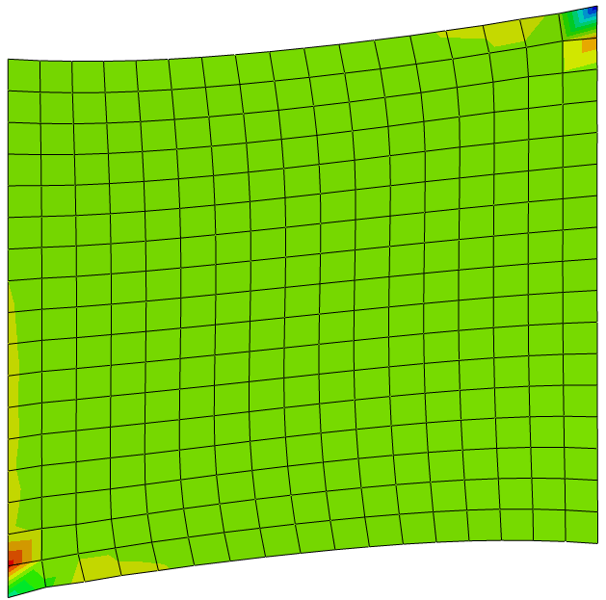
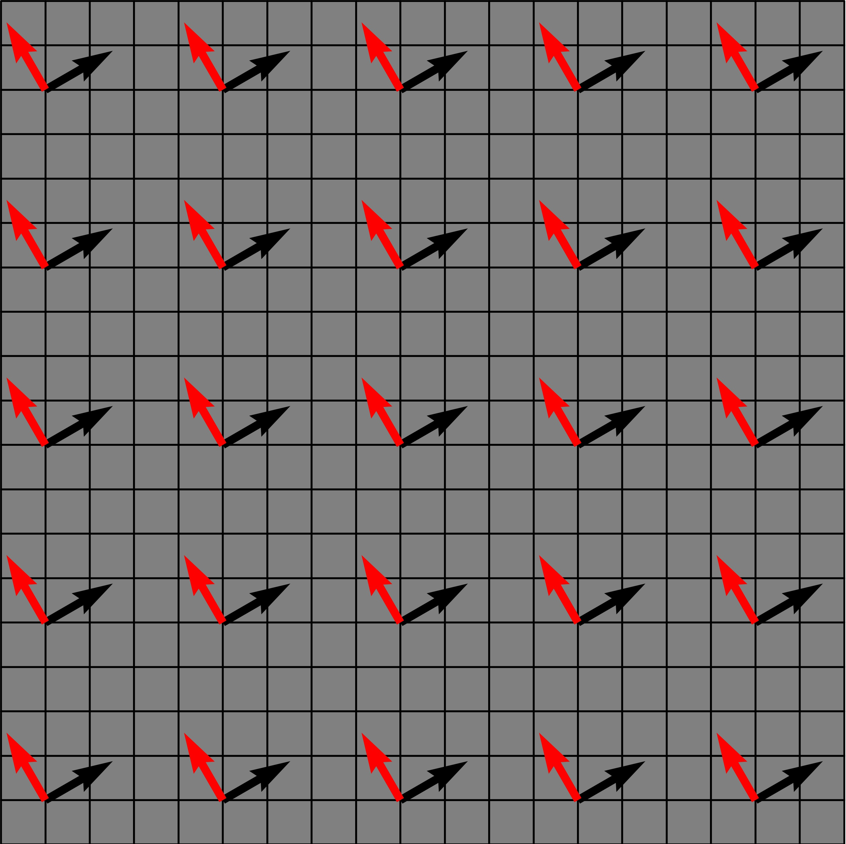
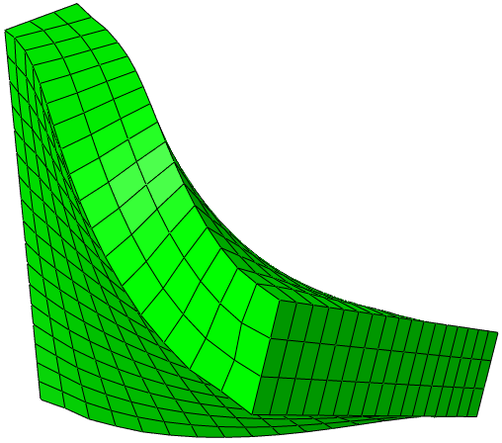
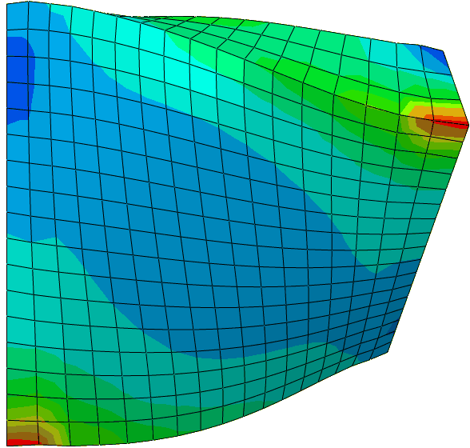
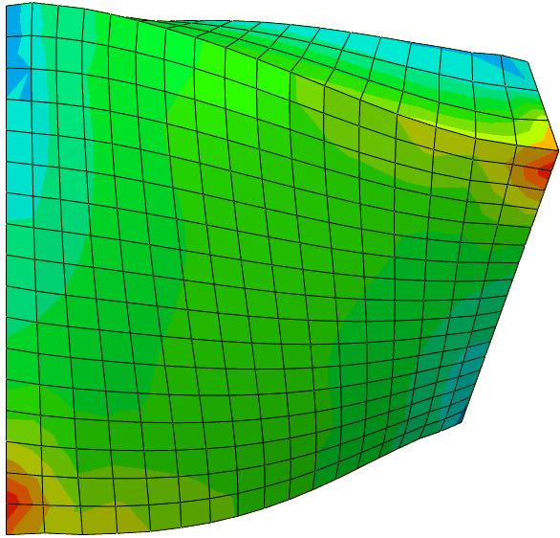







(a)
Symmetry in x
Displacement in x
$$σ_{xx} [kPa]$$
$$σ_{yy} [kPa]$$
Symmetry in y
1.5e-1
1.5e-1
5.0e-7
5.2e-7
(b)
Clamped
Displacement in x & y
$$σ_{xx} [kPa]$$
$$σ_{yy} [kPa]$$
(c)
-7.4e-4
1.4e+0
--3.0e-1
2.0e-1
Clamped
Rotation in x
$$σ_{xx} [kPa]$$
$$σ_{yy} [kPa]$$
-1.4e-1
3.3e-1
-6.4e-2
1.1e-1

