Slide 1
Additional figures

Slide 2
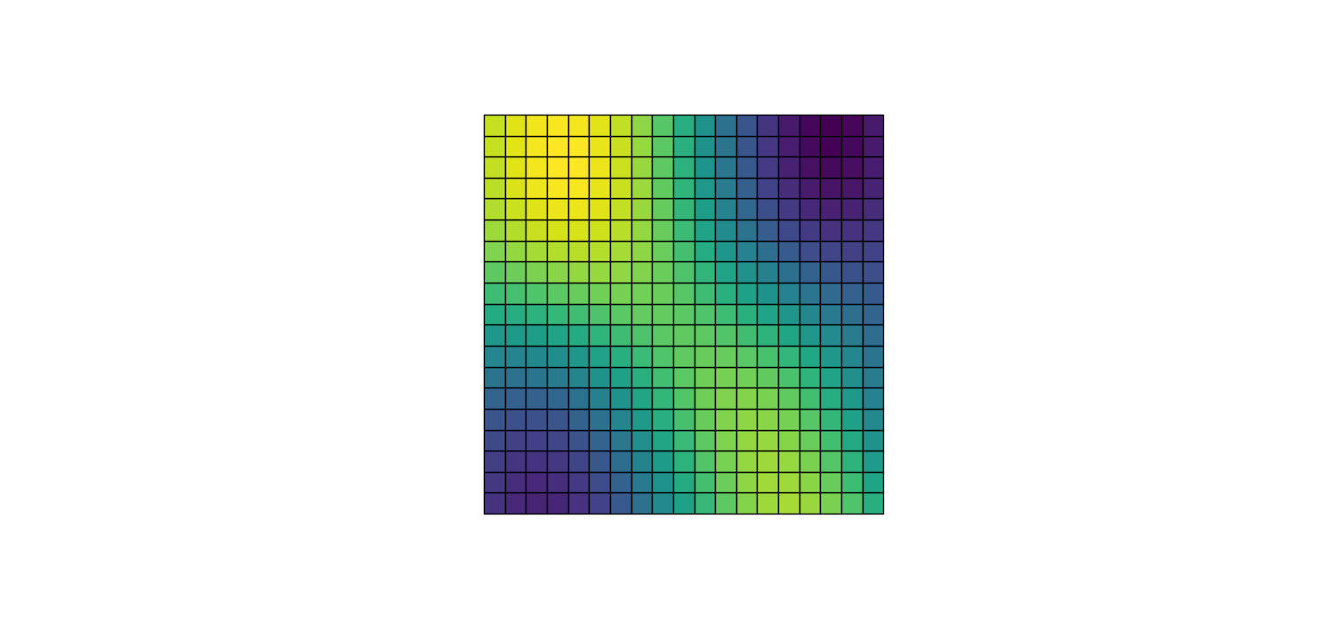
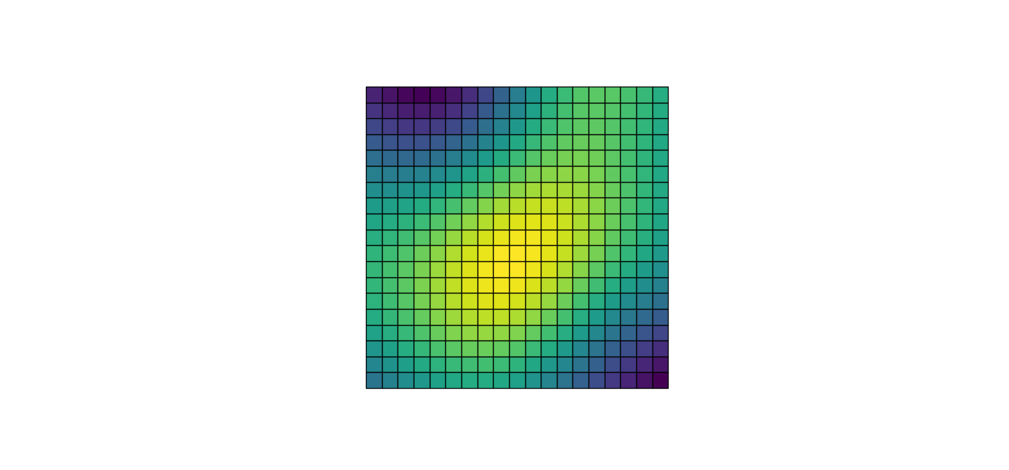
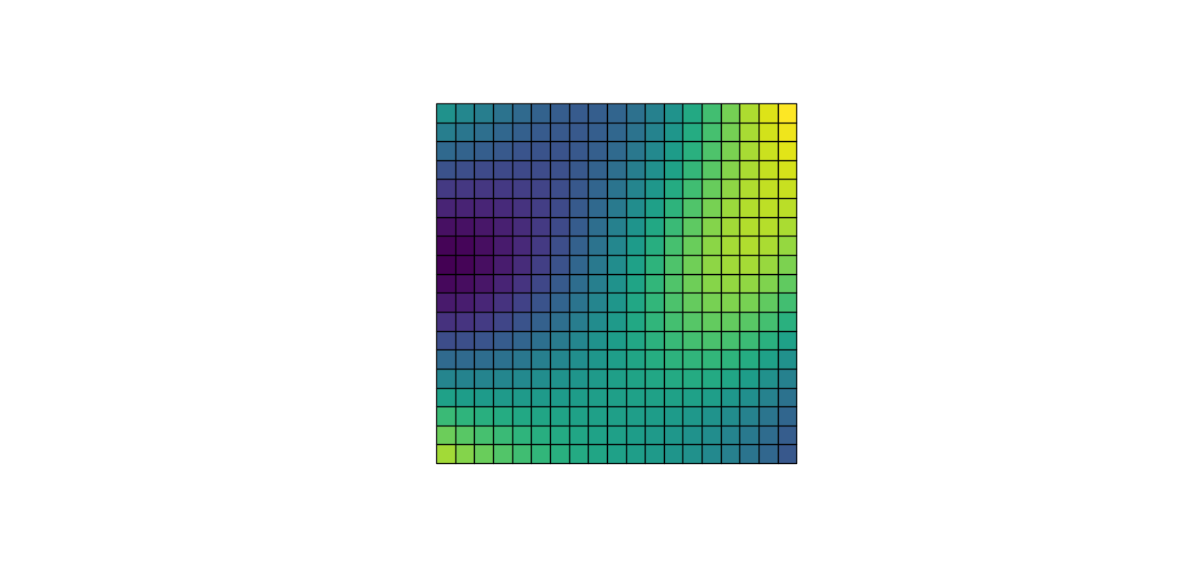
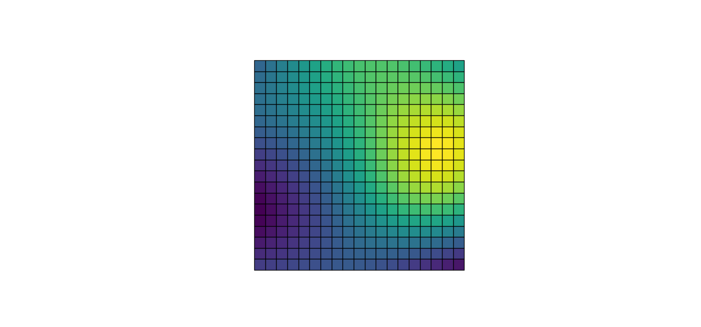
Some contours of functions sampled from the Gaussian fields in 2D (length scale = 0.4*width)

Slide 3
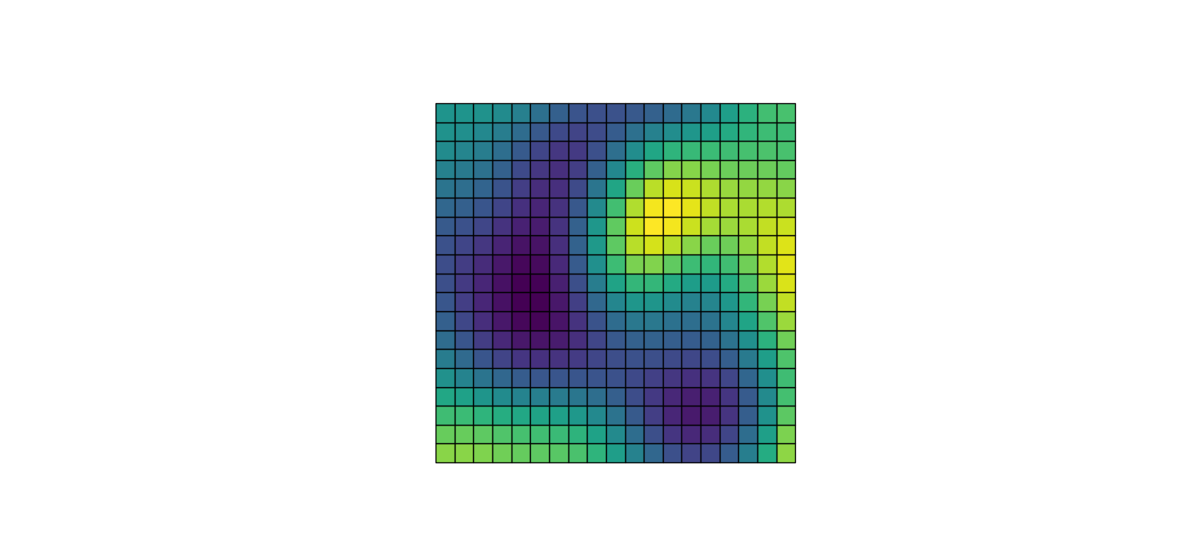
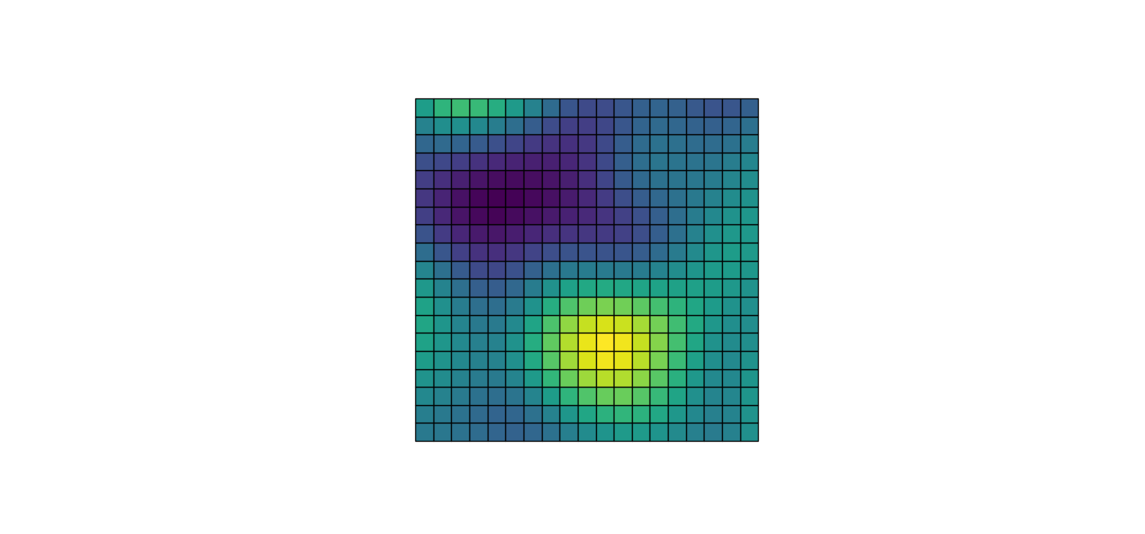
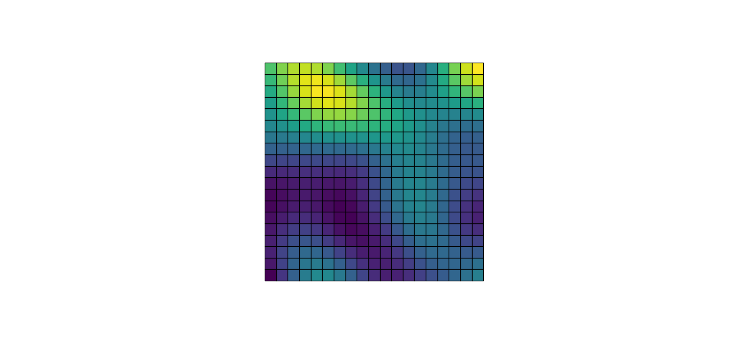
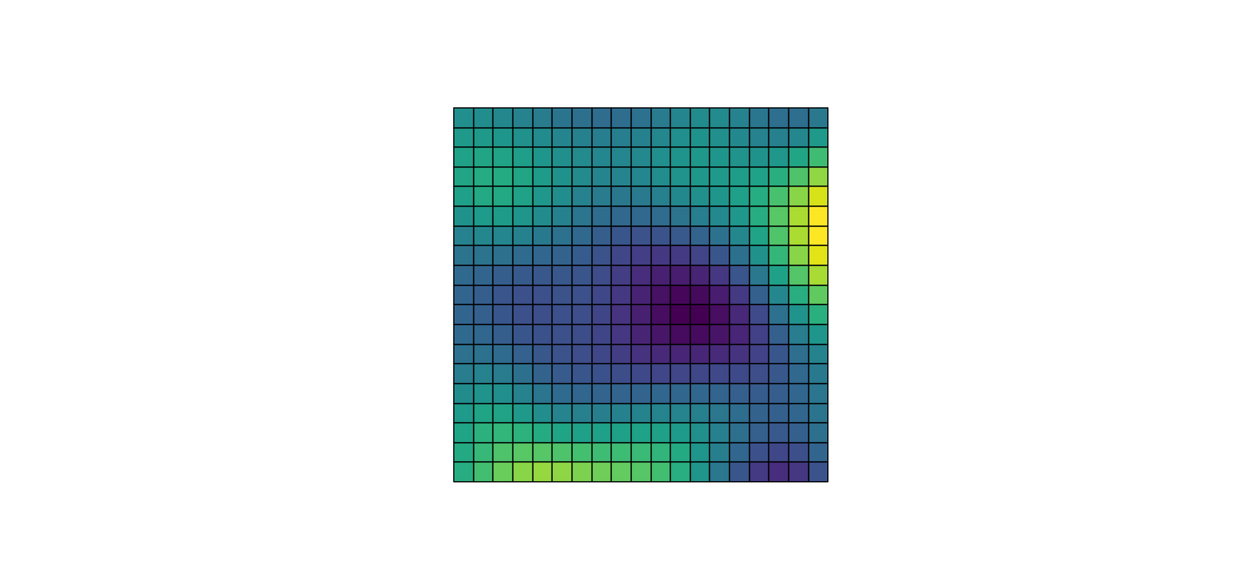
Same as the previous slide, except with smaller length scale (0.2 of the width vs 0.4 in the previous slide)

Slide 4
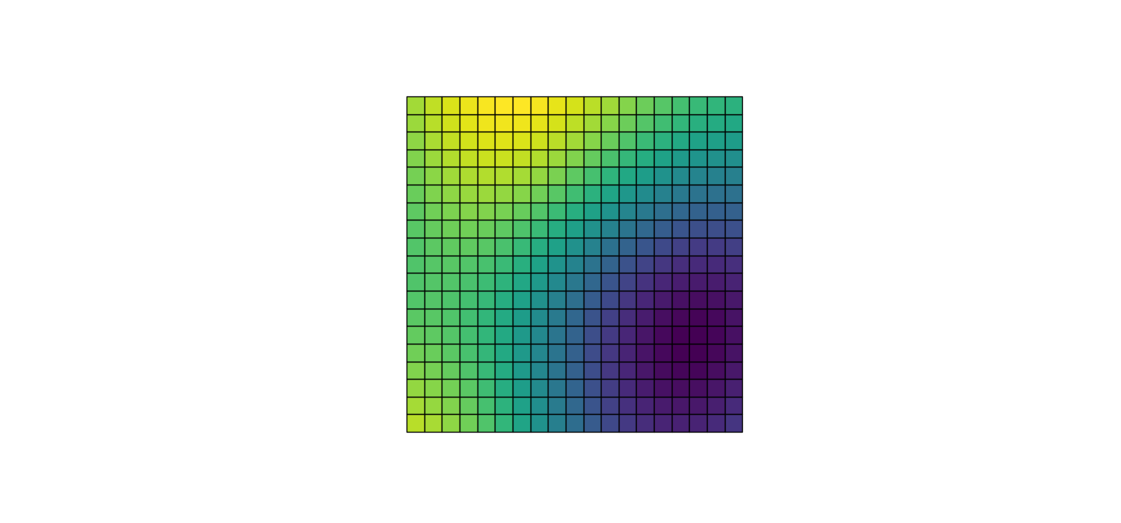
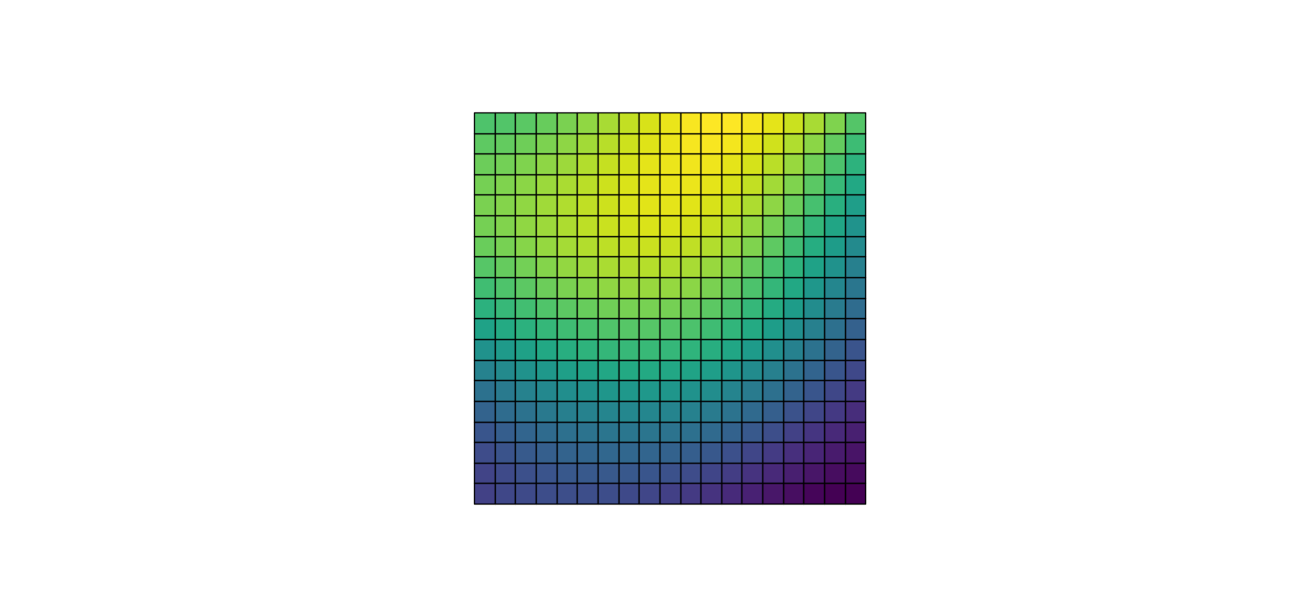
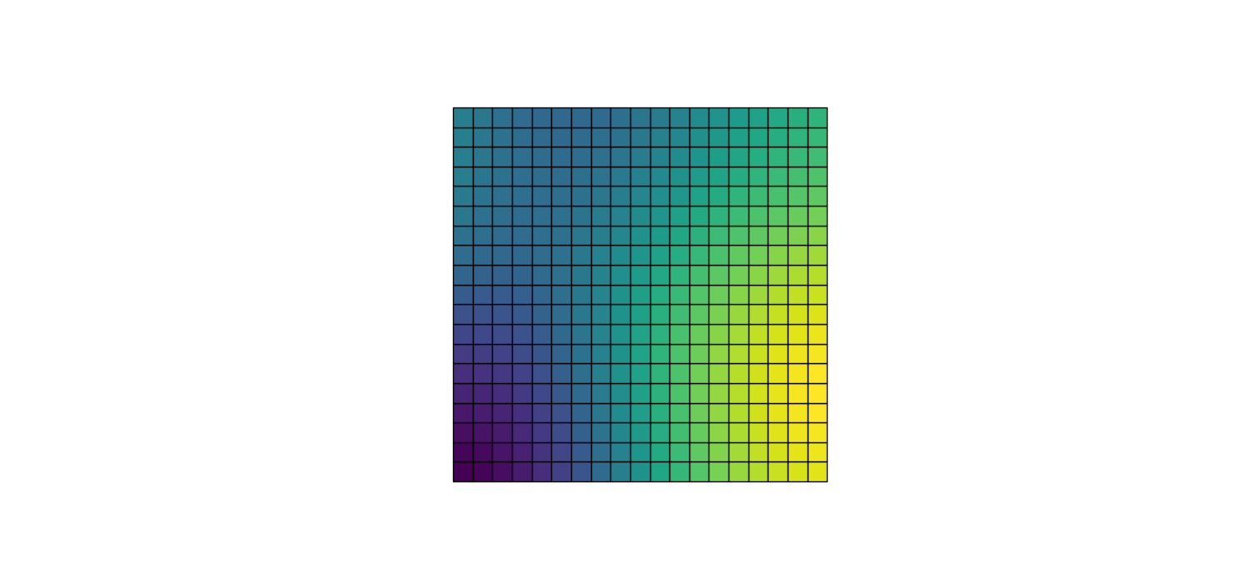
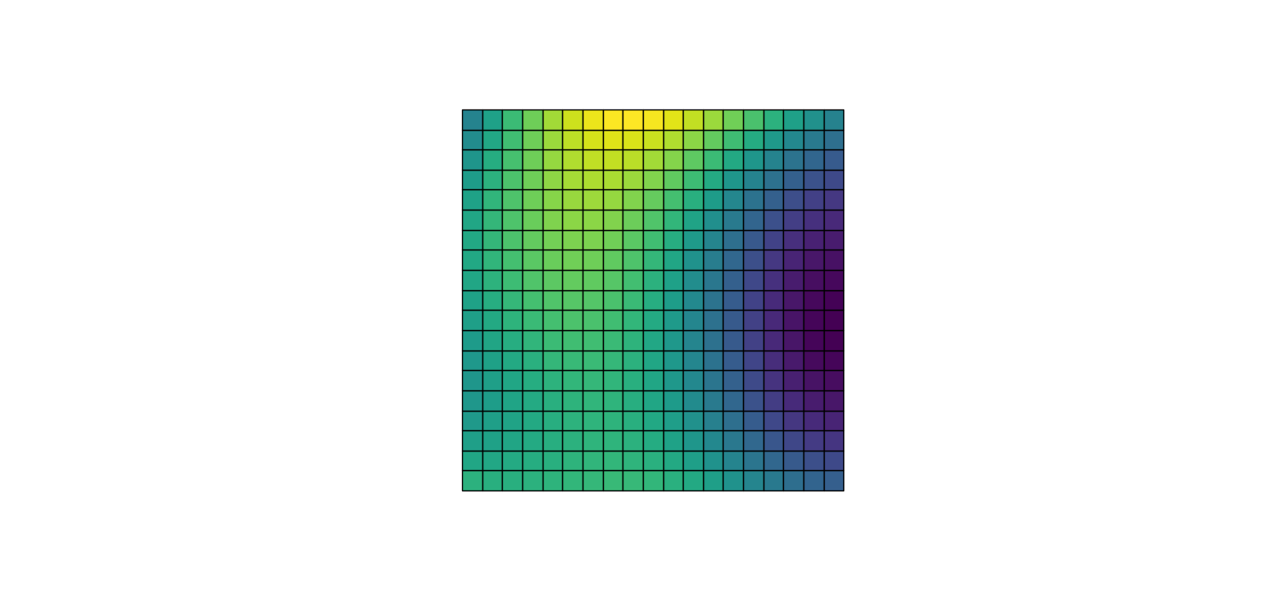
Same as the previous slide, except with larger length scale (0.6 of the width vs 0.4 in slide 1)

Slide 5







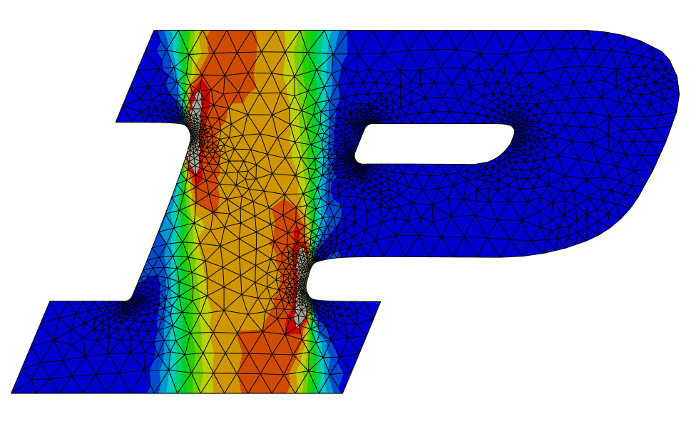





Length scale = 0.4*width
A rough representation of the resulting “stiffness” as measured by sigma_xx at lambda = 1.1 (equibiaxial).
The resulting FEM
Distribution of some of the parameters (phi_1-phi_8)

Slide 6











Length scale = 0.4*width
Same figure as the previous slide, just for another initialization.

Slide 7







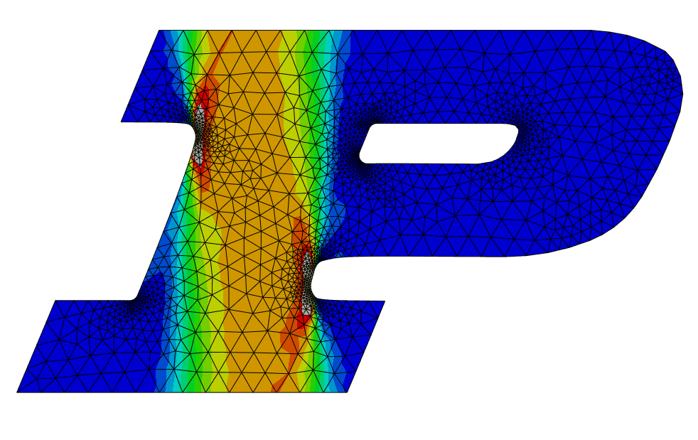




Length scale = 0.4*width
Same figure as the previous slides, just for another initialization.

Slide 8
How about different length scales?

Slide 9







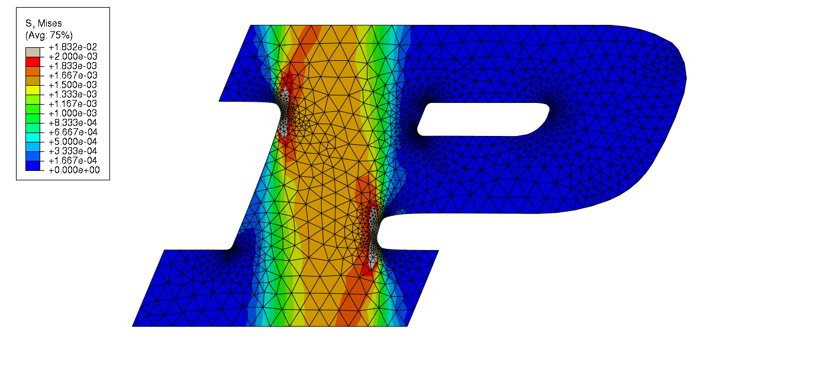




Length scale = 0.2*width

Slide 10












Length scale = 0.6*width

Slide 11
Next: 3 length scales for the square mesh

Slide 12






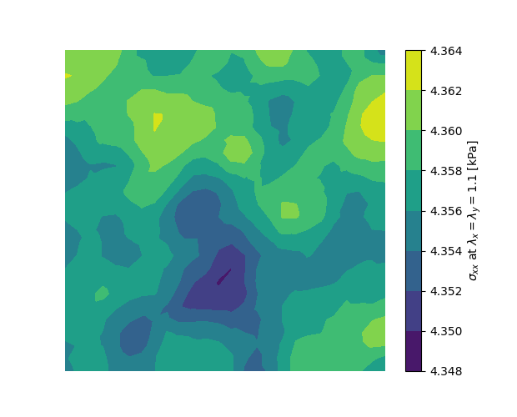
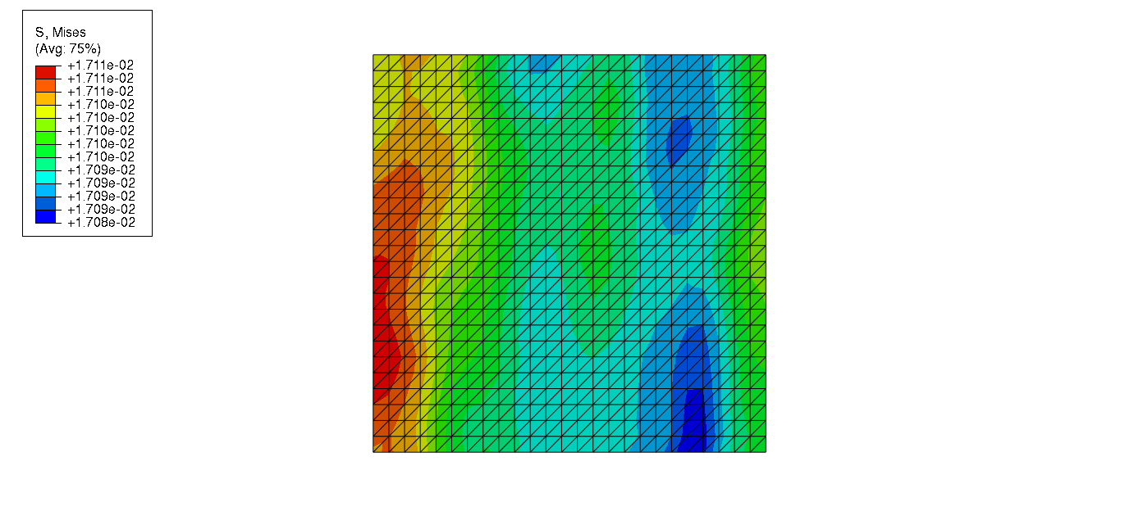




Length scale = 0.2*width

Slide 13






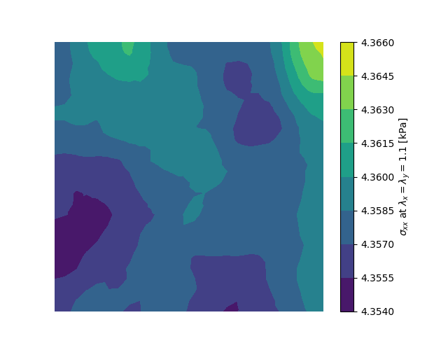
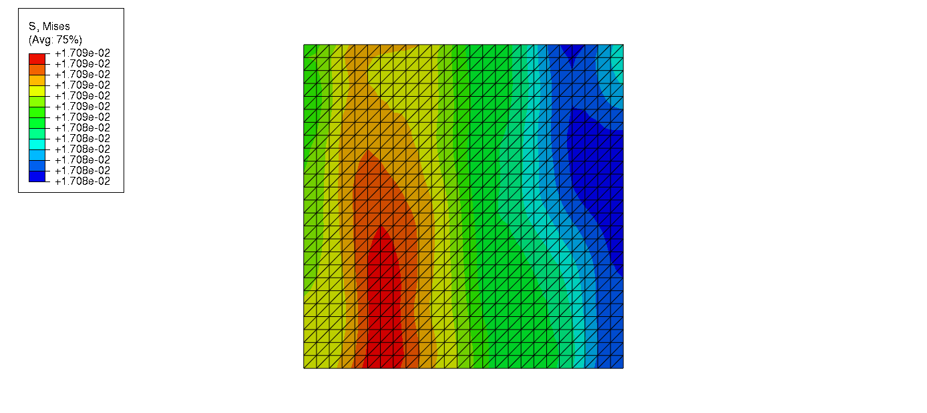




Length scale = 0.4*width

Slide 14






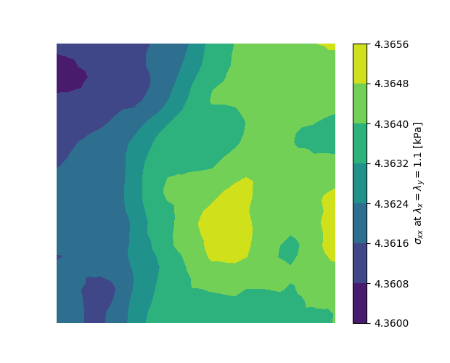
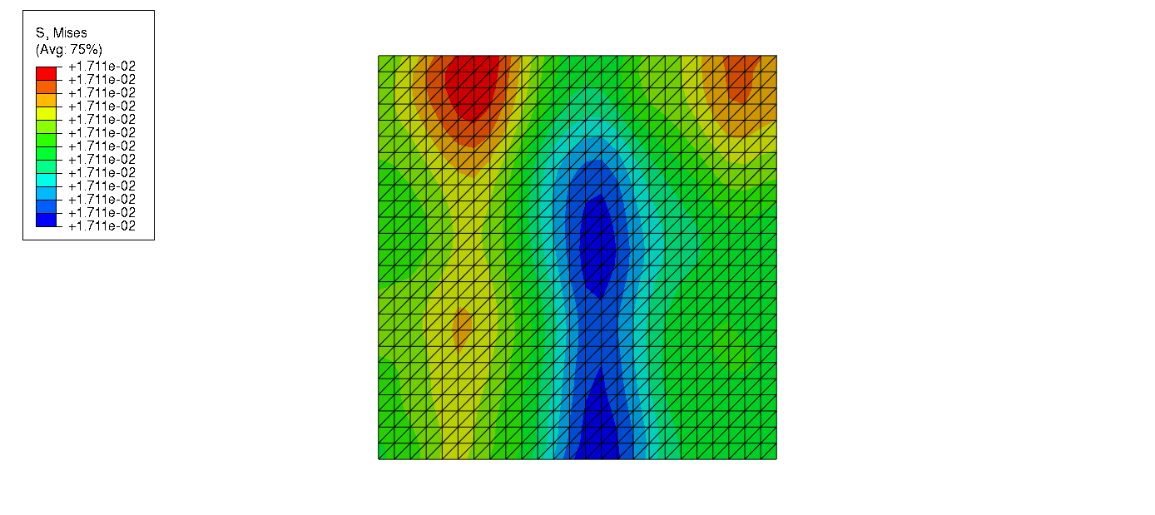




Length scale = 0.6*width

