Slide 1
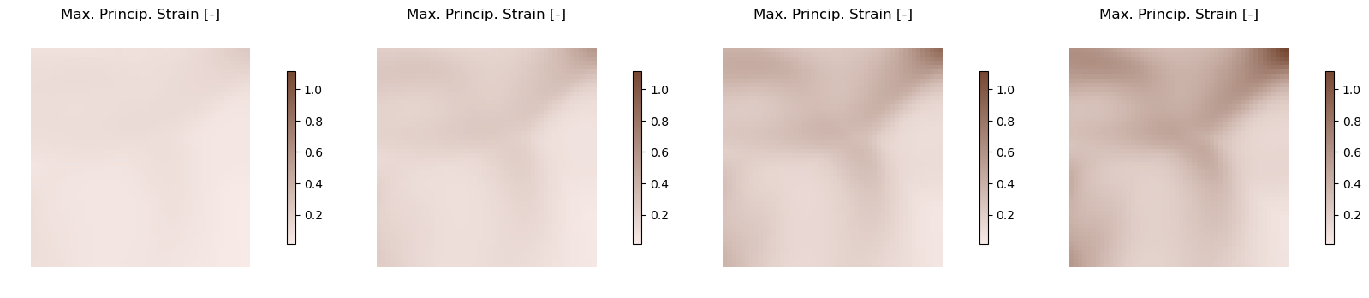
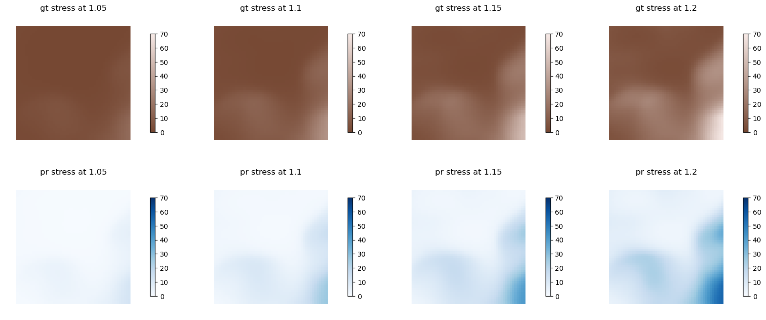
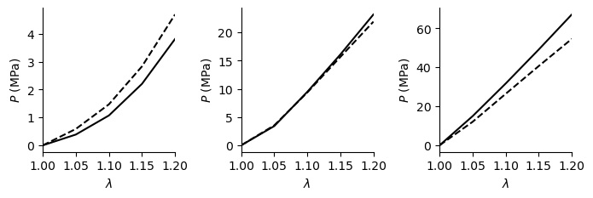
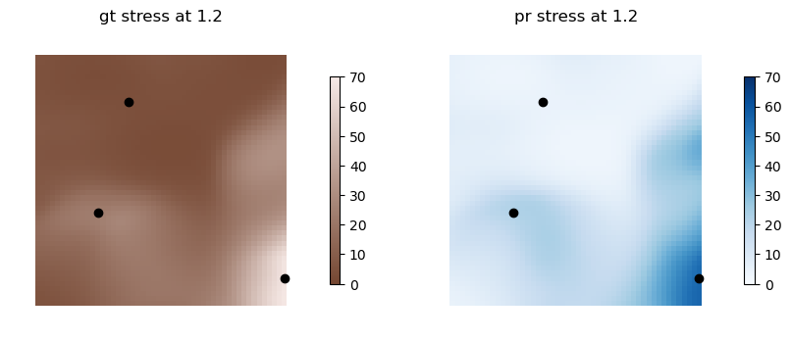
a) Observed strain fields (maximum principal)
b) Reconstructed stress fields
(Mpa)
c) Ground truth material
d) Identified material
(Mpa)
(Mpa)
Notes:
Top row: Maximum principal strain at lambda = 1.05, 1.1, 1.15, 1.2
Middle row and bottom row: P_xx in equibiaxial loading

