Slide 1
UNIT 7. Inheritance
Notes:
1

Slide 2
UNIT 7. Inheritance
Introduction
Types of inheritance
Examples of inheritance
Extending a class.
  Overriding methods
  Protected access
Abstract Classes
Interfaces
Exceptions in Java
Notes:
2

Slide 3
1. Introduction
Inheritance is one of the main techniques of the OOP (Object Oriented Programming).
A general class is first defined and then other classes more specialized inherit attributes and methods of the general class.
So, inheritance produces reuse of code.
Notes:
3

Slide 4

1. Introduction
We have two classes:
1. Parent class ( Super or Base class )
2. Child class ( Subclass or Derived class )
Ancestor: a parent of a parent
Descendant: a child of a child
Notes:
4

Slide 5
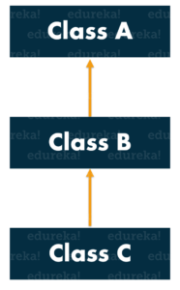
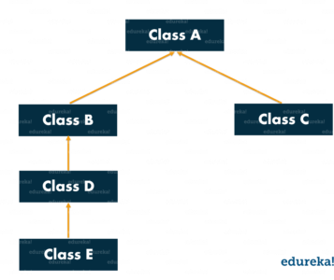
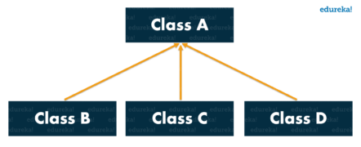
2. Types of inheritance
Single Inheritance
Multi-level Inheritance
Hierarchical Inheritance
Hybrid Inheritance
Notes:
5

Slide 6
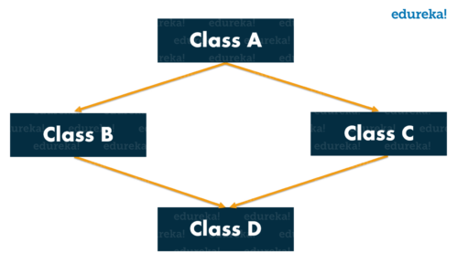
2. More Types of inheritance (not permitted in Java)
Multiple Inheritance
Notes:
6

Slide 7
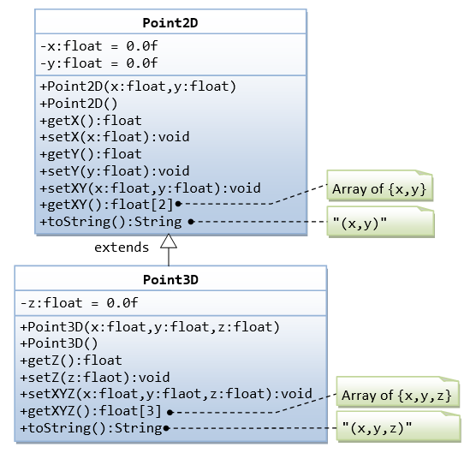
3. Examples of inheritance
Notes:
7

Slide 8
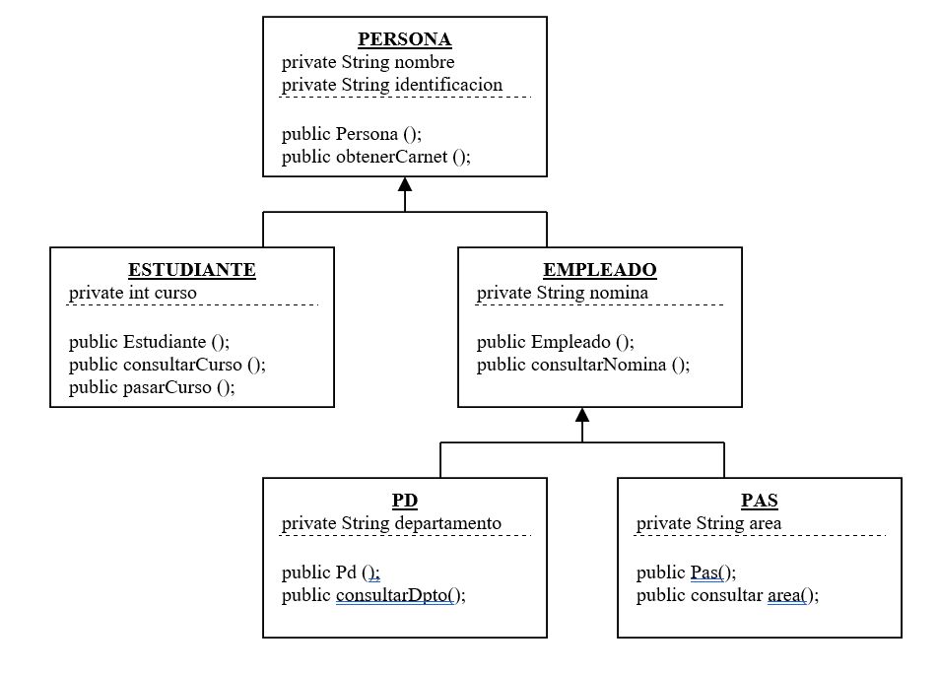
3. Examples of inheritance
Notes:
8

Slide 9
4. Extending a class
To create a child or derived class we use the extend keyword.
We created the class Point in the last unit and now we want to create the class Point3D, to represent a new coordinate, z.
Notes:
9

Slide 10
4. Extending a class
class Point {
protected double x; //x value of the point
protected double y; //y value of the point
public Point(double abs, double ord) {
x = abs;
y = ord; }
public double getX() { return x; }
public double getY() { return y; }
public String toString(){ return “(“+x+”, “+y+”)”; }
public void setX(double x) { this.x=x; }
public void setY(double y) { this.y=y; }
public void setXY(double abs, double ord) {
x = abs; y = ord; }
public double distOrigin() { return(Math.sqrt(x*x + y*y)); }
} // end of the class
Notes:
10

Slide 11
4. Extending a class
class Point3D extends Point {
private double z;
//constructor
public Point3D(double x, double y, double z) {
super(x,y); //calling the constructor of the parent class. // It must be the first line
this.z=z;}
public double getZ() {
return (this.z);}
// method distOrigin overrides the method in the parent class
public double distOrigin() {
return (Math.sqrt(x*x+y*y+z*z));}
} //end of the class
Notes:
11

Slide 12
4.a. Overriding methods
Although a derived class inherits methods from the base class, it can change or override an inherited method if necessary.
In order to override a method definition, a new definition of the method is simply placed in the class definition, just like any other method that is added to the derived class.
This is exactly what we do in the method
public double distOrigin() {
return (Math.sqrt(x*x+y*y+z*z));}
}
Of Point3D class
Notes:
12

Slide 13
4.b. protected access
The access modifier protected is used to let the child classes use that members.
class Point {
protected double x;
protected double y;
...}
class Point3D {
protected double z;
…}
Now, from the child class I can use x, y and z
Notes:
13

Slide 14
5. Abstract methods
An abstract method is a method without a body (with no implementation). The method has only the signature.
If you declare a method as abstract then the class must also be declared as abstract.
The class that extends an abstract class must implement the abstract methods.
An abstract class cannot be instantiated.
Notes:
14

Slide 15
5. Abstract methods
abstract class A {
// abstract method
abstract void m1();
// regular method in abstract class
void m2() {
System.out.println(“Regular method“);
}
}
// regular class B
class B extends A {
// class B must override m1() method
void m1() {
System.out.println("implementation of m1 in B class");
}
}
// Tester class
public class BTest{
public static void main(String args[])
{
B b = new B();
b.m1();
b.m2();
}
}
Notes:
15

Slide 16
5. Abstract methods
public abstract class Person {
  private String name;
  private String gender;
public Person(String nm, String gen){
  this.name=nm;
  this.gender=gen; }
//abstract method
public abstract void work();
@Override
public String toString(){
return "Name="+this.name+
“ Gender="+this.gender; }
public void changeName(String newName) {
this.name = newName;
} }
public class Employee extends Person {
private int empId;
public Employee(String nm, String gen, int id) {
super(nm, gen); this.empId=id; }
@Override
public void work() {
if(empId == 0){
System.out.println("Not working"); }else{
System.out.println("Working!!");
} }
public static void main(String args[]){
Person student = new Employee("Dove","Female",0);
Person employee = new Employee("Pankaj","Male",123);
student.work(); employee.work();
employee.changeName("Pankaj Kumar");
System.out.println(employee.toString());
} } // example of journaldev
Notes:
16

Slide 17
6. Interfaces
There can be only abstract methods in an interface.
We can say that an interface is a completely abstract class.
Interfaces are used to group related methods with empty bodies.
They cannot be instantiated, just like the abstract classes.
Why use Java interfaces?
  It is used to achieve abstraction.
  With interfaces we can support multiple inheritance.
Syntax:
interface <interface_name>{
// declare constant fields
// declare methods that abstract
// by default
.
}
Notes:
17

Slide 18
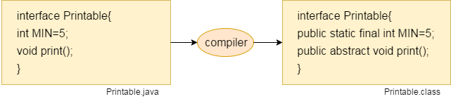
6. Interfaces
Interface fields are public, static and final by default, and the methods are public and abstract.
Notes:
18

Slide 19
6. Interfaces
// Example
interface printable{
void print();
}
class A6 implements printable{
public void print(){System.out.println("Hello");}
public static void main(String args[]){
A6 obj = new A6();
obj.print();
}
}
Notes:
19

Slide 20
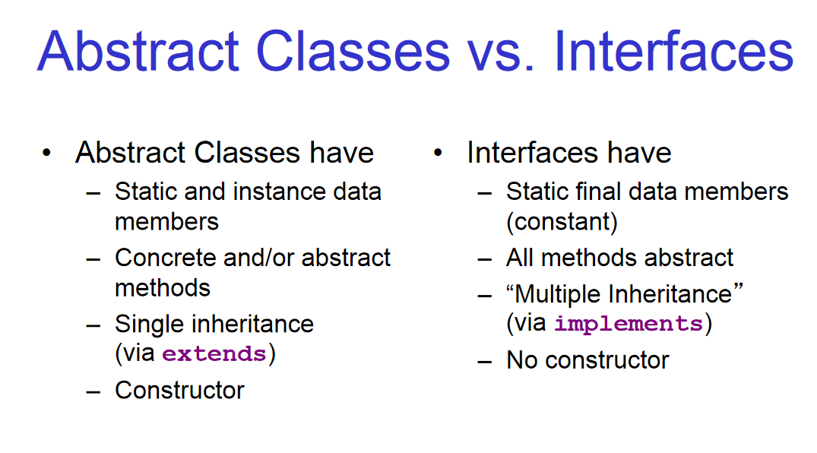
6. Interfaces
Notes:
20

