Slide 1
UNIT 6. Defining Classes

Slide 2
UNIT 6. Defining Classes
Introduction
Primitive Types, Objects and References
  Declaring Objects.
  “.” operator
  Assignment
  Cloning Objects
  == operator
  the garbage collector
Classes vs Objects
Class Definition
  Attributes or Instance Variables
  Methods
    Constructors
    Getters
    Setters
    OtherMethods
  Method overloading.
  Use of this keyword
  Static attributes
  Static methods

Slide 3
1. Introduction
Classes and Objects are basic concepts in OOP (Object Oriented Programming).
A class is a user defined blueprint or prototype from which objects are created. It represents the set of properties or methods that are common to all objects of one type.

Slide 4
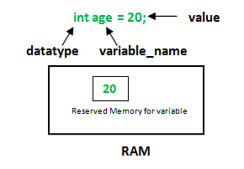
2.1. Declaring Objects
Primitive types
Objects
  Button b; //b is null
  b = new Button(); //b references the new
  // Button

Slide 5
2.2. “.” operator
The dot operator is used to access methods and data of an Object
Panel p = new Panel();
Button b=new Button();
b.setLabel("Ejemplo");
p.add(b);
If I use this operator when the variable is still null, then a NullPointerException is produced
Button b;
b.setLabel("Ejemplo"); // this dot produces exception
.

Slide 6
2.3. Assignment
We have to be careful when assigning variables that are objects:
Panel p = new Panel ();
Button but1 = new Button("BUT1");
Button but2 = but1;
but2.setLabel("BUT2");
p.add(but1);
p.add(but2);
In this case but2 and but1 reference the same object.
So, when I set the Label to BUT2, I change the label for the two objects, because in fact, they are just one object!!!!

Slide 7
2.4. Cloning Objects
Maybe, what we wanted to do (instead of assigning) was to clone the object.
But this action cannot be done with the assignment operator (=), it has to be done with the clone method, like this:
// copy of a vector of 10 double values
double [] vec1 = new double [10]
double vec2[] = vec1.clone();
In this case, at the end, we will have two vectors.

Slide 8
2.5. == operator
We have to use equals to check if two objects have the same value or not.
double v1[] = new double[100];
for (int i=0; i<100; i++) v1[i]=i;
double v2[] = v1.clone();
double v3[] = v2;
if (Arrays.equals(v1,v1)) System.out.println("v1 igual v1");
if (Arrays.equals(v1,v2)) System.out.println("v1 igual v2");
if (Arrays.equals(v2,v3)) System.out.println("v1 igual v3");
We should not use the == operator to compare objects, because the variable is a reference. If we use it, we compare memory addresses (what is really absurd).
if (v1 == v2) { .... // this would be false
// v1 and v2 are different memory addresses

Slide 9
2.6. The garbage collector
Button B1 = new Button(); // B1 references a Button
Button B2 = new Button(); // B2 references another Button
B2 = B1; // B1 and B2 reference the first Button
// nothing references the second Button
The second Button is not referenced any more. It has been lost.
The garbage collector Will pass to clean that part of the memory

Slide 10
3. Classes vs Objects
Classes and Objects are basic concepts in OOP (Object Oriented Programming).
A class is a user defined blueprint or prototype from which objects are created. It represents the set of properties or methods that are common to all objects of one type.

Slide 11
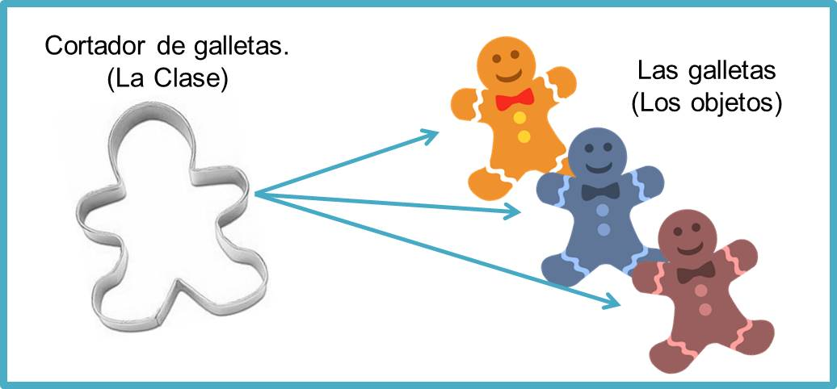
3. Classes vs Objects

Slide 12

3. Classes vs Objects
A Java program consists in one or more classes.
A class is the description. Objects are actual examples.
Example of a class:
class Dog {…}
Some objects of the Dog class:

Slide 13
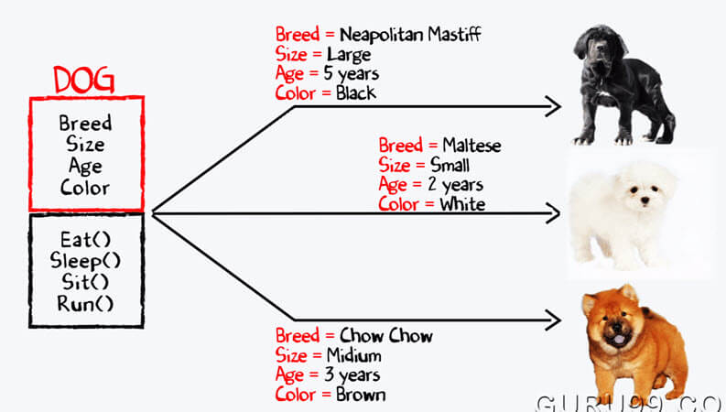
3. Classes vs Objects

Slide 14
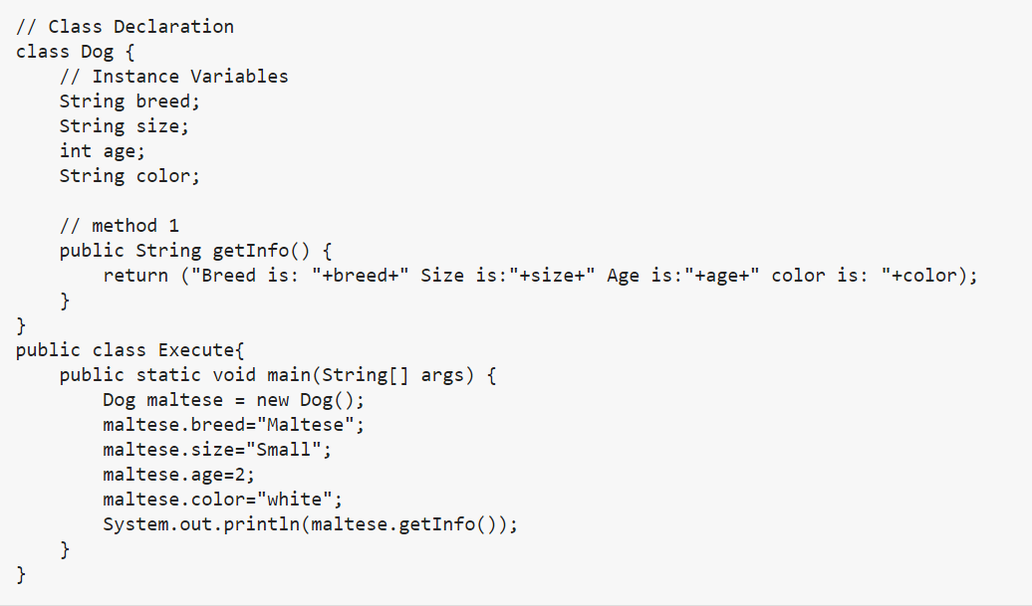
3. Classes vs Objects

Slide 15
4. Class definition
You already know how to use classes in Java.
String, Scanner are predefined classes in Java.
In this unit you will learn how to define your own classes and their methods, and how to create your own objects from them

Slide 16
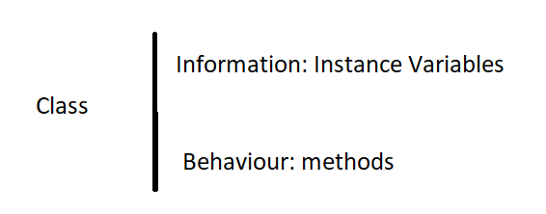
4. Class definition
A class definition specifies the data items an methods of all the objects of this class.
Data items are called fields, instance variables or attributes.

Slide 17
4. Class definition
Imagine that you want to keep the information of a point in the space (two dimensions). We can start with this basic definition:
class Point {
double x; //x value of the point
double y; //y value of the point
} // end of the class
Let’s use the new class:
public static void main (String args[]) {
Point p1 = new Point(); // we create point p1
Point p2 = new Point(); // we create point p2
Point []P = new Point[100]; // we créate an array of Points
p1.x = -1.0; p1.y = -1.0;
p2.x = 1.0; p2.y = 1.0:
double distOrigin = Math.sqrt(p2.x*p2.x + p2.y*p2.y);
System.out.println("Distance from origin:"+distOrigin);
}

Slide 18
4. Class definition
The data inside an object has to be hidden from external access.
A better version of the class Point would be:
class Point {
// attributes
private double x; // x value of the point
private double y; // y value of the point
// methods
public Point() {}
public void setCoordinates(double abs, double ord) {
x = abs; y = ord;
}
public double distOrigin() {
return(Math.sqrt(x*x + y*y));
}
public double getX() {
return(x);
}
public double getY() {
return(y);
}
} // end of the class

Slide 19
4.1. Attributes
Attributes (or properties) are the place where we keep the information of each object of a class. They represent the state of the object.
class Point {
// attributes
private double x; // x value of the point
private double y; // y value of the point
…
x and y are two attributes (of double type).
We can use the following modifiers (access type) for the attributes:
private: the attributes are accessible only for this class.
public: the attributes are accessible for all the classes.
default (when we don’t put anything): The code is only accessible in the same package.
protected: the attributes are accessible in the same package and subclasses

Slide 20
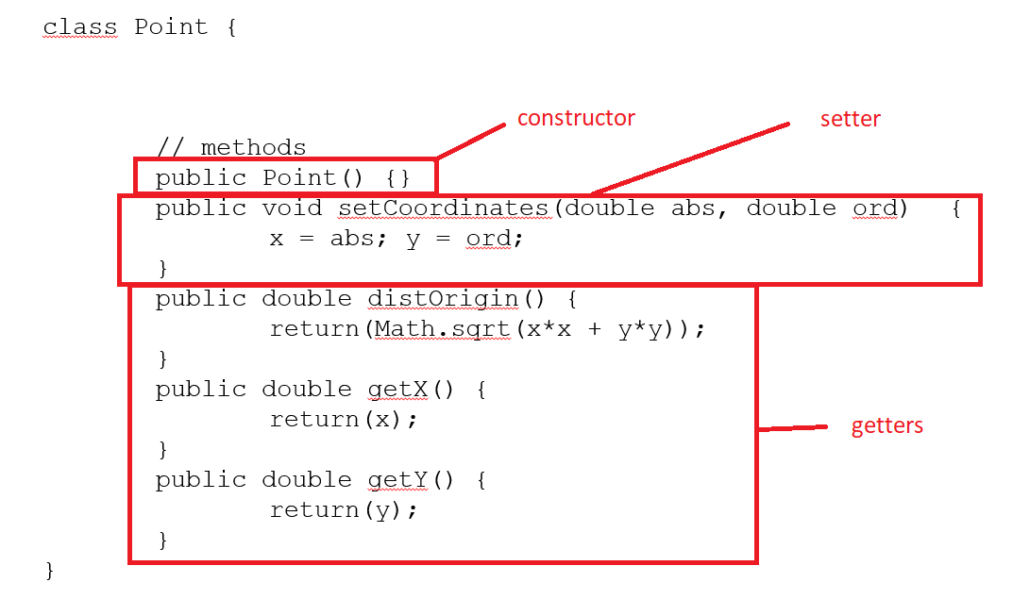
4.2. Methods
Methods are the operations we can perform with each object of a class. They represent the behaviour of the objects.
Types of methods: Constructors, Setters, Getters.

Slide 21
4.2.1. Constructors
Constructors are methods used to initialize objects.
To declare a constructor you name it as the class and you don’t put a return type before the name.
If you don’t put a constructor, Java puts an “empty” one for you.
With this code we instantiate an object of the Point class.
Point p = new Point();
The new keyword creates the object of class Point and invokes the constructor to initialize the newly created object.
class Point {
private double x; // x attribute
private double y; // y attribute
// first constructor
public Point() {
}
// second constructor
public Point(double abs, double ord) {
x = abs;
y = ord;
}
// third constructor
public Point(double coord) {
x = coord;
y = coord;
}
// other methods here …
}

Slide 22
4.2.1. Constructors
Now we have three constructors, so we can create a Point in three different ways
class testingPoints{
public static void main (String args[]) {
Point p = new Point();
Point p2 = new Point(1.0,-1.0);
Point p3 = new Point(1.0);
// ... ... ...
}

Slide 23
4.2.1. Constructors
class Point {
private double x; // x attribute
private double y; // y attribute
// first constructor
public Point() {
}
// second constructor
public Point(double x, double y) {
this.x = x;
this.y = y;
}
// third constructor
public Point(double coord) {
x = coord;
y = coord;
}
// other methods here …
}
Now in the second constructor, the parameters and the attributes have the same name. We have to use the variable this to differenciate!!!!!

Slide 24
4.2.2. Getters
Getters are methods used to retrieve the value of the attributes.
To warrant encapsulation we keep the instance variables private and we define getter methods.
class Point{
private double x; // x attribute
private double y; // y attribute
// constructors here…
public double getX() {
return X;
}
public double getY() {
return Y;
}
}

Slide 25
4.2.2. Getters
The Java convention for their names is
“get” keyword and then the name of the attribute (each word after get with the first letter capitalized)
class Point{
private double x; // x attribute
private double y; // y attribute
// constructors here…
public double getX() {
return X;
}
public double getY() {
return Y;
}
}

Slide 26
4.2.2. Getters. toString() method
toString method is a special method that returns a Strig representation of the object
class Point{
private double x; // x attribute
private double y; // y attribute
// constructors here…
public double getX() {
return X;
}
public double getY() {
return Y;
}
public String toString(){
return “(“+x+”, “+y+”)”;
}
}

Slide 27
4.2.2. Getters. toString() method
Every class in java is child of Object class either directly or indirectly. Object class contains toString() method. We can use toString() method to get string representation of an object. Whenever we try to print the Object reference then internally toString() method is invoked. If we did not define toString() method in your class then Object class toString() method is invoked otherwise our implemented/Overridden toString() method will be called.
Example:
https://www.geeksforgeeks.org/object-tostring-method-in-java/

Slide 28
4.2.3. Setters
Setters are methods used to update the value of the attributes or instance variables.
Setters allow developers to validate and control the attribute values.
class Point{
private double x; // x attribute
private double y; // y attribute
// constructors here…
// getters here…
public void setX(double x) {
this.x=x;
}
public void setY(double y) {
this.y=y;
}
}

Slide 29
4.2.3. Setters
The Java convention for their names is
“set” keyword and then the name of the attribute (each word after set with the first letter capitalized)
class Point{
private double x; // x attribute
private double y; // y attribute
// constructors here…
// getters here…
public void setX(double x) {
this.x=x;
}
public void setY(double y) {
this.y=y;
}
}

Slide 30
4.2.4. Other Methods
We can have other methods such as:
class Point{
private double x; // x attribute
private double y; // y attribute
// constructors here…
// getters and setters here…
public void setXY(double abs, double ord) {
x = abs;
y = ord;
}
public double distOrigin() {
return(Math.sqrt(x*x + y*y));
}
}
This would be a kind of setter
And this one a kind of getter

Slide 31
4.2.4. Other Methods
Another example of useful method:
class Point{
private double x; // x attribute
private double y; // y attribute
// constructors here…
// getters and setters here…
public void movePoint(double abs, double ord) {
x = x+abs;
y = y+ord;
}
}

Slide 32
4.3. Method Overloading
With method overloading multiple methods can have the same name with different parameters.
In our example, the constructor is overloaded:
public Point() {
}
// second constructor
public Point(double x, double y) {
this.x = x;
this.y = y;
}
// third constructor
public Point(double coord) {
x = coord;
y = coord;
}

Slide 33
4.3. Method Overloading
In the previous unit, we created a class ArraysMethods, with some overloaded methods, such as:
public static void fillArrayKeyboard(int []v) {
//… }
public static void fillArrayKeyboard(double []v) {
//… }
public static void fillArrayKeyboard(String []v) {
//… }
public static void fillArrayKeyboard(int [][]v) {
//… }
public static void fillArrayKeyboard(double [][]v) {
//… }
public static void fillArrayKeyboard(String [][]v) {
//… }

Slide 34
4.4. Use of this
this is a keyword used inside a method to make reference to the current object.
It can be used, for example to solve ambiguity when attributes and parameters have the same name:
class Point{
private double x; // x attribute
private double y; // y attribute
// constructors here…
// getters here…
public void setX(double x) {
this.x=x;
}
public void setY(double y) {
this.y=y;
}
}

Slide 35
4.4. Use of this
We can find very interesting uses of this keyword in the following link:
https://www.javatpoint.com/this-keyword

Slide 36
4.5. static attributes
A static variable is common to all the instances (or objects) of the class because it is a class level variable.
Example:
class example {
public int x; // x is an instance variable
public static int cont=0; // conta is global to all // the instances
public example() {
cont++;
}
}
class testExample {
public static void main (String args[]) {
example ex1 = new example();
example v[] = new example[100];
for (int i=0; i<100; i++) v[i] = new example();
int numTotal = example.conta;
System.out.println("N¶umero: "+numTotal);
}
}

Slide 37
4.5. static methods
The static keyword is used to create methods that will exist independently of any instances created for the class.
Static methods do not use any instance variables of any object of the class they are defined in. Static methods take all the data from parameters and compute something from those parameters, with no reference to variables (except from static variables)

Slide 38
4.5. static methods
In the example in item 4.4, the variables were public and that is not a good practice. It would be better like this:
class example {
private int x; // x is an instance variable
private static int cont=0; // conta is global to all // the instances
public example() {
cont++;
}
public static int getCont() {
return cont
}
}
class testExample {
public static void main (String args[]) {
example ex1 = new example();
example v[] = new example[100];
for (int i=0; i<100; i++) v[i] = new example();
int numTotal = example.getCont();
System.out.println("N¶umero: "+numTotal);
}
}

