Slide 1
Day 4: Integrating Survey Data with Geospatial Data

Slide 2
Recap of what’s covered on Day 3
Overview of geospatial data on environment and agriculture
Working with spatio-temporal data
Data quality issues with geospatial data on environment and agriculture
Hands-on exercise:
Integration of agriculture and environment data into analysis
Data visualization

Slide 3
Today’s Agenda
How to work with survey data in R
Georeferencing information in survey data
How to merge geospatial data with survey data
Data visualization (Part 2)

Slide 4
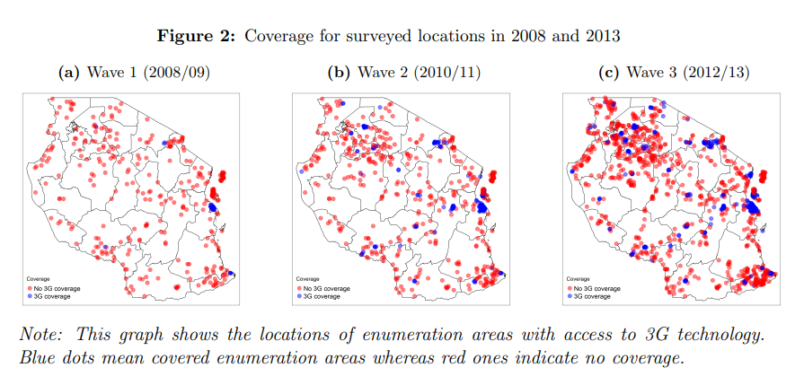
Why do we want to combine survey data with geospatial data
Bahia et al. (2023)

Slide 5
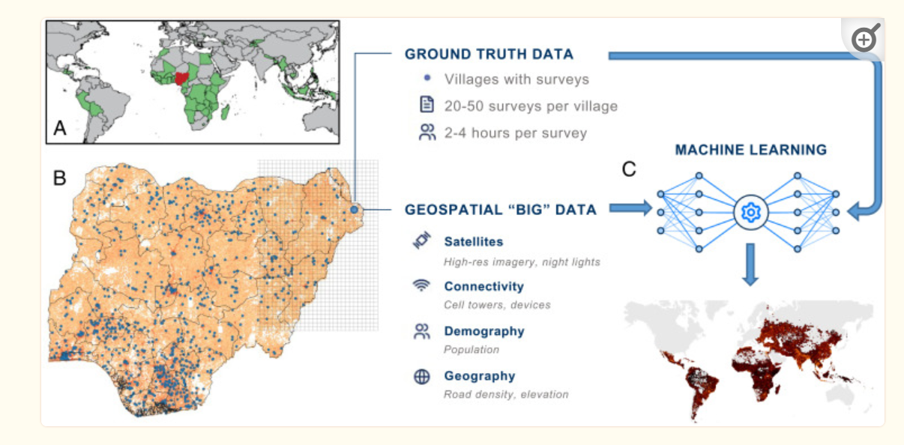
Why do we want to combine survey data with geospatial data
Chi et al. (2023)
Notes:
https://www.ncbi.nlm.nih.gov/pmc/articles/PMC8784134/

Slide 6
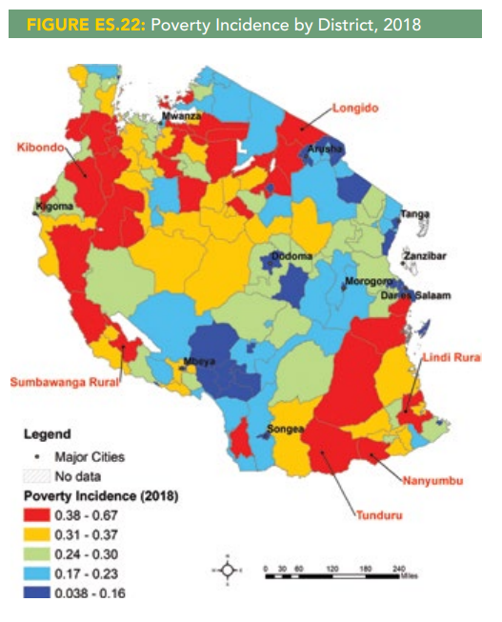
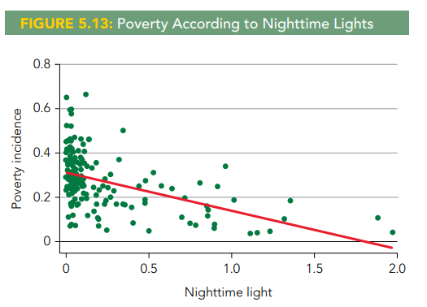
Why do we want to combine survey data with geospatial data
By matching household survey data with geospatial data, we can uncover new insights into the spatial determinants of socio-economic and demographic characteristics
2019 Tanzania Mainland Poverty Assessment

Slide 7
How to work with survey data in R

Slide 8
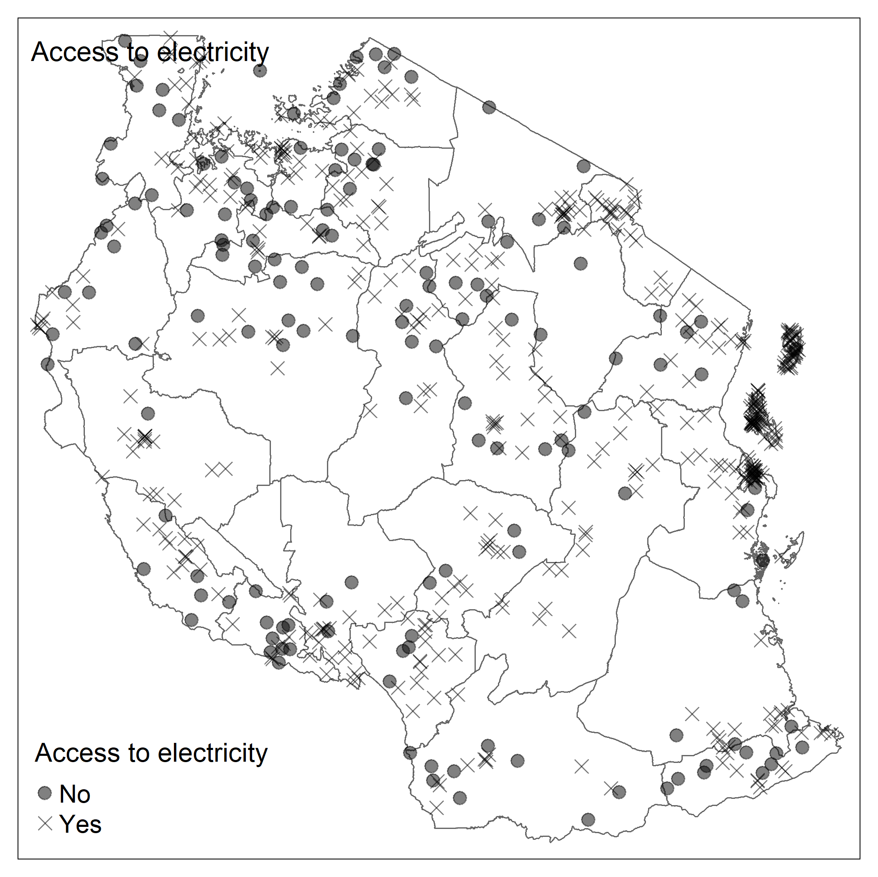
How to work with survey data in R
Dataset for demo: 2022 DHS
How to specify sampling design
Uncovering georeferencing information in DHS
How to merge survey data with geospatial data
Replication code: 4-lecture_code.R

Slide 9
Group study proposal discussion
Group study presentation
Split into a group of 5 members
Tomorrow, we will have a study presentation, please prepare a pptx presentation highlighting:
What is your research question (e.g., how much forest cover is lost over the past decade?)
Why is this research question important and how is it related to the National Environment Statistics Report (NESR) and/or the Integrated Survey of Agriculture (IAS) report
Datasets used for this study (e.g., global forest cover dataset from Global Forest Change 2000-2022 by Hansen et al. (2013))
Expected outputs (e.g., map showing deforestation rate at the region level; plot trends in deforestation over time)

