Slide 1
Day 3: Introduction to Geospatial Data on Environment and Agriculture

Slide 2
Recap of what’s covered on Day 2
Reprojection (revisited)
Zonal statistics
Data quality issues
Data cleaning
Geometric operations with vector data
Geometric operations with raster data

Slide 3
Today’s Agenda
Overview of geospatial data on environment and agriculture
Working with spatio-temporal data
Data quality issues with geospatial data on environment and agriculture
Integration of agriculture and environment data into analysis

Slide 4
Climate and Agriculture Statistics using geospatial data
Risk component | Examples of data sources
Hazard | See GFDRR website Drought - the Agricultural Stress Index (ASI), the Vegetation Health Index (VHI), Standardised Precipitation-Evapotranspiration Index (SPEI) Flood – Fathom, UNITAR (for more recent events) Precipitation / temperature – Climate Research Unit Heat waves - GFDRR Greenhouse gases - EDGAR - Emissions Database for Global Atmospheric Research
Exposure | Population – WorldPop/GRID3, GHS-POP, LandScan, Meta Road – OpenStreetMap Building footprints – Google, Microsoft, Ecopia, WorldPop/GRID3, GHSL, OpenStreetMap Landcover/Cropland – FAO, ESRI landcover, Potapov et al. (2022) Agricultural production – MapSPAM, GAEZ v4
Vulnerability | Poverty map produced in 2018 () Nighttime light – VIIRS Relative Wealth Index – Meta Access to markets, schools and health facilities – Weiss et al. (2018) and (2020), OpenStreetMap, WHO health facility database
Notes:
See Chapter 3: Components of the FDES and the Basic Set of Environment Statistics

Slide 5
Climate and Agriculture Statistics using geospatial data
Tasks
Overlay various layers of spatial data and save as a map
Plot cropland, forest cover, etc. with the locations of roads, cities, etc.
Work with climate data – precipitation, temperature
Plot a map of average monthly temperature and precipitation for Tanzania by region (December 2022)
Plot trends in monthly temperature and precipitation for Tanzania by region (1901-2022)
Plot the standard deviation of avg. monthly temperature and precipitation for Tanzania by region (against the long term mean 1901-2022)
Work with natural disaster risk indicators
Plot various natural disaster risks (https://www.un-spider.org/node/11423#:~:text=The%20Agricultural%20Stress%20Index%20System,for%20download%20from%20FAO%20FTP)
% of people/cropland in drought areas
% of people/cropland in flood areas
Combine survey statistics with agricultural statistics

Slide 6
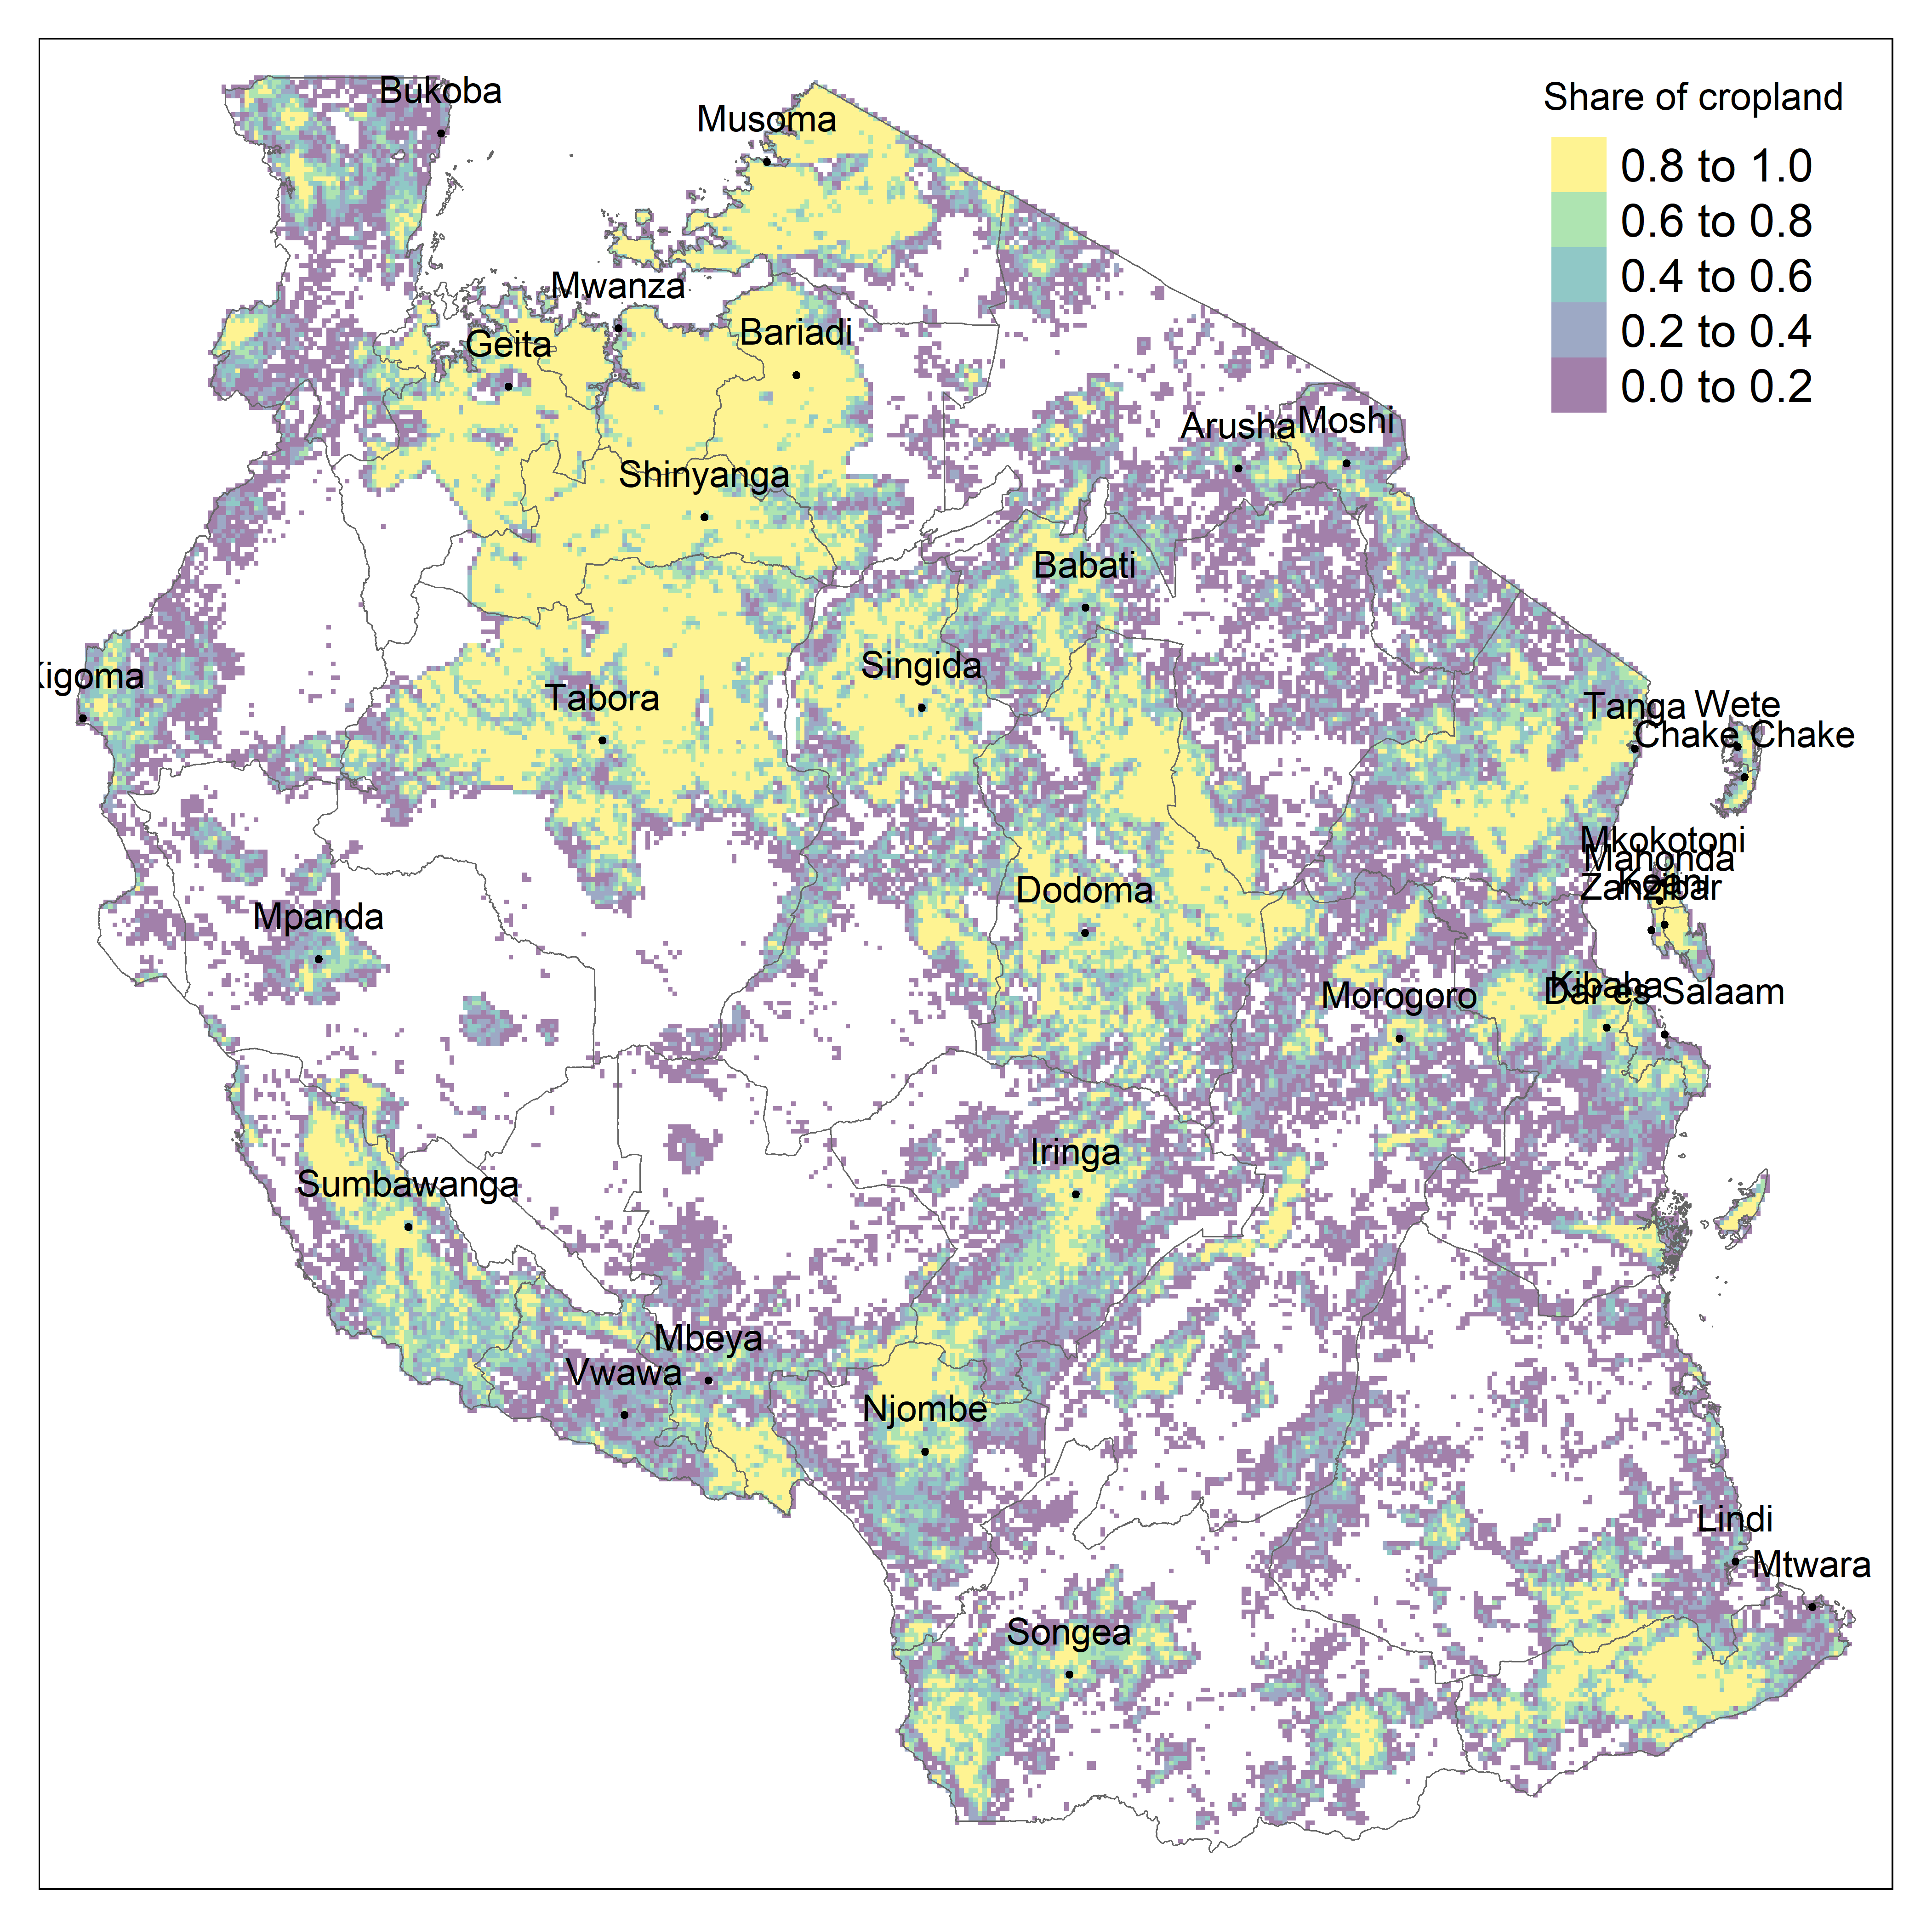
Task 1: Overlay various layers of spatial data and save as a map
Datasets:
ADM1 boundary shapefile from HDX
Landcover data on cropland from FAO
Locations of cities from World Cities Database
Replication code: 2.1.advanced_exercise.R

Slide 7
Task 2: Work with climate data – precipitation, temperature
Datasets:
ADM1 boundary shapefile from HDX
Precipitation/temperature data from the Climate Research Unit
Replication code: 2.2.advanced_exercise.R

Slide 8
Task 3: Work with natural disaster risk indicators
Datasets:
ADM1 boundary shapefile from HDX
Drought index from FAO
Population data from WorldPop
Replication code: 2.3.advanced_exercise.R

Slide 9
Task 4: Combine survey statistics with agricultural statistics
TBD

Slide 10
Google Earth Engine (if there is enough interest)

Slide 11
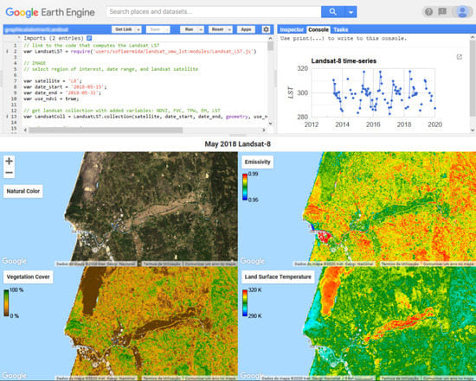

Google Earth Engine (with Python)
Google Earth Engine combines a multi-petabyte catalog of satellite imagery and geospatial datasets with planetary-scale analysis capabilities.
This segment of the training introduces you to GEE and how to work with it through geemap package in Python

Slide 12
What is GEE?
https://youtu.be/gKGOeTFHnKY

Slide 13
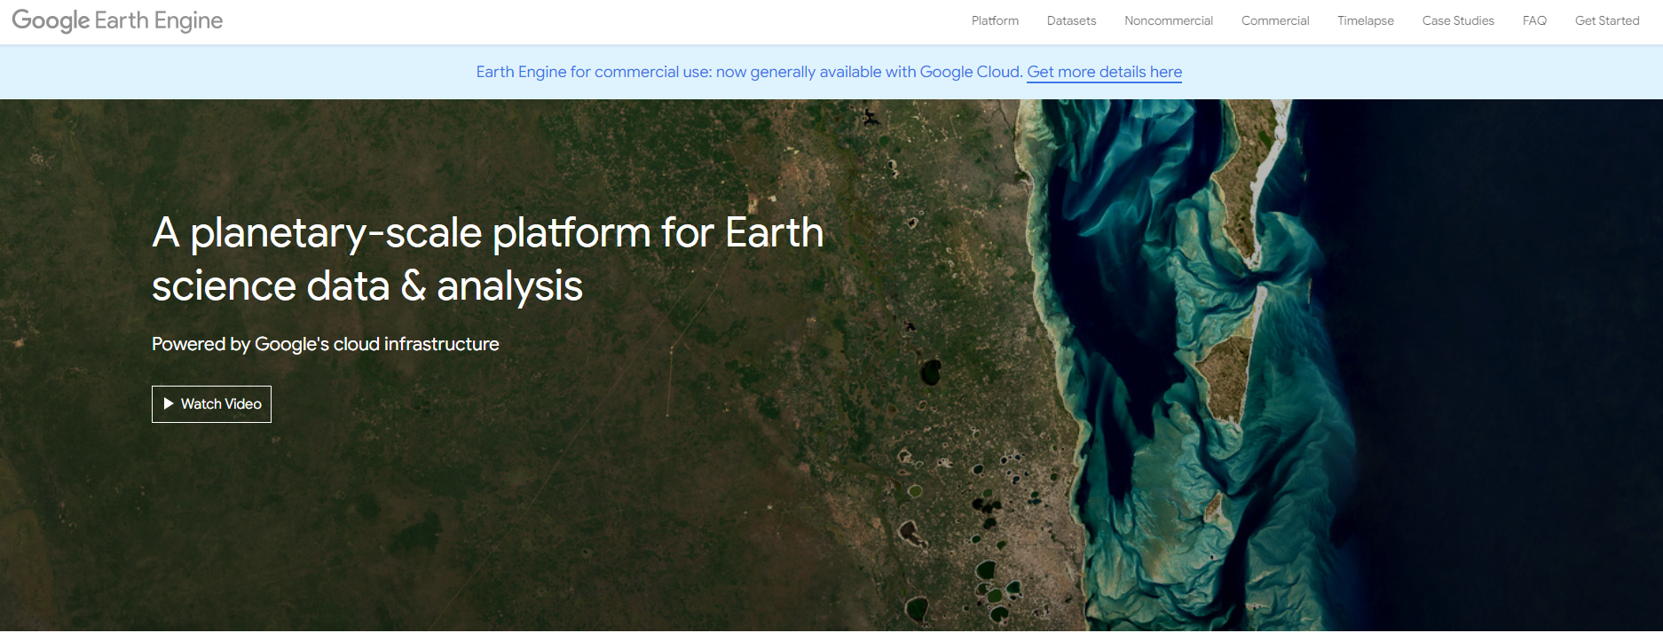
Let’s sign up for GEE
Sign in using your own Gmail on Google Chrome
Select “Get started” on the GEE website
Follow instructions to create your own GEE project

Slide 14
Setting things up
To use GEE through Python, you first need to install Anaconda, Python, and geemap package
Anaconda: a free, open-source distribution of Python and R for data science and machine learning. It includes over 250 pre-installed packages, such as SciPy, Malplotlib, Pandas, and NumPy, which are used in scientific computing.
Python: computer programming language often used to build websites and software, automate tasks, and conduct data analysis
geemap package: Python package for interactive geospatial analysis and visualization with Google Earth Engine (GEE)
Notes:
For details on installation process, see https://www.cse.unsw.edu.au/~en1811/resources/getting-started/install-anaconda.html.

Slide 15
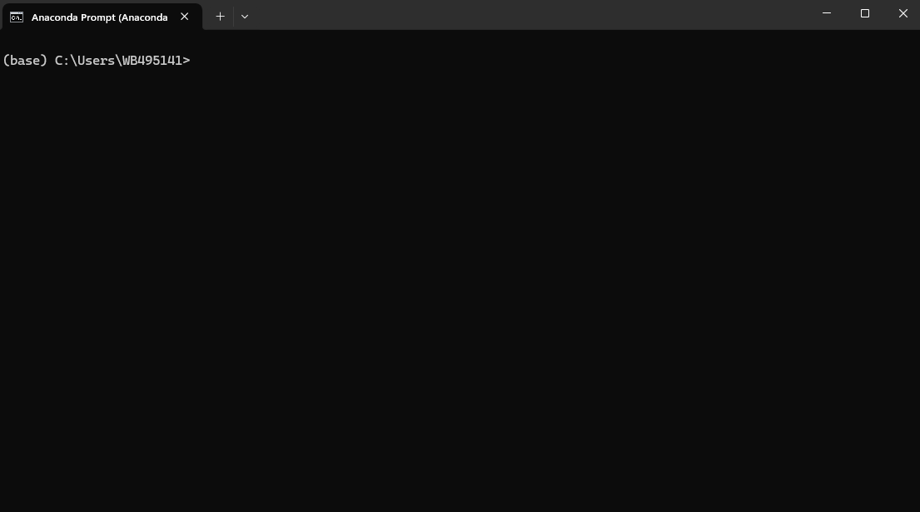
Example of GEE use – extracting imagery and data
To use GEE through Python, you first need to install Anaconda, Python, and geemap package
After Anaconda is stalled, go to Anaconda Prompt, which will open a new window like below:
Notes:
For details on installation process, see https://www.cse.unsw.edu.au/~en1811/resources/getting-started/install-anaconda.html.

Slide 16
Example of GEE use – extracting imagery and data
Copy and paste the following commands into the prompt:
conda create -n gee python=3.11
conda activate gee
conda install -n base mamba -c conda-forge
mamba install geemap -c conda-forge
mamba install geopandas localtileserver -c conda-forge
pip install geemap
pip install --upgrade jupyter

Slide 17
Example of GEE use – extracting imagery and data
Now you are ready to use GEE!
Type in the following in Anaconda Prompt:
cd “**path**“
jupyter notebook
Jupyter Notebook: server-client application that allows editing and running notebook documents via a web browser
This will take you to a web browser where you can write scripts to run analysis in Python (or other programming languages)

Slide 18
Downloading ASI from GEE
Note that ASI data is available through GEE

