Slide 1
Temple Hackathon - Node.js study session -
Shoei Takamaru, Global Mall Group

Slide 2
Agenda
１
1
What is Node,js
１
2
JavaScript vs Node.js
１
3
Node.js API
１
4
express
１
5
Socket.io
１
6
Useful Libraries

Slide 3
Agenda
What is Node.js

Slide 4
What’s Node.js?
Most people say…
“Node.js is a server-side JavaScript”
So what??

Slide 5
What’s Node.js?
Not only want to write in server-side,
but
“Node.js is a web platform”

Slide 6
Other script language
Someone says …
Ruby … “Easy and Beautiful”
Python … “Simple and Versatile”
Perl … “Diversified”
PHP … “It’s not a programming lang,
but template”
These are just wrappers of 90’s C

Slide 7
Node.js Feature
Asynchronous with Non-blocking I/O
Run as a HTTP server

Slide 8
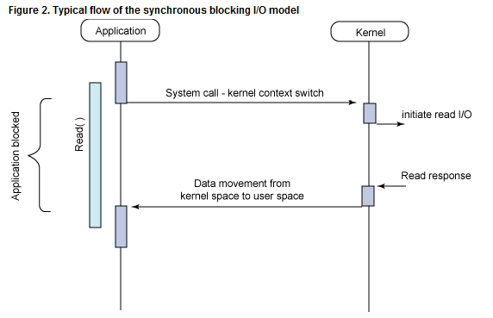
Blocking I/O vs Non-blocking I/O
Blocking I/O

Slide 9
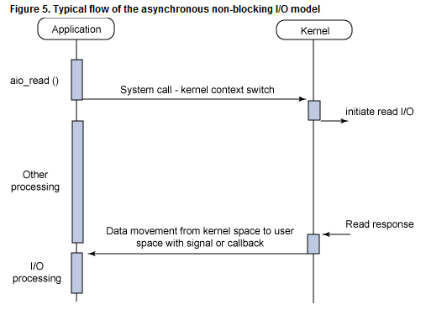
Blocking I/O vs Non-blocking I/O
Non-blocking I/O

Slide 10
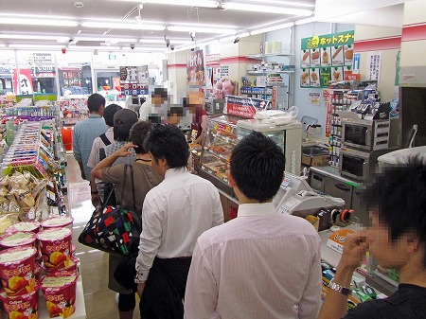
Image of blocking I/O

Slide 11
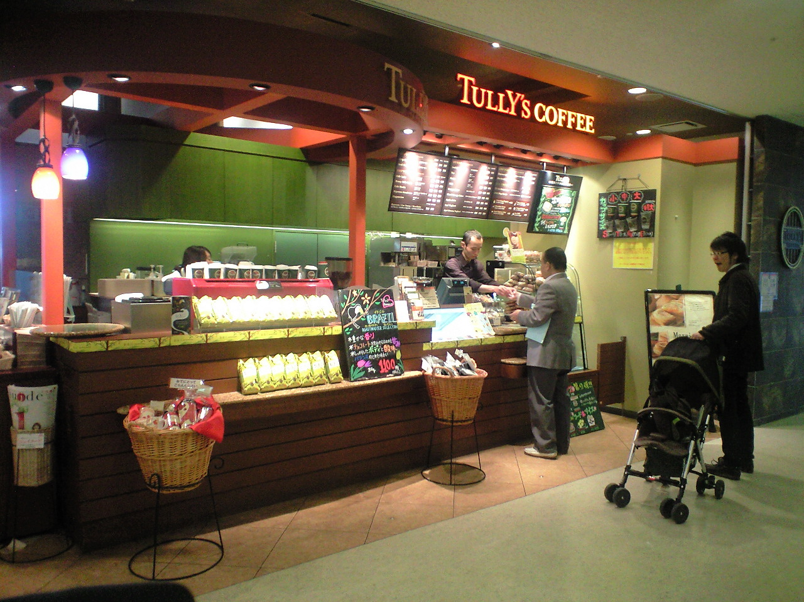
Image of Non-blocking I/O

Slide 12
Agenda
JavaScript vs Node.js

Slide 13
Most syntaxes are same
require
module.exports and exports
debug

Slide 14
Agenda
Node.js API

Slide 15
http
event

Slide 16
Agenda
express

Slide 17
express features
Node.js became popular thanks to express
light, simple, fast
install
run
template
routes

Slide 18
Agenda
Socket.io

Slide 19
supports websocket and automatically flash socket and ajax long polling
chat application
for realtime e.g. game

Slide 20
Agenda
Useful Libraries

Slide 21
Useful Libraries
https://github.com/takamario/20130730-node-handson#libraries

