Slide 1
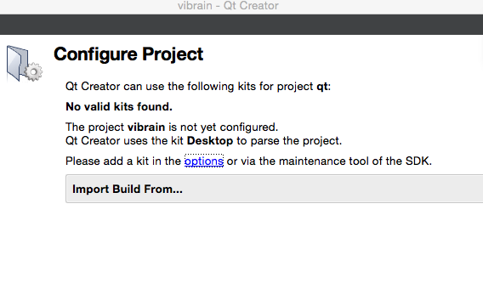

Slide 2
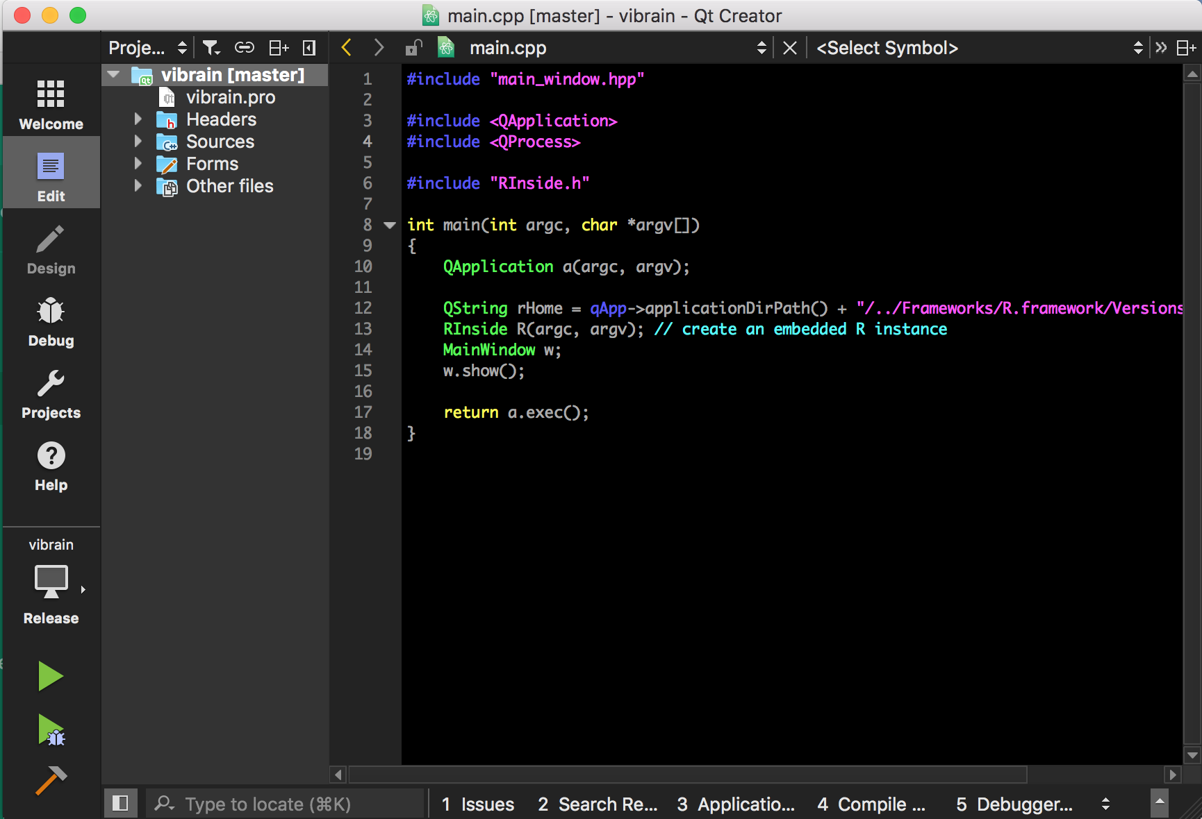
Select “Release”

Slide 3
Push this button

Slide 4
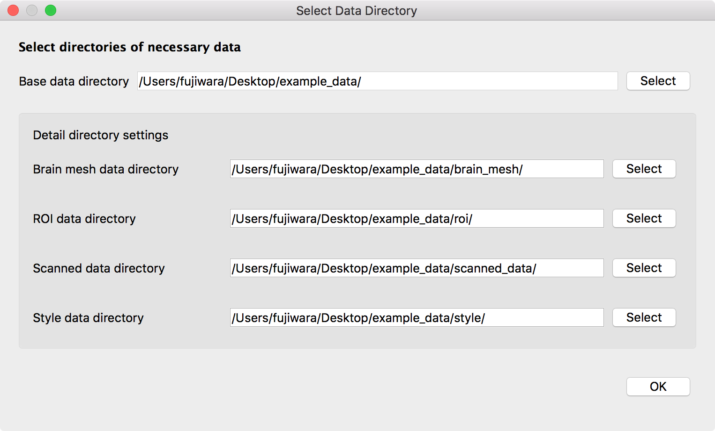
1. Select “example_data” directory
2. Click OK after selecting the directory

Slide 5
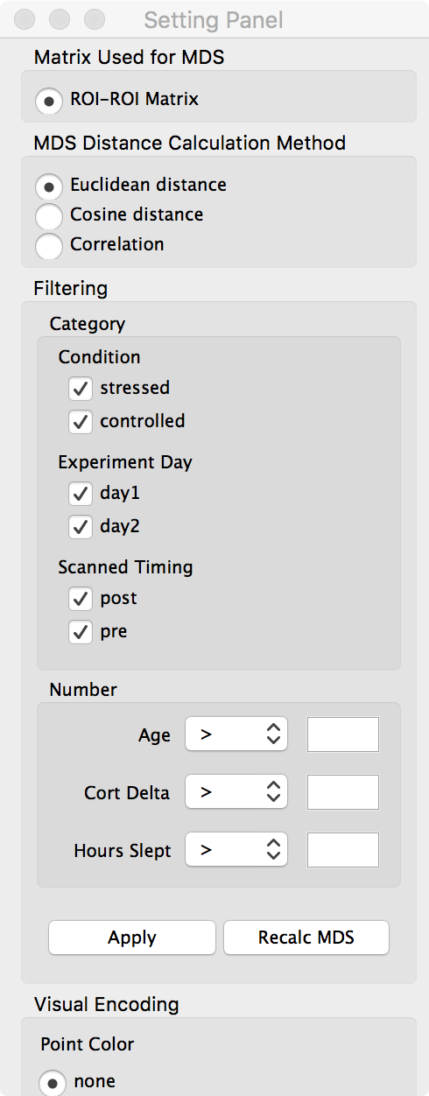
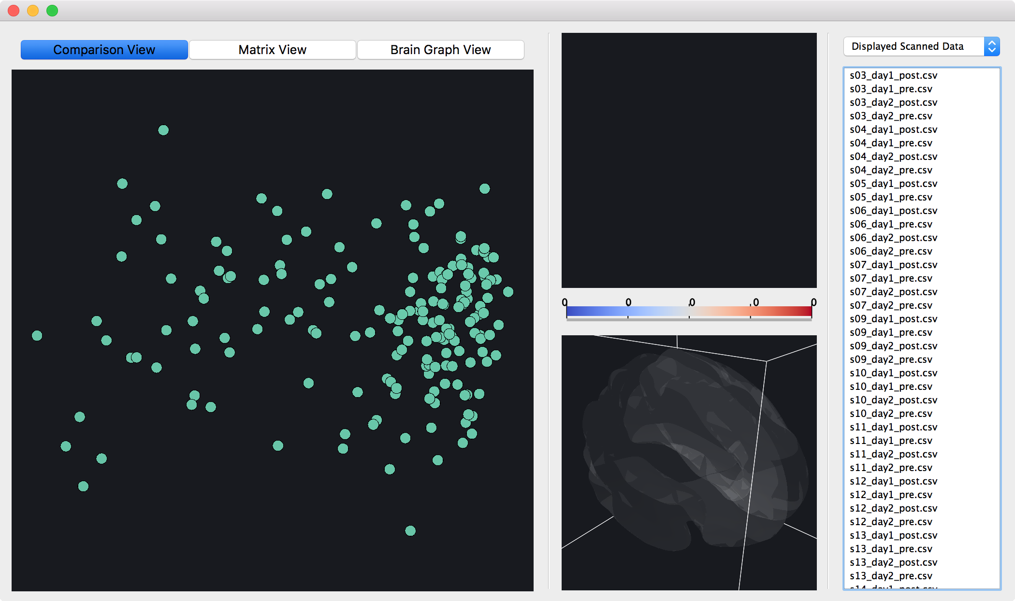
Setting Panel
Main Window
Infromation View
Matrix View
Comparison View
Brain Graph View

Slide 6
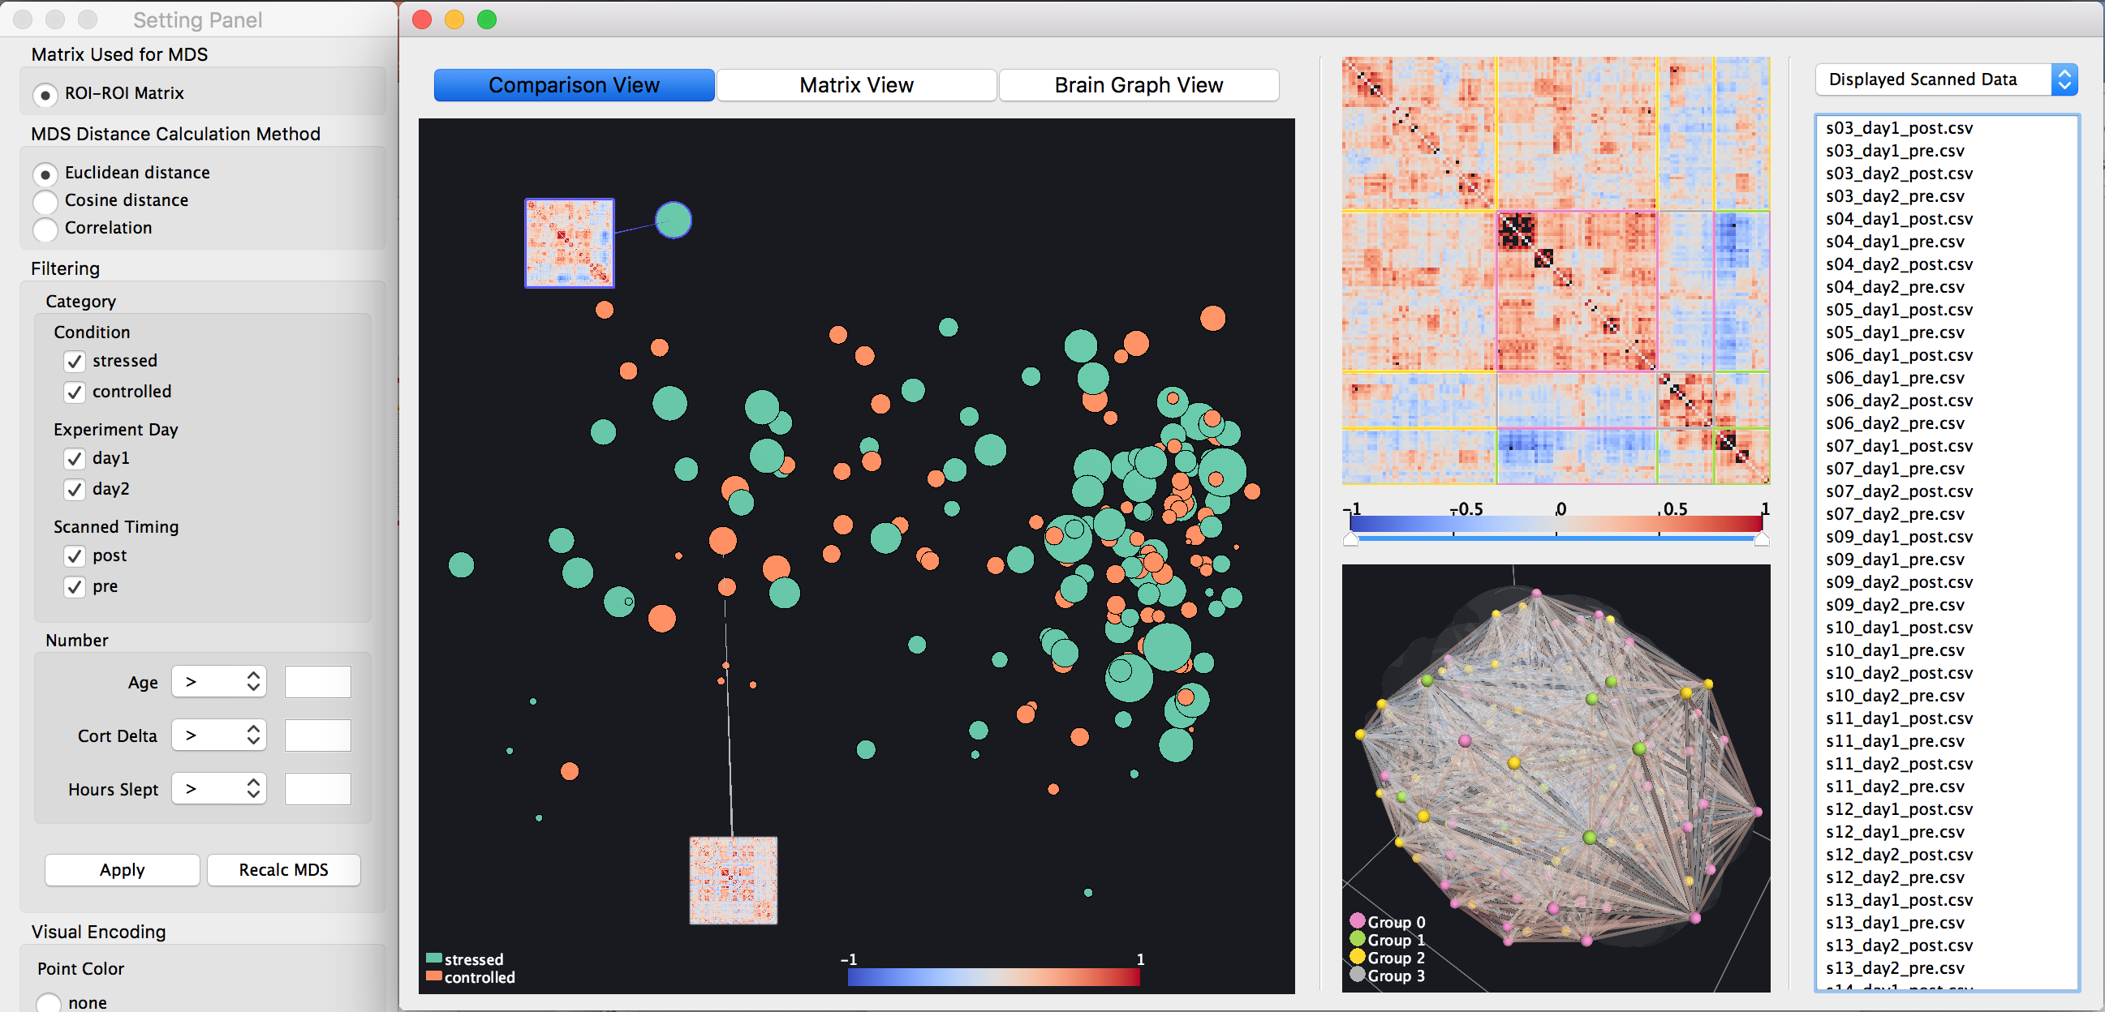

Slide 7
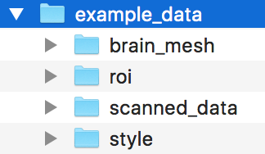

Slide 8


Slide 9
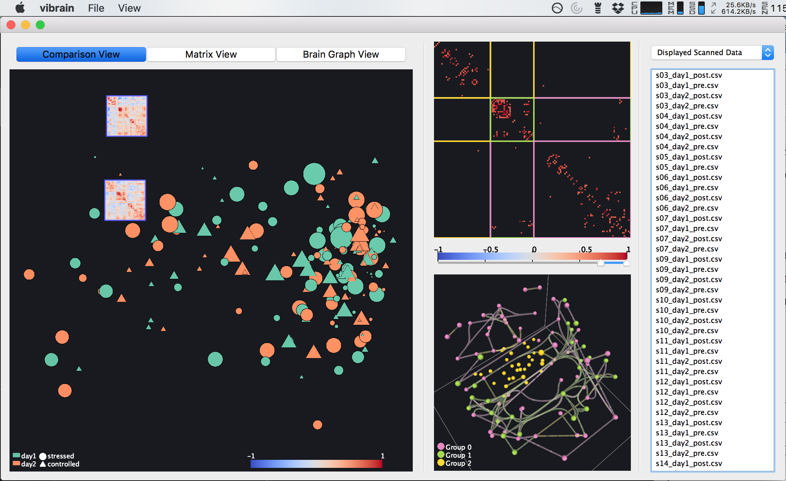
Infromation View
Matrix View
Comparison View
Brain Graph View

Slide 10
