Slide 1
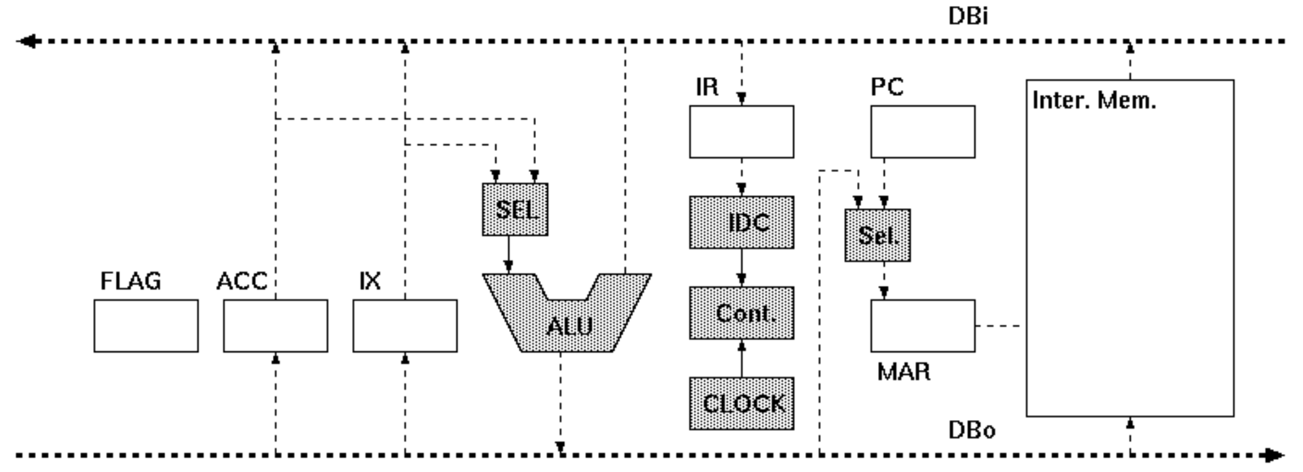
00
00
00
00: 64 80
02: B4 81
04: 74 82
06: 0F
80: 02
81: 03
82: 00
00
00
00
00
00
00
00

Slide 2
phase0
phase1
phase2
phase3
phase4

Slide 3
64
①
③
②
64
01
00: 64 80
02: B4 81
04: 74 82
06: 0F
80: 02
81: 03
82: 00
④
00
64
①
00
00
00
00
⑤
64

Slide 4
80
③
②
64
02
00: 64 80
02: B4 81
04: 74 82
06: 0F
80: 02
81: 03
82: 00
④
00
80
①
00
00
00
01
⑤
80

Slide 5
02
②
64
02
00: 64 80
02: B4 81
04: 74 82
06: 0F
80: 02
81: 03
82: 00
③
00
02
00
02
00
80
④
①
①
02

Slide 6
B4
①
③
②
B4
03
00: 64 80
02: B4 81
04: 74 82
06: 0F
80: 02
81: 03
82: 00
④
00
B4
①
00
02
00
02
⑤
B4

Slide 7
81
③
②
B4
04
00: 64 80
02: B4 81
04: 74 82
06: 0F
80: 02
81: 03
82: 00
④
00
81
①
00
02
00
03
⑤
81

Slide 8
03
②
B4
04
00: 64 80
02: B4 81
04: 74 82
06: 0F
80: 02
81: 03
82: 00
③
④
02
03
00
05
00
81
⑤
①
①
05

Slide 9
74
①
③
②
74
05
00: 64 80
02: B4 81
04: 74 82
06: 0F
80: 02
81: 03
82: 00
④
00
74
①
00
05
00
04
⑤
74

Slide 10
82
③
②
74
06
00: 64 80
02: B4 81
04: 74 82
06: 0F
80: 02
81: 03
82: 00
④
00
82
①
00
05
00
05
⑤
82

Slide 11
05
74
06
00: 64 80
02: B4 81
04: 74 82
06: 0F
80: 02
81: 03
82: 05
②
③
05
00
05
00
82
④
①
①
05

Slide 12
0F
①
③
②
0F
07
00: 64 80
02: B4 81
04: 74 82
06: 0F
80: 02
81: 03
82: 05
④
00
0F
①
00
05
00
06
⑤
0F

