Slide 1
Complex Numbers
Very important in engineering and science.
Analysis of stresses and strains on beams.
Studying resonance phenomena in structures.
Control theory.
Signal analysis.
Quantum mechanics.
Relativity.
Fluid dynamics.

Slide 2
Constructing the Complex Numbers
When z=x+iy , we call x the real part of z and y the imaginary part.
Two complex numbers are equal if they have the same real and imaginary parts:

Slide 3
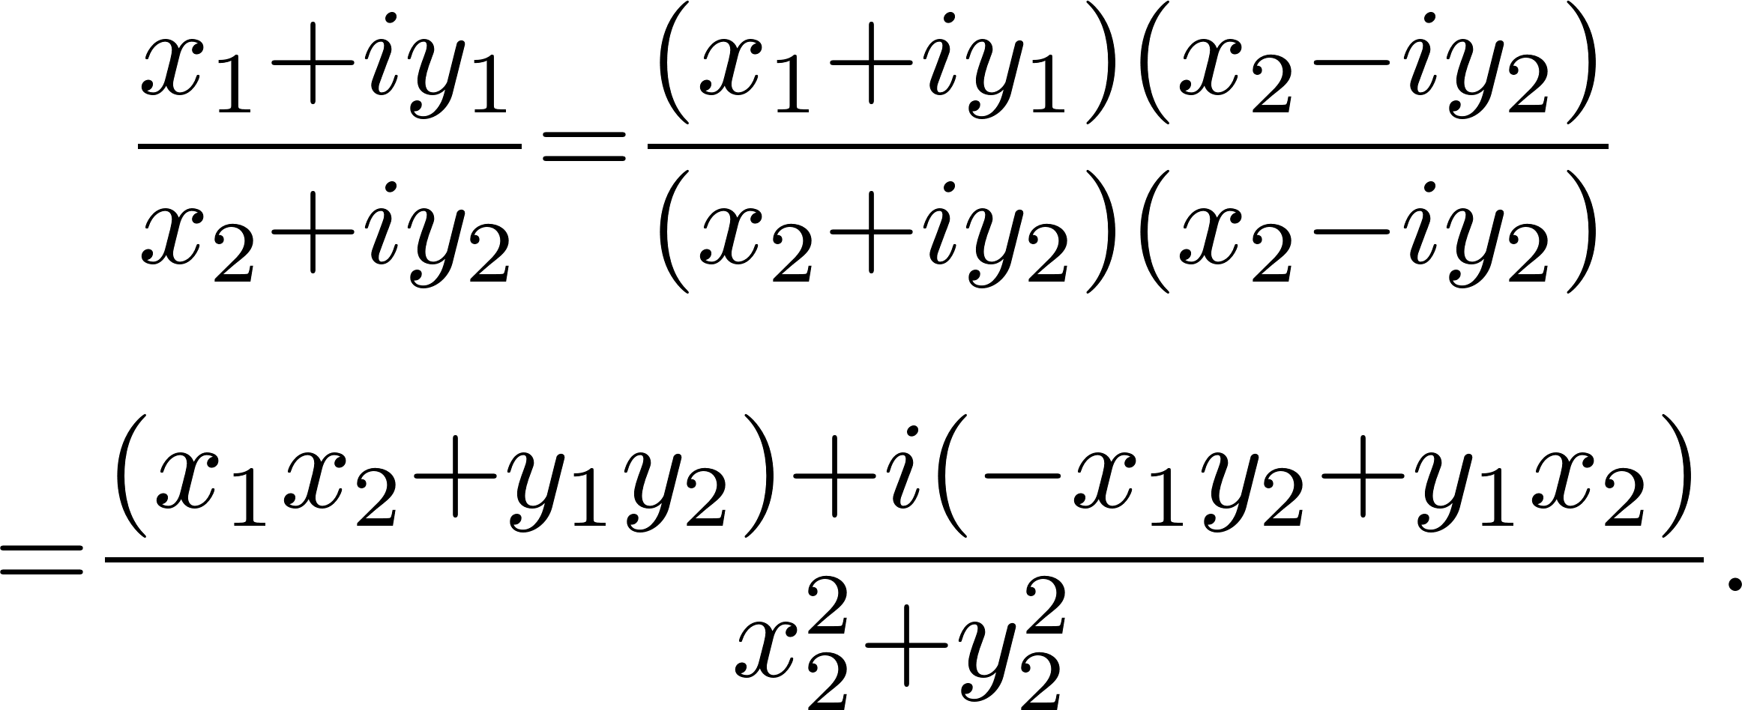
Constructing the Complex Numbers
Addition and subtraction:
Multiplication
Division
Identity

Slide 4
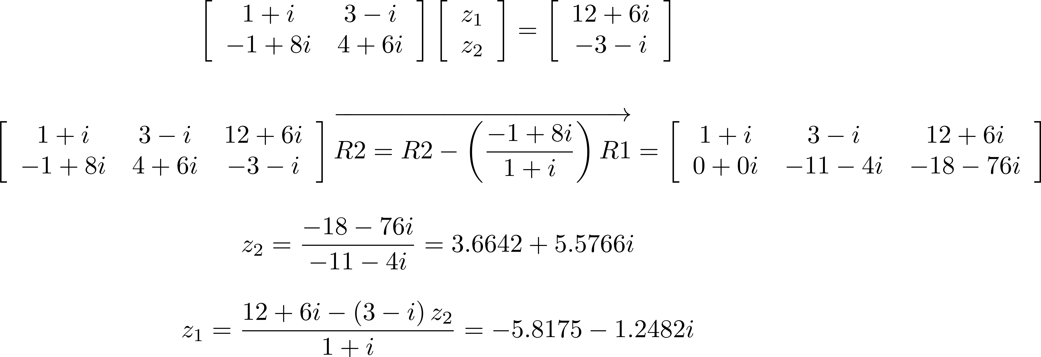
Calculating with Complex Numbers
Can now do all the standard linear algebra calculations with complex numbers.
Solve systems of linear equations

Slide 5
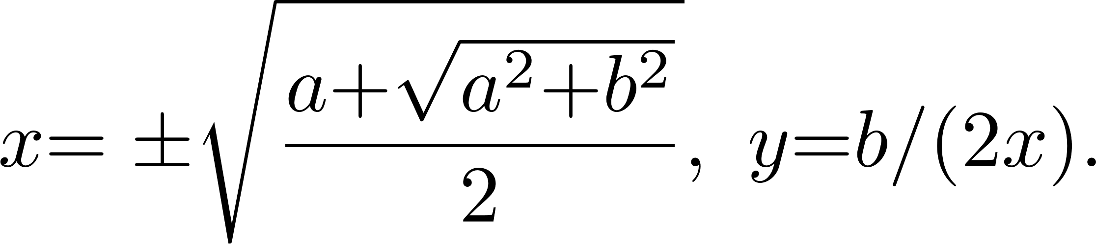
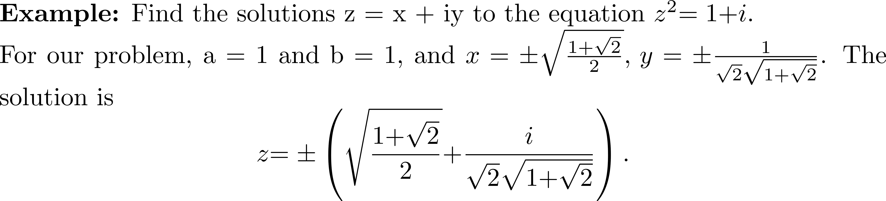
Calculating with Complex Numbers
Every complex number a+ib has a square root.

Slide 6
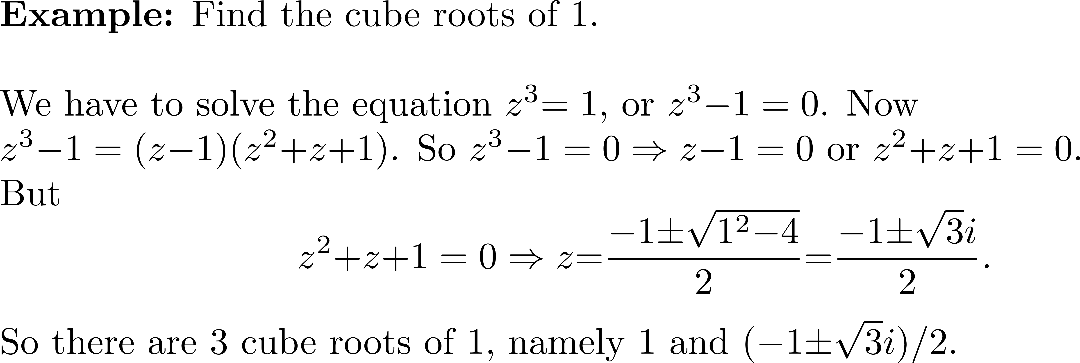
Example 1

Slide 7

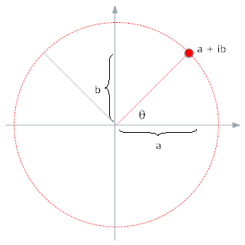
Geometric Representation of
Argand Diagram
Complex numbers add and subtract like vectors.

Slide 8
Complex Conjugate

Slide 9
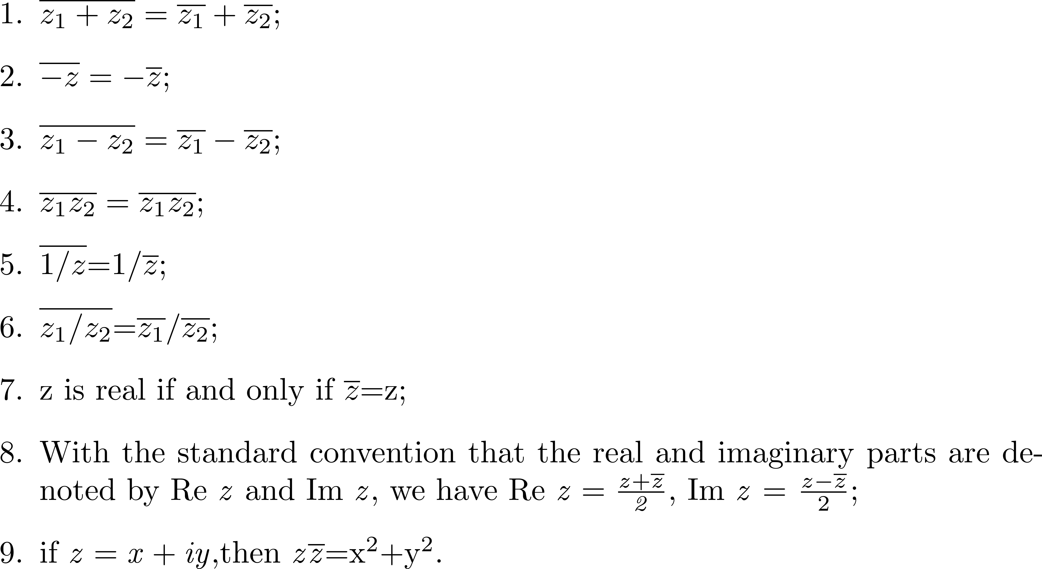
Complex Conjugate
Properties of the complex conjugate

Slide 10
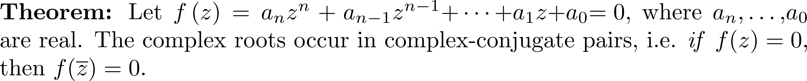
Complex Conjugate

Slide 11
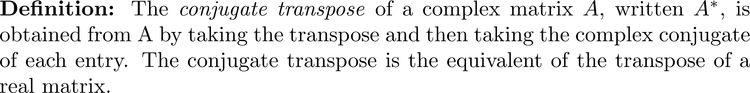
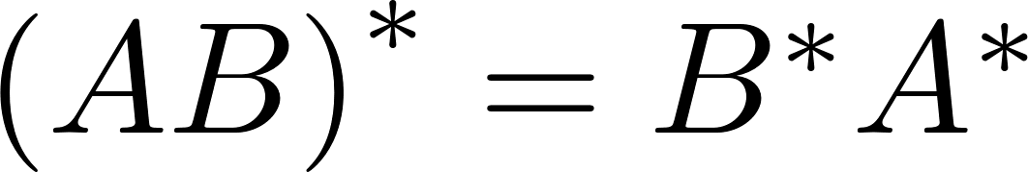
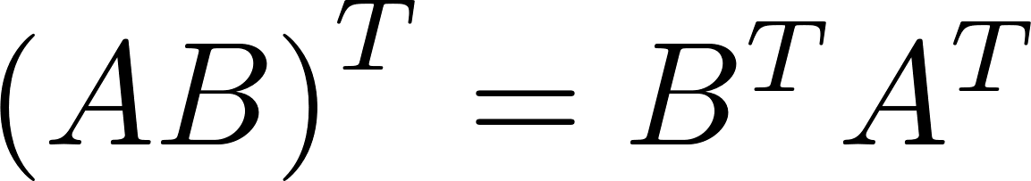
Complex Conjugate
Analogous to the result for real matrices.

Slide 12
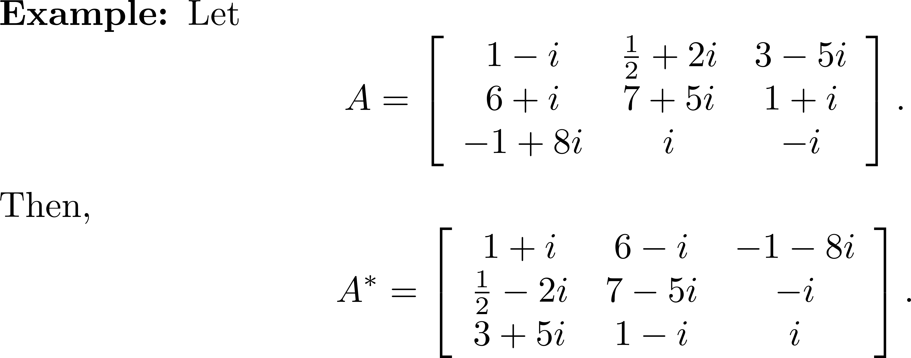
Example 2

Slide 13
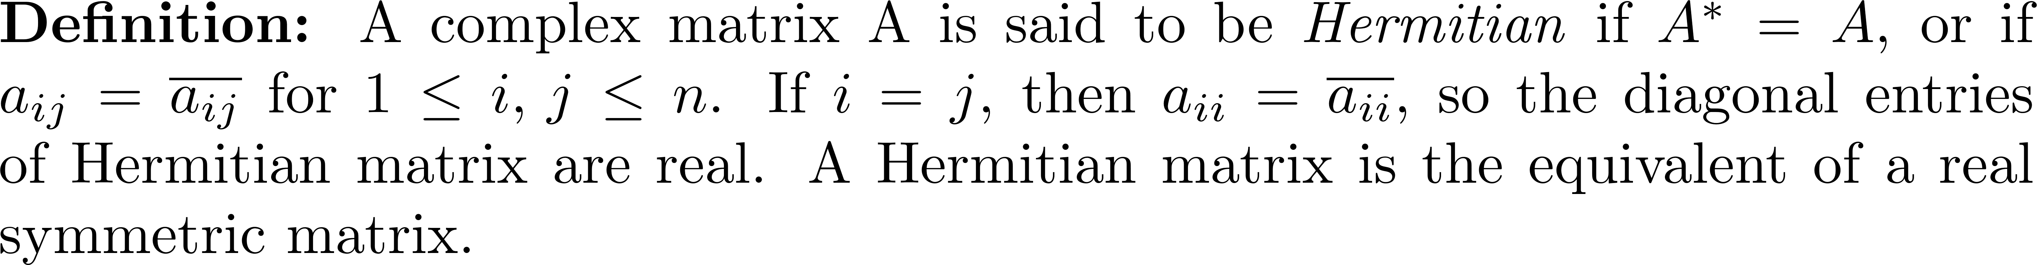
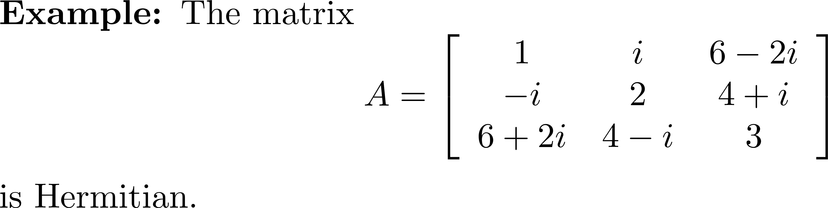
Hermitian Matrix

Slide 14
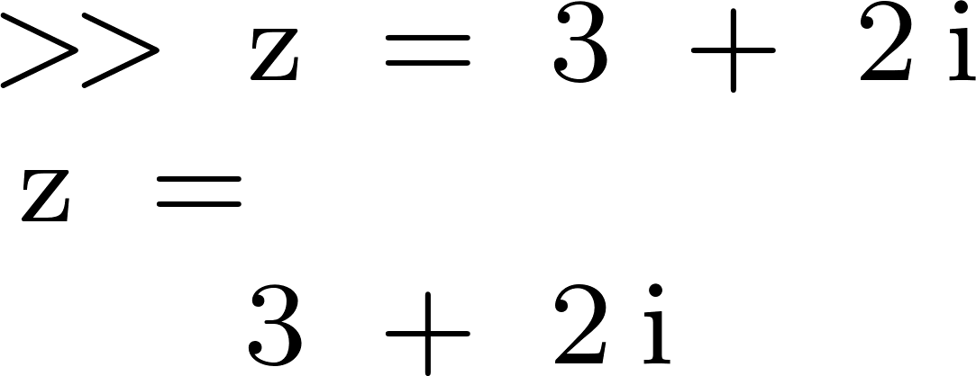
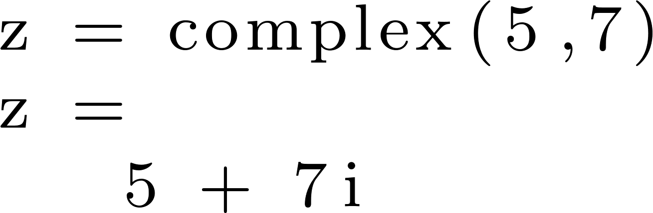
Complex Numbers in MATLAB
Can assign a complex number to a variable as follows:
Alternatively, use the function complex.

Slide 15
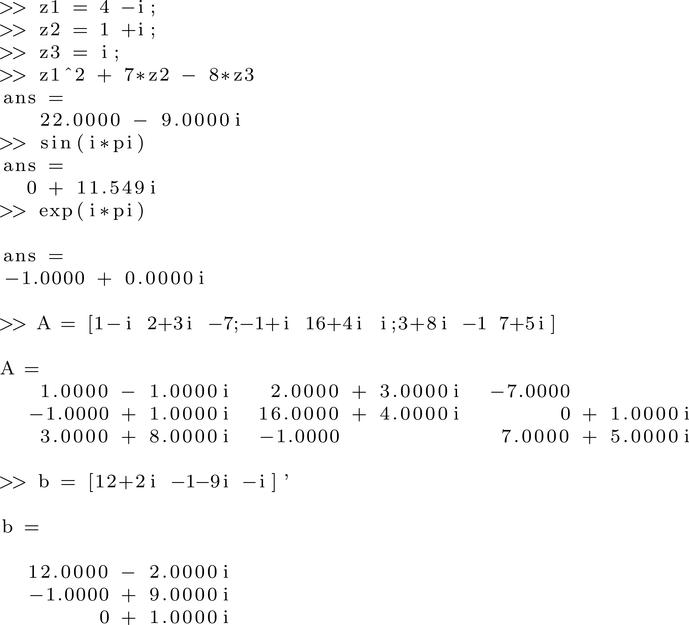
Complex Numbers in MATLAB
Can use any function that accepts a complex variable, and can create and solve complex systems of equations.

Slide 16
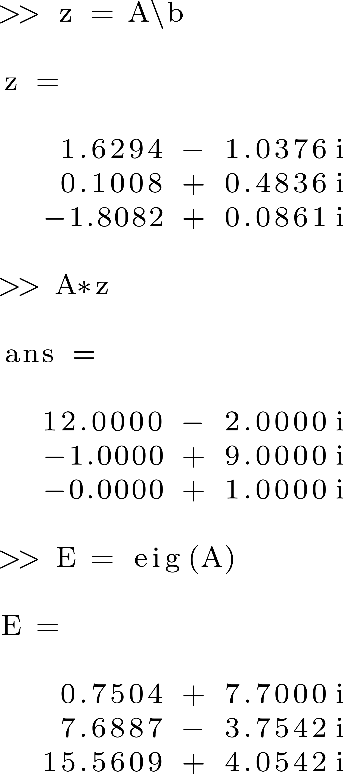
Complex Numbers in MATLAB

Slide 17
Complex Numbers in MATLAB
When the matrix is real, complex eigenvalues occur in conjugate pairs. For a complex matrix, this is not true.

Slide 18
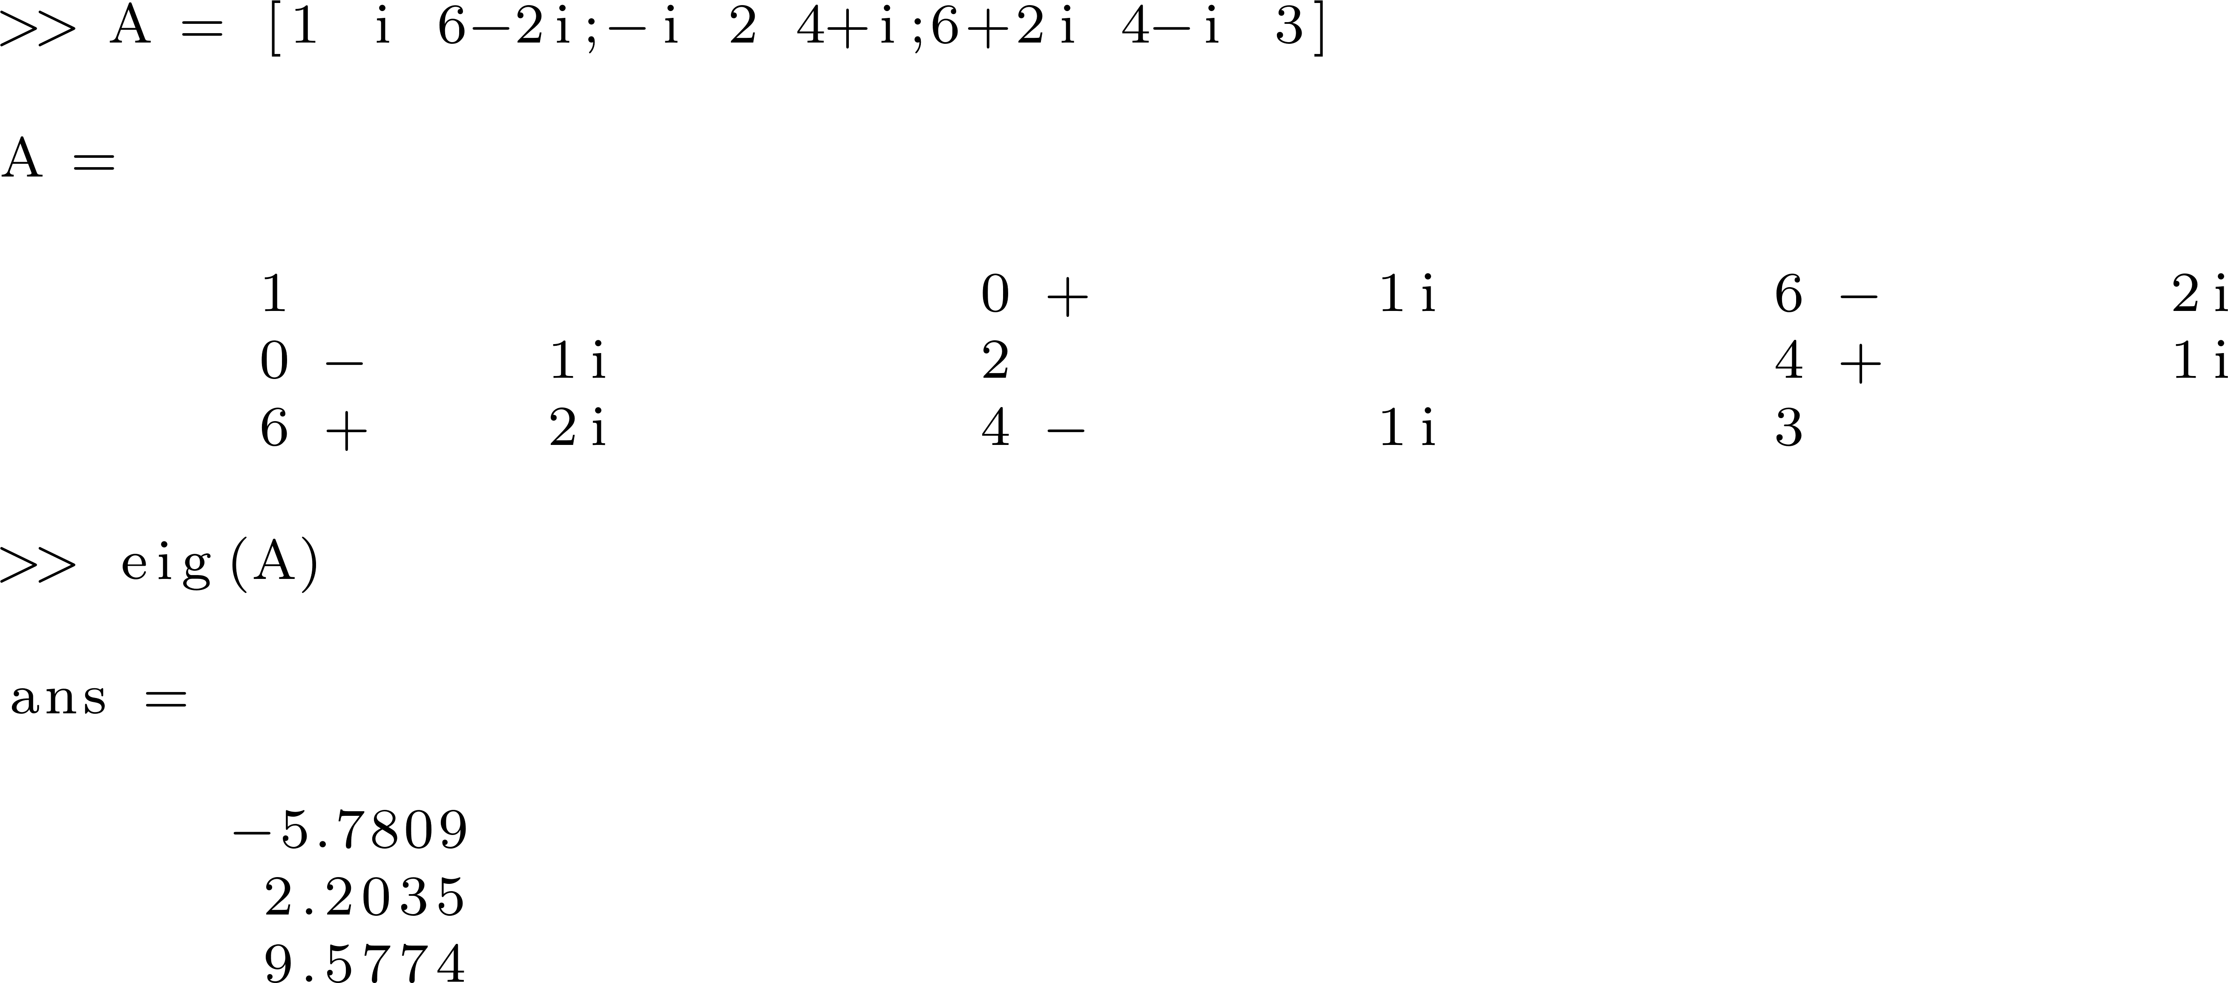
Complex Numbers in MATLAB

Slide 19
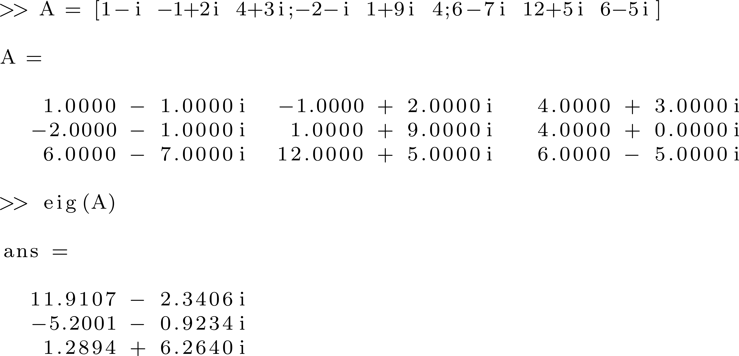
Complex Numbers in MATLAB
Recall that a real symmetric matrix has real eigenvalues. The same is true for a Hermitian matrix.

Slide 20
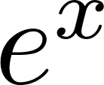
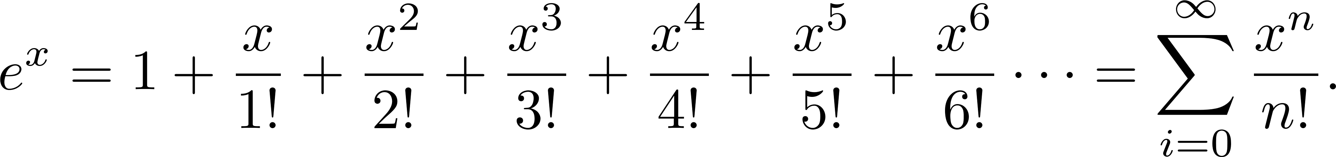
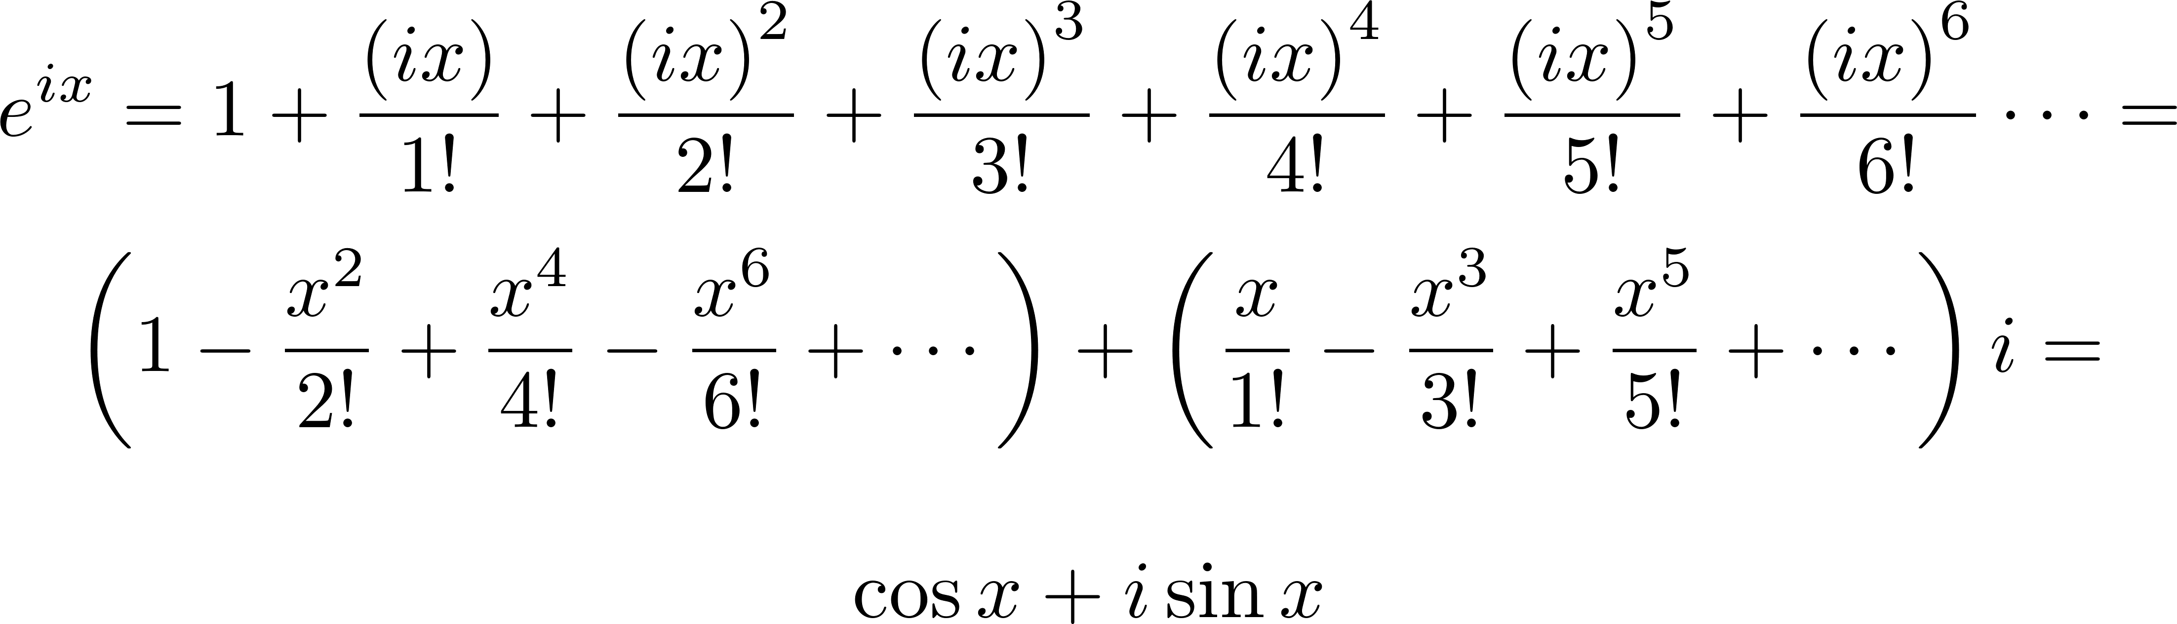
Euler's Formula
The McLaurin series for for any real number is
Substitute ix for x and get

Slide 21
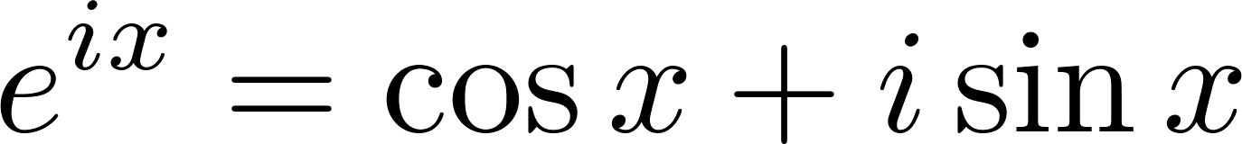

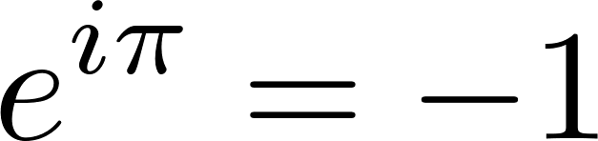
Euler's Formula
Euler's Formula
Let , and we have Euler's identity
"Like a Shakespearean sonnet that captures the very essence of love, or a painting that brings out the beauty of the human form that is far more than just skin deep, Euler's Equation reaches down into the very depths of existence." ~ Keith Devlin

Slide 22
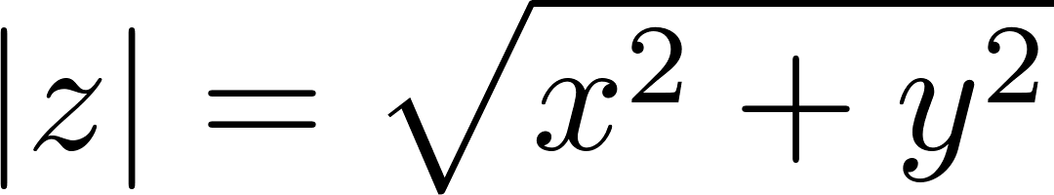

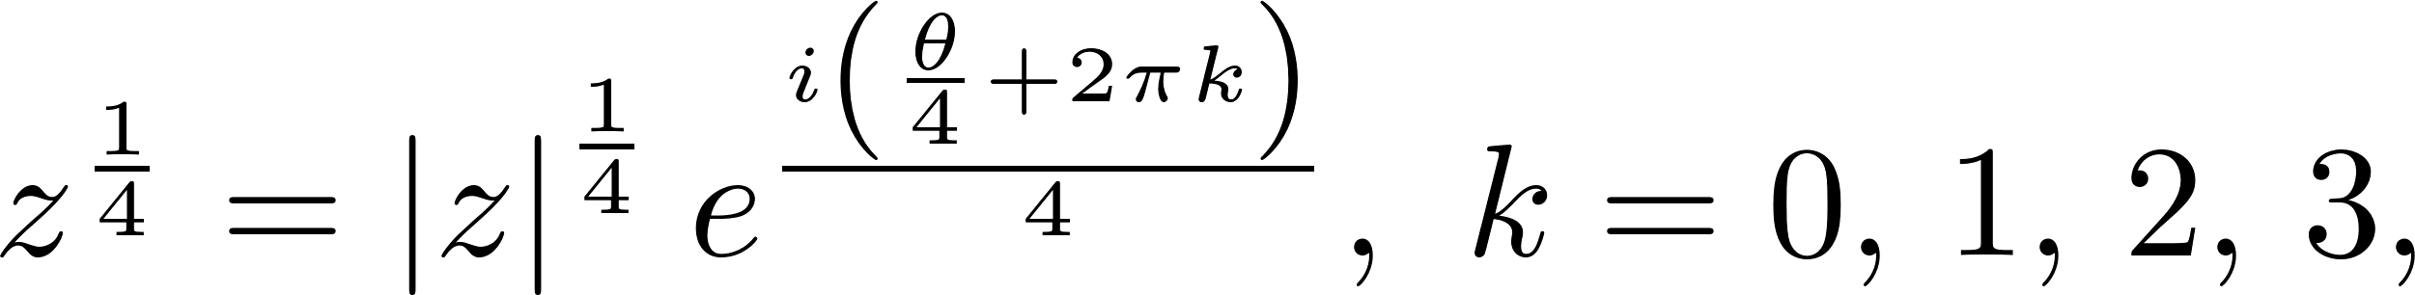
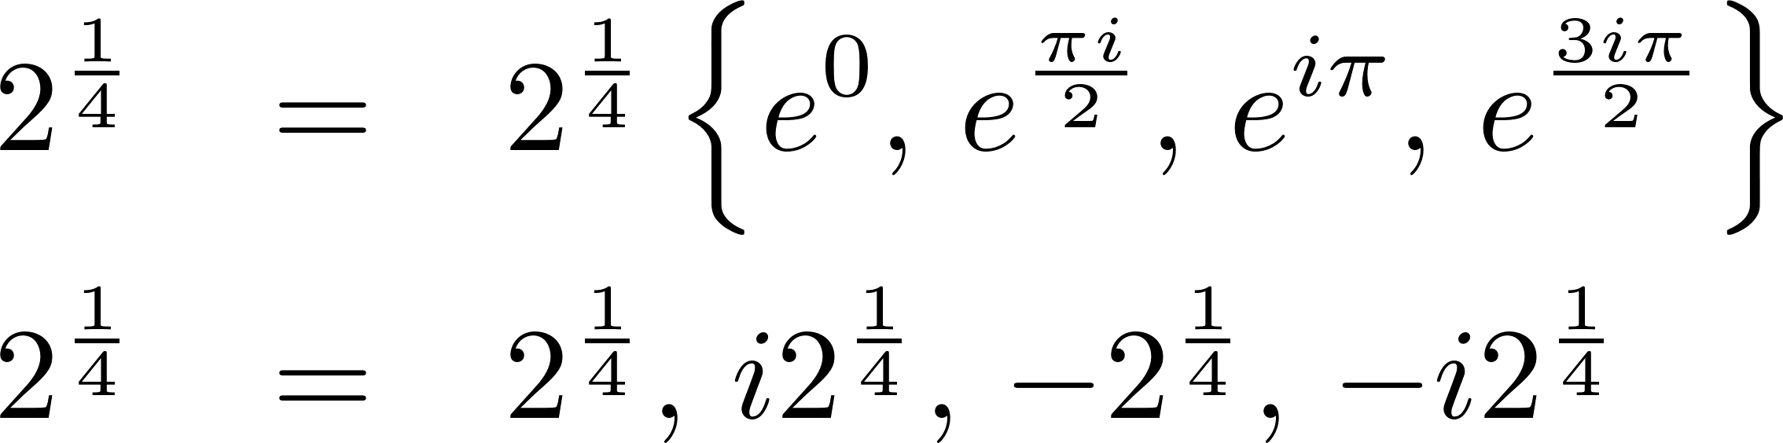
Using Euler's Formula to Find Roots
The modulus of a complex number is its length when interpreted as a point in the complex plane, , and , where is the angle made with the positive x-axis.
Since , and

